Slide 1
Instrument Intro Briefs
I0101:GPS/Radio Instrument Procedures
I0102:T44C GPS/FMS
I0103:T44C Flight Director Operation
10 Feb 2021

Slide 2
I0101 Overview
Introduction
Stage Review
Reference Materials
Local Operations
Communications
Takeoff/Departure
Enroute
Arrival/Approach Brief Example
CRM Callouts
Airfield Lights and signs
Common Mistakes
RNAV/GPS Approaches
Extras
Conclusion

Slide 3
Student Stage Review
I2100 Block BI Sims - 4 events
I2200 Block RI Sims - 2 events
I3100 Block RI Sims - 6 events
I4100 Block Flights - 4 events - Instrument Intro with emphasis on the different types of approaches
I3200 Block - 6 Emergency Instrument Sims
I4200 Block - 4 Emergency Instrument Flights
I3390 - Midstage Instrument Check (sim) IP will act as CP
I4300 Block - 4 Cross Country Flights
I3400 Sim - 1 Advanced Emergency Instrument Approaches Scenario based event after Cross Country
I4400 Block - 3 Advanced Emergency Instrument Flights that will have homework!
I4403: BRING INSTRUMENT RATING REQUEST, FILLED OUT!
After I4402 get with logs/records to ask them to pull your Wingstats to help fill out the rating request.
I3500 Block - Instrument EP Sim scenario based, anytime after I4201
I3600 Block - CRM Simulator scenario based, after I3501
I4590 - NATOPS Instrument Check ride
I4601—Solo Cross Country
Notes:
Discuss the specifics of each block while students follow along with their Master Curriculum Guides.

Slide 4
Reference Material
Instrument Stage Material
FTI
FAR AIM (to include Advisory Circulars)
CNAF M-3710.7
FAA Instrument Flying Handbook
FAA Instrument Procedures Handbook
NATOPS Instrument Flight Manual
General Planning and FLIP publications
TERPS Manual 8260.3C
Wing and Squadron SOPs
Notes:
Discuss the importance of referencing all material to prepare for discuss items. Talk about the specifics of each publication and where to locate them. Stress the importance of having an intimate knowledge of all publications by the Review Stage. Also show them the quick reference guide at the back of the handout. FAA pubs and AIM are available for free download (google)

Slide 5
Reference Material
FTI
Details standard procedures for maneuvers, approaches, and operations not specifically addressed in NATOPS
FAR AIM and AC’S
Provides Aviation Community with basic flight information and ATC procedures for use in the National Airspace System
Should be the primary source for general flight procedures
Advisory Circulars provide guidance for compliance with airworthiness regulations, pilot certification, operational standards, training standards, and any other rules within the 14 CFR.

Slide 6
Reference Material
CNAF M-3710.7
Provides (along with FAR part 91) specific rules and regs for operating Naval aircraft
FAA Instrument Flying Handbook
Designed for use by pilots preparing for an instrument rating test
FAA Instrument Procedures Handbook
Designed as a technical reference for all pilots who operate under IFR in the National Airspace System
NATOPS IFM
Contains important basic flight information and IFR procedures
One of the best places to read about needle only characteristics of different NAVAIDS

Slide 7
Reference Material
General Planning and FLIP Publications
GP contains information on flight planning and filing requirements. Chapter 4 specifically references DD-1801 filing procedures.
TERPS Manual
Explains the construction of instrument procedures and obstacle clearances in and around the terminal area.
SOPs Contain all of the local guidance that may be more limiting than the CNAF 3710.
By Review Stage, you must be intimately familiar with FLIP publications, AIM/FTI procedures and CNAF/FAR material

Slide 8
Electronic Pubs
Electronic flight bags (EFB) are allowed but are not a substitute for paper pubs.
Reference Squadron SOP for restrictions on electronic flight bags.

Slide 9
Local Operations (cont.)
Tango-3 (Should be put on with clearance from the AC)
KNGP
TAC, VOR, ILS, GPS
KCRP
VOR, TAC, ILS, GPS
KT69
VOR, GPS
KTFP
GPS
KRKP
VOR/TAC, GPS

Slide 10
Local Operations (cont.)
GCA-1 (Should be put on with clearance from the AC)
For KNGP PAR or ASR
Reference TW-4 Local Use Procedures (Blue Brains) for all coded flight plans.
All coded flight plans and 1801’s should be filed with Base OPS.
Pick up gouged app clips from supply.

Slide 11
Local Operations (cont.)
WHAT YOU BRING TO THE BRIEF
Each student must bring a flight plan (1801) for their planned profile
The plan should accomplish ungraded items in block (3 approaches for student, 1 for IP)
Shall call or text the IP the night prior
Students must either bring a local canned wx brief or file one on FWB.
NOTAMs, TAF’s, BASH, ect.

Slide 12
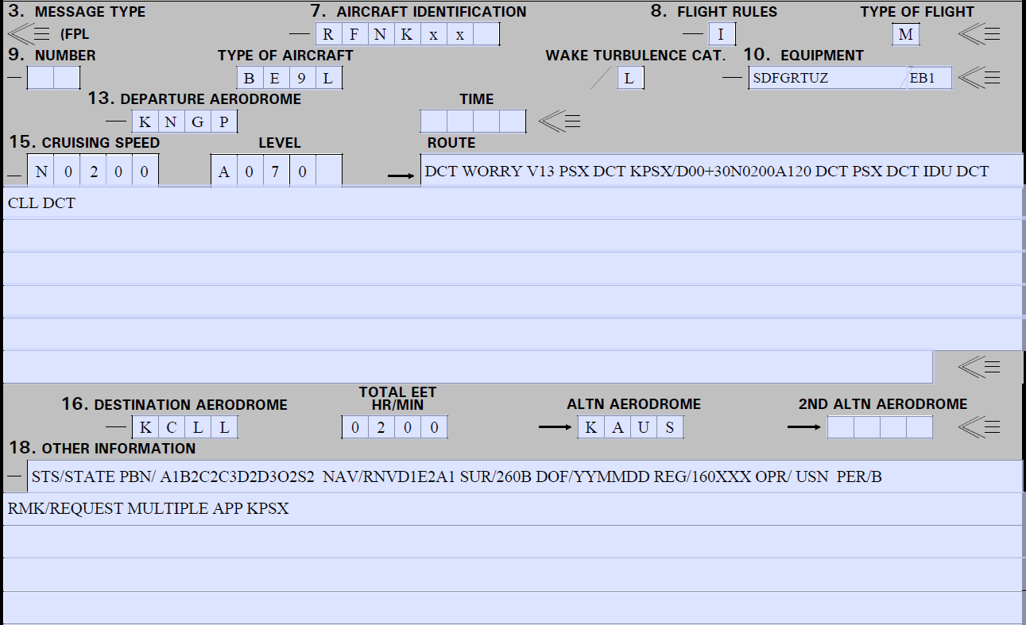
DD-1801
Reference GP for guidance

Slide 13
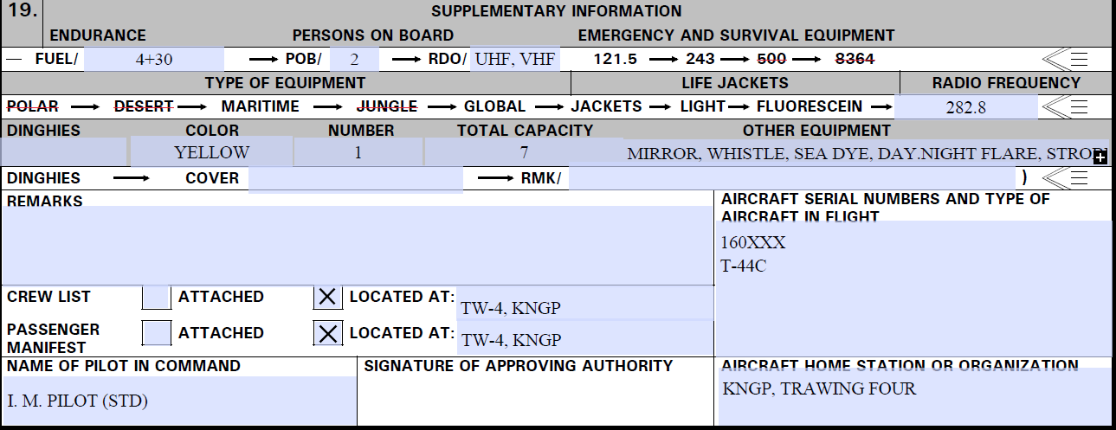
Block 19

Slide 14
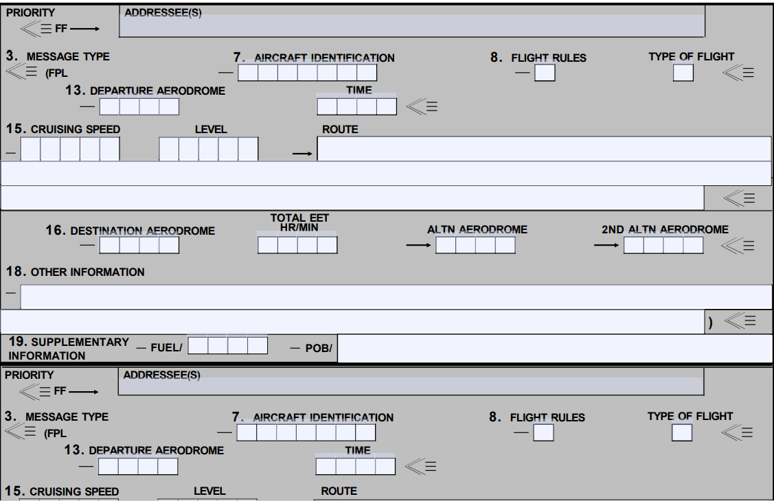
1801-C
Use 1801-C for stop over flight plans where aircraft information will remain the same.

Slide 15
PUBS BAG
Always ensure your pubs bag is up to date and includes all required app plates and charts for the flight.
Any pubs not in MX should be located in the duty office.

Slide 16
Communications
Standard phraseology
AIM chapter 4, Section 2
“Radio Communications Phraseology and Techniques”—Pilot/Controller Glossary
Approach will usually ask “how the approach will terminate?”. This is them asking what you want after that approach.

Slide 17
Communications
General Rules
Always read back specific instructions and clearances when applicable (CRAFT or DRAFT for initial clearance with clearance delivery)
Read back assigned headings, altitudes, airspeeds, frequencies, transponder codes and altimeter settings
ASK ATC TO REPEAT ANYTHING YOU DIDN’T GET

Slide 18
Required Comms
V – VFR on top altitude change
A – Leaving assigned Alt for another Alt
C – Can’t climb/descend at 500 fpm
A – Missed Approach
T – TAS changes by 5% or 10kts whichever is greater
E – Entering (time and alt) or leaving holding fix (Corpus Approach/Valley Approach does not require this call)
R – Radio or NAVAID degradation
S – Safety of flight issues (un-forecast WX is included)

Slide 19
Communications
Unicom/CTAF
Speak to the lowest common denominator, the VFR pilot with no approach plates
They don’t know what “Procedure turn VOR 32 Circle 14” means.
Sample calls for 10 and 5 miles:
“Aransas County traffic, Navy King Air 16, 10 miles northwest, 1600 feet, inbound for a straight in 14, Aransas County.”
“Alice Traffic, Navy King Air 16, 5 miles to the west. Will overfly the field at 1100 feet to enter left downwind Rwy 13, touch and go, and depart to the east, Alice.”

Slide 20
Takeoff/Departure
Instrument Departure—critical phase of flight (low, slow, and heavy)
Focus on solid, specific briefing
Ensure copilot is onboard with all aspects of brief
Instrument Departure Brief items
Instrument Departure Procedures/Trouble T
Instrument Recovery-Emergency Return (Sim IMC)
Recovery-Emergency Return (Actual Conditions)

Slide 21
Takeoff/Departure
Trouble T
The Trouble T applies on the departure as well as the approach if conducting a touch and go.
You must brief the Trouble T for both
See FTI / AIM for discussions on the 4 types of Instrument Departures.
Non-standard alternate WX Mins do not apply to DOD, use OPNAV requirements.
A-NA does apply, and is not available for use a alternate.

Slide 22
Trouble T
TERPS
Assume one engine inoperative
200 ft/nm is the standard TERPS climb gradient
TERPS OIS (Obstacle Identification Surface) 152 ft/nm
48 ft/nm obstacle clearance
Can’t make the climb gradient?
Decrease gross weight-Fuel, payload, etc
Wait for better weather-Cooler, headwind, etc
Pick a different runway-Away from obstacle
VCOA where available

Slide 23
Trouble T
Departure end crossing height of zero feet at USAF/USN fields, all others 35 feet.

Slide 24
Takeoff/Departure
Weather minimums for takeoff-CNAF M-3710.7
Standard instrument rating — Published minimums for the available NPA, but not less than 300-foot ceiling and 1-statute mile visibility. When a precision approach compatible with installed and operable aircraft equipment is available, takeoff is authorized provided the weather is at least equal to the precision approach minimums for the landing runway in use, but in no case when the weather is less than 200-foot ceiling and 1/2-statute-mile visibility/2,400-foot runway visual range (RVR).

Slide 25
Takeoff/Departure
Aviate, Navigate, Communicate
Climb at 150 kts (NATOPS climb speeds are located in chapter 7)
Contact Departure “OFF Report”
Who you are, passing altitude off whatever airport, flying whatever departure
Checklist (1,000 ft AGL)

Slide 26
Enroute
Least busy but possibly most critical part
Use this time to ‘get ahead’
Get ATIS early (You can get ATIS FOR ALL fields)
Brief approach as soon as you have the weather
Always be aware of position and situation
Utilized the MFD or MAP mode on the PFD
Pull out a low chart if time permits
Look at approach plate for extra SA (ex. Alice VOR-A), you “live” on the tail of the needle.

Slide 27
Enroute
Prepare for Arrival
Review NOTAMS/IFR Supp
Restrictions and Airport Info
Review Charts
Familiarize with local airspace, airports and terrain
Review STARS (As Required)
If a STAR is published, file it.
Review Approach Plates
Review approaches and diagrams, including airport diagram to forecast a taxi plan.
Technique: 30 Min out, begin to get WX and review airport info (Notams, ATIS, etc). Initiate checklist once briefed and setup for the approach.

Slide 28
Arrival
ABCs Technique:
ATIS (or ASOS, AWOS)
Check plate for altimeter setting notes
Brief the Approach
FTI requirements
Circling plan
Things that are different, ex. arresting gear at KNQI
T&G brief
Checklist
Full vs. Abbreviated

Slide 29
Arrival
ABBCs Technique:
ATIS (or ASOS, AWOS)
Check plate for altimeter setting notes
Build the approach/cockpit setup
FMS/NAVAIDS/Minimums/Presentation
Cockpit flow to check
Brief the Approach
FTI requirements
Don’t forget T&G brief
Checklist
Full vs. Abbreviated

Slide 30
Approach Brief
ATIS (WAR – wx, altimeter, duty runway)
Approach
What plate you are using (amendment and date)
Name and Location “ILS Z 13R at NGP”
Frequencies
Final Approach Course
GSIA or FAF
DH/MDA and MAP
TDZE/ Runway
Missed Approach
Terrain (MSA)
Specials – Touch and Go, SSE full stop, Circling intentions
How will the approach be flown?

Slide 31
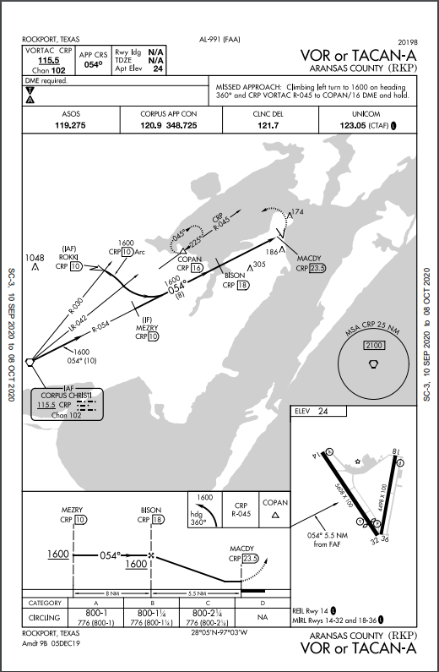
Example Approach Brief

Slide 32
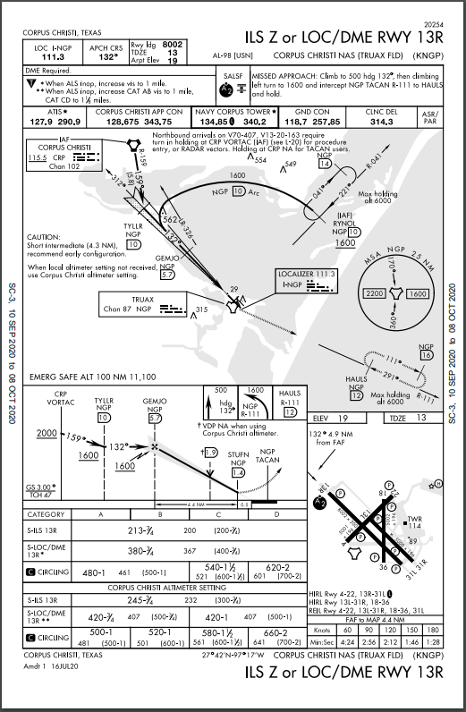
Example Approach Brief

Slide 33
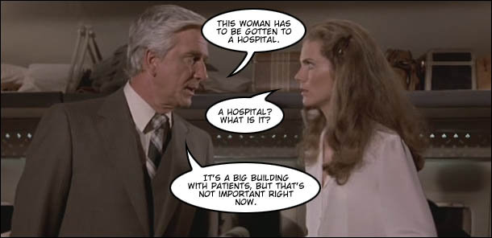
CRM

Slide 34
Mandatory CRM Callouts
Autoflight
Manual Flight
Chapter 22 of the NATOPS describes the call outs and responsibilities of the crew and needs to be read thoroughly.
The PF provides the manual input to the flight controls and the flight director may or may not be in use. Again Chapter 22 of the NATOPS gives guidance and should be read thoroughly.
General Callouts
Calls made in all situations.

Slide 35
CRM
The PF shall fly the aircraft and maintain a dedicated heads-up lookout. If the PF wishes to be heads-down for an EXTENDED period of time, aircraft control shall be transferred to the PM who shall remain heads-up.
If the PM must divert attention away from normal clearing and monitoring duties for an EXTENDED period of time, he shall state, “heads-down”. Verbal acknowledgment from the PF is necessary to prevent both pilots from being heads-down at the same time.

Slide 36
CRM
DATA ENTRY
Taxi – Data entry, while the aircraft is in motion, shall be made by the PM. Either pilot may make entries if the aircraft is stopped with the parking brake set.
In-Flight – Data entry shall be made by the PM.
Any crewmember that observes both pilots “heads-down” at the same time shall alert the PF without delay.

Slide 38
Approach Lighting Systems
Centerline guidance
Adequate length
Roll guidance
Sequenced flashers
Fixed/Variable intensity
Notes:
7

Slide 39
Pilot Controlled Lighting

Slide 40
Touch Down Zone Lights:
First 3000’ of rwy
36 ft from centerline
100 foot spacing
Centerline Lighting: 50 feet Runway Edge Lights: 200 feet
36’ 36’
200’
100’
50’
Notes:
2

Slide 41
1000’
2000’
2000’
3000’

Slide 42
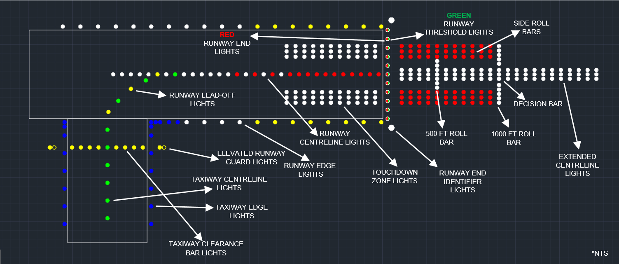
Taxiway to Runway

Slide 43
Use Me – Abuse Me
IPs and Copilots can:
Switch approach plates
Tune NAVAIDs
Check Trouble T’s, NOTAMS, ASR/PAR Mins
Take controls for the approach brief
We are training Crew Pilots with CRM Skills
Encourage the student:
To be assertive
Use the crew wisely to ease workload
Communicate! Ask Questions and LEARN SOMETHING.

Slide 44
Use Me – Abuse Me
A good technique for flow…..
Complete the climb checklist passing 1000’ AGL then pass the controls. This allows you to set up and get everything the way you want it.
Once complete setting up for the approach go ahead and brief it.
Once briefed pass the controls to the PM and ask for the approach checklist.
Feel free to ask the PM to set anything while you are at the controls. You should never be at the controls and setting everything up.

Slide 45
Descent Points
When can you descend? (IAF/Inbound)
IAF
Outbound/Abeam and on a Parallel or Intercept heading to the outbound course
Inbound on approach
VOR/TAC – within 5 radials (1 dot on CDI)
GPS – ½ scale (1 dot)
NDB – within 5 bearings
LOC – CDI off the wall

Slide 46
Descent Points
When are you ‘abeam’ a station (for timing descending/timing outbound on a PT or timing in holding)?
Your needle off the wing is only true IF your heading matches the outbound course
If your heading doesn’t match the outbound course, you must add/subtract 90
Then watch for the needle to pass that value
Try +100, -10 or -100, +10
Abeam is determined by the PT course. 90 degrees from that course is abeam.

Slide 47
Timing
Timing outbound on a PT is a technique to keep you within the ‘remain within’ distance
Don’t rely solely on timing! Use the DME, if available, to keep your SA up
Ex – if you have a strong tail wind outbound, you don’t want to time for a full minute
Any method of course reversal is ok – just brief it
So what is the remain within distance based off of?
The IAF that you are turning around.

Slide 48
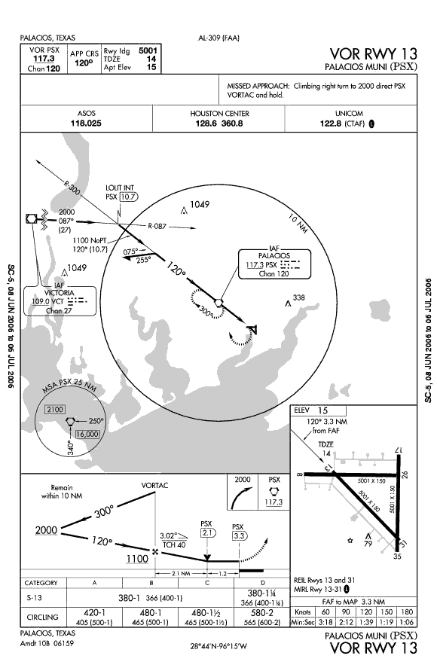
Remain within
Here your remain within distance is 10NM
Since the IAF is also the VORTAC, you can go out to 10DME (no matter what the timing)

Slide 49
Overfly or Lead?
Heading within 90 degrees of outbound course – you may lead the turn.
This includes procedure turns; not just procedure tracks
Example: Leading an arc 0.8 nm prior
Heading not within 90 degrees – you must cross the fix and turn in the shorter direction, unless you are entering a published holding pattern for a turn in holding to get aligned.

Slide 50
Descent Rates
Descend at 800 – 1200 vsi for Nonprecision.
If not, you won’t reach MDA by MAP, which is an unsuccessful approach.
SSE requires the same but will be harder to reach with the gear up.

Slide 51
Circling
2 Techniques
“Rule of 80”
Approaching reciprocal runway, offset 45 degrees toward desired downwind. Time for 35 seconds (or use 30 degrees for 50 seconds, etc.)
90 degrees, 15 seconds (T-bone the runway)
[FTI Figure 4-30]
Circling Categories
At 120 kts, we’re Cat B

Slide 52
Non-Towered Circling
AC 90-66B 03/13/18
9.6 Instrument Flight Rules (IFR) Traffic. Pilots conducting instrument approaches should be particularly alert for other aircraft in the pattern so as to avoid interrupting the flow of traffic, and should bear in mind they do not have priority over other VFR traffic. Pilots are reminded that circling approaches require left-hand turns unless the approach procedure explicitly states otherwise. This has been upheld by prior FAA legal interpretations of § 91.126(b).
The FAR/AIM mentions shortest path to base or downwind leg, just keep in mind that at non-towered fields they want you in left traffic unless the IFR procedure tells you otherwise.

Slide 53
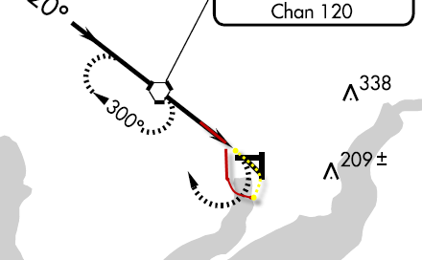
Circling Missed Approach
Comply with the intent of the missed approach.
This requires a climbing LEFT, not a climbing right!

Slide 54
Circling Missed Approach
Initiate a CLIMBING turn towards the landing runway, and CONTINUE the turn to comply with the intent of the missed approach.
Does not always mean you will get on the dotted line.

Slide 55
RNAV approaches
CDI scale
Inflight
Types of approaches
How to fly them
Warnings
CRM
Extras

Slide 56
CDI SCALE
3 Modes of Operation
Enroute
Terminal
Approach

Slide 57
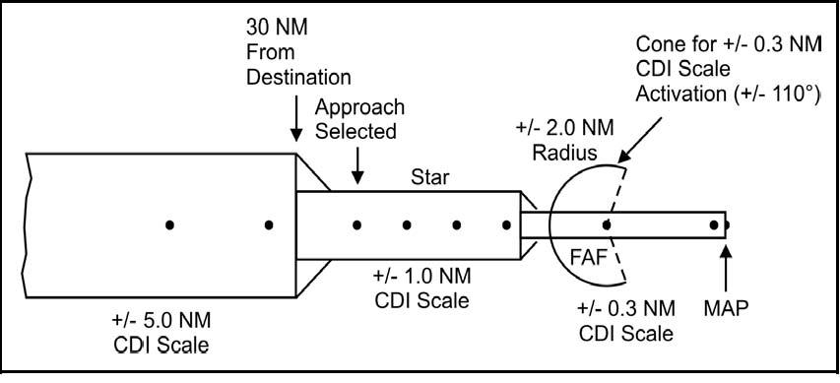
CDI SCALE
2.0 NM

Slide 58
CDI SCALE
Enroute Mode
CDI = +/-2NM
Enroute mode is active:
Until 2nm prior to 30 nm from arrival airport

Slide 59
CDI SCALE
Terminal Mode
Once within 30 nm of the arrival field, CDI sensitivity improves to +/-1NM
T-44C “TERM” message on PFD
VERBAL RESPONSE REQUIRED
“Terminal Mode Armed”
However, understand that you are in terminal mode. Terminal mode is not armed.

Slide 60
CDI SCALE
APPROACH MODE
Once within 2 nm of FAWP, CDI sensitivity improves to +/-.3NM
T-44C – “GPS APPROACH” Message on PFD
VERBAL RESPONSE REQUIRED
“APPROACH MODE ACTIVE”

Slide 61
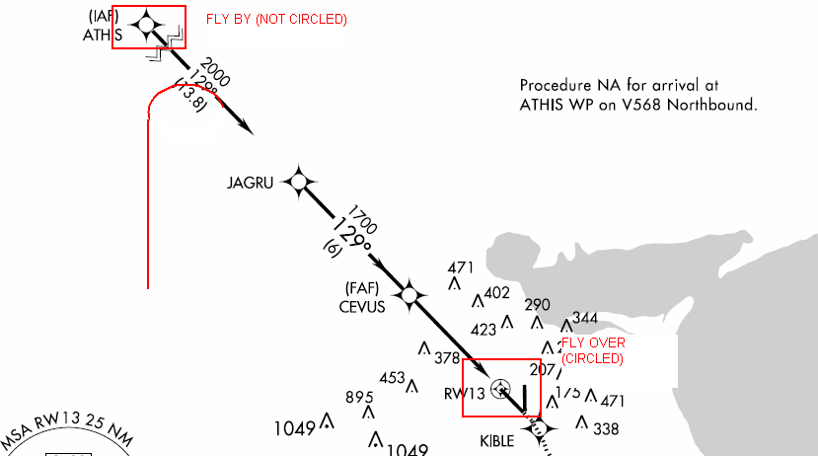
IN FLIGHT
Fly-over versus Fly-by WP, and dangers associated

Slide 62
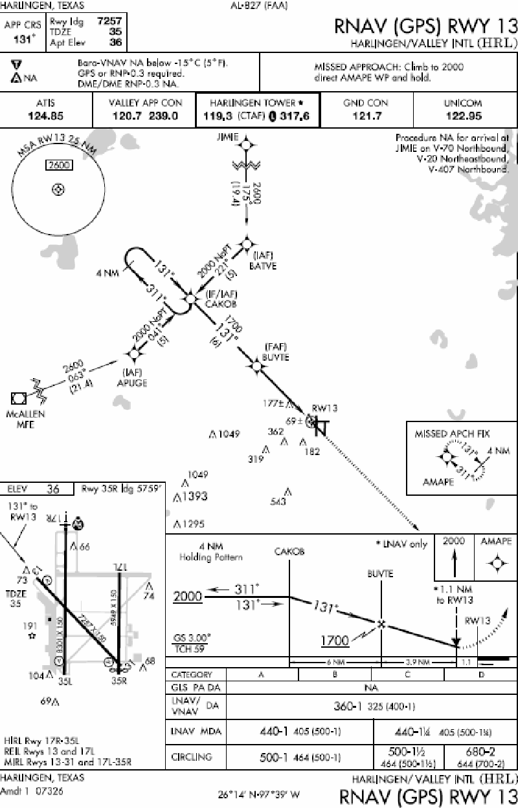
RNAV/GPS

Slide 63
TAA Entry Sectors
TAA – The TAA incorporates separate entry sectors with MSAs for each sector. They also act as part of the approach; Once inside the sector DME, you can descend to the depicted altitude once cleared for the approach.
NO DESCENT CLEARANCE NEEDED IF YOU ARE CLEARED FOR THE APPROACH!

Slide 64
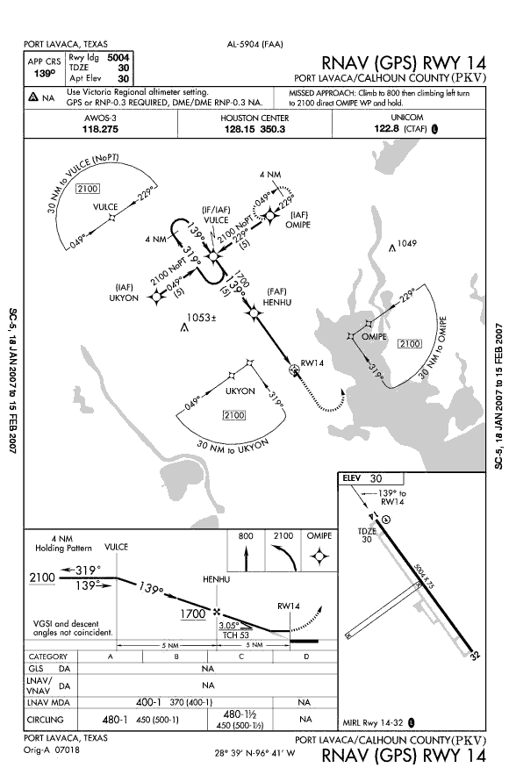
TAAs

Slide 65
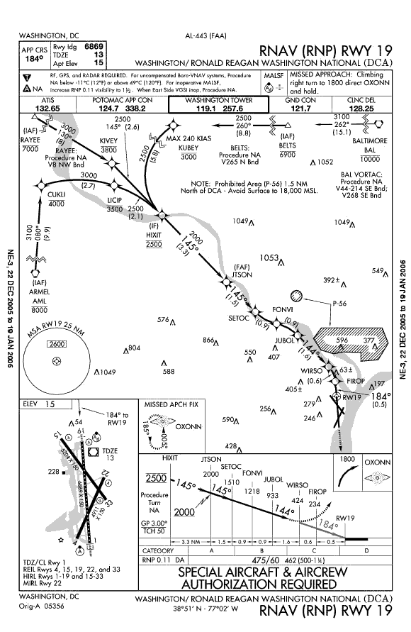
RNP
Note the curved path
on final. This requires
RNP of 0.11, listed in
the mins section.
No GPS in the title
Uses different RNAV
Equipment (not GPS)
WE CAN NOT FLY AN RNP APPROACH

Slide 66
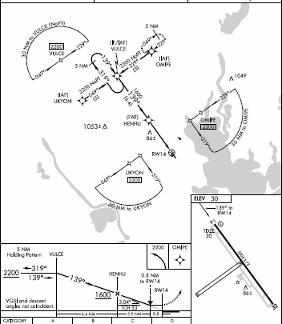
BEFORE APPROACH
Within 30 nm of airport, CDI will enter terminal mode.
OBSTACLE CLEARANCE DEPENDS ON THIS
Requires a verbal response
“Terminal Mode Armed”
It is not really armed.

Slide 67
WHEN TO DESCEND
ESTABLISHED AT IAF:
CDI ½ scale &
In Terminal Mode
ESTABLISHED AT FAF:
CDI ½ scale
IN Approach Mode (“APPROACH ACTIVE”)

Slide 68
Radar Vectors
Load the approach
Extend out along the final approach course
Blue/Green Method

Slide 69
Missed Approach
MAP: 2 Choices
1 – Go-Around button
Auto sequences and puts you in Active Legs page
2 – Manual Sequencing
At MAP, manually sequence to the MAWP

Slide 70
AFTER APPROACH
Staying at the same airport?
For another approach, simply select another one
Going somewhere else?
Change arrival airport or load Secondary flight plan.

Slide 71
WARNINGS
NO APPR GPS RAIM
RAIM is not available
NO RAIM = Can’t use GPS for guidance for approaches
Will get NO APPR if past FAF and no RAIM (signal may be good, but GPS can not check it’s signal)
Can use for SIDS/STARS with no RAIM
(enroute/term mode)

Slide 72
WARNINGS
If no RAIM:
PRIOR TO FAWP
Transition to a ground-based navaid approach or get vectors.
DO NOT DESCEND TO MDA and go Missed at the MAWP
AFTER FAWP
Climb to alt prior to FAF and proceed to MAWP

Slide 73
GPS EXTRAS
You cannot create any IAPs, nor alter them.
You may only pull them directly from the database.
You may not alter any thing from the final approach fix inbound.
Needle will remain on WPT until abeam, then will cycle to next WPT
When in Holding, the pink/cyan needle remains pointed at the holding WPT

Slide 74
ADS-B
ADS-B provides altitude, aircraft flight ID and vertical air speed.
ADS-B reports two kinds of altitudes: barometric and geometric. Geometric altitude is calculated by GPS.
ADS-B does not report horizontal airspeed. Instead, ADS-B reports horizontal velocity relative to the Earth.

Slide 75
Conclusion
Focus of Maritime Advanced Program
Study!
NATOPS
FTI
AIM/FAR
AIGT workbook
NATOPS Instrument Flight Manual (IFM)
CNAF 3710.7
Be familiar with Local Operations
Chair fly Approaches, Briefs and Eps
Arrive Prepared

