Slide 1
T-44C FMS Guide
Revision: 16 Feb 21

Slide 2
Objectives
Familiarize user with FMS layout
Introduce Procedures to Initialize and Load Flight Plan
Understand FMS use during different phases of flight
Introduce the capabilities of the FMS to increase SA during Contact stage and Low Level stage of flight training.

Slide 3
Main Menu
Click on the subject to skip to it or start with FMS Theory and go through the entire presentation.
FMS Theory
  Collins FMS 3000
  CDU Orientation
  CDU Roadmap
  Scratchpad Operation
Grounds Ops
  STATUS
  POS INT
  FLPN
  LEGS
  DEP/ARR
  PERF
  RAIM
  Takeoff (Instruments)
  Selecting an Approach
Enroute Procedures
  Airway Intercept Green VS Blue
  Fuel Management
  Display Options
VNAV
Approaches
HOLDS
FIXES
Terminal Area Procedures
  Approach Techniques
  Vectors to Final, Blue and Green Method
  RNAV HILO Approaches
Seagull – Building the Box
Low Level Routes
MAIN MENU
At any point in the Presentation, click
The main menu button to return here.
Reference Material: T-44C NATOPS, JFTI Appendix H, FMS 3000 User Guide, Rockwell Collins

Slide 4
FMS Theory
MAIN MENU

Slide 5
WHAT DOES THE FMS DO?
Figures out where it is
Knows where it is going (Flight Plan)
Computes heading to get TO each
waypoint
** Is a “TO” navigator **
“High-Tech Dead Reckoning Tool”
MAIN MENU

Slide 6
BLENDING SENSOR INPUTS
Each sensor’s position is independently calculated
Individual positions are blended in FMC - Kalman Filter–
  Blended position = FMS position
  (DME/DME/GPS)
  (VOR/DME/GPS)
MAIN MENU

Slide 7
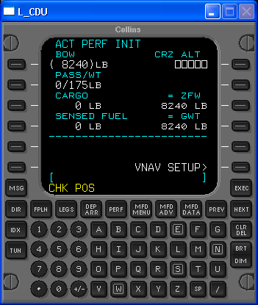
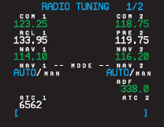
FMS Sensor Control
Sensor Weighing in the Position Solution
  DME/DME
    DME Auto Tuning
    Can be inadvertently disabled.
    May be a problem if not tuned to receivable navaid

Slide 8
FMS Sensor Control
Sensor Weighing in the Position Solution
  DME/DME
    FMS Selects VOR & DME Navaid Based on the FMS Present Position
      Selection Criteria
        Distance to Station
        Navaid’s Service Volume
        Selects those DME with Geometry for Best Possible Solution ->25’
    Reasonableness Check
      Identifier Cross Check (BFO)
      Actual Station Data Compared with
      Predicted Station Data

Slide 9
FMS Sensor Control
Sensor Weighing in the Position Solution
  VOR/DME
      Used to a Lesser Degree than GPS & DME/DME
      De-Weighted Based on Distance and the 60-1 Rule
      Navaid is Removed for the Nav Solution When outside its Service Volume

Slide 10
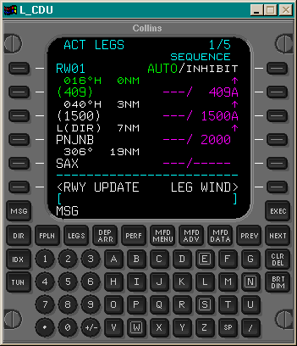
CDU ORIENTATION
Page Title Line
Line Select Keys
(copy and paste)
Data Entry Scratchpad
Keypad
Function Keys
MFD Function Keys
(ADV/ DATA N/A)
MAIN MENU

Slide 11
COLLINS CDU ROADMAP
Display
Messages
MSG
EXEC
EXECUTE
FLT PLN
DIRECT - TO
DIR
FPLN
LEGS
DEP
ARR
PERF
MFD
MENU
MFD
ADV
MFD
DATA
PREV
NEXT
CDU PAGE
CONTROL
CDU PAGE
CONTROL
NEAREST AIRPORTS
MCDU
IDX
COPY
ACTIVE
MAP
MENU
MAP
MENU
CLR
DEL
DEP
ARR
MAPS
CLEAR SP
DELETE LINE
STATUS
TUN
ACT FPLN
SEC
FPLN
SEC FPLN
TOGGLE
BRT
DIM
DISPLAY
BRIGHTNESS
POS INIT
VOR CTL
OFFSET
OTHER
MAP
MENU
TEXT
PAGES
DATA
GPS CTL
NEAREST AIRPORTS
FMS CTL
TO + APPR REF
AUTO/
INHIBIT
SEQUENCE
HI NAVAIDS
FREQUENCY
PERF INIT
FPLN PROG
LO NAVAIDS
FIX
LEG
WIND
VNAV SETUP
NAV STATUS
INTERS
HOLD
ARPTS
TAKEOFF
POS SUMMARY
TERM WPTS
PROG
COM
ADVISORY VNAV
MFD WINDOW
SEC FPLN
POS SUMMARY
NDBS
ROUTE MENU
NAV
VNAV PLN SPD
VOR STATUS
ETA
AUTO/MAN
MODE
FLT LOG
SPEED
DATA BASE
LRN STATUS
RNG: ALT SEL
FUEL MGMT
ALTITUDE
DB DISK OPS
APPROACH
DEFAULTS
ADF
LRN POS
XPONDER
SEC PERF
ALTN FPLN
ARR DATA
MAIN MENU
SIDE L/R

Slide 12
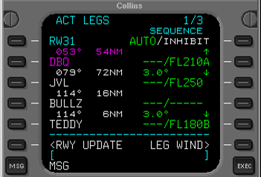
Data Entry Basics
TITLE LINE & PAGE NUMBER
LATERAL NAV
FR WPT: CYAN
TO WPT: GREEN
VERTICAL NAV
& SPEEDS
MAGENTA
<SHORTCUTS>
SCRATCHPAD
MESSAGES
Large fonts indicate pilot selectable/ changeable data.
Small fonts indicate internally generated data (exceptions)
MAIN MENU

Slide 13
SCRATCHPAD OPERATION
Enter data in scratchpad and transfer
OR
Copy data TO
scratchpad and transfer
Page change and scratchpad work independently
MAIN MENU

Slide 14
SCRATCHPAD OPERATION
Clearing Scratchpad Data
Press CLR/DEL once to delete
one character
or all characters
by holding it down
Press CLR/DEL to place “DELETE”
in scratchpad
for use elsewhere via line select keys.
MAIN MENU

Slide 15
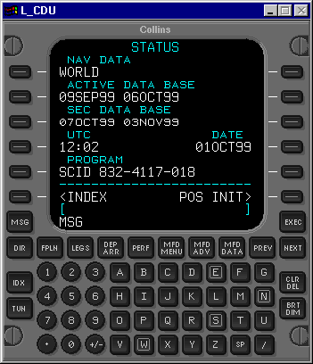
MESSAGE LINE
Messages suppressed for two minutes above 60 knots during Take-Off and Climb
Complete list of messages in back of pilot’s guide
SCID 832-4117-036
Press MSG button for summary
MESSAGE LINE
MAIN MENU

Slide 16
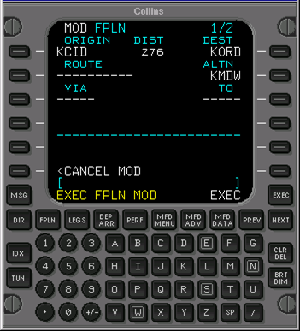
EXECUTE KEY
Saves modifications to FPLN
“Are you sure?” function
Occasionally...
appears in MSG line…
**modification is not confirmed, press EXEC if desired**
EXECUTE FPLN MOD
MAIN MENU

Slide 17
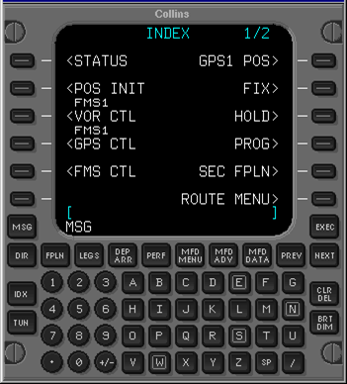
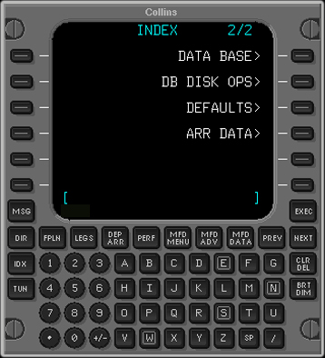
INDEX PAGE
Accessed with IDX key, select next for page 2.
Page 1
Page 2
MAIN MENU

Slide 18
Ground Operations
  STATUS
  POS INT
  FLPN
  LEGS
  DEP/ARR
  PERF
  RAIM
6 pages required to flight plan, then check RAIM
MAIN MENU

Slide 19
STATUS
World or regional databases available
Active Database
Second Database
PROMPT> provides shortcut to next step
SCID 832-4117-036
Verify Active Data Base date is current
  UTC time and date
MAIN MENU

Slide 20
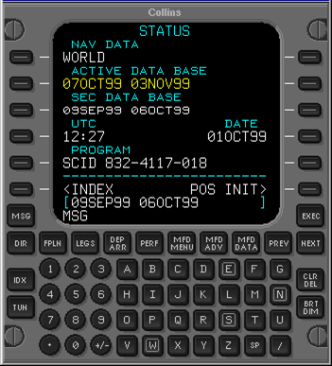
EXCHANGING DATABASES
Copy second database to active
NOTE:
Changing databases deletes
current flight plan
May only be done on the ground
SCID 832-4117-036
MAIN MENU

Slide 21
TIME & DATE
FMS clock is updated by GPS every 17 minutes
SCID 832-4117-036
MAIN MENU

Slide 22
PROMPTS
Shortcut to other functions
Usually next logical step in planning
May save keystrokes
For Example: POS INIT
  May use prompt - 1 keystroke
  OR
  INDEX + POS INIT - 2 keystrokes
SCID 832-4117-036
MAIN MENU

Slide 23
Ground Operations
  STATUS
  POS INIT
  FLPN
  LEGS
  DEP/ARR
  PERF
  RAIM
MAIN MENU

Slide 24
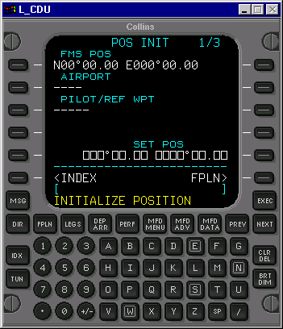
Position Initialization
5 methods of initializing the FMS
May have to use a different method in isolated circumstances
Pilot must verify aircraft position has been entered. (AIM 5-1-15 p.170)
Mandatory for FMS operation.
Gives FMS Permission to Navigate.
NOTE
“MUST ENTER” boxes identify MANDATORY pilot inputs
MAIN MENU

Slide 25
POS INIT
Desired position copied and pasted into SET POS boxes
Regardless of what method is used to obtain a LAT/LONG:
1. FMS POSITION
2. AIRPORT POSITION
3. PILOT/REFERENCE WAYPOINT
    4. MANUAL LAT/LONG ENTRY
    5. RUNWAY UPDATE
    6. AIRBORNE INITIALIZATION
NOTE
Initialize the position with the most accurate position data available. GPS latitude and longitude position data is available on the POS INIT 2/2 page.
MAIN MENU

Slide 26
Ground Operations
  STATUS
  POS INIT
  FLPN
  LEGS
  DEP/ARR
  PERF
  RAIM
MAIN MENU

Slide 27
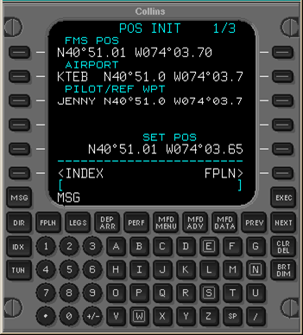
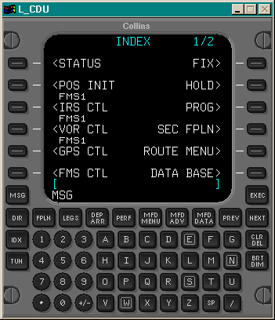
Follow prompt to next step...
MAIN MENU

Slide 28
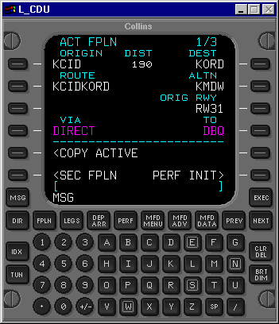
FLIGHT PLAN PAGE
Similar to filing with FSS:
  SIDs
  Victor Airways
  J-Routes
  STARs
  Approaches
  Waypoints
MAIN MENU

Slide 29
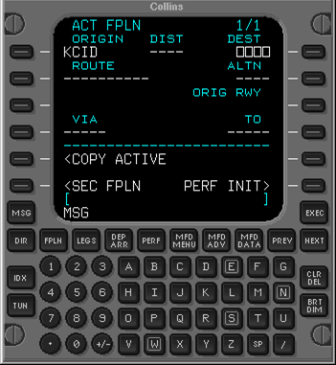
ENTER ORIGIN & DESTINATION
Enter origin and destination to access database
Entering new origin airport
deletes current flight plan
Origin can only be entered on the ground
(except secondary flight plan)
MAIN MENU

Slide 30
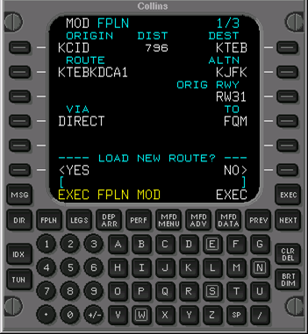
STORED ROUTES
Enter name of previously stored route
OR
Name current flight plan if desired.
NOTE
This feature is currently only used for low level stored routes.
MAIN MENU

Slide 31
ALTERNATE
If alternate is required, enter under ALTN
Entering alternate adds second segment to flight plan
  Direct to ALTN will eliminate WPs between PPOS and ALTN will move ALTN into DEST
  After sequenced to ALTN, STARS, etc may be added to flightplan
MAIN MENU

Slide 32
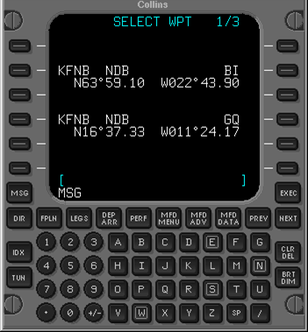
DUPLICATE IDENTIFIERS
Lists duplicate IDs in order:
  Closest to present position
    Airports first
    Then NAV stations
MAIN MENU

Slide 33
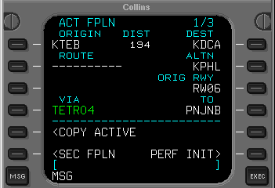
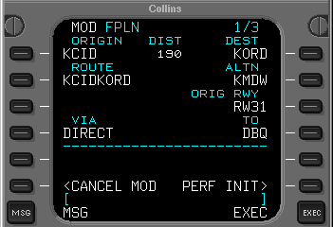
FLIGHT PLAN TYPES
“ACTIVE” FLIGHT PLAN
Used by FMS to generate steering commands
“MODIFIED” FLIGHT PLAN
Created when active flight plan changed
Verify changes on
CDU or PFD Map mode…
… Cancel Mod or EXEC
MAIN MENU

Slide 34
FLIGHT PLANNING SEQUENCE
NEW ACTIVE
EXECUTE
ACTIVE
FLT PLN
EDIT
MOD FPLN
CANCEL
MOD
PREVIOUS
MAIN MENU

Slide 35
Ground Operations
  STATUS
  POS INIT
  FLPN
  LEGS
  DEP/ARR
  PERF
  RAIM
MAIN MENU

Slide 36
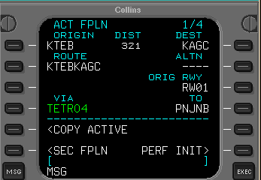
FLIGHT PLAN - vs - LEGS
FLIGHT PLAN PAGE
LEGS PAGE
MAIN MENU

Slide 37
LEGS PAGE
Use for:
  Changes
  Additions
  Deletions
  Monitoring progress
  Removing Discontinuities
  (can also be done from FPLN)
MAIN MENU

Slide 38
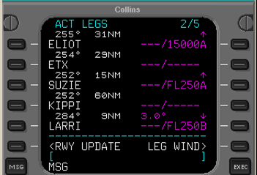
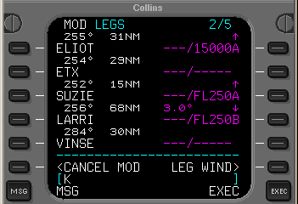
LEGS STATUS
ACTIVE LEGS
MODIFIED LEGS
Shown when modifying flight plan
  Not Executed yet
MAIN MENU

Slide 39

LEGS DETAILS
CDU DISPLAY FORMAT
  Color
    Blue (FROM)
    Green (TO)
  Font size
    Large (pilot modify)
    Small (FMS computed)
  Left Side: Lateral navigation
  Right Side: Vertical navigation
MAIN MENU

Slide 40
LEGS DETAILS
VNAV information
Selecting DIR / PREV allows access to past waypoints.
  NOTE
  Provides history of up to previous 15 WPs
MAIN MENU

Slide 41
LEG SEQUENCING
AUTO
INHIBIT
  Internally selected when on approach
AUTO is default
Will revert to AUTO sequencing when GA selected
MAIN MENU

Slide 42
AUTO SEQUENCING
FLY BY WAYPOINT:
  Will “turn-anticipate” based on GS
    Up to 7NM if <350KTS
    Up to 12NM if >350KTS
X
FLY OVER WAYPOINT:
  Will fly over WP before sequencing to next leg
X
MAIN MENU

Slide 43
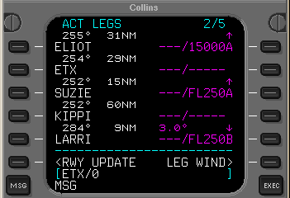
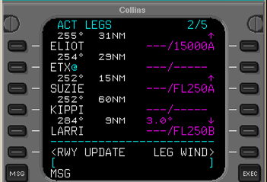
AUTO SEQUENCING
To create a fly-over WP:
  Bring WP into scratchpad and add /0
  Paste WP back over the original waypoint via LSK
    Will have a cyan @
    Note
    Pilot may create waypoints prior to a point by selecting waypoint /- then entering a distance. (ETX/-30 = 30 NM prior to ETX)
    *This may be useful for altitude crossing restrictions
MAIN MENU

Slide 44
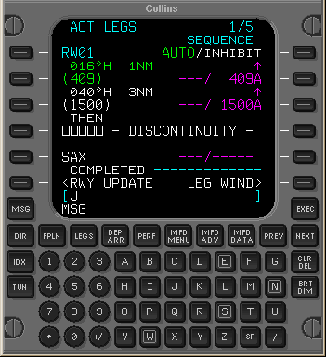
DISCONTINUITY
Indicates break in
flight plan sequence
  Cleared by selecting desired point in the flight plan and placing it on top of the discontinuity
MAIN MENU

Slide 45
Ground Operations
  STATUS
  POS INIT
  FLPN
  LEGS
  DEP/ARR
  PERF
  RAIM
MAIN MENU

Slide 46
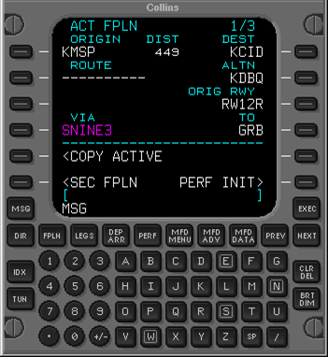
DEPARTURES & ARRIVALS
Departure / arrival procedure
automatically displayed under VIA
Accessed with DEP / ARR key
NOTE
Departures, STAR’s, and Approaches available for selection depend on Origin/Destination airports selected in FPLN
MAIN MENU

Slide 47
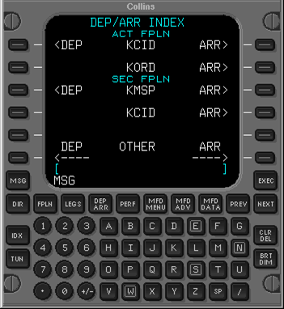
DEPARTURES & ARRIVALS
Pressing DEP/ARR key twice shows
DEP/ARR INDEX page
Secondary FPLN Departures and Arrivals are also listed.
MAIN MENU

Slide 48
Ground Operations
  STATUS
  POS INT
  FLPN
  LEGS
  PERF
  RAIM
MAIN MENU

Slide 49
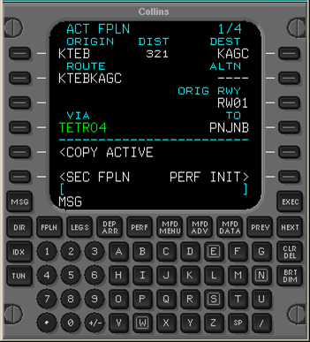
PERFORMANCE
Follow Prompt> to next step...
OR PERF function key
MAIN MENU

Slide 50
PERFORMANCE INITIALIZATION
MUST ENTER DATA
  Cruise Altitude
  As a technique use lowest possible cruise altitude to enable Top of Descent calculations above that altitude. (IE. 1000’)
MAIN MENU

Slide 51
Ground Operations
  STATUS
  POS INT
  FLPN
  LEGS
  PERF
  RAIM
MAIN MENU

Slide 52
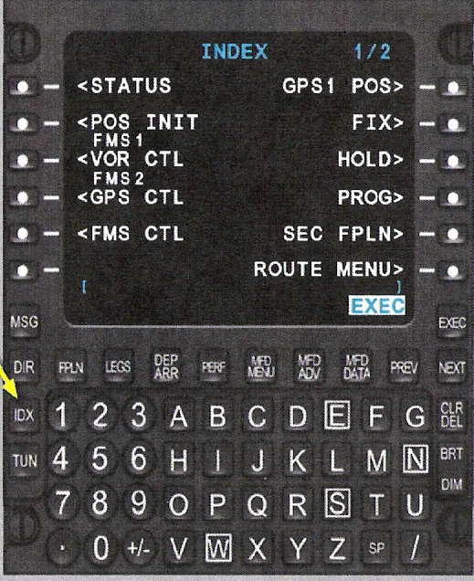
Ground Ops – RAIM
Check RAIM
  Press IDX Function key
  Select GPS CTL LSK
MAIN MENU

Slide 53
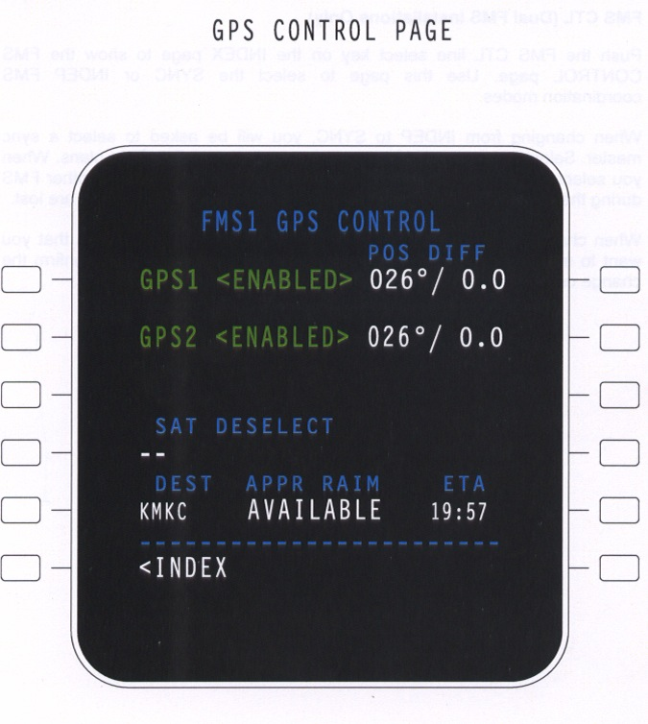
Ground Ops – RAIM
Satellite Deselect
  Enter satellites to be deselected into scratchpad
  Press SAT DESELECT LSK
  ***Caution: Prior to checking RAIM on the deck, deselect NOTAMED inoperative satellites or they will be taken into account on the RAIM check.
Enter DEST and ETA and the FMS will check APPR RAIM.
  **Clear/Delete ETA after RAIM check so that FMS will update for actual ETA once airborne.
MAIN MENU

Slide 54
FMS Takeoff Tools
Secondary Flight Plan
Selecting Approach
MAIN MENU

Slide 55
Ground Ops – Takeoff (Instruments)
Secondary Flight Plan:
  The secondary flight plan is an excellent tool to be utilized when conducting multiple FMS, overlay, or GPS approaches.
Note: When a SEC FPLN is activated and executed, the ACT FPLN and SEC FPLN exchange places. This prevents losing the previous flight plan in case you want to return to it.
MAIN MENU

Slide 56
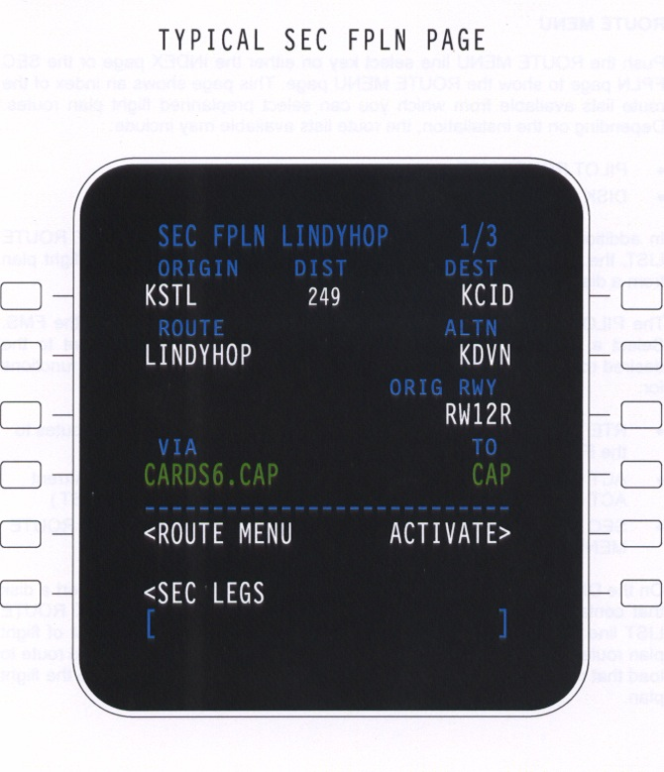
Ground Ops – Takeoff (Instruments)
To access the secondary flight plan
  Press the FPLN function key
  Press the SEC FPLN LSK
  Enter information as done with the ACT FPLN
  To activate, press the ACTIVATE LSK, verify on the PFD and execute.
MAIN MENU

Slide 57
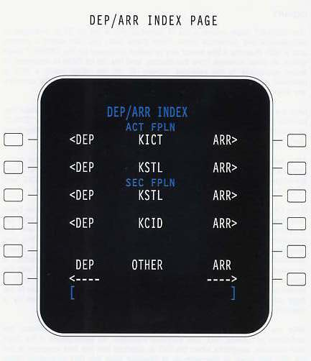
Selecting an Approach
Press DEP/ARR function key to access DEP/ARR index page
Press the ARR LSK for the destination airport of your active flight plan.
MAIN MENU

Slide 58
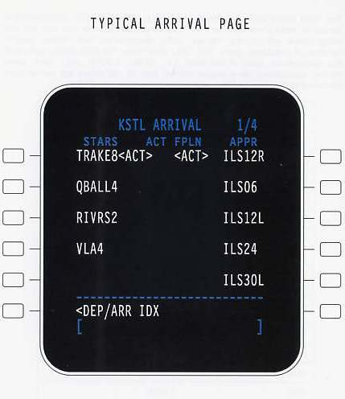
Selecting an Approach
Press the LSK corresponding to the approach you wish to shoot.
MAIN MENU

Slide 59
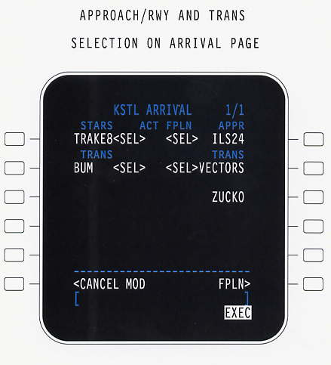
Selecting an Approach
Press the LSK corresponding with vectors or the IAF desired.
  Press LSK for VECTORS if ATC will be vectoring aircraft to the final approach course
  PRESS LSK for the Initial Approach Fix (IAF) if commencing the approach from there (ZUCKO shown here)
MAIN MENU

Slide 60
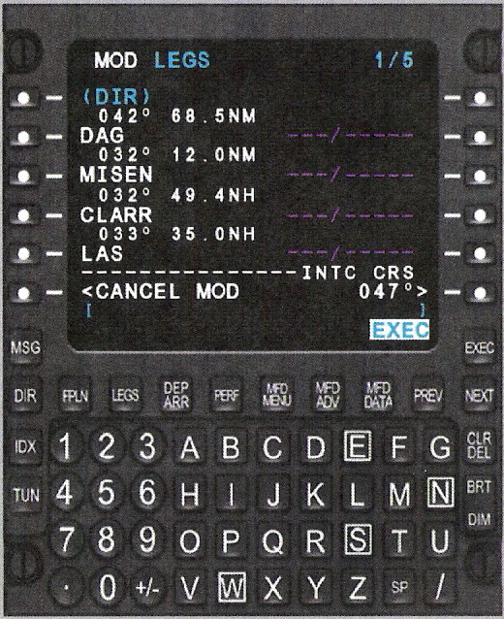
Selecting an Approach
Press the LEGS function key to verify the approach with the approach plate
  To scroll down press the NEXT function key
If everything is correct, ask the instructor to verify and execute the flight plan.
MAIN MENU

Slide 61
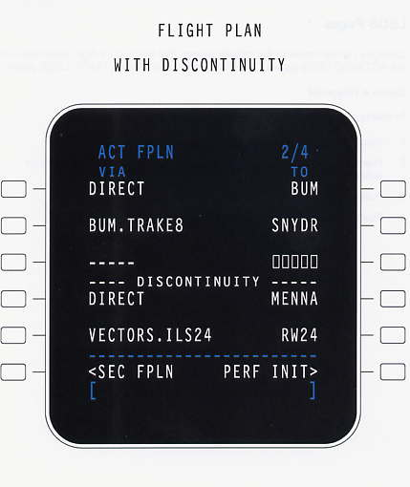
Selecting an Approach
When checking the flight plan after loading an approach, there will be a discontinuity between the cruise route and the approach procedure.
  This will be corrected once airborne
  This will be discussed in the terminal area procedures section
MAIN MENU

Slide 62
Enroute Procedures
Departing local area
Intercept course
  Green VS Blue method of intercept
Enroute techniques
MAIN MENU

Slide 63
Enroute Procedures – Departing Local Area
When departing the local area, load the flight plan in the FMS
The aircraft may be vectored or cleared by ATC on a departure route then cleared to a point or airway and told “resume own navigation”
At this point you will need to manipulate your flight plan in the FMS
MAIN MENU

Slide 64
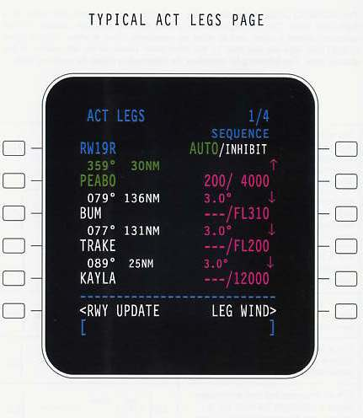
Enroute Procedures – Departing Local Area
If cleared to a point on flight planned route:
  In LEGS, the top line will be blue. This is where you are coming from.
  The second line is green. This is your next point.
MAIN MENU

Slide 65
Enroute Procedures – Departing Local Area
If flying the flight plan to the right. You departed RWY 19R.
All the points listed are along V13.
ATC tells you “cleared direct BUM intercept V13 and resume own navigation”
MAIN MENU

Slide 66
Enroute Procedures – Departing Local Area
ATC now expects you fly direct BUM, but that is not the next point in the Flight Plan.
To make BUM the next point, press the LSK next to it to move it to the scratch pad
MAIN MENU

Slide 67
Enroute Procedures – Departing Local Area
Next press LSK 2, the one next to the Green line.
This moves BUM into the Green then EXEC. The FMS will now provide navigation information to fly direct to BUM.
MAIN MENU

Slide 68
Enroute Procedures – Departing Local Area
In summary, if ever cleared direct to a point in the flight plan that is not your next point
Select the desired point and move it to the green line
Next, Execute, to fly direct from your present position direct to the new waypoint.
A second method to proceed DIR to a waypoint is press the DIR function and select the appropriate waypoint.
MAIN MENU

Slide 69
Enroute Procedures
ATC may clear you to intercept an airway between two points on your flight plan, not direct to a point.
An example of this clearance would be:
  “Fly heading 350 to intercept V13 and resume own navigation”
MAIN MENU

Slide 70
Enroute Procedures
Green Method
Note the FMS derived course to the next point on the desired airway then…
Press the LSK for the point ahead of you on the airway.
Enter this point into the Green (active) LSK.
Enter FMS derived course previously noted for V13 and Press INTC CRS LSK
Verify and Execute
MAIN MENU

Slide 71
Enroute Procedures
This “Green method” will draw an infinite line from the point on the airway selected corresponding to the entered INT CRS.
When within 10 radials of the course the CDI will start to come alive.
Intercept the course
MAIN MENU

Slide 72
Enroute Procedures
Blue Method
Blue method can be used when intercepting an airway between two points.
Select the point the aircraft has passed and place it in the “Blue” (from line).
The next waypoint on the legs page will then be the point you are going to next in the “Green”
The FMS calculates the intercept course and sets the CDI to the proper course.
Intercept the course.
MAIN MENU

Slide 73
Enroute Procedures
A third situation you may encounter when enroute is being vectored by ATC off your plan route for something such as traffic avoidance.
Once off route you may be cleared direct to the same point you were just flying to, but now you are displaced off the airway and you CDI shows course deviation.
You can’t re-intercept the course on you CDI because ATC expects you to fly direct from your present position.
MAIN MENU

Slide 74
Enroute Procedures
For example, you were flying direct PEABO when vectored off course. ATC then cleared you “direct present position to PEABO and resume own navigation.”
MAIN MENU

Slide 75
Enroute Procedures
To re-center your CDI to fly direct from your present position:
  Press LSK for PEABO to move it to the scratch pad.
  Press the same LSK again to move it back up
MAIN MENU

Slide 76
Enroute Procedures
This tells the FMS that you want to fly present position direct the point you moved into the Green. After doing this, the CDI should center up.
This is referred to as “Double Tapping.”
MAIN MENU

Slide 77
Enroute Procedures – Fuel Log
When challenged with “Fuel Log” on the cruise checklist you can use the FMS to determine fuel required to you destination.
Press the PERF function key to access the Performance Menu
MAIN MENU

Slide 78
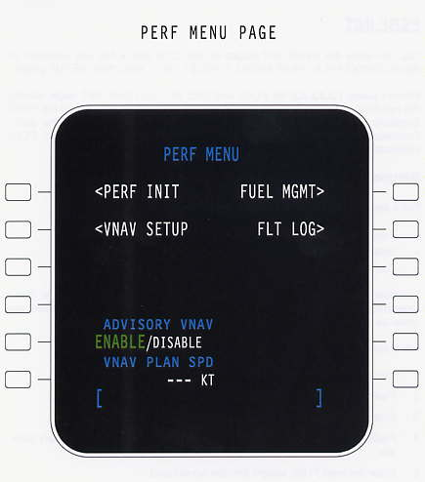
Enroute Procedures – Fuel Log
The Press the FUEL MGMT LSK to access the Fuel Management submenu.
MAIN MENU

Slide 79
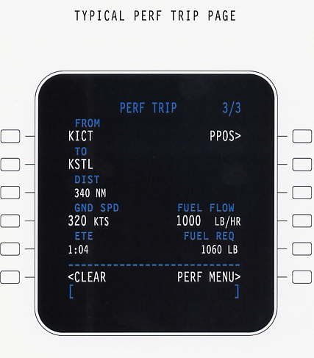
Enroute Procedures – Fuel Log
Go to page 3 of the Fuel Management section to access the PERF TRIP page.
  Do this by press the NEXT function key twice.
Ref – Appendix H Cruise Checklist Step 5
MAIN MENU

Slide 80
Enroute Procedures – Fuel Log
Look at the fuel flow gauges and add the two fuel flows together.
  360L+340R=700lbs/hr
Enter this number in the scratch pad
Press the FUEL FLOW LSK
The fuel required to reach your destination will show under FUEL REQ.
WARNING – The ETE should be compared to the IDX, PERF page for accuracy.
MAIN MENU

Slide 81
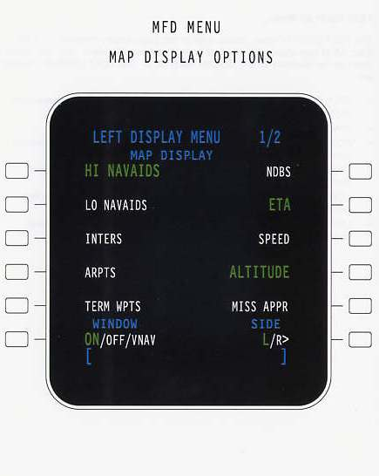
Enroute Procedures – Display Options
While enroute to your destination, you can use the FMS to display useful information on your PFD.
MAIN MENU

Slide 82
Enroute Procedures – Display Options
To access the MFD menu, press the MFD MENU function key.
MAIN MENU

Slide 83
Enroute Procedures – Display Options
Press the LSK for the item you wish to display on you PFD.
  Note: These will only appear when in 120 map mode
Press the SIDE LSK to switch between L or R PFDs
  Each side can display different items.
MAIN MENU

Slide 84
Enroute Procedures – Display Options
HI NAVAIDS – Shows the high altitude NAVAIDs
LO NAVAIDS – Shows the low altitude NAVAID
INTERS – Shows intersections
ARPTS – Shows nearest airports
TERM WPTS – Shows terminal waypoints
WINDOW – Not Applicable
NDBS – Shows non-directional beacons
ETA – Shows the ETA adjacent to the waypoints, intersections, or NAVAID
SPEED – Shows the current speed adjacent to waypoints, intersections, or NAVAID
MAIN MENU

Slide 85
Enroute Procedures – Display Options
ALTITUDE – Shows reference altitude data adjacent to waypoints, intersections, or NAVAID
MISS APPR – Shows the plan path for the published missed approach procedure (based upon the approach selected on the ARRIVAL page)
PAGE 2 (Not Pictured)
RNG TO ALT – Shows the arch symbol the flight path where the airplane will reach it’s target altitude
LRN POS – Shows the LRN sensor position symbol
ALTN FPLN – Shown the alternate flight plan route
MAIN MENU

Slide 86
VNAV
Vertical navigation concepts
VNAV Climbs
VNAV descents
Altitude constraints
Direct to descents
MAIN MENU

Slide 87
VNAV
FMS provides multiple Vertical Navigation waypoints for each
phase of flight. Vertical Navigation helps the pilot to comply with the
items that follow:
• Altitude and speed constraints at waypoints
• Speed limits at altitudes
• The vertical flight profile as specified by the pilot.
Vertical Navigation (VNAV) mode automatically commands the flight
director to sequence modes and set target speeds and altitudes.
MAIN MENU

Slide 88
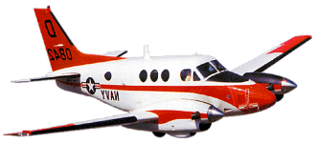
VERTICAL NAVIGATION
FL310
TOD
Used by FMS to plan and provide steering commands for:
  climbs
  descents
3 deg
5000’
WAYPOINT
MAIN MENU

Slide 89
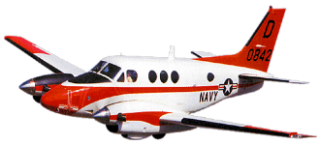
VNAV CLIMB
Preselector
TOC
Preselector
TOC
Pilot MUST initiate climb
Crossing Restriction
Pilot MUST initiate climb
VNAV will never pull nose UP
WPT
MAIN MENU

Slide 90
VNAV DESCENT
TOD
Crossing Restriction
3 deg
TOD
Crossing Restriction
Preselector
3 deg
Pilot MUST lower preselector
WPT
WPT
MAIN MENU

Slide 91
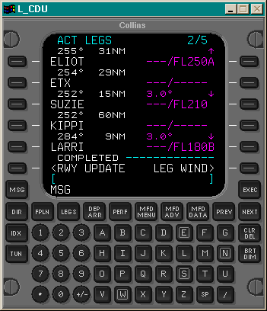
VNAV ALTITUDE CONSTRAINT
Entered by database
Entered manually
Followed by letter:
  A - At or Above
  B - At or Below
  None - At
VPA (vertical path angle) may be changed (1-6’)
Arrow indicates if constraint will be honored in climb or descent
MAIN MENU

Slide 92
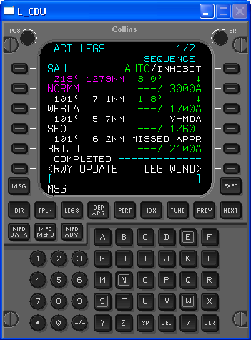
FMS Capabilities
Stepdown Fixes
Final Approach Segment Stepdowns without database angles
  KSFO “VOR or GPS-B”
  No database angle
  VNAV not authorized after FAF
    NATOPS limitation

Slide 93
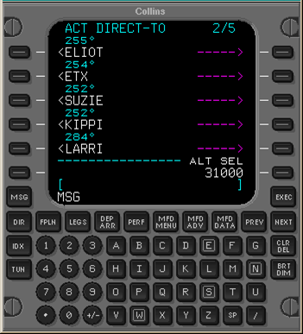
DIRECT TO DESCENTS
PRESELECTOR
DIRECT
MAIN MENU

Slide 94
Approaches
Types
Precision / Non –precision
Departure arrival page
Vectors
ARCs
Runway approaches
Visual
MDA Approaches
Localizer/ ILS approaches
MAIN MENU

Slide 95
APPROACH TYPES
Two types of approaches:
  FMS APPROACH
NON-FMS APPROACH
RUNWAY
MDA /DA
ILS
LOCALIZER
Only provides guidance down to published MDA
Or DA for LNAV/VNAV
FMS will not provide guidance for ANY localizer type approach
Straight in guidance to 50’ above threshold
Includes visual approaches
MAIN MENU

Slide 96
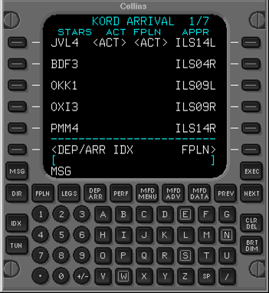
DEPARTURE/ARRIVAL KEY
Selects:
  STARs
  Approaches
Missed Approach Procedures
loaded automatically
MAIN MENU

Slide 97
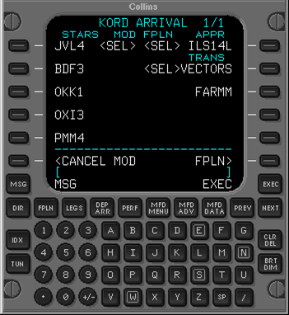
VECTORS
Default after approach selected
May choose transition or leave as default
MAIN MENU

Slide 98
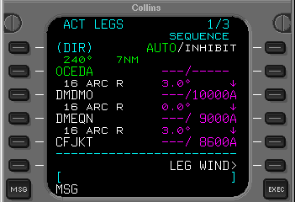
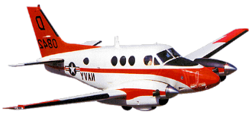
DME ARCS
OCEDA
DMDMO
DMEQN
052°
CFJKT
YICMA
MAIN MENU

Slide 99
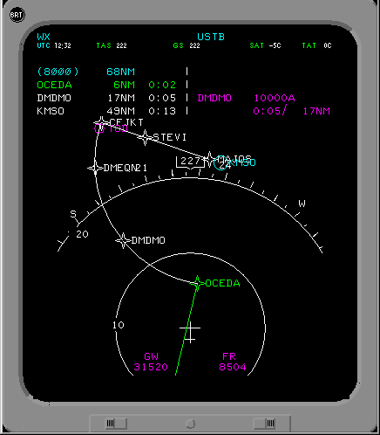
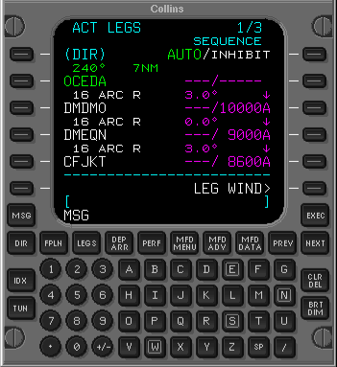
DME ARCS
Fly to transitions
OR...
MAIN MENU

Slide 100


DME ARCS
Intercept between transition waypoints
MAIN MENU

Slide 101

RUNWAY APPROACH
Pulled from database when approach was selected
Indicates type of approach and associated constraints
MAIN MENU

Slide 102
RUNWAY APPROACHES
Vertical guidance provided
NO obstacle clearance
Will NOT level off at MDA in Approach mode (VGP)
Glide Path
CF
FF
MDA
3 degrees
50 ft TCH
Runway
MAIN MENU

Slide 103

MDA APPROACH
May change VGP
May change MDA
MAIN MENU

Slide 104
MDA APPROACHES
Used with non-runway MAPs
Glide path calculated from FAF
Glide Path
MDA
CF
FF
Glide path is
usually 3 degrees
from Final Fix
MAP
MAIN MENU

Slide 105

VISUAL APPROACH
RX
RWY
DOES NOT GUARANTEE OBSTACLE CLEARANCE
MAIN MENU

Slide 106
VISUAL APPROACHES
Vertical guidance provided
Lateral guidance provided
Preselector honored
Glide Path
RX
3 degrees
Runway
Extension
Waypoint
5 mile typical
Runway
Does NOT guarantee obstacle clearance
MAIN MENU

Slide 107

LOCALIZER APPROACH
30NM from ARP
  Tunes Loc Frequency.
  AUTOTUNE
Sets inbound course
when tuned
FMS-1
Localizer
MAIN MENU

Slide 108

ILS APPROACH
Localizer is primary
NAVsource
VNAV holds Altitude until GS interception
FMS is “in waiting”
At FAF, sequencing is
“INHIBITed”
Vertical Glide Path (VGP)
MAIN MENU

Slide 109
ILS APPROACH
Missed approach procedure loaded with each approach
Go Around button returns sequencing to AUTO
Selecting GA displays
Missed Approach Procedure on CDU/ PFD map mode
First waypoint on MAP becomes“TO” waypoint
MAIN MENU

Slide 110


ILS APPROACHES
Tunes Loc Frequency
  Autotune
  Manual
Sets inbound course
30 NM TERMINAL AREA
APPR
MODE
052°
MAIN MENU

Slide 111
ILS APPROACHES
Glide Slope
When APPR selected:
  Loc will become primary NAV source
VNAV holds altitude until GS interception
FMS is in standby
At FAF:
  Sequencing is INHIBITed (won’t sequence to Missed Appch procedure until GA button activated)
FAF
Runway
MAIN MENU

Slide 112
HOLDS
Data entry
Execution
Examples
Exit
Cancel exit
Modify legs
Timing VS DME
MAIN MENU

Slide 113

HOLDS
Accessed through IDX
Waypoint
Identified as HOLD AT
  Procedure holds identified as HOLD TO
Present Position
MAIN MENU

Slide 114

HOLDS
Quadrant/Radial
Inbound Course
Leg Time
Leg Distance
FAA
Fix ETA
EFC Time
MAIN MENU

Slide 115

HOLDS
New Hold
Exit Hold
Cancel Exit
MAIN MENU

Slide 116
HOLD ENTRY
Entry type determines when hold is ‘established’
      Displays option to EXIT HOLD
    May only EXIT HOLD once established
      Parallel entry not established until second crossing
True for procedure hold entries also
    Procedure hold automatically set up for exit upon entry
      Displays option to CANCEL EXIT
    May only CANCEL EXIT once established
      Parallel entry not established until second crossing
MAIN MENU

Slide 117



HOLDS
Hold NESTO
IB Course 180°
Left turns, etc……
VINSE
NESTO
MAIN MENU

Slide 118




HOLDS
Enter IB course
Enter Left turns
Hold NESTO
IB Course 180°
Left turns, etc……
250°
VINSE
NESTO
MAIN MENU

Slide 119



HOLDS
180°
VINSE
NESTO
MAIN MENU

Slide 120


HOLDS
VINSE
NESTO
MAIN MENU

Slide 121

Enroute – Holding
Modify a Hold
To change a time-based leg to a distance-based leg, enter the distance into the scratchpad
Push the LEG DIST LSK key to replace
To change or enter the EFC time, enter time into scratchpad
Push the EFC TIME LSK to replace
Verify the flight plan change on the PFD and execute
MAIN MENU

Slide 122
Enroute – Holding
Holding Exit
The FMS steers the aircraft to exit the hold in one of three ways
  If inbound, it will continue along the existing track to exit
  If on the outbound turn, it will continue through the outbound leg back to the fix
  If on the outbound leg before the inbound turn, it will start an immediate turn to the inbound leg to exit the holding pattern
The FMS calculated exit path will show on the PFD in map mode.
MAIN MENU

Slide 123

Enroute – Holding
Holding Exit
To exit holding from the ACT LEGS or ACT FPLN HOLD page:
  Push the EXIT HOLD LSK
  Verify the change on the PFD
  Push the EXEC function key to execute the change and exit the holding pattern.
MAIN MENU

Slide 124
Enroute – Holding
Holding Exit (HILO)
NOTE: Course reversal holds that commonly appear in approach transitions are automatically armed for exit once the airplane is established in the hold. However, the exit may be cancelled by the pilot prior to reaching the final course intercept point.
To cancel a holding exit
  Push the LEGS function key
  Push the CANCEL EXIT LSK
  Push EXEC to execute the changes
MAIN MENU

Slide 125


FIXES
Used for reference only
Accessed through index page
Seen only in MAP mode on the PFD
Reference
Distance
Abeam
MAIN MENU

Slide 126
Terminal Area
When challenged with FMS in the approach checklist, ensure the proper approach is loaded in the FMS and the points are correct with the instrument approach plate.
To review this see Ground Ops – Takeoff – Selecting an Approach
When shooting an FMS approach, when within 30 nm of the destination you should see “TERM” in white on you PFD. Announce “Approach mode is armed.”
When within 2 nm of your FAF the TERM should change to a green “GPS APPCH”. Announce “Approach mode active.”
MAIN MENU

Slide 127
Terminal Area
Approach Checklist: Upon reaching the “FMS” portion of the approach checklist, remember to check a few things:
  The waypoints for the approach
  Check for the white “TERM”, indicating that Approach Mode is armed
MAIN MENU

Slide 128
Terminal Area - Discontinuities
As discussed earlier, you may see a discontinuity in your flight plan.
Discontinuities are inserted automatically during certain edits of a flight plan. Their purpose is to segregate portions of the flight plan that are not naturally connected, such as an approach procedure not connected by an IAF to the last en route or arrival waypoint.
MAIN MENU

Slide 129
Terminal Area – Removing Discontinuities
Press CLR/DEL function key then select the LSK associated with the discontinuity.
  Use this method if you are going direct from the point before the discontinuity to the point after it.
MAIN MENU

Slide 130
Terminal Area – Removing Discontinuities
If the points are not as discussed in the previous slide, press the LSK for the point you want to go to.
Then press the DISCONTINUITY LSK.
This replaces the discontinuity with that point.
MAIN MENU

Slide 131
Terminal Area – Removing Discontinuities
Another way to remove a discontinuity is by use of the DIR (direct) function key.
Once cleared direct to a point, press the DIR function key
Then press the LSK corresponding to the point you are cleared to.
This will move the point up and remove the discontinuity
MAIN MENU

Slide 132
Terminal Area – IAF
If you selected the Initial Approach Fix as the point you are starting your approach from, remove the discontinuity as shown previously and commence the approach when cleared.
MAIN MENU

Slide 133
Terminal Area - Vectors
Two techniques exist for shooting an FMS based approach when you choose vectors as your transition method.
  Blue Method
  Green Method
This transition consists of a Course to Fix (CTF) leg in the flight plan leading to the FAF.
MAIN MENU

Slide 134
Terminal Area – Vectors
Blue Method
  When the aircraft is properly positioned and cleared for the approach, intercept the CTF leg by placing the CTF point in the Blue Line on the flight plan (CTF fix is the point prior to the FAF).
  Comply with the vectors to intercept the course.
MAIN MENU

Slide 135
Terminal Area - Vectors
Green Method
  Use heading mode to comply with ATC vectors.
  Place the FAF in the Green line on the flight plan.
  Press INTC CRS LSK to set the appropriate course to intercept
  Sets “infinite course” to selected point.
MAIN MENU

Slide 136
Terminal Area – GPS HILO
Loading
  To load a GPS approach that is a HILO, select the IAF that corresponds to the holding fix
  This will load that same IAF, followed by a waypoint called (INTC), followed by the IAF again
  (INTC) is the point where the holding pattern intercepts the final approach course
  In 360 mode, the aircraft is abeam (INTC) when the FMS bearing pointer is perpendicular to the FMS CDI
(FAF)
JOYRY
(IAF)
IHPOP
(INTC)
MAIN MENU

Slide 137
Terminal Area – GPS HILO
(INTC) is placed based upon either a DME hold pattern or a 1 min pattern depending on the approach
When an approach with a 1 minute hold is initially loaded, the FMS will place the point based on 175 KIAS max holding airspeed. Two options exist:
  1. Entering the holding pattern on speed: Upon crossing the holding fix, the FMS will reposition (INTC) based on the current aircraft speed provided it is less than 175 KIAS.
  2. Prior to crossing the holding fix, manually enter 150 on the legs page and pressing the RLSK corresponding to the (INTC) waypoint
MAIN MENU

Slide 138
Terminal Area – GPS HILO
Flying the HILO:
  Once past the IAF on any entry, the FMS will cycle to the (INTC) waypoint, and DME information will be from that point
  When the bearing pointer is perpendicular to the CDI, the DME will be at its minimum indicating that you should turn inbound
  Hence, when looking for when to turn inbound, ignore the DME and focus on the bearing pointer
(FAF)
JOYRY
(IAF)
IHPOP
(INTC)
MAIN MENU

Slide 139
Terminal Area – GPS HILO
Hold Exit
  When the FMS sequences to the hold waypoint, it is automatically armed for exit
  On parallel entries, it will be automatically armed for exit after the entry maneuver
  To remain in the holding pattern, if required, push the CANCEL EXIT LSK on the LEGS page
  To exit an extended hold, press the EXIT HOLD LSK on the LEGS page; however, do not do this prior to the inbound turn, or the FMS will try to turn the aircraft to the inbound leg directly from the present position on the outbound leg
MAIN MENU

Slide 140
Terminal Area – FAF Sequencing
To prevent the FAF from sequencing prematurely, regardless of aircraft position, special criteria applies to the FAF.
At 2.0 NM radial distance from the FAF, the aircraft must have:
  Less than 1.6 NM cross track deviation
  The magnitude of intercept must be less than 90 degrees
  The altitude must be less than 300 ft above the FAF altitude constraint
  The FAF must be the TO waypoint or the next waypoint after the TO waypoint
MAIN MENU

Slide 141
Terminal Area – Missed Approach
The published missed approach procedures are loaded when the approach is selected and can be verified on the legs page.
Missed approach procedures will not show on the PFD until the MA is active.
There are several ways to initiate the Missed Approach in the FMS
  Push the Take Off/Go Around (TOGA) button
  Make a lateral change to the flight plan between the FAF and MAP
  Delete the FAF or MAP waypoint
  Select AUTO sequencing after crossing the MAP
MAIN MENU

Slide 142
Terminal Area – Missed Approach
Technique
  When shooting multiple FMS overlay or GPS approached and climb out instructions are issued by ATC, delete missed approach points in LEGS pg to declutter page and prevent flying the wrong missed approach procedure.
MAIN MENU

Slide 143
Seagull – Building the Box
“Building the Box” in the FMS is a way to enter waypoints into the FMS so that it draws lines between the points creating a Box in the shape of the training area.
It aides in staying in the area, but does not replace knowing the area boundaries and using traditional Nav sources to maintain yourself in the area. It is at the instructor’s discretion to allow the student to use this technique.
MAIN MENU

Slide 144

Seagull – Building the Box
This example will walk you through building the box for the central seagull training area.
Access the ACT FPLN page
Enter KNGP into the ORIGIN and DEST
MAIN MENU

Slide 145
Seagull – Building the Box
Enter CRP 130/26 in the scratchpad and press the TO LSK
Enter CRP 130/33.8 and press TO LSK
Repeat the process with CRP 100/33, CRP 100/60, CRP 115/60, CRP 130/60, and CRP 130/33.8 to close it off
MAIN MENU

Slide 146
Seagull – Building the Box
On the LEGS page select INHIBIT for auto sequencing to prevent the FMS from cycling the point after you pass it.
Select FMS as the primary NAV source on the PFD and select 120 Map Mode format.
Zoom out and verify the box appears correct. It will appear as dashed lines.
If it is correct, EXECUTE. After executing, the lines will become solid.
MAIN MENU

Slide 147
Low Level Routes
The majority of the Low Level Routes are stored in the FMS.
To access the route list
  Press IDX function key
  Go to index menu page 2
  Press ROUTE MENU LSK
  Press PILOT ROUTE LIST LSK
  Press the LSK associated with the route you want
  Verify the route in correct in the legs page
  Verify in 120 map mode against your stick diagram
  If all is correct, execute.
MAIN MENU

