Slide 1
Instrument Intro Briefs
I0101:GPS/Radio Instrument Procedures
(The brief you are getting right now)
I0102:T44C GPS/FMS
I0103:T44C Flight Director Operation
I0104-I0106: Self-paced laptop trainer covering; Weather Radar, Flight Guidance Panel, Messages and Annunciations
21 Mar 2025

Slide 2
I0101 Overview
Introduction
Stage Review
Reference Materials
Local Operations
Communications
Takeoff/Departure
Enroute
Arrival/Approach Brief Example
CRM Callouts
Airfield Lights and signs
Common Mistakes
RNAV/GPS Approaches
Extras
Conclusion

Slide 3
Stage Review
I2100 Block BI Sims - 4 events
I2200 Block RI Sims - 2 events
I3100 Block RI Sims - 6 events
I4100 Block Flights - 4 events - Instrument Intro with emphasis on the different types of approaches
I3200 Block - 6 Emergency Instrument Sims
I4200 Block - 4 Emergency Instrument Flights
I3390 - Midstage Instrument Check (sim) IP will act as CP
I4300 Block - 4 Cross Country Flights
I3400 Sim - 1 Advanced Emergency Instrument Approaches Scenario based event after Cross Country
I4400 Block - 3 Advanced Emergency Instrument Flights that will have homework!
I4403: BRING INSTRUMENT RATING REQUEST, FILLED OUT!
After I4402 get with logs/records to ask them to pull your Wingstats to help fill out the rating request.
I3500 Block - Instrument EP Sim scenario based, anytime after I4201
I3600 Block - CRM Simulator scenario based, after I3501
I4590 - NATOPS Instrument Check ride
I4601—Solo Cross Country
Notes:
Discuss the specifics of each block while students follow along with their Master Curriculum Guides.

Slide 4
Reference Material
Instrument Stage Material
FTI
FAR AIM (to include Advisory Circulars)
CNAF M-3710.7
FAA Instrument Flying Handbook
FAA Instrument Procedures Handbook
NATOPS Instrument Flight Manual
General Planning and FLIP publications
TERPS Manual 8260.3C
Wing and Squadron SOPs
Notes:
Discuss the importance of referencing all material to prepare for discuss items. Talk about the specifics of each publication and where to locate them. Stress the importance of having an intimate knowledge of all publications by the Review Stage. Also show them the quick reference guide at the back of the handout. FAA pubs and AIM are available for free download (google)

Slide 5
Reference Material
FTI
Details standard procedures for maneuvers, approaches, and operations not specifically addressed in NATOPS
FAR AIM and AC’S
Provides Aviation Community with basic flight information and ATC procedures for use in the National Airspace System
Should be the primary source for general flight procedures
Advisory Circulars provide guidance for compliance with airworthiness regulations, pilot certification, operational standards, training standards, and any other rules within the 14 CFR.

Slide 6
Reference Material
CNAF M-3710.7
Provides (along with FAR part 91) specific rules and regs for operating Naval aircraft
FAA Instrument Flying Handbook
Designed for use by pilots preparing for an instrument rating test
FAA Instrument Procedures Handbook
Designed as a technical reference for all pilots who operate under IFR in the National Airspace System
NATOPS IFM
Contains important basic flight information and IFR procedures
One of the best places to read about needle only characteristics of different NAVAIDS

Slide 7
Reference Material
General Planning and FLIP Publications
GP contains information on flight planning and filing requirements. Chapter 4 specifically references DD-1801 filing procedures.
TERPS Manual
Explains the construction of instrument procedures and obstacle clearances in and around the terminal area.
SOPs Contain all of the local guidance that may be more limiting than the CNAF 3710.
By Review Stage, you must be intimately familiar with FLIP publications, AIM/FTI procedures and CNAF/FAR material

Slide 8
Electronic Pubs
Electronic Kneeboard (EKB) tablets equipped with ForeFlight are authorized for use by all aircrew. Squadron members are responsible for ensuring all software and publications on their EKBs are kept up-to-date and batteries are charged for the duration of their events.
REF: VT35INST 3710.1N
SNAs shall not use any type of Global Positioning System tracking or approach plates with notes during training events. The decision to carry a set of current paper publications on each flight for backup is up to IP discretion. EKBs shall not be left in unoccupied aircraft due to the risk of fire from battery thermal runaway.
REF: VT35INST 3710.1N
NOTE: Students not in compliance with regulations will receive an OLQ Pink sheet with UNSAT left up to the discretion of the instructor.

Slide 9
Standard INST Rating Requirements

Slide 10
Standard INST Rating Requirements Actual vs. simulated time
Actual IMC:
No external visual reference to the horizon.
Note: is logged by both pilots.
Simulated IMC:
Conditions external are VMC.
Only the pilot at the controls logs the time.

Slide 11
Standard INST Rating Requirements
Simulated Instrument Approach:
An Approach flown in VMC conditions.
Actual Instrument Approach:
An instrument approach flown in actual instrument conditions below 1000’ AGL.

Slide 12
Standard INST Rating Requirements
Notes:
Cannot count approaches conducted on check flight.
Can count approaches from previous check flight, however.
Simulator Usage:
- Up to half of required time and approach requirements can be used toward minimums.

Slide 13
Preflight Planning

Slide 14
Stopover Flights within the contiguous unites states

Slide 15
Hazardous Weather

Slide 16
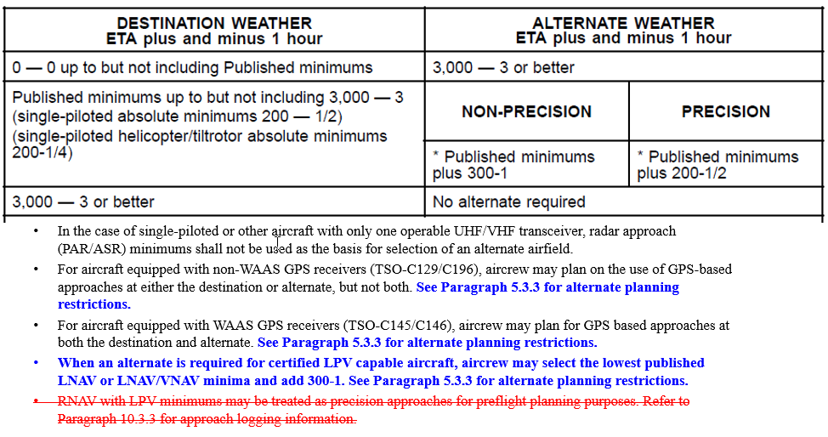
Aircrew Definitions Single-Piloted vs. Multi-Piloted
Alternate selection
Single-piloted:
Two sets of flight controls and instruments, but only one NATOPS qualified pilot.
Multi-piloted:
Two sets of flight controls and instruments
Two NATOPS qualified/instrument rated pilots.

Slide 17
Local Operations (cont.)
Tango-3 (Should be put on with clearance from the AC)
KNGP
TAC, VOR, ILS, GPS
KCRP
VOR, TAC, ILS, GPS
KT69
VOR, GPS
KTFP
GPS
KRKP
VOR/TAC, GPS
Notes:
Discuss the local outlying airfields and their specific approaches they can expect. Also mention that the NDBs are getting closed down except at airfields with only NDBs available.
Draw the local area and the routes/corridors to transition between them. Students should follow along with the L19/20.

Slide 18
Local Operations (cont.)
GCA-1
For KNGP PAR or ASR
Should be put on with clearance from the aircraft on button 2.
Sample radio call: “Navy Corpus Clearance STGRY XX. We’d like to put a GCA-1 on request; first approach PAR/ASR [RWY].”
Reference TW-4 Local Use Procedures (TW-4 IFG) for all coded flight plans.
All coded flight plans and 1801’s should be filed with Base OPS or ForeFlight.
Pick up gouged app clips from supply.
Notes:
Discuss how you only need one flight plan to get you in an area and can shoot any approaches controlled by the local approach controller.

Slide 19
Local Operations (cont.)
WHAT YOU BRING TO THE BRIEF
Shall call or text the IP the night prior to discuss plan.
Each student must bring a flight plan (1801) for their planned profile.
If planning to file with base ops, the email is:
cnicsenaccbaseops@us.navy.mil
The plan should accomplish ungraded items in block (3 approaches for you, 1 for IP).
Students must either bring a local canned wx brief or file one on FWB.
Notams, TAF’s, BASH, ect.

Slide 20
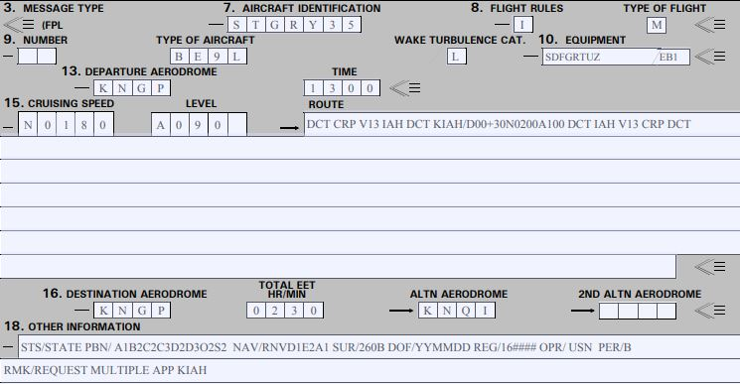
DD-1801
Reference GP for guidance
I: Entire flight will operate under IFR
Y: Initially under IFR the one or more changes to flight rules.
V: entire flight operated under VFR.
Z: Flight initially VFR followed by one or more flight rules changes.
JO 7360.1J
Appendix B
S = VHF RTF, VOR/ILS; D = DME; F = ADF; G = GNSS; R = PBN Approved; T = TACAN; U = UHF RTF; Z = Other
K = Kilometers
M = Mach number
F = Flight Level
M = Meters
E = TXDR – Mode S (acft ID, Press Alt, and ADS-B Capable)
B1 = ADS-B with “out” capability.
A1 = RNAV 10 (RNP 10); B2 = RNAV 5 GNSS; C2 = RNAV 2 GNSS; C3 = RNAV 2 DME/DME
D2 = RNAV 1 GNSS; D3 = RNAV 1 DME/DME
O2 = Basic RNP 1 GNSS; S2 = RNP APCH with BARO-VNAV
STATE = military, customs, police
260B = ADS-B ACFT has 1090MHz squitter in compliance with FAA requirements
Notes:
Discuss equipment codes.
Discuss how to file terminal delays.

Slide 21
Block 19

Slide 22
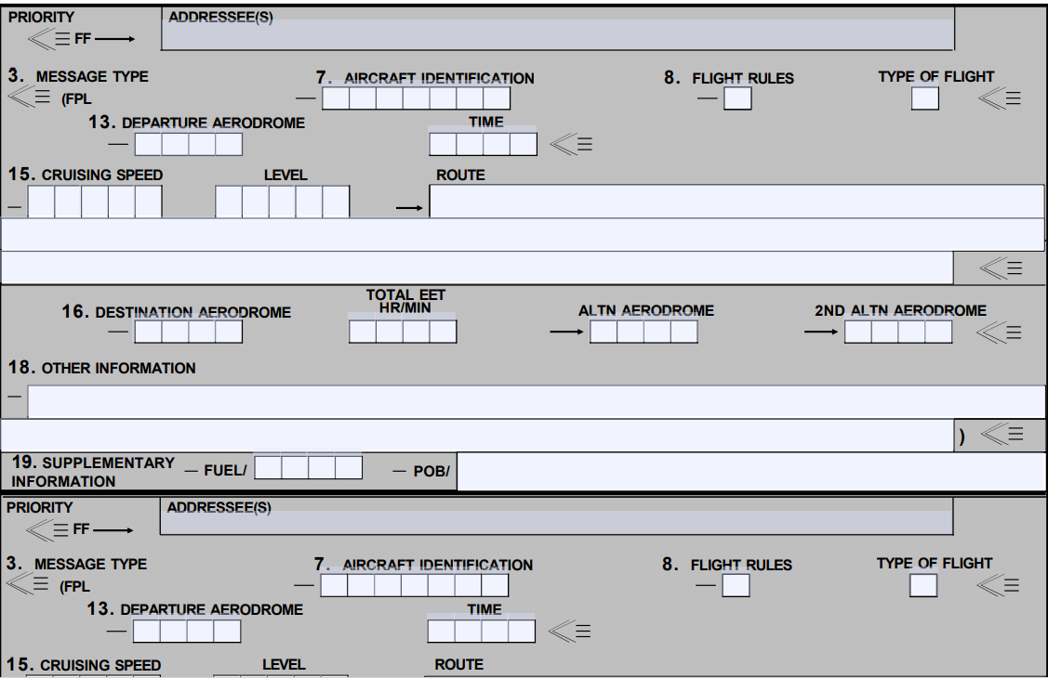
1801-C
Use 1801-C for stop over flight plans where aircraft information will remain the same.

Slide 23
Communications
Standard phraseology
AIM chapter 4, Section 2
“Radio Communications Phraseology and Techniques”—Pilot/Controller Glossary
https://www.faa.gov/air_traffic/publications/atpubs/aim_html/chap4_section_2.html
Approach will usually ask “how the approach will terminate?”. This is them asking what you want after that approach. Take this time to give them everything you want to do and how you plan on it ending it:
EX: “STGRY XX requests RV ILS 13 KCRP followed by VOR 18 KCRP, followed by the PAR 13R at KNGP for the full stop.”
Notes:
Reference the AIM for student radio call verbiage. The website for the pilot/controller glossary is provided. All students should pick up an AIM prior to instrument flying. Remind them to think before they talk and to be clear and concise.

Slide 24
Communications
General Rules
Always read back specific instructions and clearances when applicable (CRAFT or DRAFT for initial clearance with clearance delivery)
Read back assigned headings, altitudes, airspeeds, frequencies, transponder codes and altimeter settings. Most everything else just warrants an acknowledgment by stating your callsign.
ASK ATC TO REPEAT ANYTHING YOU DIDN’T GET!!!
Notes:
FORGET WILCO. Make them repeat this. It’s better to ask for a repeat instruction than to offer an incomplete/incorrect read back.

Slide 25
Required Comms
V – VFR on top altitude change
A – Leaving assigned Alt for another Alt
If instructed to descend “at pilot’s discretion,” you can descend when deemed necessary, but you still have to let ATC know when you are vacating that altitude to the new altitude.
C – Can’t climb/descend at 500 fpm
A – Missed Approach
T – TAS changes by 5% or 10kts whichever is greater
E – Entering (time and alt) or leaving holding fix (Corpus Approach/Valley Approach does not require this call)
R – Radio or NAVAID degradation
S – Safety of flight issues (un-forecast WX is included)

Slide 26
Communications
Unicom/CTAF
Speak to the lowest common denominator, the VFR pilot with no approach plates
They don’t know what “Procedure turn VOR 32 Circle 14” means.
Sample calls for 10 and 5 miles:
“Aransas County traffic, STGRY16, 10 miles northwest, 1600 feet, inbound for a straight in 14, Aransas County.”
“Alice Traffic, Navy King Air 16, 5 miles to the west. Will overfly the field at 1100 feet to enter left downwind Rwy 13, touch and go, and depart to the east, Alice.”
Notes:
Cover what Unicom and CTAF are and the difference between the two.
Go over the sample calls.

Slide 27
Takeoff/Departure
Instrument Departure—critical phase of flight (low, slow, and heavy)
Focus on solid, specific briefing
Ensure copilot is onboard with all aspects of brief
Instrument Departure Brief items
Instrument Departure Procedures/Trouble T
Instrument Recovery-Emergency Return (Sim IMC)
Recovery-Emergency Return (Actual Conditions)
Notes:
Discuss the items included in a good Takeoff brief. Give examples of each item. Also, talk about practical emergency returns if weather is VMC. If actual IMC exists, then execute the briefed IFR emergency return. Otherwise, consideration should be given to returning VFR in order to expedite. Students, however need to always brief/plan for the IFR return.

Slide 28
Takeoff Minimums
Standard instrument rating :
Non-precision:
Published minimums for the available non-precision approach, but not less than 300-foot ceiling and 1-statute mile visibility.
Precision:
When a precision approach compatible with installed and operable aircraft equipment is available, takeoff is authorized provided the weather is at least equal to the precision approach minimums for the landing runway in use, but in no case when the weather is less than 200-foot ceiling and 1/2-statute-mile visibility/2,400-foot runway visual range (RVR).
Notes:
Discuss the items included in a good Takeoff brief. Give examples of each item. Also, talk about practical emergency returns if weather is VMC. If actual IMC exists, then execute the briefed IFR emergency return. Otherwise, consideration should be given to returning VFR in order to expedite. Students, however need to always brief/plan for the IFR return.

Slide 29
Takeoff/Departure
Trouble T
The Trouble T applies on the departure as well as the approach if conducting a touch and go.
You must brief the Trouble T for both
See FTI / AIM for discussions on the 4 types of Instrument Departures.
Non-standard alternate WX Mins do not apply to DOD, use OPNAV requirements.
A-NA does apply, and is not available for use a alternate.
Notes:
Explain that briefing the Trouble T on an approach is in the event of an Missed Approach, during which and aircraft may not climb until the DER from a very low altitude, which is essentially similar to a take off.

Slide 30
Trouble T
TERPS
Assume one engine inoperative
200 ft/nm is the standard TERPS climb gradient
TERPS OIS (Obstacle Identification Surface) 152 ft/nm
48 ft/nm obstacle clearance
Can’t make the climb gradient?
Decrease gross weight-Fuel, payload, etc
Wait for better weather-Cooler, headwind, etc
Pick a different runway-Away from obstacle
VCOA where available

Slide 31
Trouble T
Departure end crossing height of zero feet at USAF/USN fields, all others 35 feet.

Slide 32
Takeoff/Departure
Weather minimums for takeoff-CNAF M-3710.7
Standard instrument rating — Published minimums for the available NPA, but not less than 300-foot ceiling and 1-statute mile visibility. When a precision approach compatible with installed and operable aircraft equipment is available, takeoff is authorized provided the weather is at least equal to the precision approach minimums for the landing runway in use, but in no case when the weather is less than 200-foot ceiling and 1/2-statute-mile visibility/2,400-foot runway visual range (RVR).
Notes:
Among other items in OPNAV 3710, this must be studied until immediate recall is easy.

Slide 33
Takeoff/Departure
Aviate, Navigate, Communicate
Climb at 150 kts (NATOPS climb speeds are located in chapter 7)
Contact Departure “OFF Report”
Who you are, passing altitude off whatever airport, flying whatever departure
Checklist (1,000 ft AGL)
Notes:
Talk about techniques for cockpit flow while doing multiple local approaches in a busy airspace.
Example: Gear up, Props 1900 – “Switch my approach plate, Tune Identify and Monitor CRP’s navaids. Passing 1000 ft let’s do the Climb Checklist.”

Slide 34
Standard Instrument Departures
SIDs:
Are always charted graphically.
Primary goal is to reduce ATC/pilot workload while providing. seamless transitions to the en route structure.
ATC clearance must be received prior to flying a SID.
While you are not required to depart using a SID, it may be more difficult to receive an “as filed” clearance when departing busy airports that frequently use SID routing.
Reference:
Instrument Procedures Handbook FAA-H-8083-168, Standard Instrument Departures, pg. 1-26. https://www.faa.gov/sites/faa.gov/files/regulations_policies/handbooks_manuals/aviation/instrument_procedures_handbook/FAA-H-8083-16B.pdf

Slide 35
Standard Instrument Departures
SIDs:
Vector off SID cancels the SID entirely, unless instructed otherwise.
- “Climb Via” is an abbv. ATC clnc that req. compliance w/ procedure lateral path, spd, alt restrictions
When cleared on a SID but NOT given a “climb via” clearance, compliance with published altitude restrictions is not required, the pilot will climb to the ATC assigned maintain altitude and comply with published speed restrictions.
Pilots are required to advise ATC on initial contact that they are climbing via/descending via a procedure, and must include any additional restriction and/or modified information.

Slide 36
Transition Level Altimeter setting
Altitude at which you switch from local altimeter setting to 29.92
FAA: 18,000 MSL
Differ by country
FL180 unusable when local altimeter is below 29.92

Slide 37
Enroute - Weather
PMSV Pilot-to-Metro service
FIH CHPT C-15 – C-22
“Full Service” – manned by full qualified personnel.
“Limited Service” – manned by “weather apprenitices” not qualified to prepare, issue , or interpret forecasts.
Automated Weather Observing Station
AWOS systems collect and process data on weather conditions (wind speed, visibility, temperature, and cloud coverage).
Uses algorithms to create official observations (METARs) that are broadcast to aviation personnel.
Automated Surface Observation System
- provide hourly reports on weather conditions, including wind speed and direction, visibility, precipitation, and etc.
Updated every minute.
Automatic Terminal Information System
Flight Service Station
Provides services such as: closing flight plans, in-flight filing, wx observations, relay phone calls, etc.
FREQs: 122.2, 122.4, 122.6
Phone: 1-800-WX-BRIEF
Notes:
When doing multiple approaches in one area grab atis for all fields while enroute.

Slide 38
Enroute
Least busy but possibly most critical part
Use this time to ‘get ahead’
Get ATIS early (You can get ATIS FOR ALL fields)
Brief approach as soon as you have the weather
Always be aware of position and situation
Utilized the MFD or MAP mode on the PFD
Pull out a low chart if time permits
Look at approach plate for extra SA (ex. Alice VOR-A), you “live” on the tail of the needle.
Notes:
When doing multiple approaches in one area grab atis for all fields while enroute.

Slide 39
Enroute - IFR Altitudes
Minimum en route altitude (MEA)
The lowest altitude an aircraft can fly between radio fixes
Important for preventing collisions with mountainous terrain and ensuring that pilots can stay connected to ATC.
Flying below the MEA could result in signal loss or terrain interference.
Minimum Obstacle Clearance Altitudes
The lowest altitude that an aircraft can fly at while still meeting obstacle clearance requirements for a specific route segment.
Only guarantees obstacle clearance.
(typically used in emergencies to get below icing, etc).

Slide 40
En route - IFR Altitudes
Minimum Safe Altitude:
An altitude that provides a minimum of 1,000 feet of clearance from obstacles.
Emergency Safe Altitude:
A specific altitude depicted on approach charts that provides a pilot with at least 1,000 feet of clearance above obstacles in non-mountainous areas.
In mountainous regions, this clearance may be increased to 2,000 feet.
Minimum Vectoring Altitude:
the lowest altitude at which air traffic control can safely vector an aircraft within a specific airspace sector, typically determined by the highest obstacle in that area.
1,000 feet of clearance in non-mountainous regions.
2,000 feet of clearance in designated mountainous regions.

Slide 41
Enroute
Prepare for Arrival
Review NOTAMS/IFR Supp
Restrictions and Airport Info
Review Charts
Familiarize with local airspace, airports and terrain
Review STARS (As Required)
If a STAR is published, file it.
Review Approach Plates
Review approaches and diagrams, including airport diagram to forecast a taxi plan.
Technique: 30 Min out, begin to get WX and review airport info (Notams, ATIS, etc). Initiate checklist once briefed and setup for the approach.

Slide 42
ENROUTE - Descent
Common descent terminology:
“Pilot’s Discretion”
“When used in conjunction with altitude assignments, means that ATC has offered the pilot the option of starting climb or descent whenever he/she wishes and conducting the climb or descent at any rate he/she wishes. He/she may temporarily level off at any intermediate altitude.”
Does not mean descend now. Can be delayed.
“Descend to XXXXX altitude, altimeter XX.XX.”
Implies descend now to said altitude.
You read back “STINGRAY XX leaving XXXXX altitude for XXXXX altitude.
When to descend?
Calculated descent point via FMS using VNAV with a TOD.
Manual Calculation using 3:1 rule:
Rule posits that you take the altitude to lose and multiply it by 3.
Ex: at 21,000’ MSL down to 5,000’ MSL.
Need to lose 16,000 so take 16 and multiply it by 3.
48 NM is a good distance request a descent.
Caveat is this is for an idle descent, so recommend taking groundspeed, divide by 2 and add a 0 for ROD in FPM.
EX: GS = 200. Divide by 2 = 100, add a 0 = 1000FPM
Same technique for ROD is used to quickly calculate a descent rate on an instrument approach for a 3° glideslope.

Slide 43
ENROUTE - Descent
Other considerations:
How are you going to get down?
VS vs FLC
Minimum descent rate required.
Can’t do an idle descent due to pressurization.
NATOPS say on 7.14 Descent: “NOTE: Approximately 75 percent N1 (single engine 85 percent) N1) is required to maintain the pressurization schedule during descent.
May need as much as 85 percent with both engines.

Slide 44
Arrival
ABCs Technique:
ATIS (or ASOS, AWOS)
Check plate for altimeter setting notes
Brief the Approach
FTI requirements
Circling plan
Things that are different, ex. arresting gear at KNQI
T&G brief
Checklist
Full vs. Abbreviated

Slide 45
Arrival
ABBCs Technique:
ATIS (or ASOS, AWOS)
Check plate for altimeter setting notes
Build the approach/cockpit setup
FMS/NAVAIDS/Minimums/Presentation
Cockpit flow to check. (Hook, Line, Sinker)
Brief the Approach
FTI requirements
Don’t forget T&G brief
Checklist
Full vs. Abbreviated

Slide 46
Arrival - STARs
- All pilots can refuse STARs.
Note on flight plan “No STARs”
DESCEND VIA – An abbreviated ATC clearance that requires compliance with a published procedure lateral path and associated speed restrictions and provides a pilot-discretion descent to comply with published altitude restrictions.
A “descend via” clearance must not be used where procedures contain only published “expect” altitude
If the intent is to comply with altitude restrictions while changing the top/bottom altitude use ‘climb/descend via except'.
If compliance with the altitude restrictions is not required when rejoining a procedure use “resume” and "maintain“ to rejoin the procedure and assign a new altitude to the aircraft.

Slide 47
Approach Brief
ATIS (WAR – wx, altimeter, duty runway)
Approach
What plate you are using (amendment and date)
Name and Location “ILS Z 13R at NGP”
Frequencies
Final Approach Course
GSIA (glideslope intercepted altitude) or FAF
DH/MDA and MAP
TDZE/ Runway
Missed Approach
Terrain (MSA)
Specials – Touch and Go, SSE full stop, Circling intentions
How will the approach be flown?

Slide 48
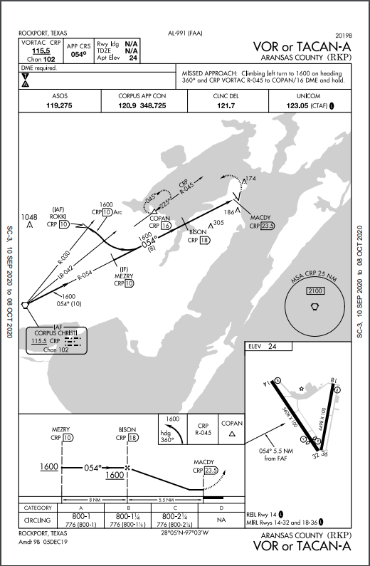
Example Approach Brief

Slide 49
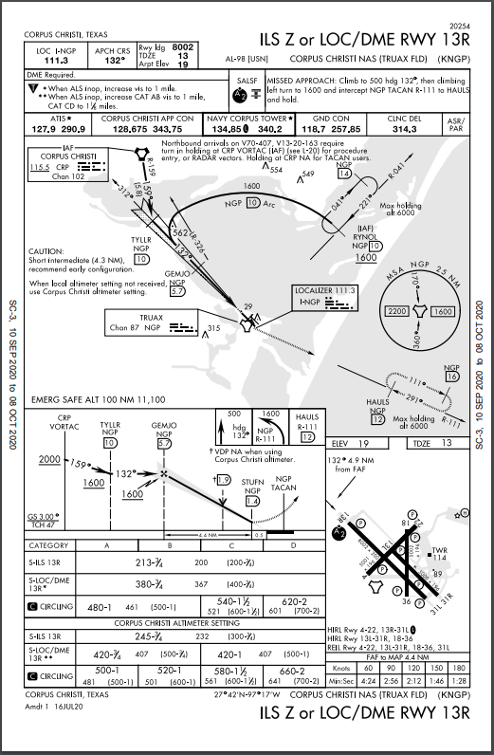
Example Approach Brief

Slide 50
HOLDING
Published Holding:
Ex: COPAN, RYNOL
Still need Expected Further Clearance time and any other amendments/special instructions from ATC.
Non-Published Holding:
Holding fix
Direction to holding fix
Leg Length (DME or time)
Turn Direction
Altitude
EFC

Slide 51
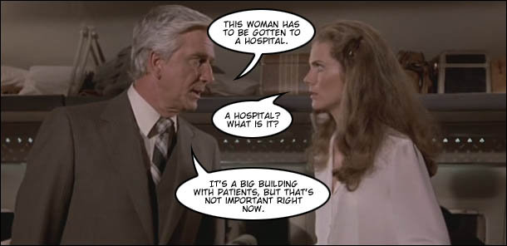
CRM

Slide 52
Mandatory CRM Callouts
Autoflight
Manual Flight
Chapter 22 of the NATOPS describes the call outs and responsibilities of the crew and needs to be read thoroughly.
The PF provides the manual input to the flight controls and the flight director may or may not be in use. Again Chapter 22 of the NATOPS gives guidance and should be read thoroughly.
General Callouts
Calls made in all situations.
This chapter will serve you well for the rest of your training. It discusses ORM/TEM, levels of automation and CRM. READ IT!!!

Slide 53
CRM
The PF shall fly the aircraft and maintain a dedicated heads-up lookout. If the PF wishes to be heads-down for an EXTENDED period of time, aircraft control shall be transferred to the PM who shall remain heads-up.
If the PM must divert attention away from normal clearing and monitoring duties for an EXTENDED period of time, he shall state, “heads-down”. Verbal acknowledgment from the PF is necessary to prevent both pilots from being heads-down at the same time.
Notes:
PF = Pilot Flying (not related to who is Pilot or Copilot)
PM = Pilot Monitoring (not related to who is Pilot or Copilot)
Glances down at the FMS are not considered EXTENDED. An EXTENDED period of time is to push buttons and program something.

Slide 54
CRM
DATA ENTRY
Taxi – Data entry, while the aircraft is in motion, shall be made by the PM. Either pilot may make entries if the aircraft is stopped with the parking brake set.
In-Flight – Data entry shall be made by the PM.
Any crewmember that observes both pilots “heads-down” at the same time shall alert the PF without delay.

Slide 56
Approach Lighting Systems
Centerline guidance
Adequate length
Roll guidance
Sequenced flashers
Fixed/Variable intensity
Notes:
7
Learning Objective: Understand basic components of Approach Lighting Systems (ALS)
Good centerline guidance is having the centerline lights on the actual runway centerline. Primitive lighting systems used to put the lights off to one side so you needed to judge where the actual centerline was, which could be very difficult in a low visibility scenario.
Centerline and roll guidance help to build a composite crosscheck. Unless you are doing a Category III ILS autoland, at some point you are going to have to transfer to visual cues to complete the landing.
High intensity is important to cut through fog or other visibility restrictions. (200 watts) Under some conditions however, the bright lights might reflect and be more of a hindrance than a help. For that reason it is beneficial to be able to control the intensity to a comfortable level. (Med intensity is 80 watts)
The system length should be long enough to be useful in establishing that composite crosscheck. Length is also important to the extent that the approach procedure designer can often prescribe lower visibility minimums when a longer approach lighting system is installed.
Sequenced flashers give a running path to follow. AKA “the rabbits”

Slide 57
Pilot Controlled Lighting
Notes:
Learning Outcome: Review Pilot Controlled Lighting
Negative symbology means PCL (except Declared Distances)

Slide 58
Touch Down Zone Lights:
First 3000’ of rwy
36 ft from centerline
100 foot spacing
Centerline Lighting: 50 feet Runway Edge Lights: 200 feet
36’ 36’
200’
100’
50’
Notes:
2
Learning Outcome: Review TDZL dimensions
Touch Down Zone Lights are 36 ft from centerline
Spacing: Centerline lighting: 50 feet
Touchdown Zone Lights: 100 feet
HIRLS: 200 feet
AIM 2007 p. 535
TDZL lights – start 100 ft beyond landing threshold to 3000 ft beyond the landing threshold or to the midpoint of the runway, whichever is less

Slide 59
1000’
2000’
2000’
3000’
Notes:
Learning Outcome: Review the importance of knowing runway light characteristics in stopping zone
IN-RUNWAY LIGHTING – bottom line – at every 1,000 foot point during last 3,000 feet, something changes to let you know how much distance you have left.
a. Runway Centerline Lighting System (RCLS): Runway centerline lights are installed on some precision approach runways to facilitate landing under adverse visibility conditions. The runway centerline lights are white until the last 3,000 feet of the runway. The white lights begin to alternate with red for the next 2,000 feet, and for the last 1,000 feet of the runway, all centerline lights are red.
b. Touchdown Zone Lights (TDZL): Touchdown zone lights are installed on some precision approach runways to indicate the touchdown zone when landing under adverse visibility conditions. They consist of two rows of transverse light bars disposed symmetrically about the runway centerline. The system consists of steady-burning white lights which start 100 feet beyond the landing threshold and extend to 3,000 feet beyond the landing threshold or to the midpoint of the runway, whichever is less.
c. Taxiway Lead-Off Lights: Taxiway lead-off lights extend from the runway centerline to a point on an exit taxiway to expedite movement of aircraft from the runway. These lights alternate green and yellow from the runway centerline to the runway holding position or the ILS/MLS critical area, as appropriate.
d. Land and Hold Short Lights: Land and hold short lights are used to indicate the hold short point on certain runways which are approved for Land and Hold Short Operations (LAHSO). Land and hold short lights consist of a row of pulsing white lights installed across the runway at the hold short point. Where installed, the lights will be on anytime LAHSO is in effect.

Slide 60
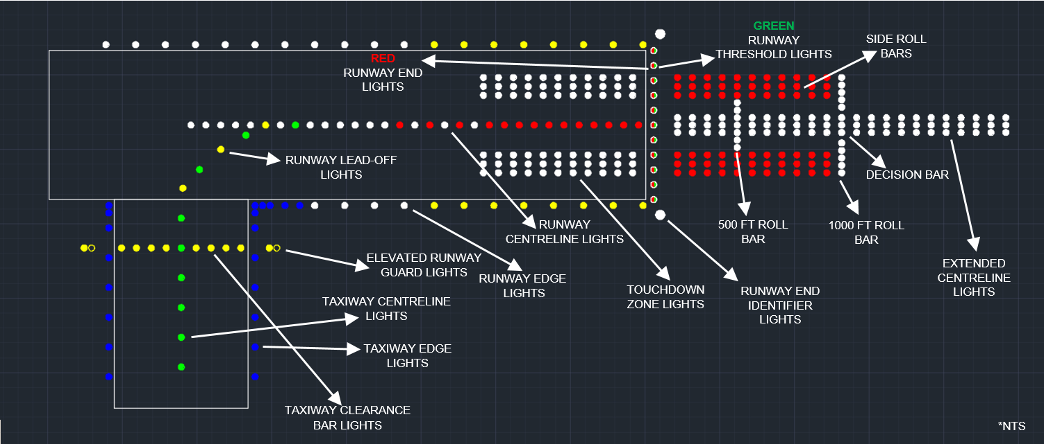
Taxiway to Runway

Slide 61
Use Me – Abuse Me
IPs and Copilots can:
Switch approach plates.
Tune NAVAIDs.
Check Trouble T’s, NOTAMS, ASR/PAR Mins.
Take controls for the approach brief.
We are training Crew Pilots with CRM Skills.
Be assertive.
Use your crew wisely, to include the observer, to ease your workload.
Communicate! Ask Questions and LEARN SOMETHING.
Don’t be shy, we’re here to teach you.

Slide 62
Use Me – Abuse Me
A good technique for flow…..
Complete the climb checklist passing 1000’ AGL then pass the controls. This allows you to set up and get everything the way you want it.
Once complete setting up for the approach go ahead and brief it.
Once briefed have IP pass the controls back, couple the FD back to your side, and ask for the approach checklist.
Feel free to ask the IP to set anything while you are at the controls. You should never be at the controls and setting everything up.

Slide 63
Use Me – Abuse Me
IP’s should NOT INTENTIONALLY do something incorrectly if you have directed them to do it, to see if you catch it. (setting wrong frequency, or giving you a wrong MDA if you ask for it while you are flying the approach)
This would defeat the purpose of using your CP!!

Slide 64
Descent Points
When can you descend? (IAF/Inbound)
IAF
Outbound/Abeam and on a Parallel or Intercept heading to the outbound course
Inbound on approach
VOR/TAC – within 5 radials (1 dot on CDI)
GPS – ½ scale (1 dot)
NDB – within 5 bearings
LOC – CDI off the wall

Slide 65
Descent Points
When are you ‘abeam’ a station (for timing descending/timing outbound on a PT or timing in holding)?
Your needle off the wing is only true IF your heading matches the outbound course
If your heading doesn’t match the outbound course, you must add/subtract 90
Then watch for the needle to pass that value
Try +100, -10 or -100, +10
Abeam is determined by the PT course. 90 degrees from that course is abeam.
Notes:
Computing the Abeam point: It’s 90 degrees off the outbound radial or inbound course.
Technique: + 100, - 10. For example, at ALI, outbound is the 264. Plus 100 Minus 10 gives 354, the Abeam radial. Minus 100 Plus 10 gives 174, also an abeam radial.
As long as the head or tail is swinging through one of these, the aircraft is Abeam.

Slide 66
Timing
Timing outbound on a PT is a technique to keep you within the ‘remain within’ distance
Don’t rely solely on timing! Use the DME, if available, to keep your SA up
Ex – if you have a strong tail wind outbound, you don’t want to time for a full minute
Any method of course reversal is ok – just brief it
So what is the remain within distance based off of?
The IAF that you are turning around.

Slide 67
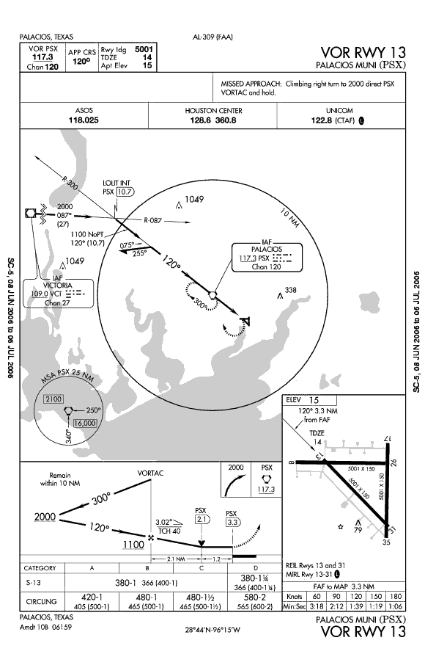
Remain within
Here your remain within distance is 10NM
Since the IAF is also the VORTAC, you can go out to 10DME (no matter what the timing)

Slide 68
Overfly or Lead?
Heading within 90 degrees of outbound course – you may lead the turn.
This includes procedure turns; not just procedure tracks
Example: Leading an arc 0.8 nm prior
Heading not within 90 degrees – you must cross the fix and turn in the shorter direction, unless you are entering a published holding pattern for a turn in holding to get aligned.

Slide 69
Precision v. non precision approaches

Slide 70
Precision v. non precision approaches

Slide 71
Descent Rates
Descend at 800 – 1200 vvi for Nonprecision.
If not, you won’t reach MDA by MAP, which is an unsuccessful approach.
SSE requires the same but will be harder to reach with the gear up.

Slide 72
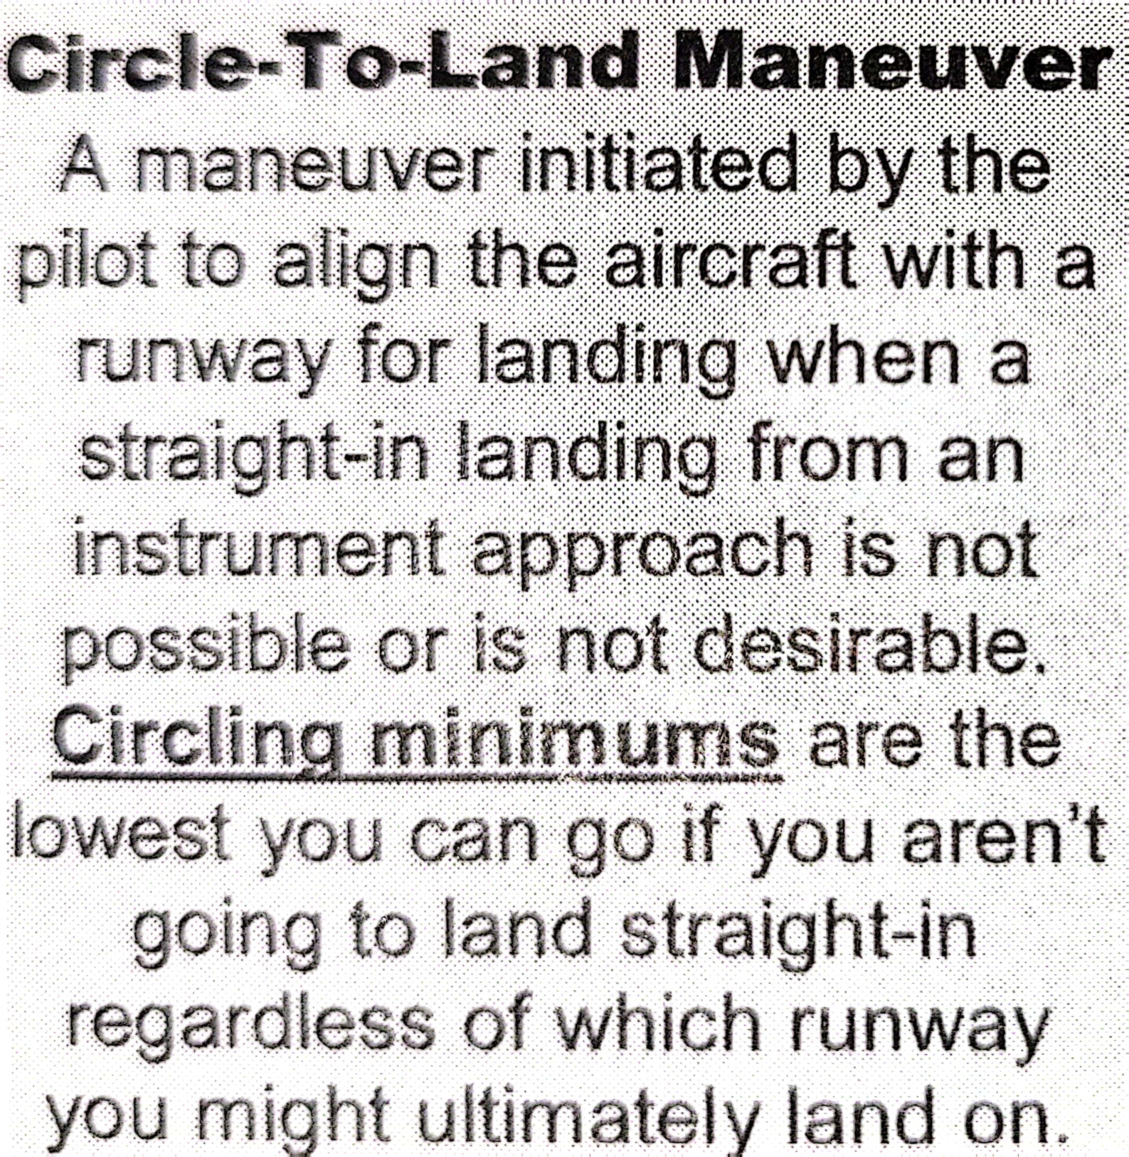
CIRCLING
Definition:
An approach that requires a turn more than 30° from the final approach course for a ground-based approach, or 15° for an RNAV approach.
Notes:
Normally only offers 300’ of obstacle clearance (very important if flying above an airfield on an extremely low temperatures because true altitude of aircraft can be significantly lower.
Example: At -22°F (-30°C) flying at 2000’ AGL indicated = 380’ lower than indicated, or 1,620’ true altitude.
Important in mountainous terrain.

Slide 73
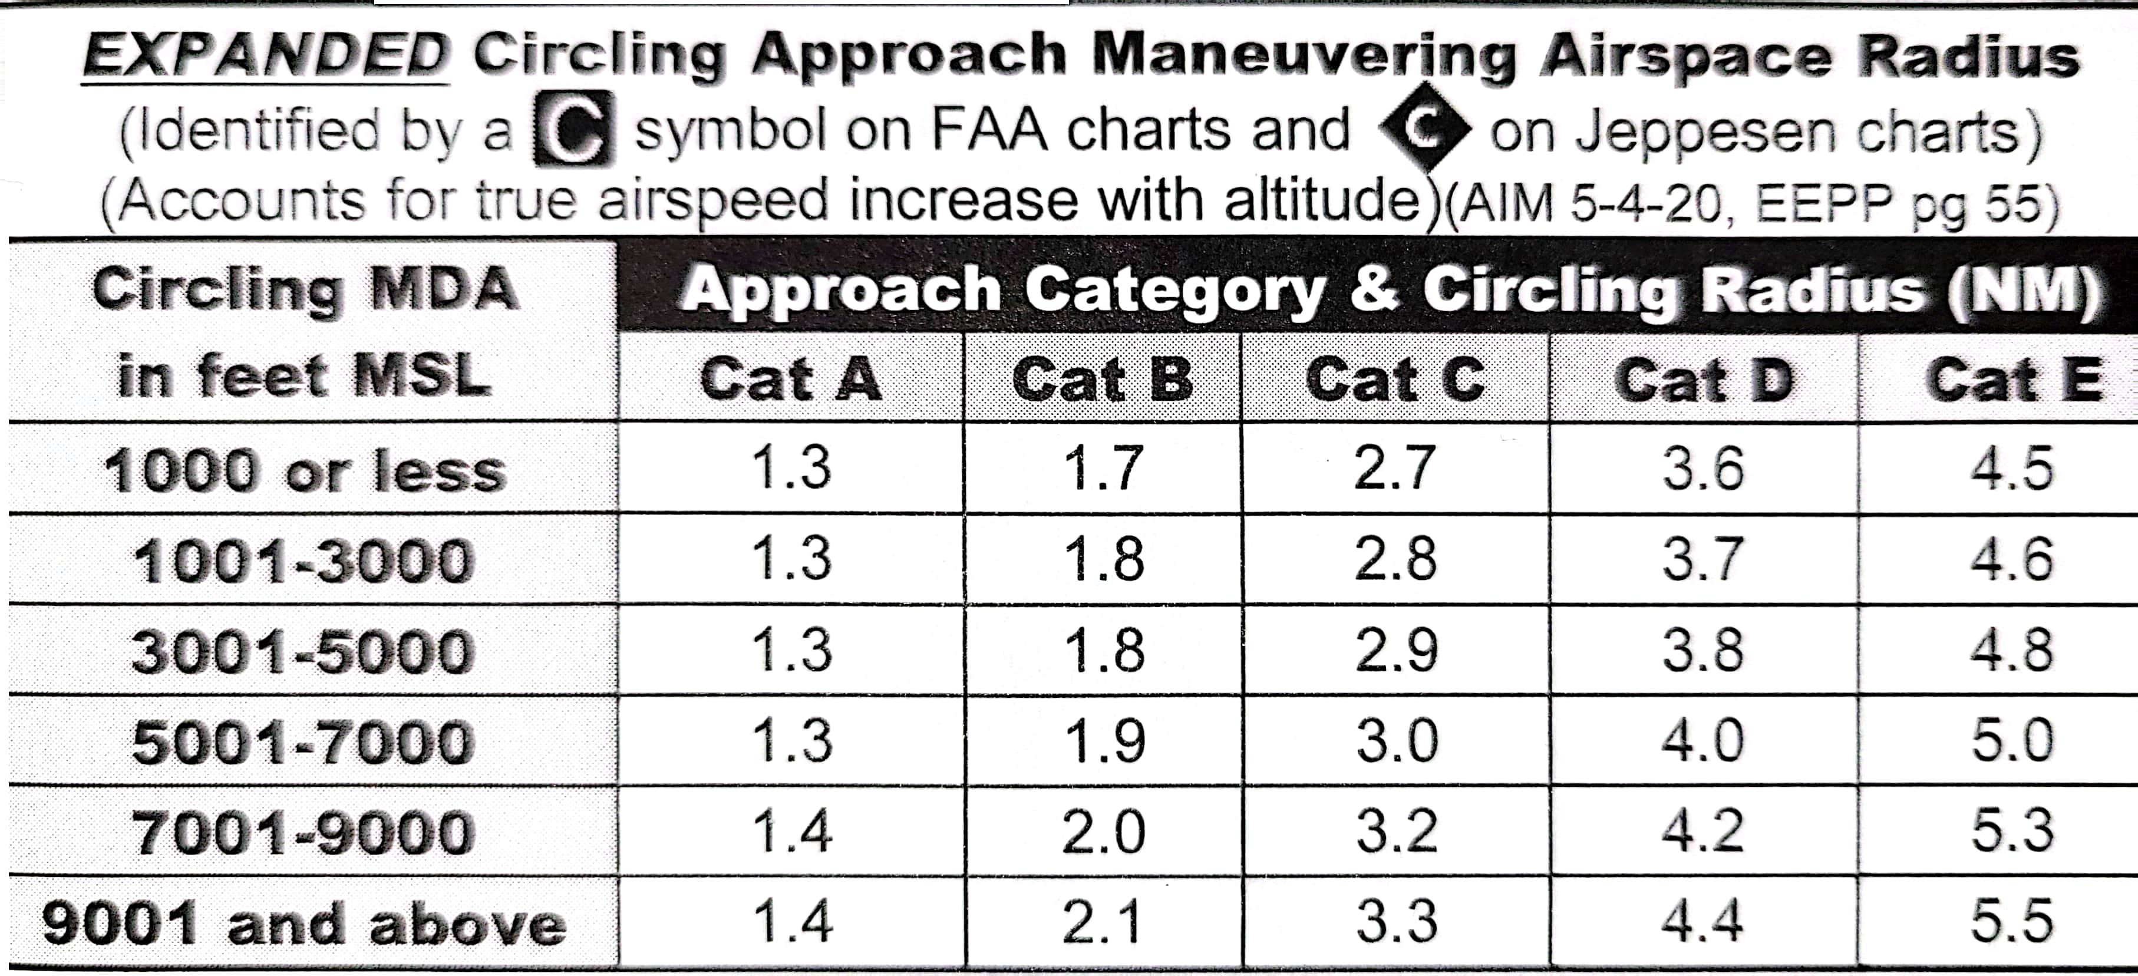
Circling
4 Techniques
45 degrees, 30 seconds (good)
30 degrees, 45 seconds (not as good)
90 degrees, 15 seconds (T-bone the runway)
TLAR (that looks about right)
Circling Categories
At 120 kts, we’re Cat B

Slide 74
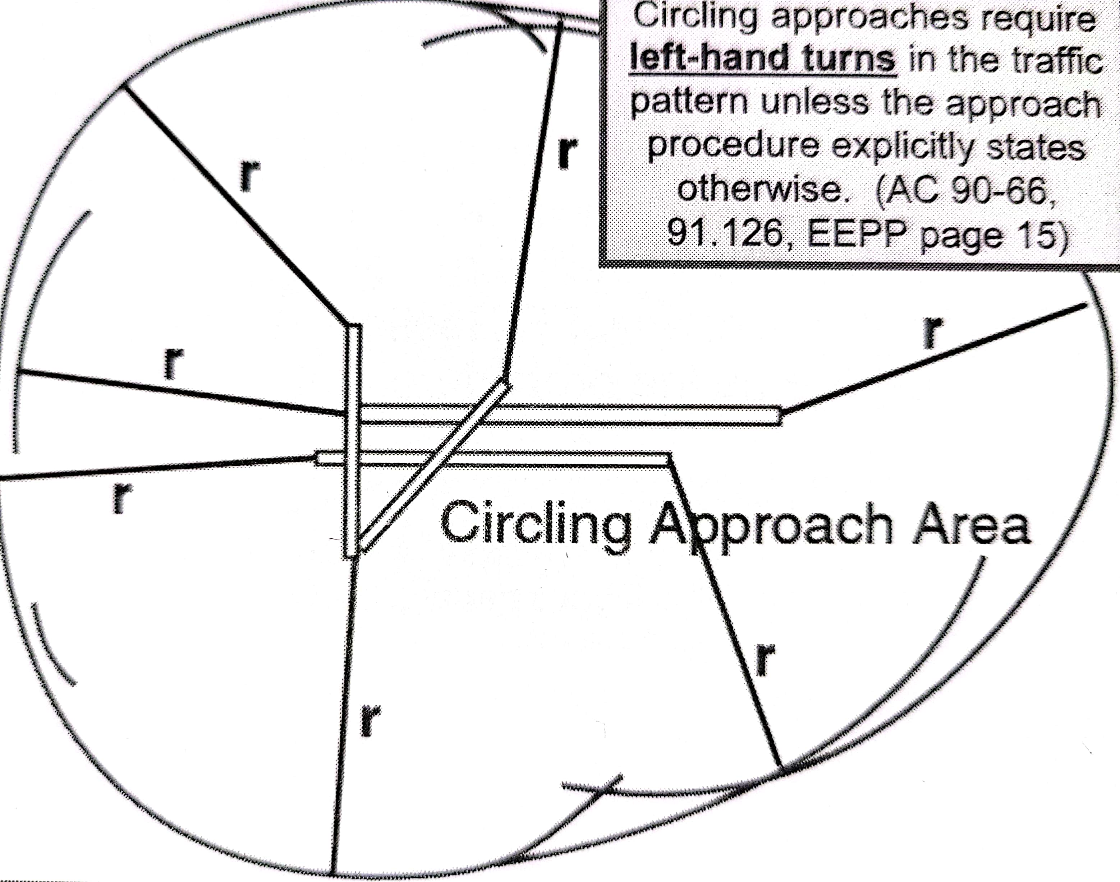
CIRCLING
Protected Areas:
Defined by arcs drawn from the end each runway.
Arc radii differs by each approach category.

Slide 75
Non-Towered Circling
AC 90-66B 03/13/18
9.6 Instrument Flight Rules (IFR) Traffic. Pilots conducting instrument approaches should be particularly alert for other aircraft in the pattern so as to avoid interrupting the flow of traffic, and should bear in mind they do not have priority over other VFR traffic. Pilots are reminded that circling approaches require left-hand turns unless the approach procedure explicitly states otherwise. This has been upheld by prior FAA legal interpretations of § 91.126(b).
The FAR/AIM mentions shortest path to base or downwind leg, just keep in mind that at non-towered fields they want you in left traffic unless the IFR procedure tells you otherwise.

Slide 76
NON-TOWERED Circling
Reference:
- FAR/AIM 91.126(b)(1)

Slide 77
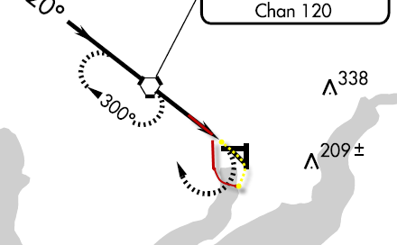
Circling Missed Approach
Comply with the intent of the missed approach.
This requires a climbing LEFT, not a climbing right!
Notes:
Draw a picture of a FAC setting the pilot up for a downwind entry.

Slide 78
Circling Missed Approach
Initiate a CLIMBING turn towards the runway, and CONTINUE the turn to comply with the intent of the missed approach.
Does not always mean you will get on the dotted line.
Notes:
Draw a picture of a FAC setting the pilot up for a downwind entry.

Slide 79
RNAV approaches
CDI scale
Inflight
Types of approaches
How to fly them
Warnings
CRM
Extras

Slide 80
CDI SCALE
3 Modes of Operation
Enroute
Terminal
Approach
Notes:
Flying off the FMS is different than off land-based NAVAIDs.
DME is always counting down to the next point, not the field/NAVAID.
Your CDI is always supposed to be centered on a course. You cannot center it by lining it up with the needle. You are always using it.
Your CDI changes scales based on distance from your Departure field and Arrival field.

Slide 81
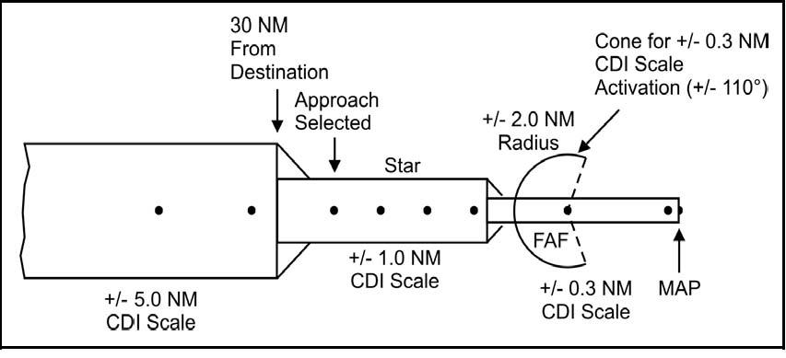
CDI SCALE
2.0 NM
Notes:
At takeoff, the CDI scale is +/- 1nm until you reach 30 nm away from your Departure field.
At 2 nm prior to 30nm, the CDI scale smoothly (it takes 5-10 seconds so that the CDI doesn’t jump) moves from +/- 2 nm to +/- 1 nm.
Once within 2 nm of the FAF (assuming an approach is loaded), the CDI once again changes; this time from +/- 1nm to +/- .3 nm. It will stay this way until you go missed approach, at which time it will go back to +/- 1 nm.

Slide 82
CDI SCALE
Enroute Mode
CDI = +/-2NM
Enroute mode is active:
Until 2nm prior to 30 nm from arrival airport

Slide 83
CDI SCALE
Terminal Mode
Once within 30 nm of the arrival field, CDI sensitivity improves to +/-1NM
T-44C “TERM” message on PFD
VERBAL RESPONSE REQUIRED
“Terminal Mode Armed”
However, understand that you are in terminal mode. Terminal mode is not armed.
Notes:
*** We must verify that the CDI scale has transitioned from +/- 2 nm to +/- 1 nm. If it doesn’t, you are not legal to descend on the approach. This is called the “Approach Mode” being “Armed”.
We verify this in one of 2 ways:
T-44A/TC-12B – Green APPR light on your FMS annunciator lights.
T-44C – “TERM” message on your PFD
2. Verify your CDI displacement in the FMS.

Slide 84
CDI SCALE
APPROACH MODE
Once within 2 nm of FAWP, CDI sensitivity improves to +/-.3NM
T-44C – “GPS APPROACH” Message on PFD
VERBAL RESPONSE REQUIRED
“APPROACH MODE ACTIVE”
Notes:
*** We must verify that the CDI scale has transitioned from +/- 1 nm to +/- .3 nm. If it doesn’t, you are not legal to descend past the FAF. This is called the “Approach Mode” being “Active”.
We verify this in one of 2 ways:
T-44A/TC-12B – No lights appear!! You must verify on the FMS.
T-44C – “GPS APPROACH” message on your PFD
2. Verify your CDI displacement in the FMS.

Slide 85
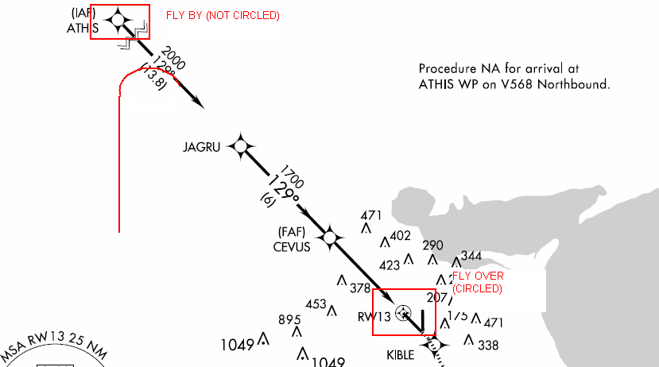
IN FLIGHT
Fly-over versus Fly-by WP, and dangers associated
Notes:
FLY BY WP – Not circled – the FMS will calculate a turn radius based on your angle to the following leg and speed.
FLY OVER WP – Circled – the FMS will take you directly over the WP.
Watch out for large angles of intercept to fly-by points. This is usually seen when sent direct to the IAF and not aligned for the next leg. As shown, the FMS will ‘fly-by’, or lead the turn to the next leg based on groundspeed and angle of intercept.
*** If your intercept angle is greater than 90 degrees, the FMS will cycle you VERY early; possibly placing out of protected airspace. In this case, you need to keep the FMS from cycling to the next WP, until crossing over the fix. T-44A/TC-12B procedures differ from T-44C to do this; see your IP.
*** The same approach rules apply at GPS IAFs; within 90 degrees of the next course, you may lead the turn; not within 90 degrees, cross over and turn in the shorter direction.

Slide 86
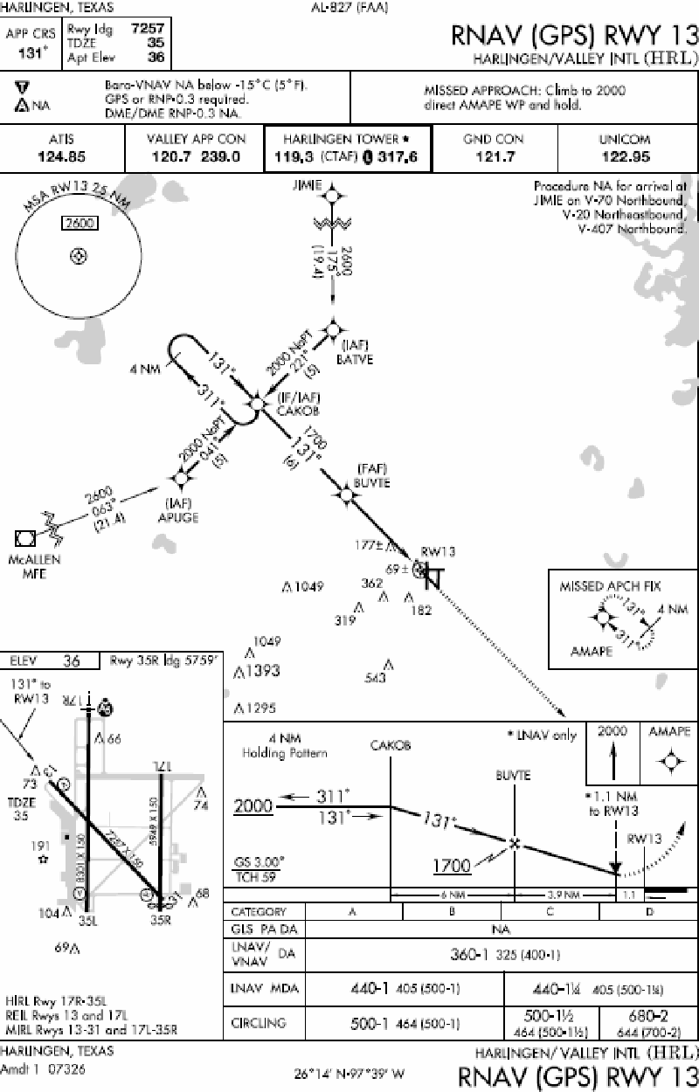
RNAV/GPS
Notes:
Example of Standard RNAV/GPS IAP.
Have students/IPs take a good look at this IAP and compare to the next one.

Slide 87
TAA Entry Sectors
TAA – The TAA incorporates separate entry sectors with MSAs for each sector. They also act as part of the approach; Once inside the sector DME, you can descend to the depicted altitude once cleared for the approach.
NO DESCENT CLEARANCE NEEDED IF YOU ARE CLEARED FOR THE APPROACH!
Notes:
You will only know it is a TAA because of the MSA sectors. It will not say TAA anywhere else.

Slide 88
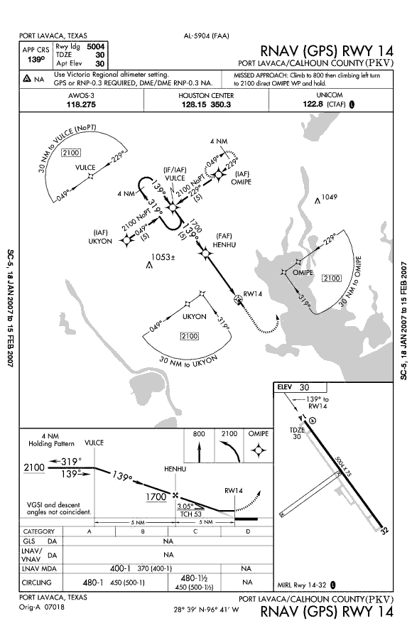
TAAs
Notes:
Almost the same as the T-shaped RNAV/GPS approach, except for the TAA areas.
You know a Terminal Arrival Area (TAA) approach based on the segmented areas. The following slide puts it into words.

Slide 89
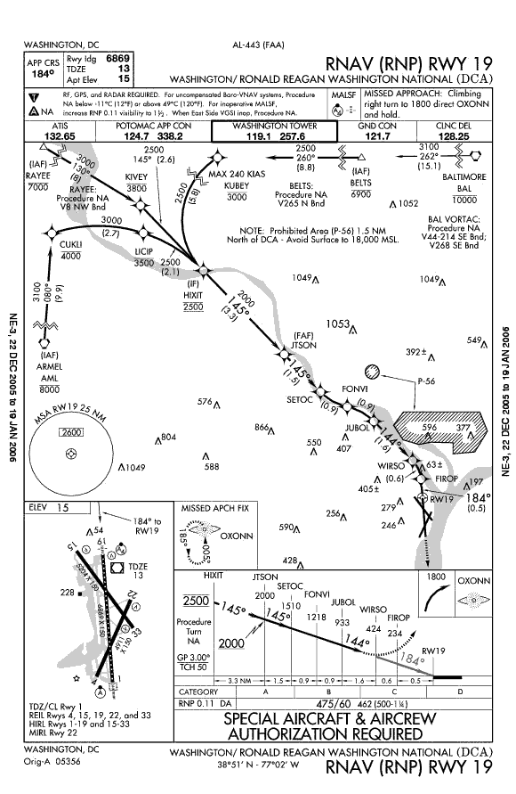
RNP
Note the curved path
on final. This requires
RNP of 0.11, listed in
the mins section.
No GPS in the title
Uses different RNAV
Equipment (not GPS)
WE CAN NOT FLY AN RNP APPROACH
Notes:
Example of an RNP approach. Also known as SAAAR (SPECIAL AIRCRAFT & AIRCREW AUTHORIZATION REQUIRED). I.E. We can’t fly them. Notice the curved path final. The airlines fly these coupled to the autopilot and using auto-throttles.

Slide 90
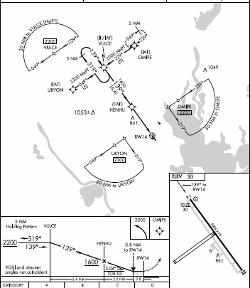
BEFORE APPROACH
Within 30 nm of airport, CDI will enter terminal mode.
OBSTACLE CLEARANCE DEPENDS ON THIS
Requires a verbal response
“Terminal Mode Armed”
It is not really armed.

Slide 91
WHEN TO DESCEND
ESTABLISHED AT IAF:
CDI ½ scale &
In Terminal Mode
ESTABLISHED AT FAF:
CDI ½ scale
IN Approach Mode (“APPROACH ACTIVE”)
Notes:
Explain ‘off the wall’ for students.

Slide 92
Radar Vectors
Load the approach
Extend out along the final approach course
Blue/Green Method
Notes:
Explain ‘off the wall’ for students.

Slide 93
Missed Approach
MAP: 2 Choices
1 – Go-Around button
Auto sequences and puts you in Active Legs page
2 – Manual Sequencing
At MAP, manually sequence to the MAWP
Notes:
*** DO NOT change the FMS settings prior to the MAP (delete the Discontinuity, cycle to the next point, etc..). Doing so will change the CDI displacement back to +/- 1 nm and you will not have the required navigational performance to be down at MDA.

Slide 94
AFTER APPROACH
Staying at the same airport?
For another approach, simply select another one
Going somewhere else?
Change arrival airport or load Secondary flight plan.
Notes:
If you’re staying at the same airport, select a new approach.
If you’re going to a new airport, you must change your destination in the FMS.

Slide 95
WARNINGS
INTEG Light (NAV “OFF” FLAG)
RAIM is not available
NO RAIM = Can’t use GPS for guidance for approaches
Will get a NAV flag if past FAF and no RAIM (signal may be good, but GPS can not check it’s signal)
Can use for SIDS/STARS with no RAIM
(enroute/term mode)
Notes:
The main point to be aware of is to treat the INTEG light as a NAV ‘OFF’ flag.

Slide 96
WARNINGS
If no RAIM:
PRIOR TO FAWP
Transition to a ground-based navaid approach or get vectors.
DO NOT DESCEND TO MDA and go Missed at the MAWP
AFTER FAWP
Climb to alt prior to FAF and proceed to MAWP
Notes:
FAWP = Final Approach Waypoint

Slide 97
GPS EXTRAS
You cannot create any IAPs, nor alter them.
You may only pull them directly from the database.
You may not alter any thing from the final approach fix inbound.
Pink needle will remain on WPT until abeam, then will cycle to next WPT
When in Holding, the pink needle remains pointed at the holding WPT

Slide 98
ADS-B
ADS-B provides altitude, aircraft flight ID and vertical air speed.
ADS-B reports two kinds of altitudes: barometric and geometric. Geometric altitude is calculated by GPS.
ADS-B does not report horizontal airspeed. Instead, ADS-B reports horizontal velocity relative to the Earth.

Slide 99
Cross Country
Destination is IPs choice, but skeds does try to match
Find who you like to fly with, talk to your on-wing and start calling around.
Check the CCX board in ops
Notes:
Encourage students to actively pursue a satisfying cross country with someone they feel comfortable learning from. Nobody wants to go on the road with the A-hole.

Slide 100
Cross Country
Considerations
Weather
Contract Gas
Ramp Fees
Rental Car Access
Study all brief items beforehand. You probably will brief the entire block on the first leg of the trip.
BRING A FUEL PLAN TO THE BRIEF!!! (It’s in the FTI)
Use OPARS brief on multi-engine university for fuel plan.

Slide 101
Conclusion
Focus of Maritime Advanced Program
Study!
NATOPS
FTI
AIM/FAR
AIGT workbook
NATOPS Instrument Flight Manual (IFM)
CNAF 3710.7
Be familiar with Local Operations
Chair fly Approaches, Briefs and Eps
Arrive Prepared

