Slide 1
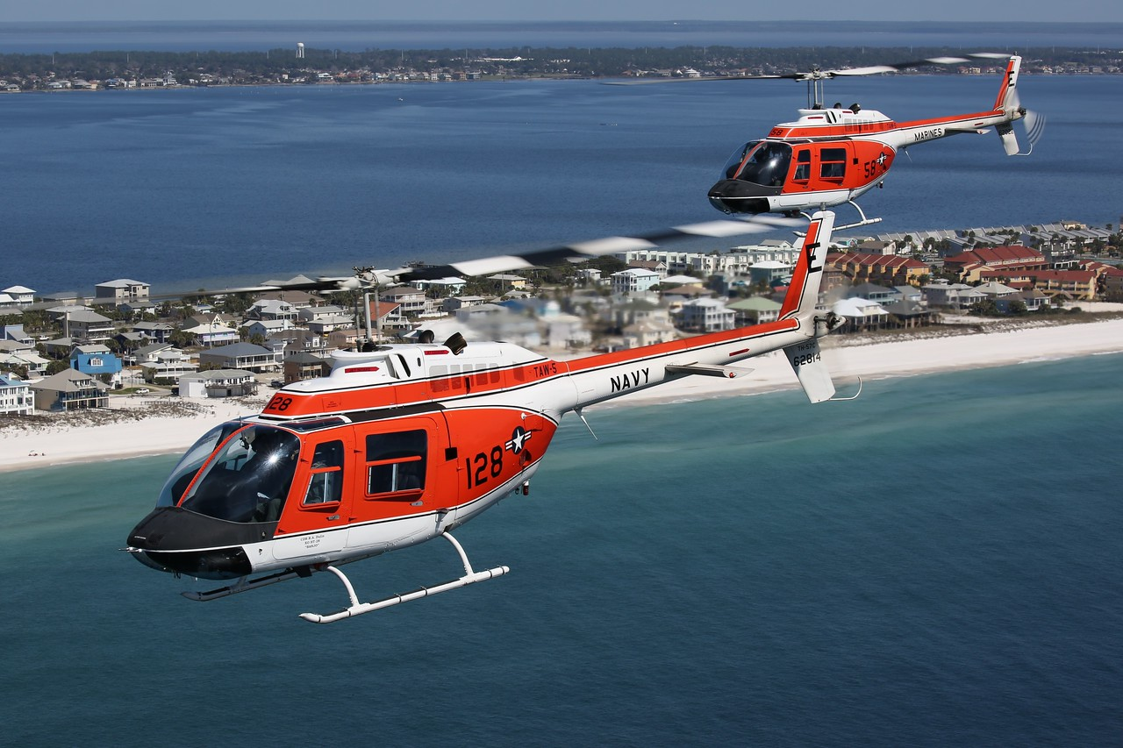
BRIDGE FORMATION STAGE
1542.156F Updated 14JUN2023

Slide 2
Bridge Syllabus Events
IP led “Walk Through”
  Conducted during FRM4001 brief
FRM3001
  Sim event with CI.
  First look at formation maneuvers with a Lead (recorded videos)
FRM4001/4002
  Standard flights with the formation maneuvers per grade card
FRM4003
  Section Low Level Flight
  Usually paired with FRM4002 (Florala Out-and-In)
FRM4101A and FRM4102A Capstone
  Out and in profile

Slide 3
Bridge Capstone Events
Possible FRM4101/FRM4102 Destination Options
  Mobile, AL
  Andalusia, AL
  Stennis, LA
  Pascagoula, MS
  Tallahassee, FL
  Gulfport, LA
  Gulf Shores, AL
  Montgomery, AL
  Dothan, AL

Slide 4
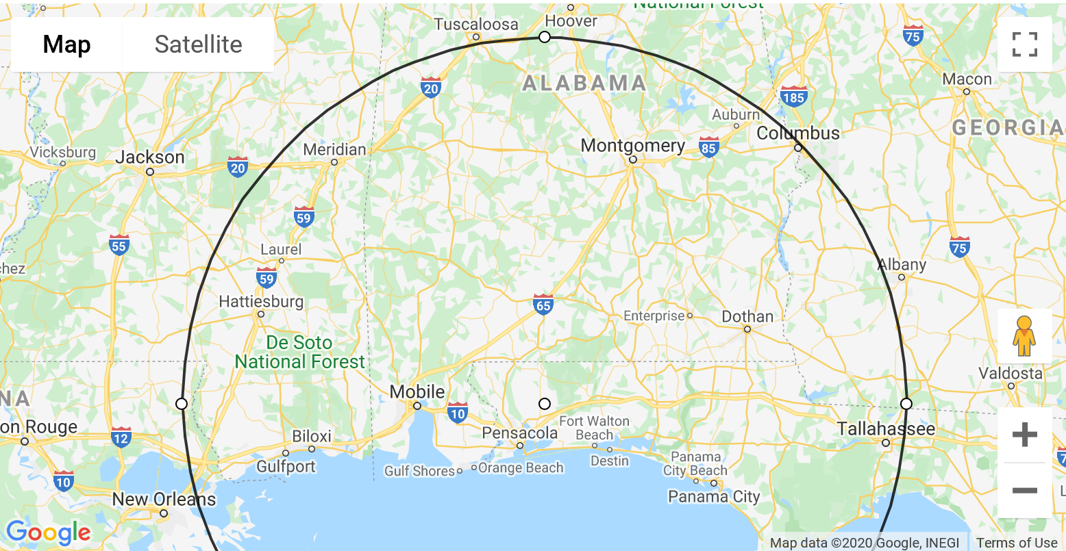
Formation Capstone Destinations
Crews should utilize a location to provide an out and in
Crews can utilize other airports/LZs along the route for formation landings
Crews will stay within 150nm/2hr legs
KMGM
Montgomery, AL
KMOB / KBFM
Mobile, AL
KDHN
Dothan, AL
KGPT
Gulfport, LA
KHSA
Stennis, LA
KTLH
Tallahassee, FL
KJKA
Gulf Shores, AL

Slide 5
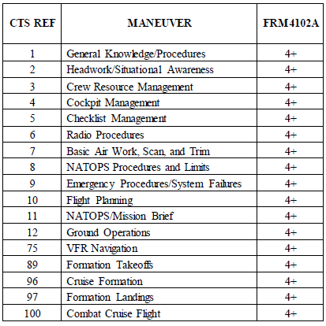
Capstone Block MIF/ Graded Items

Slide 6
Flight Event
Overall Intent
  Demonstrate how a formation executes an out and in profile
  Emphasize CRM between the crews in the formation
  Prepare a route using MPS and the appropriate charts with multiple visual checkpoints
  SNAs will use the shell PowerPoint brief on JMPS computers (similar to fleet style brief).
    Builds smart packs, print JMPS route, and LZ diagrams
    Use the Shell Powerpoint labeled: “forms brief 2.0.ppt”
      SNAs will add CPs for their desired route and LZs. Also, update the basic “RED” information
      SNAs shall contact the squadron Form Stage Lead or the scheduled instructor for the event
      Briefs are located at \\c27audtwhtgp01\Student Folder
      SNA’s may use other students’ briefing products as a starting point
  Mission Brief lead by SNAs

Slide 7
Proposed Capstone Simulated Mission Types
Two options for mission profiles are listed below. Each squadron STAN department can further refine their level of detail for planning and expand the mission sets below with new ideas. Two main options:
    Main Option - Logistics in a conflict zone: TW5 aircraft are directed to support NATO operations in support of Blukranian forces. LZs and FOBs have been created and surveyed to allow air assets to bring in supplies and move injured personnel. The assigned assets will provide armed surveillance and reconnaissance and theater mobility to and from designated LZs from KNDZ, as well as provide transportation for injured personnel to safer FOBs for medical assistance.
    B/U Option - Generic cross country flight: Similar to a fleet squadron transferring to a different base for an exercise, work-up, etc. Recommend including Wx/IIMC scenario resulting in individual approaches or EP scenarios requiring to “PEL to an airfield.”

Slide 8
Event Key Points
Task delegation
  SL should distribute tasks for both lead and wing to perform
  Cover during brief but can be coordinated in the air
Fuel consideration
  Set Jokers and a Bingo
  Conduct fuel checks
  Pass “Fuel States”
Congested airspace
  Wing will always get ATIS away from KNDZ
  Designate one a/c to conduct CTAF calls
Comms plan
  Cover who will take what calls/monitor which frequencies
  Keep a Tac Freq (BTN 18, 249.9, 246.8)
Route development
  Sectional and JMPS
  Use GTN and input planned route
LZ/Airfield
  Utilize destination diagram
  SWEEP checks in flight
    Conduct low approach

Slide 9
Contingencies and Possible Scenarios
System Degradations
  Demonstrate Go/No-Go’s
  Possible Scenarios:
    One A/C lost comms
    Bent GTN (no VHF/XPDR)
Wx
  Cover procedures to either circumnavigate or divert
  Possible Scenario:
    Bad wx on route resulting in divert to a different airfield
IIMC
  FTI procedures (ie. Fan break up)
  Possible Scenario
    Execute the break up
    Coordinate with ATC
    Pick up an approaches into destination
EPs/Bird Strike
  FTI/Natops Procedures
  Possible Scenario
    Wing has an engine fire
    Wing handles the EP internally and then calls for a lead change
    The good aircraft inspects the EP aircraft
    The section determines where to land
Down aircraft
  FTI procedures
  Set altitude blocks/standoff as briefed
  Possible Scenario
    A/c (either internal or external) goes down at an airfield
    Set pre-briefed blocks
    Cover On-scene commander checklist
    Land to assist

Slide 10
Contingencies and Possible Scenarios
    SAR Scenario
      Pop-up tasking to prosecute a search and rescue
      Delegate responsibilities
        One aircraft assumes OSC
        Other aircraft conducts search pattern and rescues survivor(s)
      OSC – Conducts OSC checklist, establishes bingo to hospital/nearest refuel location, gives information to SRU
      SRU – Conducts search pattern and rescues survivors
    Fuel Management
      Be able to calculate a bingo fuel in flight using groundspeed, distance, and fuel burn rate (27 gph)
      Ex. At Bay Minette, determine fuel required to get to Stennis
    Power Management
      Determine how much weight you can pick up at an LZ based on NATOPS weight limits (3,200 lbs) and torque limits (100% for 5 mins)
      Be familiar with the Torque Available and Power Required to HIGE/HOGE charts in the PCL
      Ex. How much cargo can we carry from Bay Minette to Stennis? Can we land and takeoff at this LZ with 3,200 lbs?
        Determine how heavy the aircraft will be at the LZ (based on fuel state and operating weight)
        Determine how much cargo you can take while remaining below 3,200 lbs
        Use your performance charts in the PCL to determine your power required to HIGE and HOGE
        Determine your power available using charts or a power check
        “Based on my calculated HIGE/HOGE of 88% and 102% and max power available of 100% for 5 minutes, we have a power margin of 12% if we enter a HIGE during takeoff/landing at 3,200lbs. We are unable to enter a HOGE.”

Slide 11
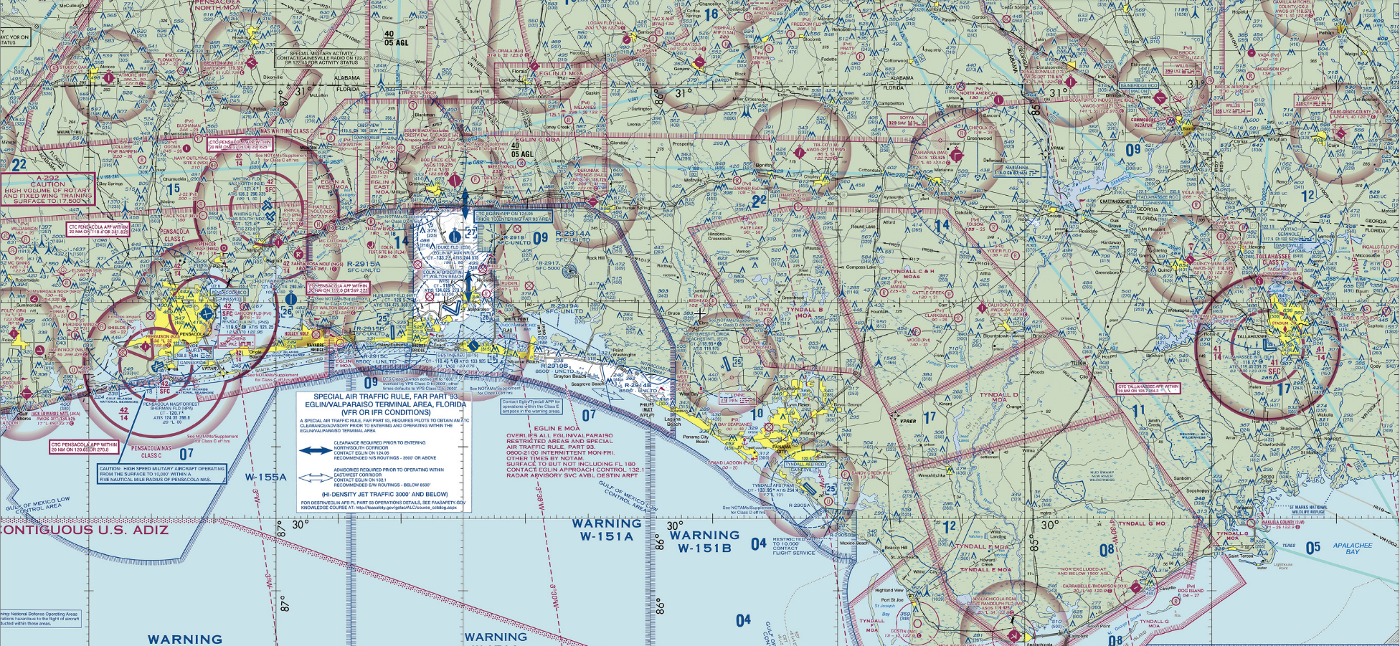
Eastern Route Options
Destination:
  KTLH (Tallahassee, FL)
En route Airspaces
  Eglin Corridor
  Beach Corridor
  Tallahassee Class C
  Multiple MOAs
Airfields for landings
  KCEW (Bob Sikes)
  54J (Defuniak Springs)
    “Brownout” landings
  1J0 (Tri-county)
  KMAI (Mariana)

Slide 12
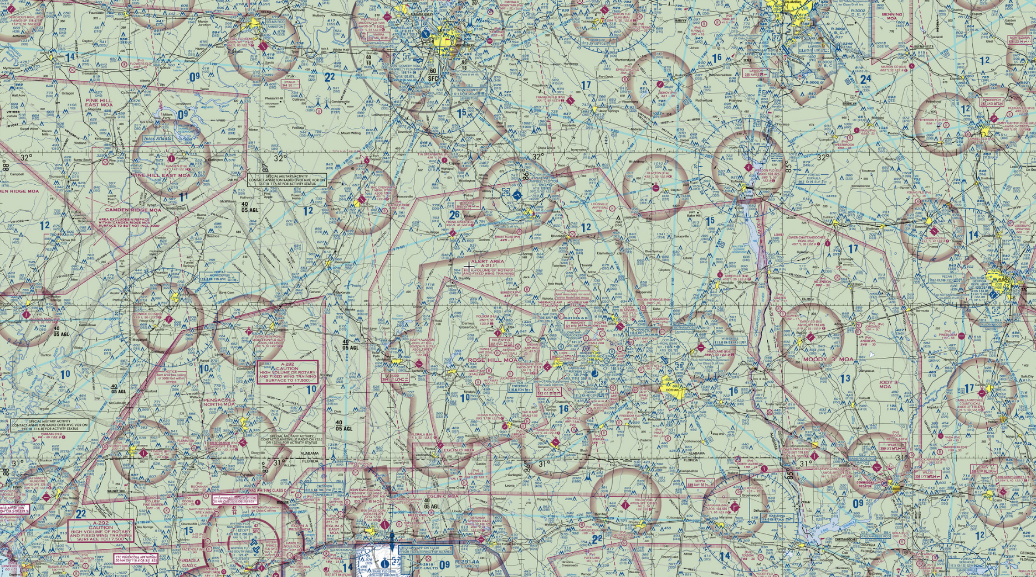
Northern Route Option
Destination:
  KDHN (Dothan, AL)
  KMGM (Montgomery, AL)
En route Airspaces
  Rose Hill MOA
  Fort Rucker OLFs
  Dothan Class D
  Montgomery TRSA
Airfields for landing
  KCEW (Crestview)
  0J4 (Florala)
  79J (Andalusia)

Slide 13
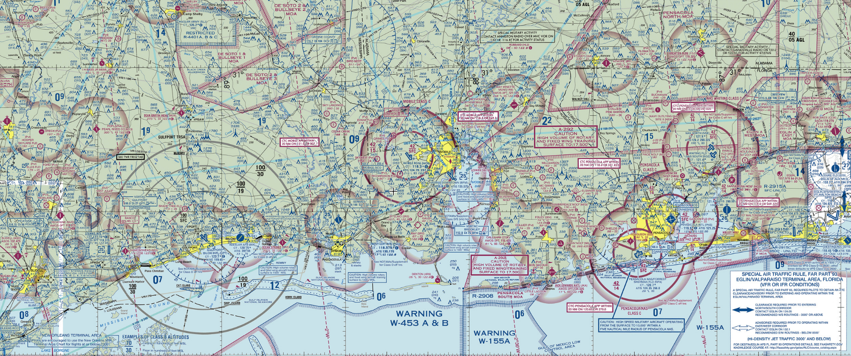
Western Route Options
Destinations
  KJKA (Gulf Shores, AL)
  KMOB/KBFM (Mobile, AL)
  KPQL (Pascagoula, MS)
  KGPT (Gulfport, LA)
  KHSA (Stennis, LA)
En route Airspaces
  Pensacola Class C
  Mobile Class C
  Gulfport TRSA
Airfields for landing
  82J (Ferguson)
  KJKA (Jack Edwards)
  KCQF (Sunny Callahan)
  0R1 (Atmore)
  1R8 (Bay Minette)

Slide 14
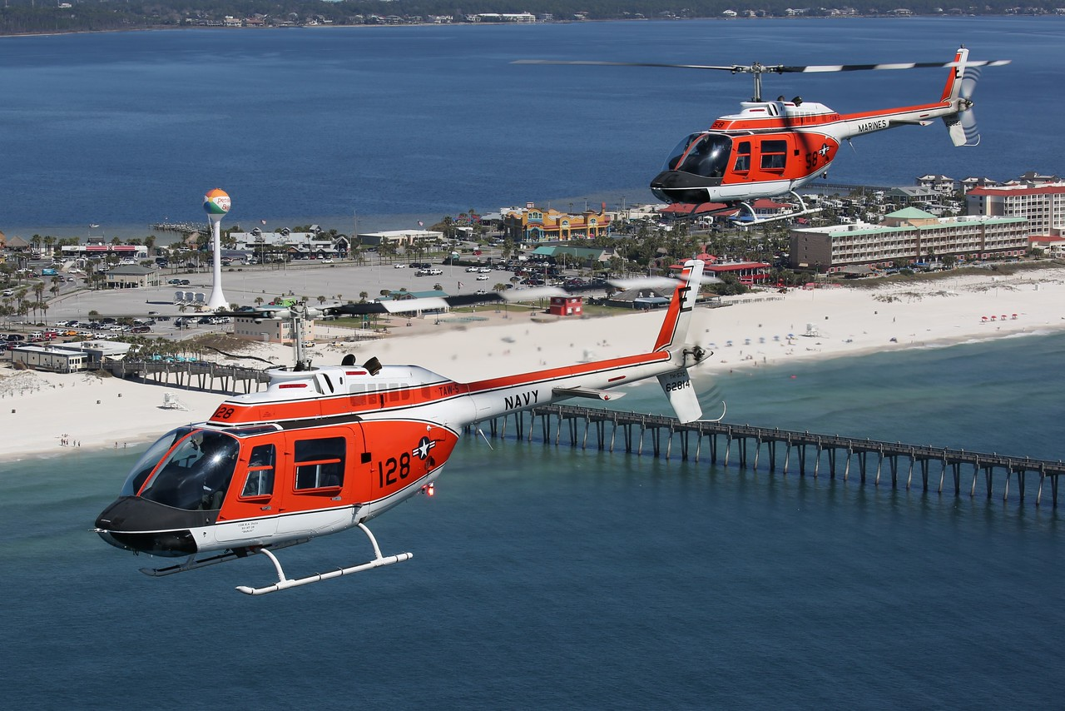
Send any questions to Squadron Formation Stage Lead

