Slide 1
***DISCLAIMER***
DO NOT BREAK CREW REST/DAY
This is meant to be a “Hasty”/Condensed mission planning process. Plan ahead and utilize time appropriately before/after flights to mission plan within your crew day.
Any questions please see the NVG Stage Lead in STAN

Slide 2
REMOVE SLIDE
Pick one of the Following Routes/Scenario’s to base your mission on. It should be the opposite direction of your NVG4102 route. So if you planned EAST on NVG4102, plan a scenario to the WEST for the Capstone.
There are basic route outlines available later in this presentation
Contact IP the night before for latest mission drop and updates
Contact LT Harris if you have any questions

Slide 3
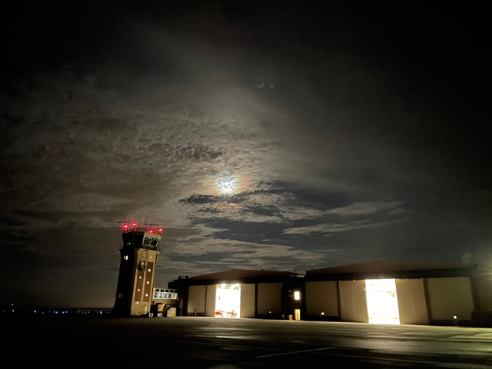
NVG CAPSTONE
NVG4201A
YOUR IP NAME HERE
YOUR NAME HERE

Slide 4
ORIENTATION
Time Hack
A/C Assignment
External Callsign / Internal Callsign
Smart Pack Review
Maps Required
Weather
SLAP
SITUATION
Commander’s Intent
MISSION EXECUTION
Overview
Scheme of Maneuvers:
Preflight
Takeoff
Route
Objective Area
RTB
CONTINGENCIES
ADMIN & LOGISTICS
Flight Duration
Fuel
Mission Fuel / Bingo Fuel
COMMAND AND SIGNAL
Communications/ Radio Procedures
Frequencies / NAVAIDS
Terminate/KIO
SQUAWK
NATOPS by Exception
DUE OUTS

Slide 5
ORIENTATION - WEATHER
REQUIRED – 1000/3
CURRENT
KNDZ METAR: 35008KT 10SM FEW250 23/09
FORECAST
KNSE 01008KT 9999 FEW250
  FM272000 35006KT 9999 SKC
  BCMG 2811/2812 10009 9999 FEW015
KPNS 02008KT 10SM CLR
  02008KT 9999 FFEW250
  FM272000 35007KT P6SM SKC
DESTINATION
KCQF 32004KT 10SM RA BKN009 BKN034 17/17
ADD WEATHER FOR YOUR ROUTE OF FLIGHT

Slide 6
ORIENTATION - SLAP DATA
SNIPPING TOOL COPY/PASTE YOUR SLAP DATA HERE

Slide 7
ORIENTATION
Time Hack
A/C Assignment
External Callsign / Internal Callsign
Smart Pack Review
Maps Required
Weather
SLAP
SITUATION
Commander’s Intent
MISSION EXECUTION
Overview
Scheme of Maneuvers:
Preflight
Takeoff
Route
Objective Area
RTB
CONTINGENCIES
ADMIN & LOGISTICS
Flight Duration
Fuel
Mission Fuel / Bingo Fuel
COMMAND AND SIGNAL
Communications/ Radio Procedures
Frequencies / NAVAIDS
Terminate/KIO
SQUAWK
NATOPS by Exception
DUE OUTS

Slide 8
SITUATION / MISSION EAST (Choose ONE)
SITUATION
Skrussian forces have invaded sovereign Blukrainian territory in attempt to overthrow the government and annex the region.
The war has reached a stalemate with each side sustaining heavy casualties.
Last month, NATO began efforts to directly support Blukrainian forces with naval, air, and ground forces.
U.S. forces are being directed to assist Blukraine’s military, while attempting to avoid direct conflict with Skrussian forces.
LZs and FOBs have been created and surveyed to allow air assets to bring in supplies and move injured personnel.
TW5 HT Squadrons have been tasked to support NATO efforts. The assigned assets will provide armed surveillance and reconnaissance and theater mobility to and from designated LZs from KNDZ, as well as provide transportation for injured personnel to safer FOBs for medical assistance.
MISSION
1 HT-28 aircraft will launch as tasked at 2000L and fly to LZ ANDALUSIA to deliver ammunition to Blukrainian forces.
After departing from LZ ANDALUSIA , the flight will proceed to FOB Defuniak Springs to resupply/pickup any injured personnel.
RTB at the completion of second drop off back to KNDZ.
Assets will be ready to assist with any pop-up tasking throughout the mission.
COMMANDER’S INTENT
ALR: Moderate (notional)
Weapons Posture: Hold (notional)
Assigned crews shall provide any tasked assistance and safe delivery of supplies.
Movement of injured personnel authorized.
No loss of aircraft and/or personnel.

Slide 9
SITUATION / MISSION WEST 1(Choose ONE)
SITUATION
Skrussian forces have invaded sovereign Blukrainian territory in attempt to overthrow the government and annex the region.
The war has reached a stalemate with each side sustaining heavy casualties.
Last month, NATO began efforts to directly support Blukrainian forces with naval, air, and ground forces.
U.S. forces are being directed to assist Blukraine’s military, while attempting to avoid direct conflict with Skrussian forces.
LZs and FOBs have been created and surveyed to allow air assets to bring in supplies and move injured personnel.
TW5 HT Squadrons have been tasked to support NATO efforts. The assigned assets will provide armed surveillance and reconnaissance and theater mobility to and from designated LZs from KNDZ, as well as provide transportation for injured personnel to safer FOBs for medical assistance.
MISSION
1 HT-28 aircraft will launch as tasked at 2000L and fly to LZ SONNY CALAHAN to deliver ammunition to Blukrainian forces.
After departing from LZ SONNY CALAHAN, the flight will proceed to USS Dauphin Island to resupply/pickup any injured personnel.
RTB at the completion of second drop off back to KNDZ.
Assets will be ready to assist with any pop-up tasking throughout the mission.
COMMANDER’S INTENT
ALR: Moderate (notional)
Weapons Posture: Hold (notional)
Assigned crews shall provide any tasked assistance and safe delivery of supplies.
Movement of injured personnel authorized.
No loss of aircraft and/or personnel.

Slide 10
SITUATION / MISSION WEST 2(Choose ONE)
SITUATION
Skrussian forces have invaded sovereign Blukrainian territory in attempt to overthrow the government and annex the region.
The war has reached a stalemate with each side sustaining heavy casualties.
Last month, NATO began efforts to directly support Blukrainian forces with naval, air, and ground forces.
U.S. forces are being directed to assist Blukraine’s military, while attempting to avoid direct conflict with Skrussian forces.
LZs and FOBs have been created and surveyed to allow air assets to bring in supplies and move injured personnel.
TW5 HT Squadrons have been tasked to support NATO efforts. The assigned assets will provide armed surveillance and reconnaissance and theater mobility to and from designated LZs from KNDZ, as well as provide transportation for injured personnel to safer FOBs for medical assistance.
MISSION
1 HT-28 aircraft will launch as tasked at 2000L and fly out to LZ ATMORE to deliver ammunition to Blukrainian forces and pickup an observer
After departing from LZ ATMORE, the flight will proceed to USS Abandoned Hospital to conduct Reconnaissance of the surrounding Area
Proceed to LZ Bay Minnette to drop of observer
RTB at the completion of second drop off back to KNDZ.
Assets will be ready to assist with any pop-up tasking throughout the mission.
COMMANDER’S INTENT
ALR: Moderate (notional)
Weapons Posture: Hold (notional)
Assigned crews shall provide any tasked assistance and safe delivery of supplies.
Movement of injured personnel authorized.
No loss of aircraft and/or personnel.

Slide 11
ORIENTATION
Time Hack
A/C Assignment
External Callsign / Internal Callsign
Smart Pack Review
Maps Required
Weather
SLAP
SITUATION
Commander’s Intent
MISSION EXECUTION
Overview
Scheme of Maneuvers:
Preflight
Takeoff
Route
Objective Area
RTB
CONTINGENCIES
ADMIN & LOGISTICS
Flight Duration
Fuel
Mission Fuel / Bingo Fuel
COMMAND AND SIGNAL
Communications/ Radio Procedures
Frequencies / NAVAIDS
Terminate/KIO
SQUAWK
NATOPS by Exception
DUE OUTS

Slide 12
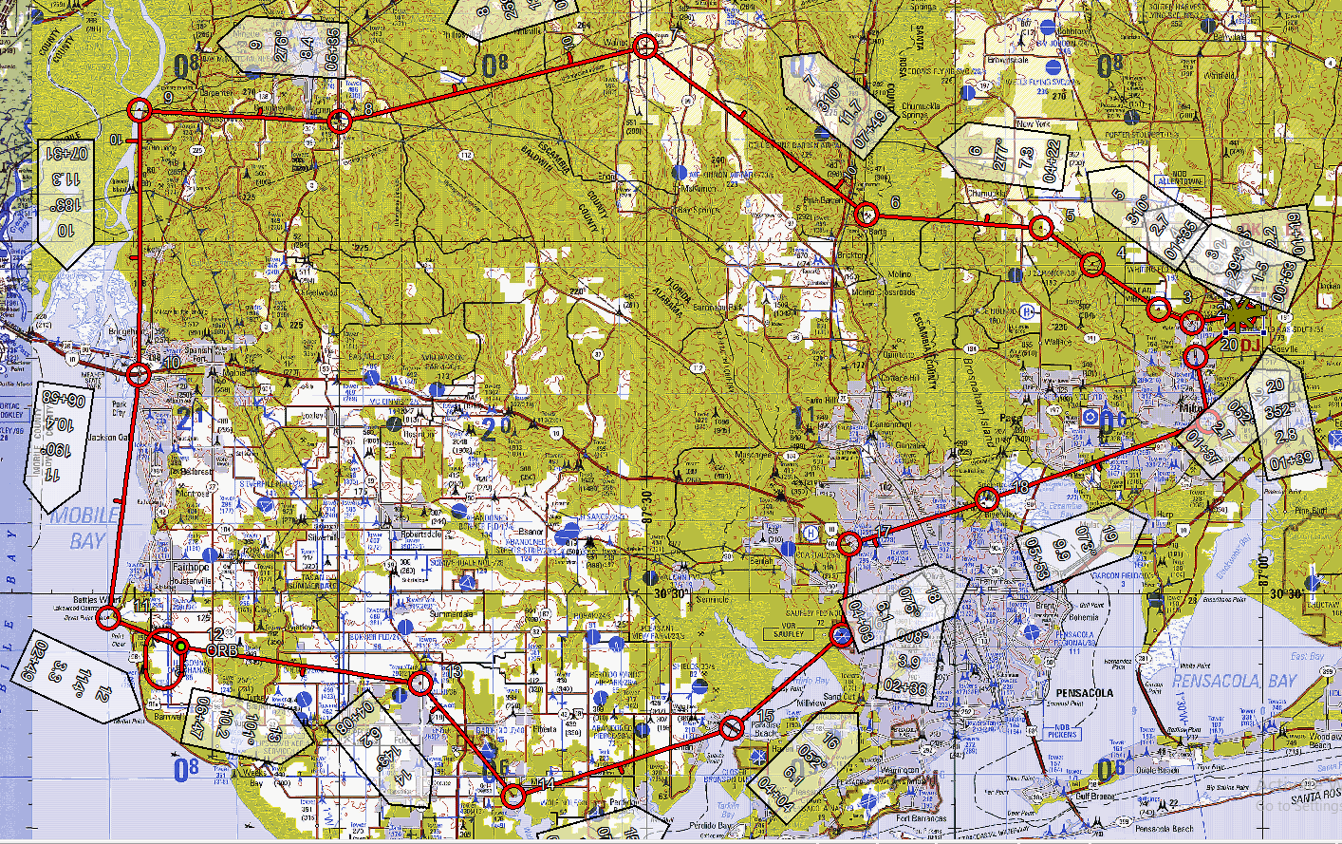
Concept of Operations – OVERVIEW West(Choose ONE)
INSERT SCREENSHOT FROM YOUR JMPS Route.
Remember to contact IP night prior for routing guidance
Use this to brief boundaries, airspace, restricted areas, towers, traffic, birds, powerlines, and LZs

Slide 13
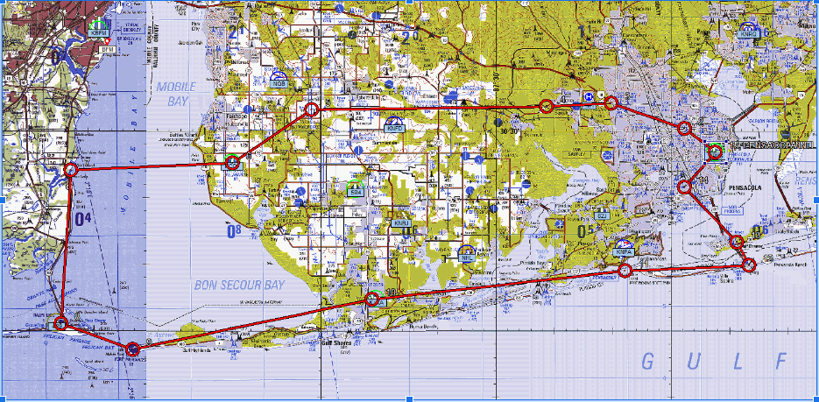
Concept of Operations – OVERVIEW West(Choose ONE)
INSERT SCREENSHOT FROM YOUR JMPS Route.
Remember to contact IP night prior for routing guidance
Use this to brief boundaries, airspace, restricted areas, towers, traffic, birds, powerlines, and LZs

Slide 14
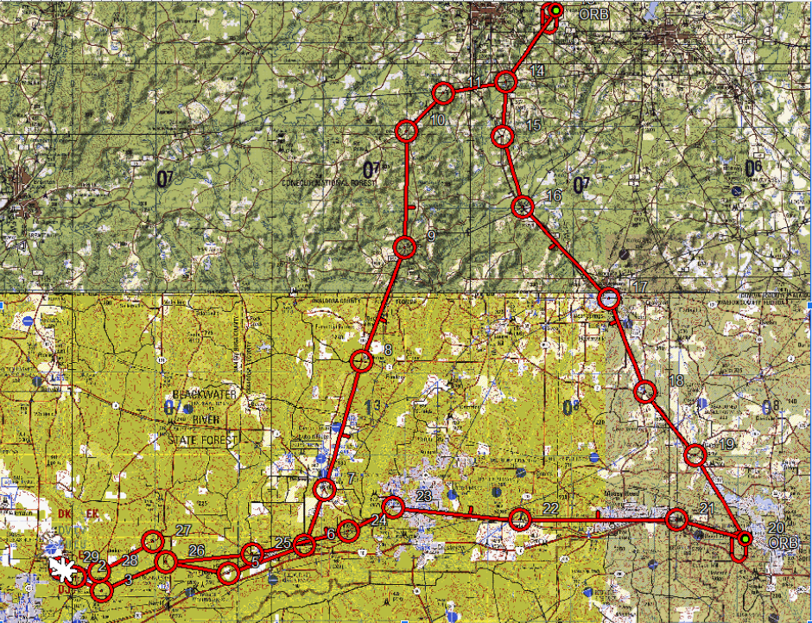
Concept of Operations – OVERVIEW East(Choose ONE)
INSERT SCREENSHOT FROM YOUR JMPS Route.
Remember to contact IP night prior for routing guidance
Use this to brief boundaries, airspace, restricted areas, towers, traffic, birds, powerlines, and LZs

Slide 15
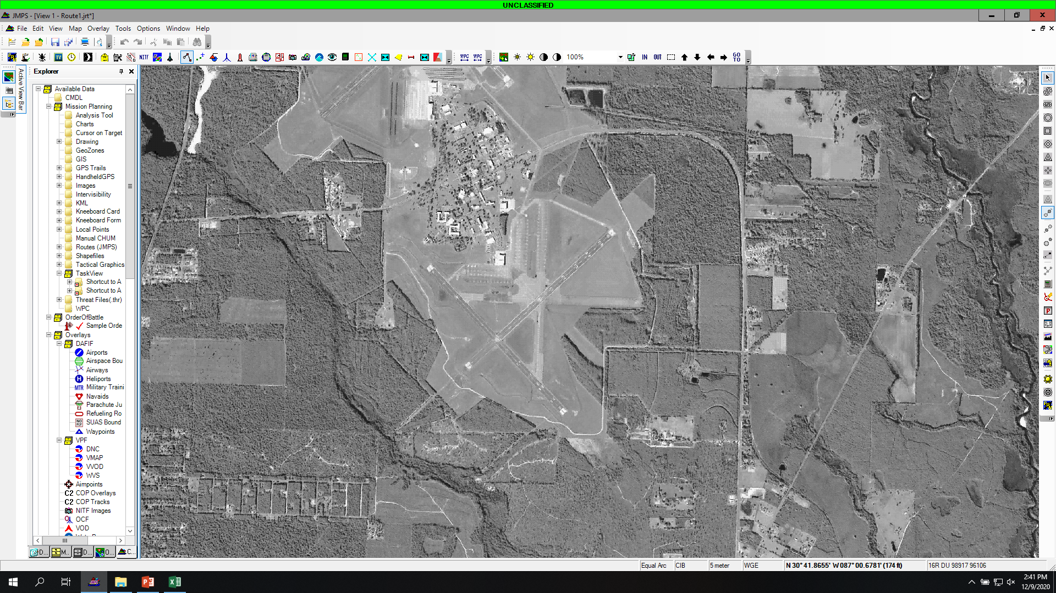
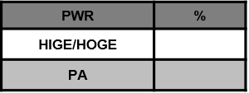
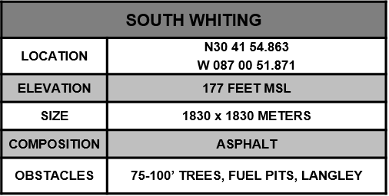
SOUTH WHITING
315
45
NORTH WHITING AIRSPACE
270
90
225
180
135
MAG VAR -2.0
HANGARS
FUEL PITS
EGRESS 135°
TO ABLE
F- Cruise Formation
A- 100KIAS, 900’MSL
L-Normal Lighting
C- BTN 4, 121.95, 0100
O: KNSE, MX Pattern
N: GTN Route
INGRESS 051°
FROM IGOR

Slide 16
Routing
USE YOUR JOG AIR to Brief routing
Use Canned Scenarios for mission overview
Remember to contact IP night prior for routing guidance

Slide 17
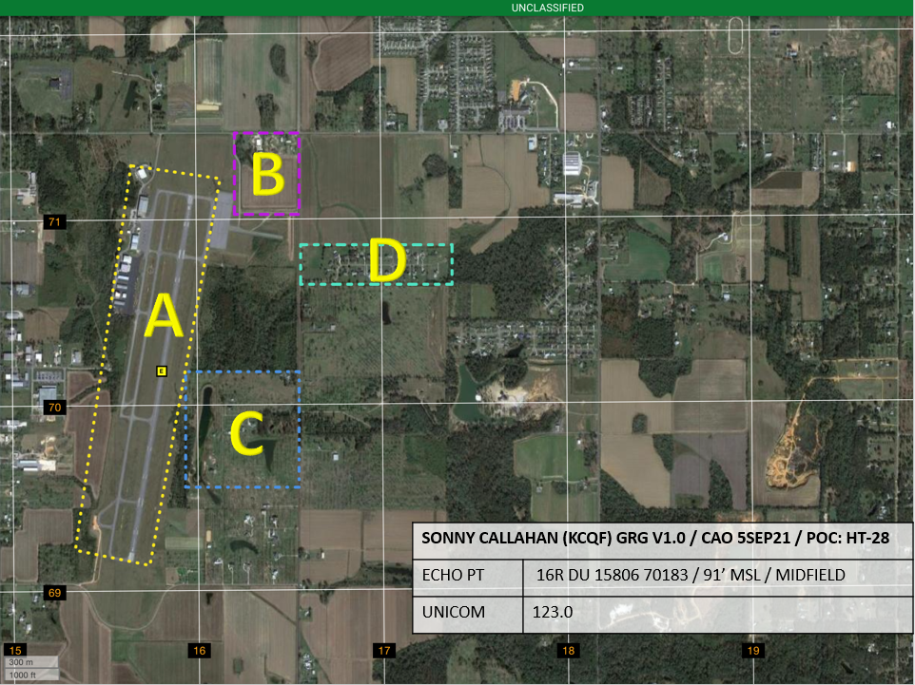
LZ DIAGRAM
INSERT LZ Diagram HERE FOR APPROPRIATE DESTINATION AIRFIELD
Be prepared to discuss exactly WHERE you will land
SAMPLE KCQF GRG

Slide 18
SOUTH WHITING
315
45
NORTH WHITING AIRSPACE
270
90
225
180
135
MAG VAR -2.0
HANGARS
FUEL PITS
EGRESS 135°
TO ABLE
F- Cruise Formation
A- 100KIAS, 900’MSL
L-Normal Lighting
C- BTN 4, 121.95, 0100
O: KNSE, MX Pattern
N: GTN Route
INGRESS 051°
FROM IGOR

Slide 19
ORIENTATION
Time Hack
A/C Assignment
External Callsign / Internal Callsign
Smart Pack Review
Maps Required
Weather
SLAP
SITUATION
Commander’s Intent
MISSION EXECUTION
Overview
Scheme of Maneuvers:
Preflight
Takeoff
Route
Objective Area
RTB
CONTINGENCIES
ADMIN & LOGISTICS
Flight Duration
Fuel
Mission Fuel / Bingo Fuel
COMMAND AND SIGNAL
Communications/ Radio Procedures
Frequencies / NAVAIDS
Terminate/KIO
SQUAWK
NATOPS by Exception
DUE OUTS

Slide 20
CONTINGENCIES
Emergencies and System Failures
IIMC
  Safe Heading
  Altitude
Lost Comms
Disorientation Procedures
Ditching / Emergency Landing / Egress
Simulated Emergencies

Slide 21
ORIENTATION
Time Hack
A/C Assignment
External Callsign / Internal Callsign
Smart Pack Review
Maps Required
Weather
SLAP
SITUATION
Commander’s Intent
MISSION EXECUTION
Overview
Scheme of Maneuvers:
Preflight
Takeoff
Route
Objective Area
RTB
CONTINGENCIES
ADMIN & LOGISTICS
Flight Duration
Fuel
Mission Fuel / Bingo Fuel
COMMAND AND SIGNAL
Communications/ Radio Procedures
Frequencies / NAVAIDS
Terminate/KIO
SQUAWK
NATOPS by Exception
DUE OUTS

Slide 22
ADMIN AND LOGISTICS
Flight Duration
Mission Fuel
  ___ gal
Bingo Fuel
  ___ gal from checkpoint ___
Sources of Fuel
Sources of Medical Services (notional)

Slide 23
ORIENTATION
Time Hack
A/C Assignment
External Callsign / Internal Callsign
Smart Pack Review
Maps Required
Weather
SLAP
SITUATION
Commander’s Intent
MISSION EXECUTION
Overview
Scheme of Maneuvers:
Preflight
Takeoff
Route
Objective Area
RTB
CONTINGENCIES
ADMIN & LOGISTICS
Flight Duration
Fuel
Mission Fuel / Bingo Fuel
COMMAND AND SIGNAL
Communications/ Radio Procedures
Frequencies / NAVAIDS
SQUAWK
NATOPS by Exception
DUE OUTS

Slide 24
COMMAND & SIGNAL
Communications
  Frequencies
  Navaids
ID and Recognition
  Squawks

Slide 25
ORIENTATION
Time Hack
A/C Assignment
External Callsign / Internal Callsign
Smart Pack Review
Maps Required
Weather
SLAP
SITUATION
Commander’s Intent
MISSION EXECUTION
Overview
Scheme of Maneuvers:
Preflight
Takeoff
Route
Objective Area
RTB
CONTINGENCIES
ADMIN & LOGISTICS
Flight Duration
Fuel
Mission Fuel / Bingo Fuel
COMMAND AND SIGNAL
Communications/ Radio Procedures
Frequencies / NAVAIDS
SQUAWK
NATOPS by Exception
DUE OUTS

Slide 26
NATOPS By Exception
Weight and Balance
Flight Publications Required
NOTAMs
Emergencies
  Dynamic Rollover
PAC/PNAC Responsibilities
Control Change
Lookout Doctrine
Instrument/Night Flight
  Safety of flight. PNAC will monitor performance instruments, question anything exceeding the following parameters, and be prepared to assume the controls:
    AOB > 30
    Rate of climb/descent > 1,000 FPM
    Airspeed errors by 10 KIAS
    Heading errors by 10⁰
    Altitude errors > 100ft
    Vertigo/disorientation

Slide 27
NVG Brief
SLAP DATA
NVG PREFLIGHT
GOGGLE/DEGOGGLE PROCEDURES
INTERNAL/EXTERNAL AIRCRAFT LIGHTING
RADALT
HAZARDS
LZ OPERATIONS
NVG EMERGENCIES

Slide 28
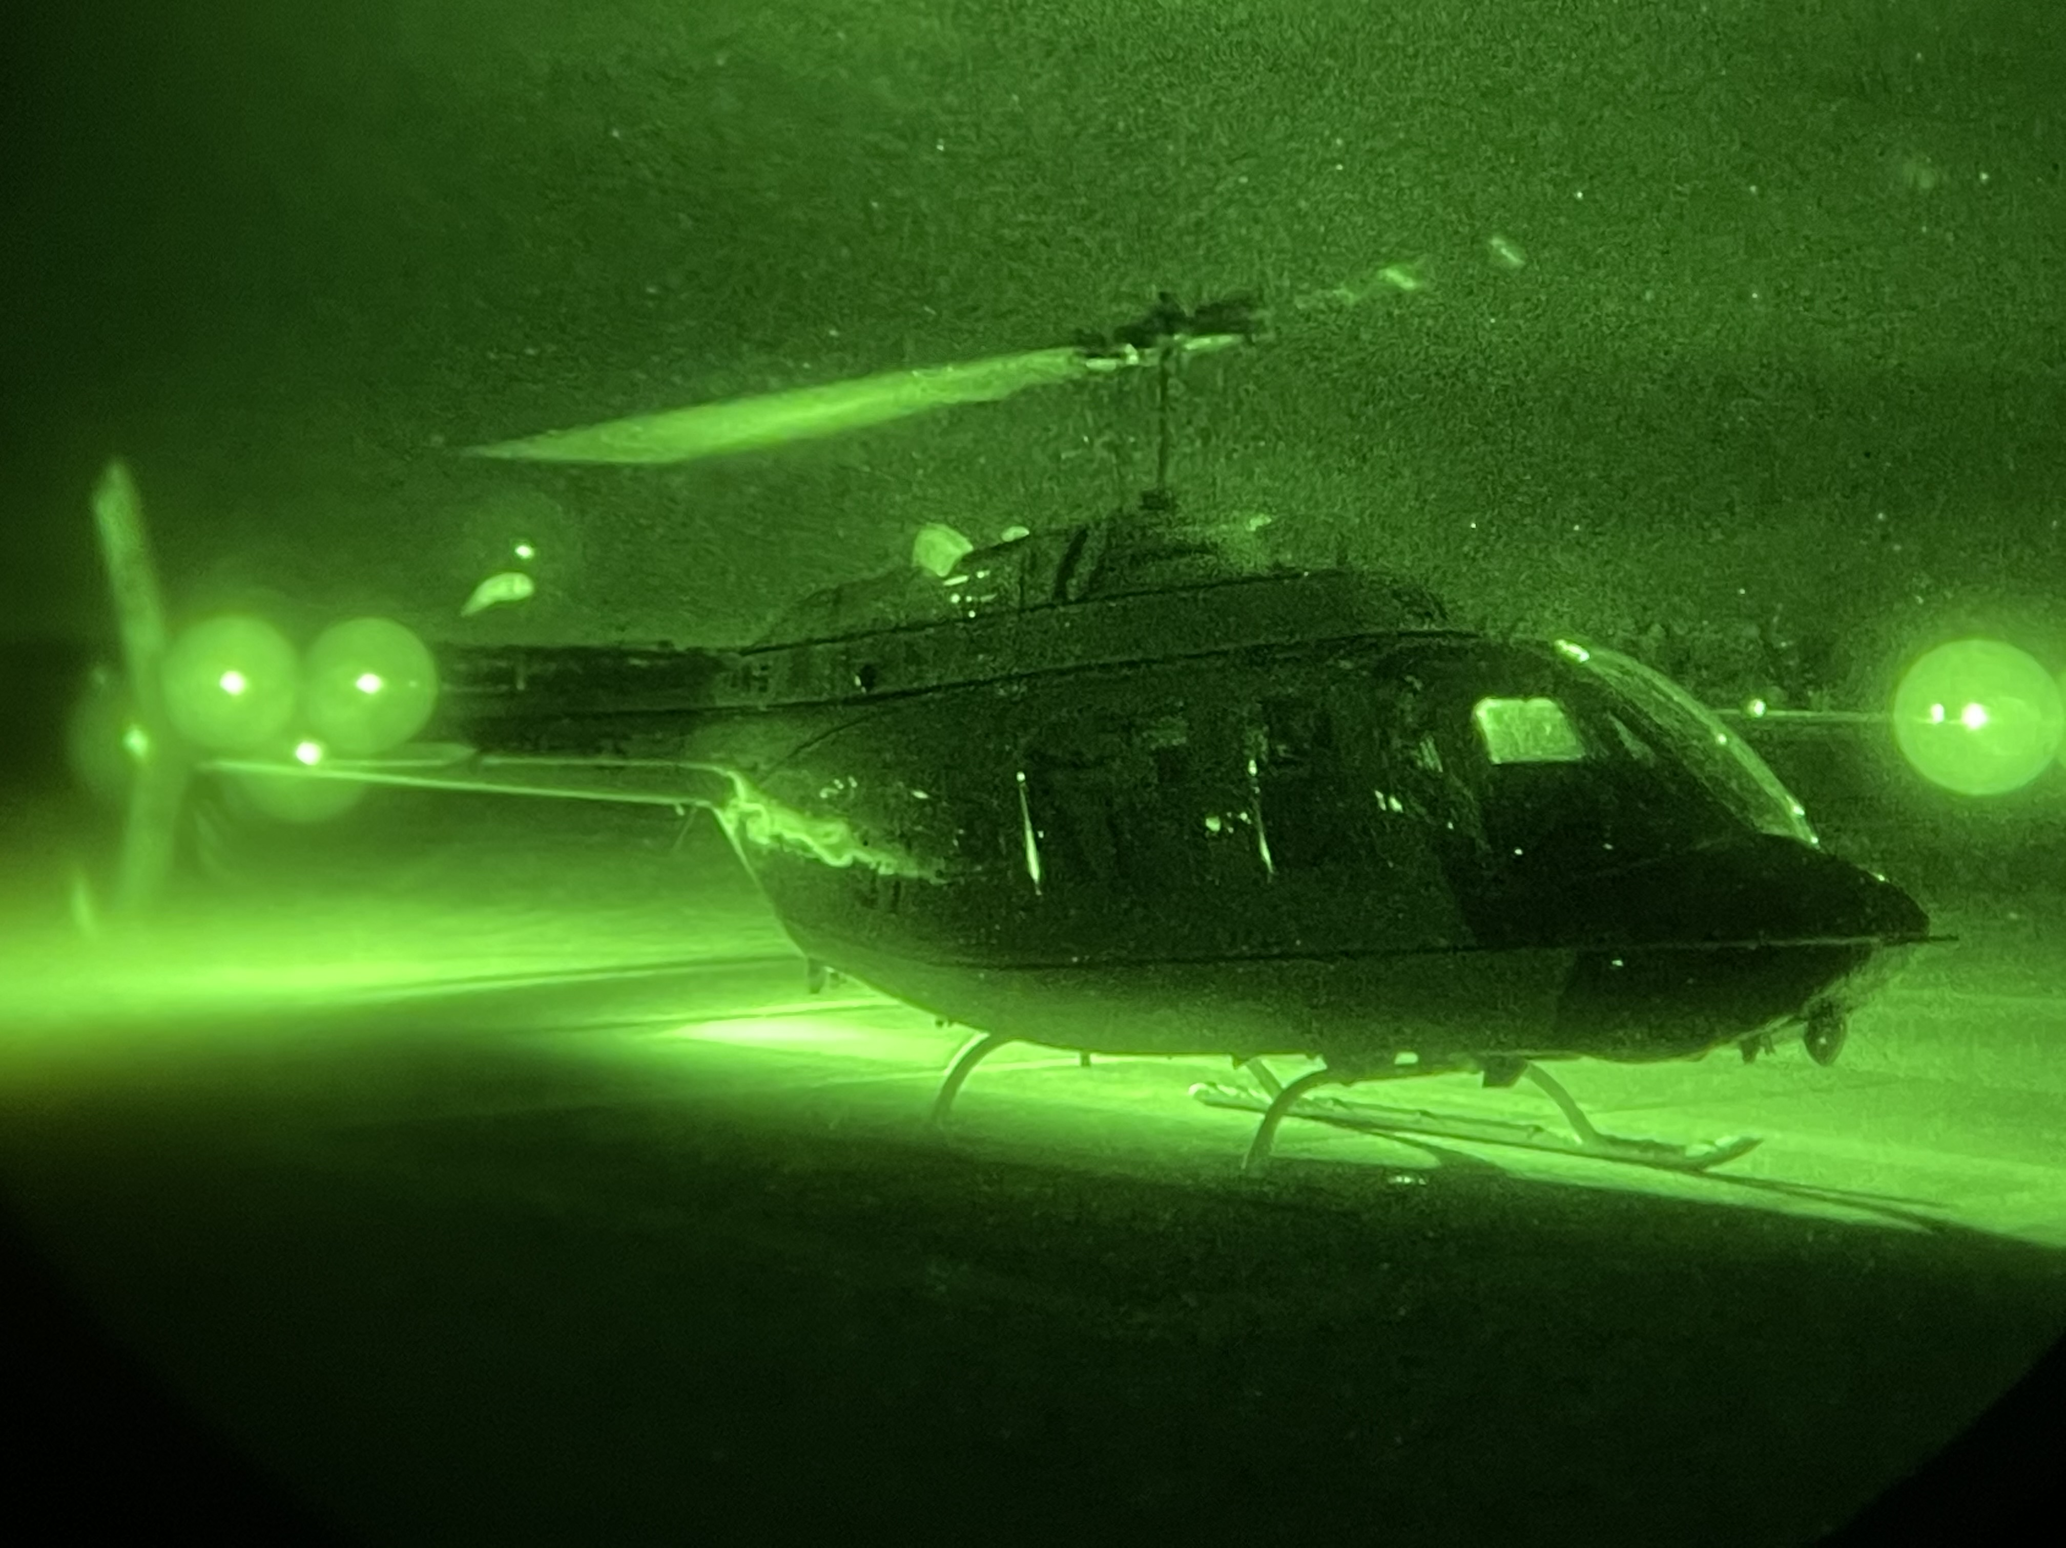
Due Outs

