Slide 1
CNATRA
Training Improvement Program (TIP)
CNATRA invites all TRAWING personnel and contract instructors to submit changes to correct errors or improve training in; courseware (CAI/MIL), exams, publications, and curricula.
Recommended changes are submitted via an online form available on the CNATRA website at www.cnatra.navy.mil.
All submissions via www.cnatra.navy.mil will be turned into Training Change Requests (TCR) and tracked in the TCR database.
ALL TCR SUBMISSIONS MUST BE SUBMITTED VIA THE TIP WEBSITE. PAPER AND EMAIL SUBMISSIONS ARE NO LONGER ACCEPTED.

Slide 2
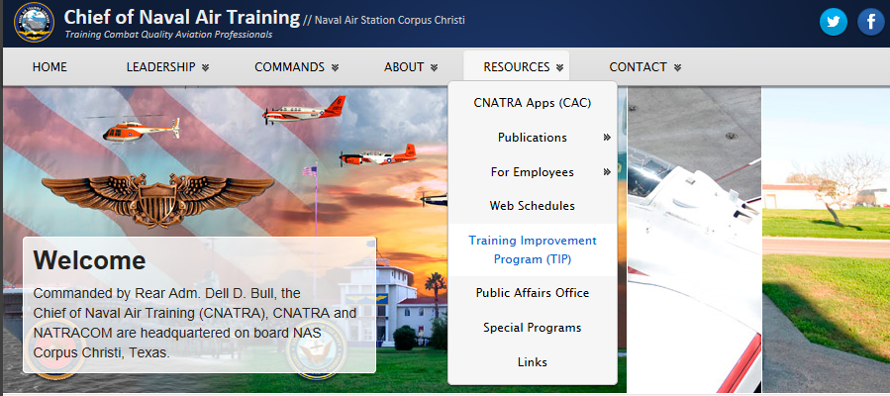
CNATRA
Training Improvement Program (TIP)
To reach the Training Improvement Program page, go to www.cnatra.navy.mil
Click on RESOURCES and from the dropdown menu select Training Improvement Program (TIP).

Slide 3
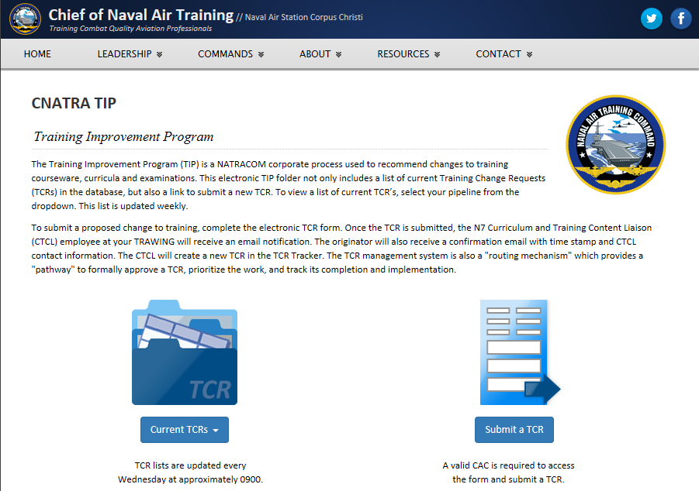
CNATRA TIP Website
The TIP page will open
To create a TCR, select Submit a TCR button to open the Training Change Request (TCR) form

Slide 4
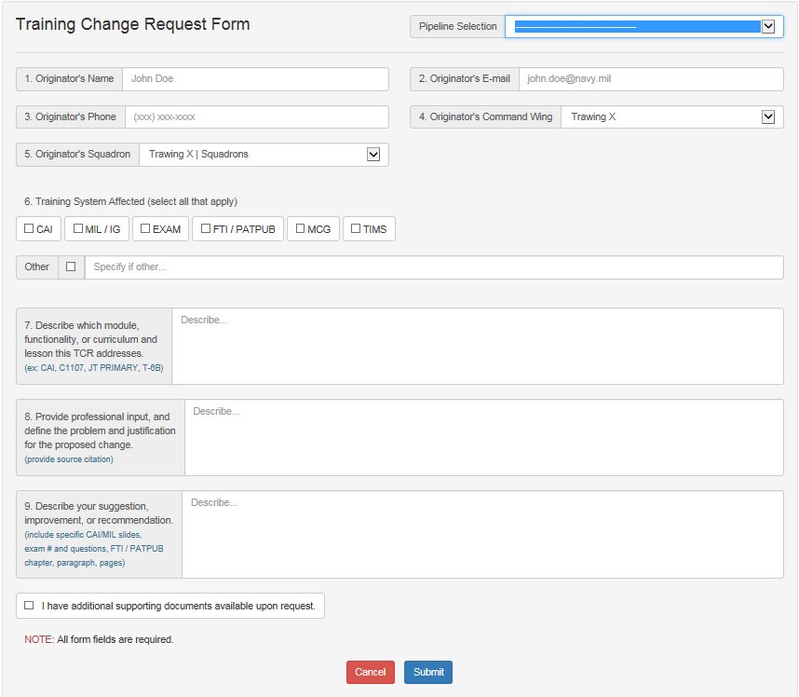
Training Change Request Form
The online TCR Form must be completed entirely. Then click the Submit button.

Slide 5
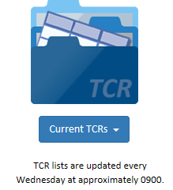
CNATRA TIP Website
Information from the form will be entered into the TCR database to create a TCR and given a TCR number.
Each submitter will receive a confirmation email. The email may request clarifying or additional information.
Submitters may track the status of their submission by selecting the Current TCRs button on the Training Improvement Program page,
then selecting their Program Phase:
Primary T-6B (TW4, TW5)
Rotary TH-57 (TW5)
Tilt-rotor (TW5)

Slide 6
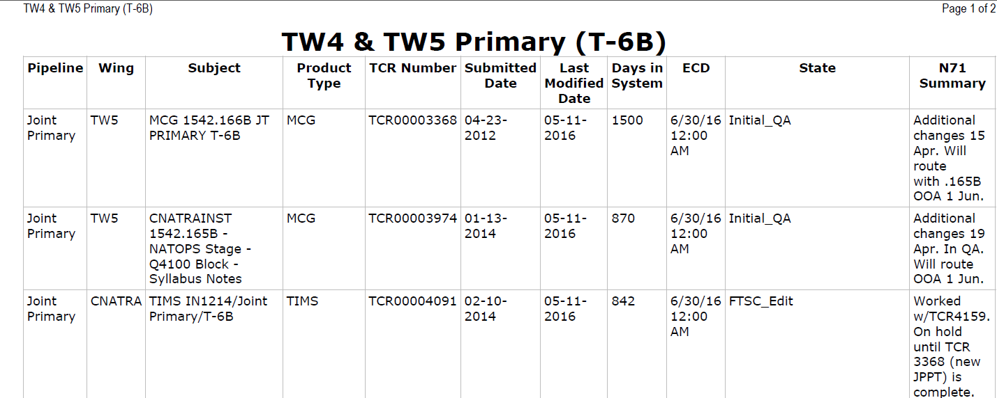
Current TCR Page
When the page opens personnel can view the status of TCRs under the State column.
Please note, this table is only updated every Wed morning.

Slide 7
TW-5 Draft TCR Paper Form
Many recommended changes originate in the Testing Center and the Learning Resource Center (CAI lab).
Unfortunately there is no internet access in either site to submit a TCR form in CNATRA’s TIP website.
To assist personnel, each site has a TW-5 draft form with directions that can be used to record needed changes until you can reach an NMCI computer.
Do not submit this local, draft form. It may only be used to record information to be entered later when completing the online form. TW-5 form appears on the next slide.

Slide 8
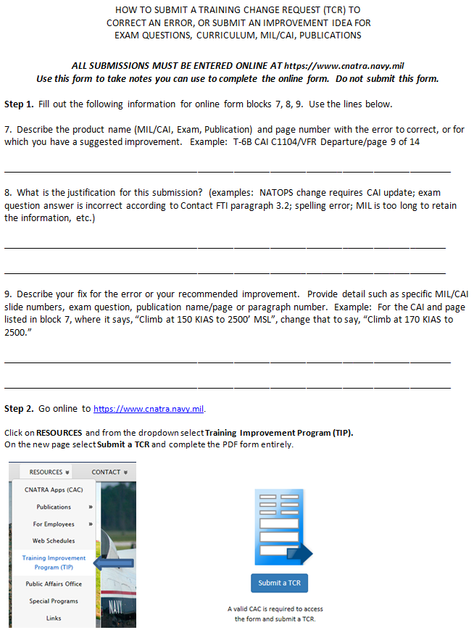
TW5 Draft TCR Paper Form
TW-5 draft TCR Form is available in the Testing Center and Learning Resource Center to capture submissions for later entry into CNATRA’S online TCR form.

Slide 9
CNATRA TIP Website
Contact the TW-5 Curriculum Coordinator if you have questions or need assistance:
Larry Mizak
623-7659
lawrence.mizak@navy.mil

