Slide 1
TRF Zero
(GND0402A)
Version 1.3

Slide 2
Learning Objectives
Be able to re-iterate the lessons from JMPS 1.
Be able to plan a low level route using manual point input (MGRS or Lat-Long) and Local Points.
Be able to prepare route chart and route card IAW FTI.
Understand briefing techniques and briefing space preparation.
Brief low level route IAW FTI.

Slide 3
Purpose
The purpose of the TRF Zero is to give the SNA a refresher on how to utilize JMPS for their Low Level, NVG, and Form flights and a demonstration of how to plan their route, set up their briefing space, and successfully deliver a Low Level Brief.
THIS CLASS SHOULD UTILIZE THE FULL 2.5 HRS.
The Instructor shall remain in the classroom to assist and answer questions until the last SNA has departed.

Slide 4
Agenda
JMPS Review / Work Space setup
Build TFR 4001 route through Check Point 5 using local points
Route Card preparation
SLAP data and Vertical Obstruction analysis
Chart preparation
Transpose the route on the chart
  Doghouse placement
  Identifying key features
Briefing space set up techniques

Slide 5
Agenda (continued)
IP demo brief of Green route through Check Point 5
IP inspection of route cards
Area clean up.

Slide 6
Share-Drive Connection
Overview: Ensure everyone is connected to the share drives, and then start the JMPS Program

Slide 7
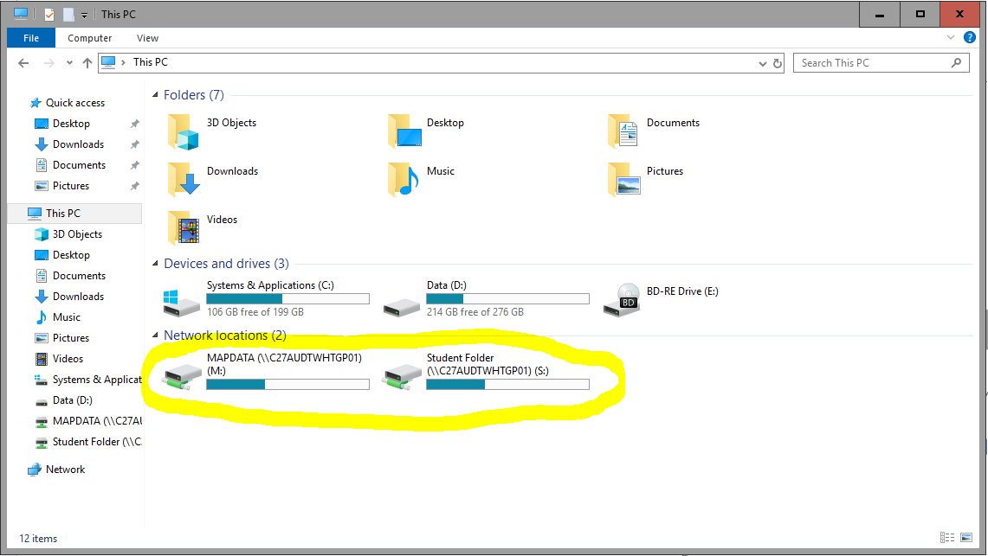
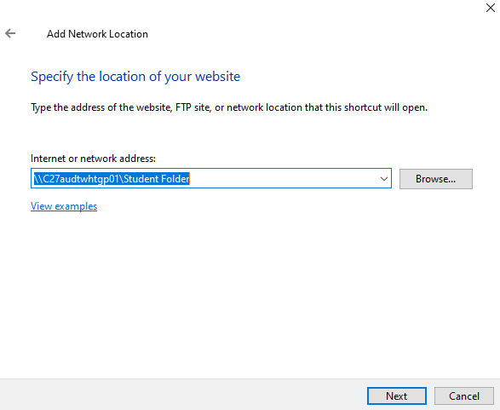
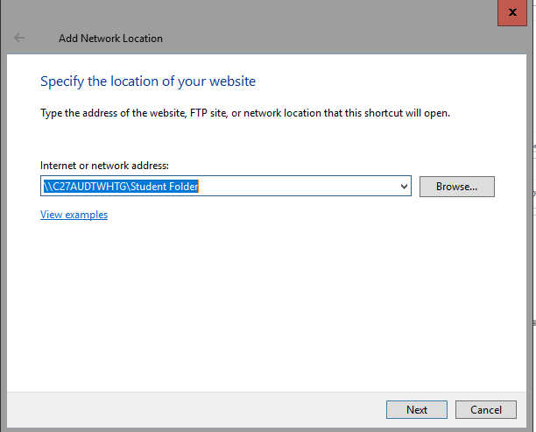
Adding Both Drives
Open file explorer->
Go to “This PC” ->
Right click and select “Add a network location” ->
Click next and then “Choose custom location” ->
under “Internet or network address:” ensure the following drives are added.
\\C27AUDTWHTGP01\Student Folder
\\C27AUDTWHTGP01\Mapdata
(add map drive as a M: drive)

Slide 8
Brief JMPS Review
Overview: Go over some basics of how JMPS is laid out, Tabs, Mapdata, Overlays, and Tools

Slide 9
Work Space Setup
Overview: Demonstrate how to set up JMPS workspace with the correct overlays, loading local points, importing a preference file, saving the system layout, opening up route editor, etc. (~10 minutes)

Slide 10
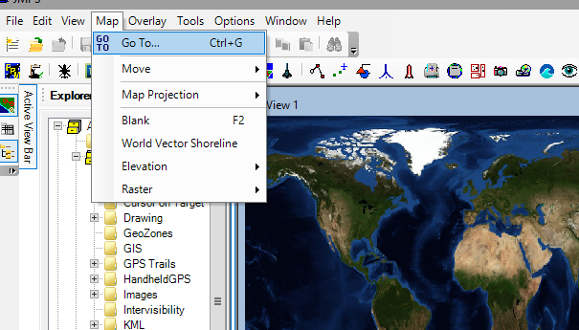
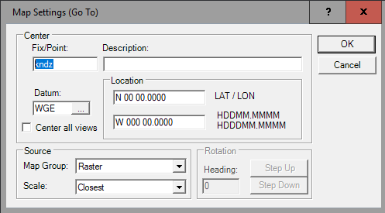
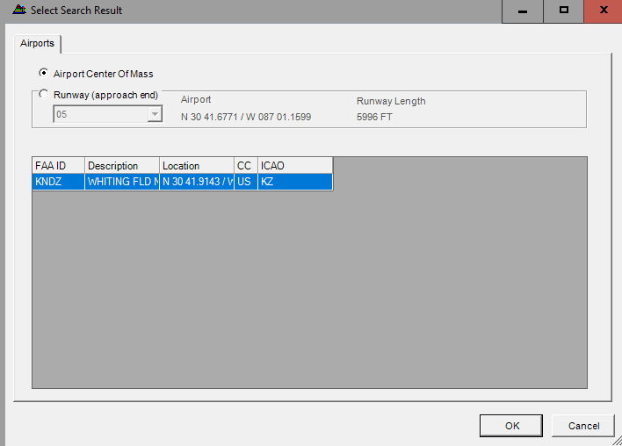

Map Go-To Tool
Ensure you hit tab instead of enter so you can select the desired map level.
Under map group select raster and for scale select desired layer. E.g. CADRG 1:250 (JOG)

Slide 11
JMPS Program
Open JMPS desktop shortcut
  May open to previous flight plan
    To Close: Click “File” then “Close”
Check DAFIF currency
  Select “Tools” Menu
  “Data Administration”
  System Health”
  Up-Date DAFIF under “DAFIF Selection”

Slide 12
Checking DAFIF Currency
Follow the step by step guide.

Slide 13
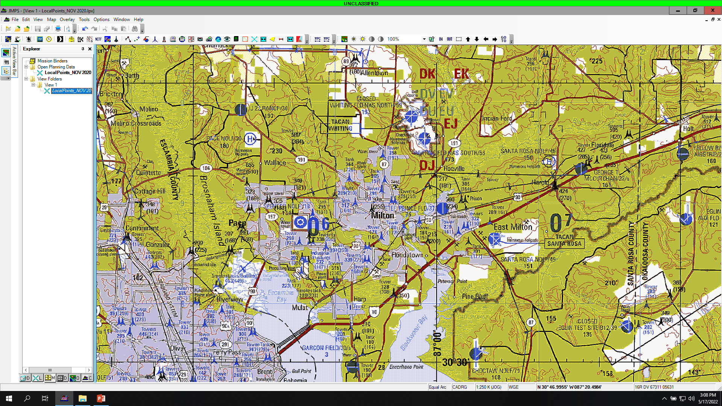

Slide 14
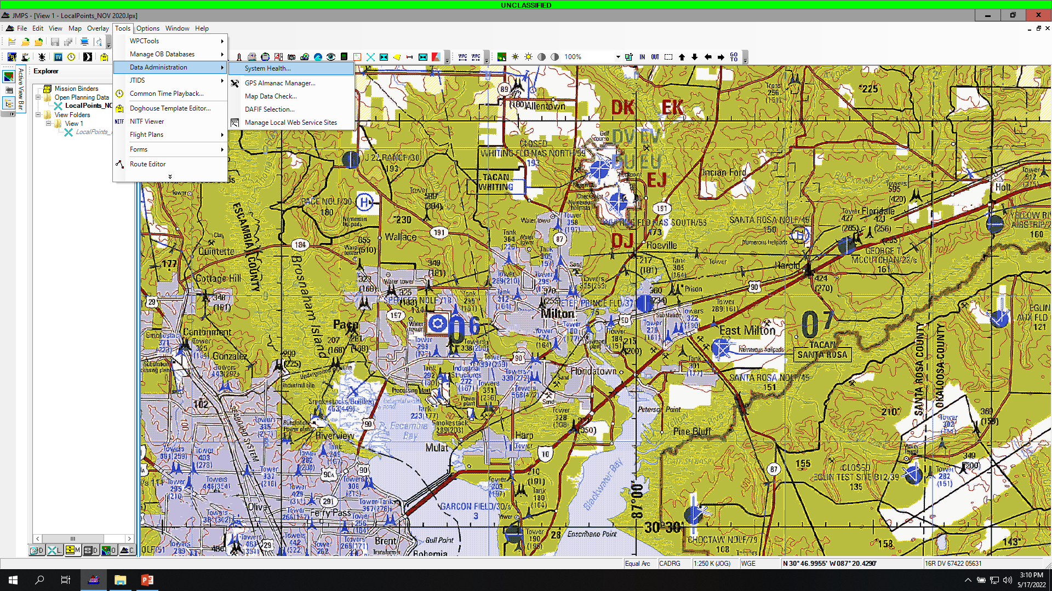
  1. Select “Tools” Menu
  2. “Data Administration”
  3. System Health”

Slide 15
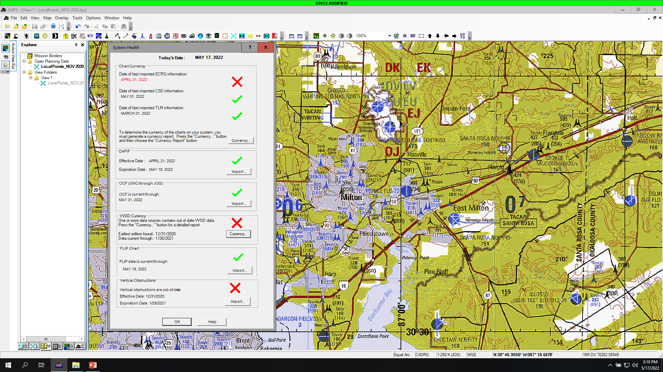
  This will open.

Slide 16


JMPS System Health
Check DAFIF currency
Check Chart Currencies
Check OCF (Obstacle Clearance File)
Check FLIPS
Check Vertical Obstruction Data
= Not current with system time and date
= Current with system time and date

Slide 17
Import Preferences
Import the system preferences via the options tab.
  Go to “Options Tab”
  Select “Preferences”
  Select the “Preference Sets” Tab
  NOTE: DO NOT MANUALLY CHANGE THE PREFERNCES UNDER THE PREFERENCE TAB, THE WRONG EDIT CAN THROW OFF THE JMPS SYSTEM AND WOULD BE HARD TO FIND/FIX.
  For TH57 SNAs, select the preference set titled 57_User_V2
  Select “Apply”
  If you need to update the preference set or it’s not there then select Import, Navigate to the CTW-5 Nav stan folder -> Standard JMPS Files-> Preferences and select the set to import. You will then have to apply it after import.

Slide 18
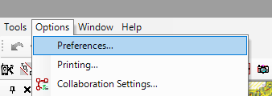
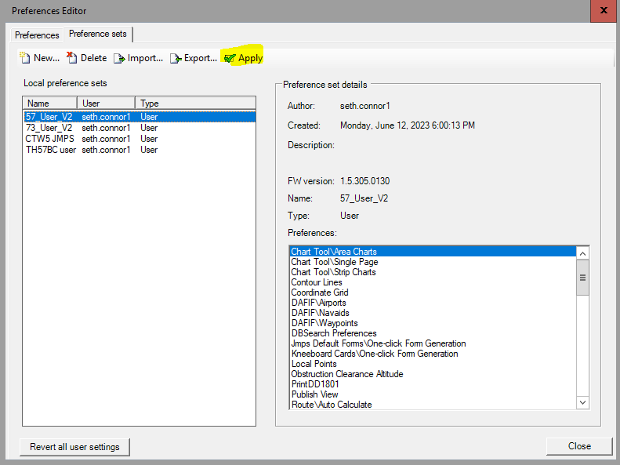
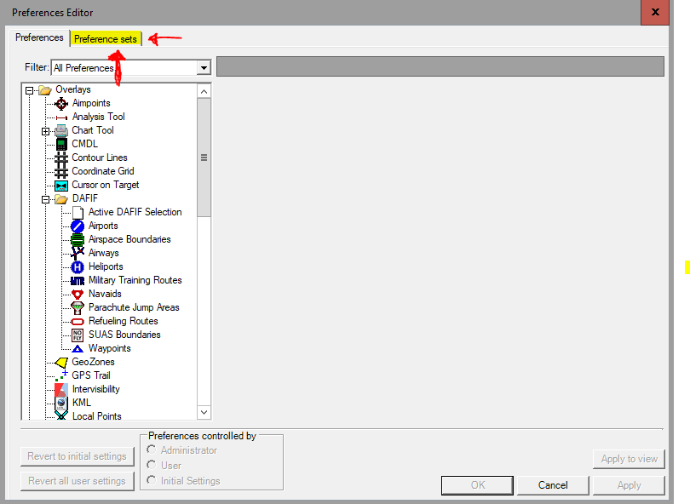

Slide 19
Setting Up Overlays
Follow the step by step guide.

Slide 20
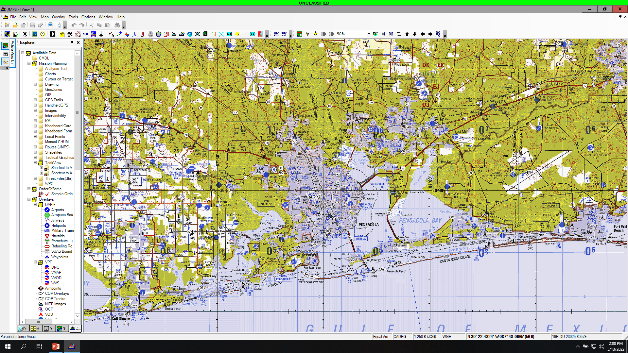
Click here to set up the overlays.

Slide 21
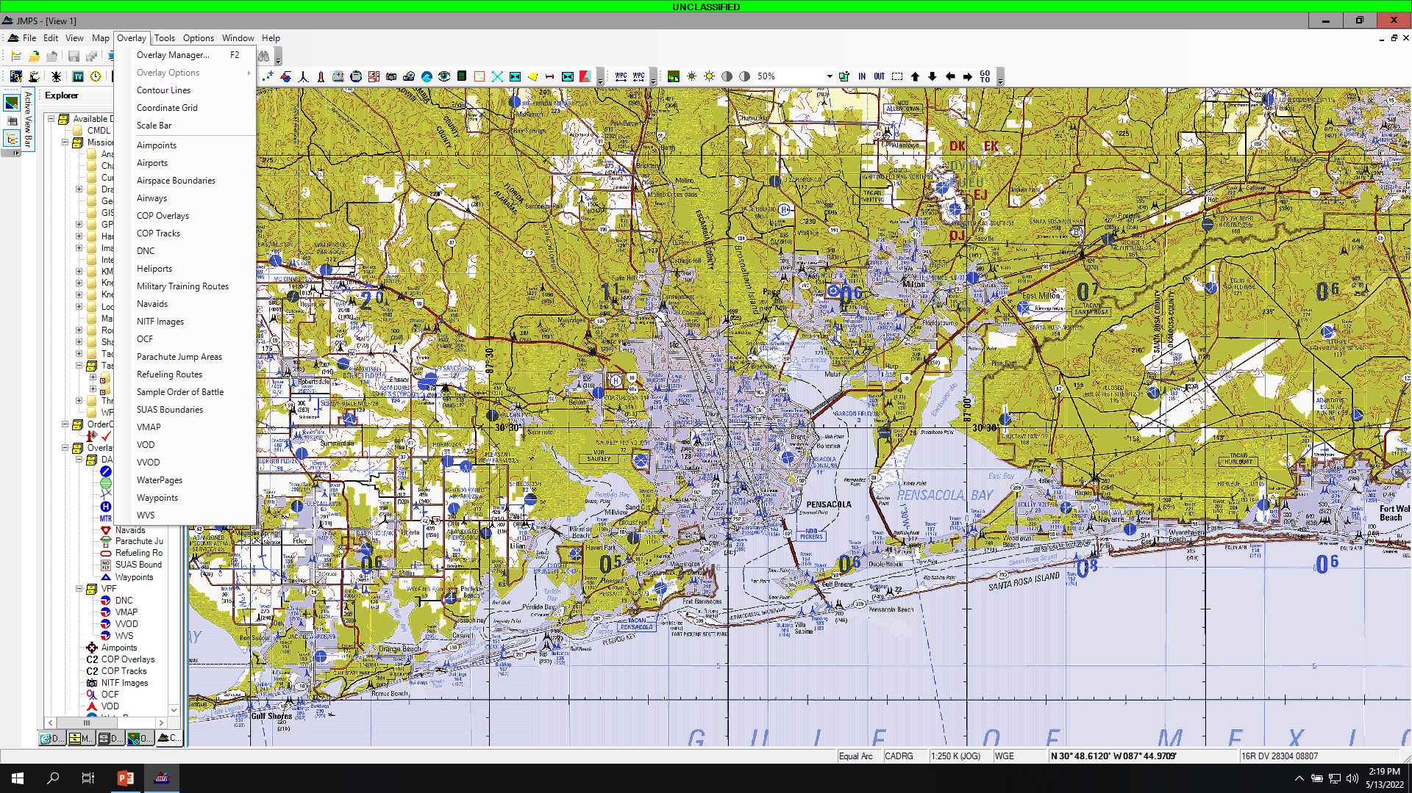

Slide 22
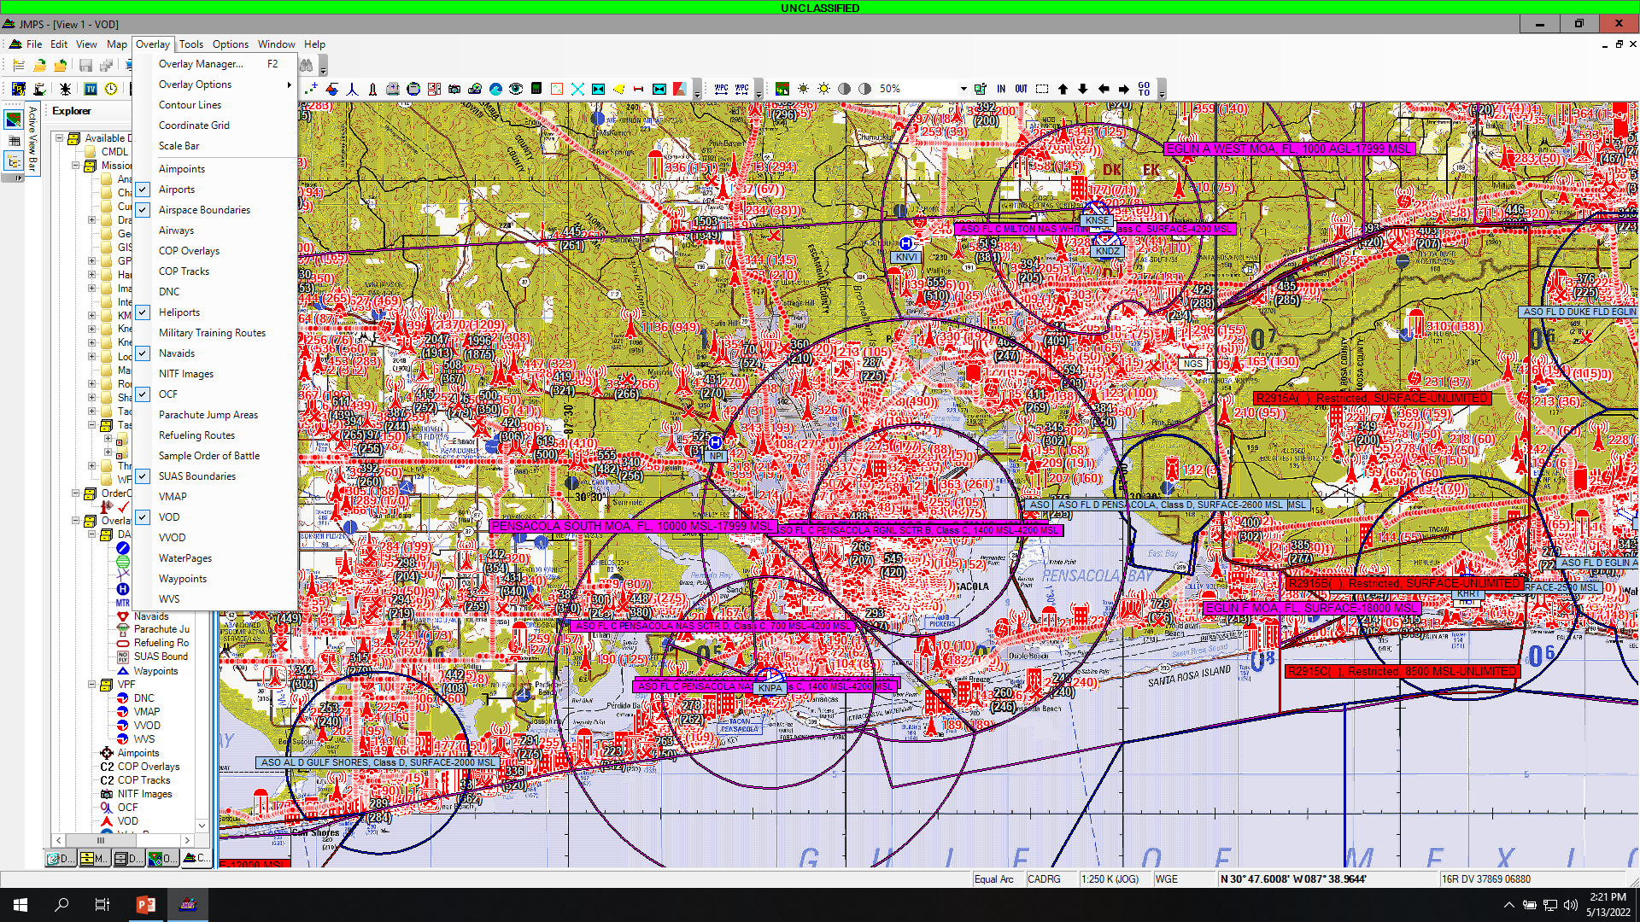
Select these options.

Slide 23
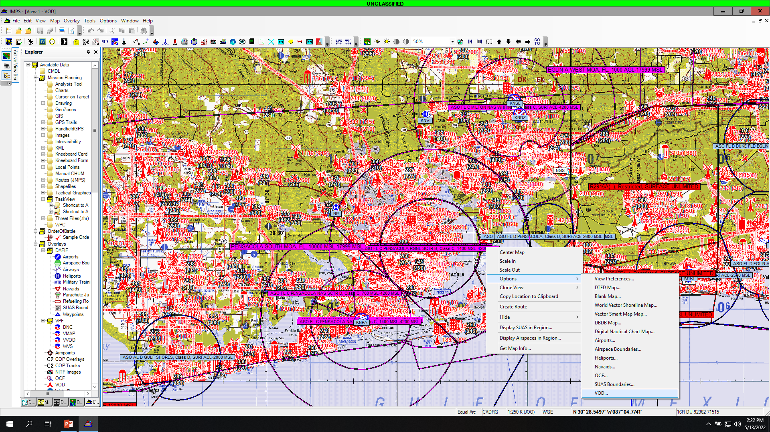
Right click to bring this up.

Slide 24
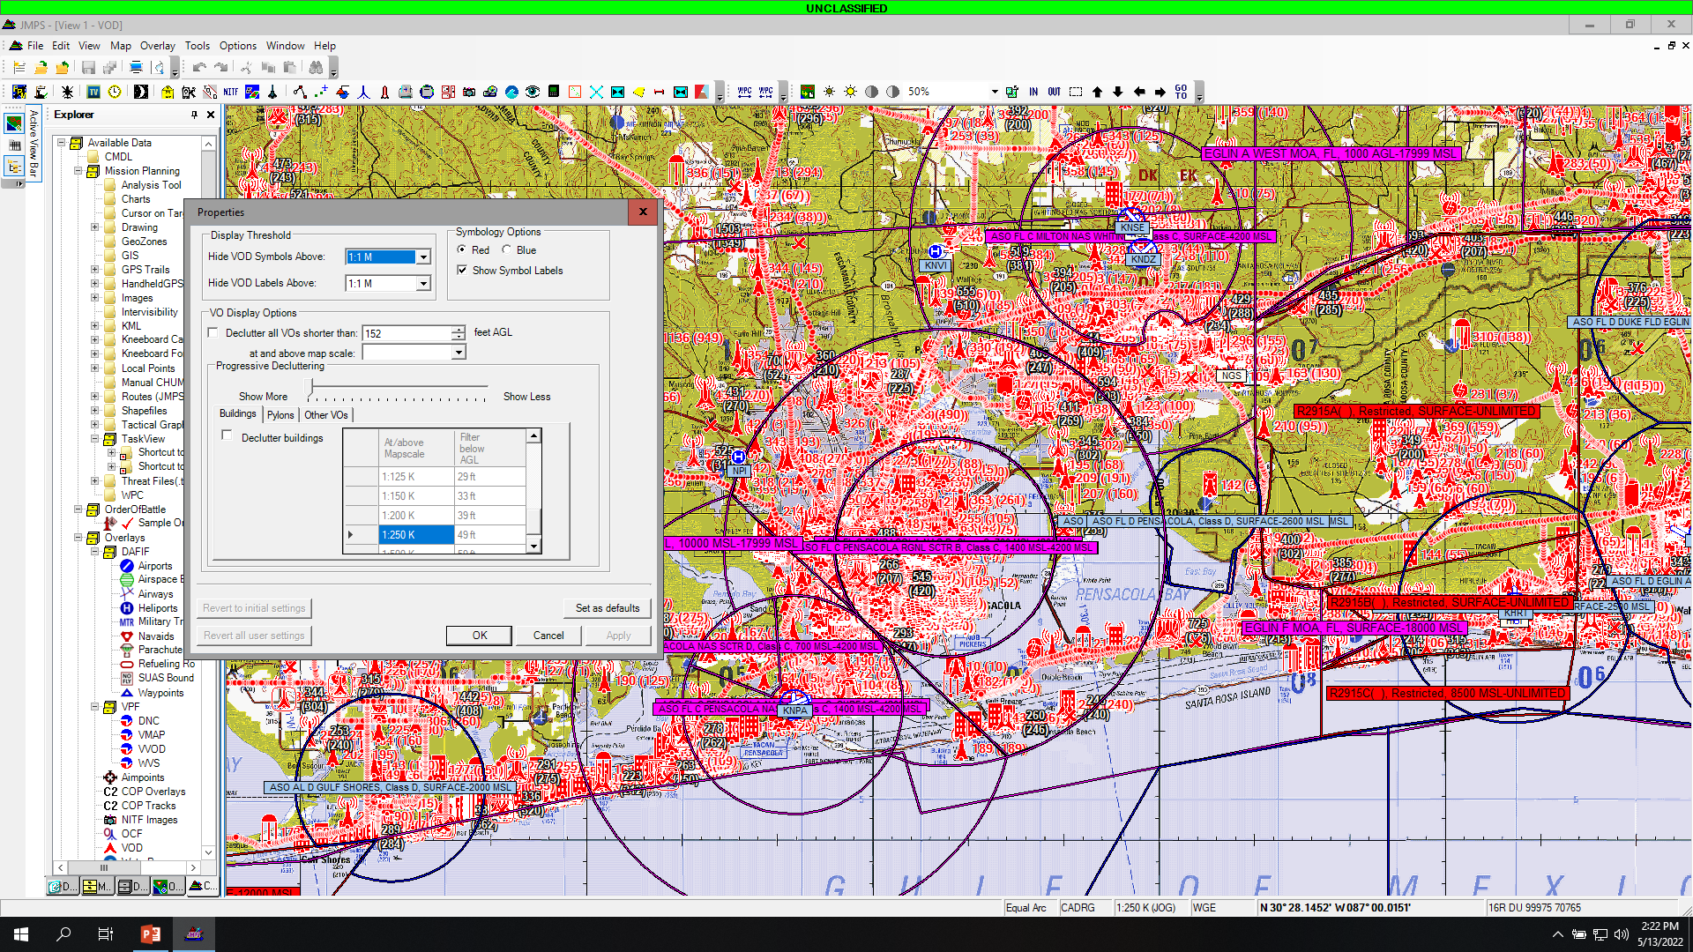

Slide 25

1. Check the box.
2. Select your altitude, recommend 300’.
3. Select apply.
1.
2.
3.

Slide 26
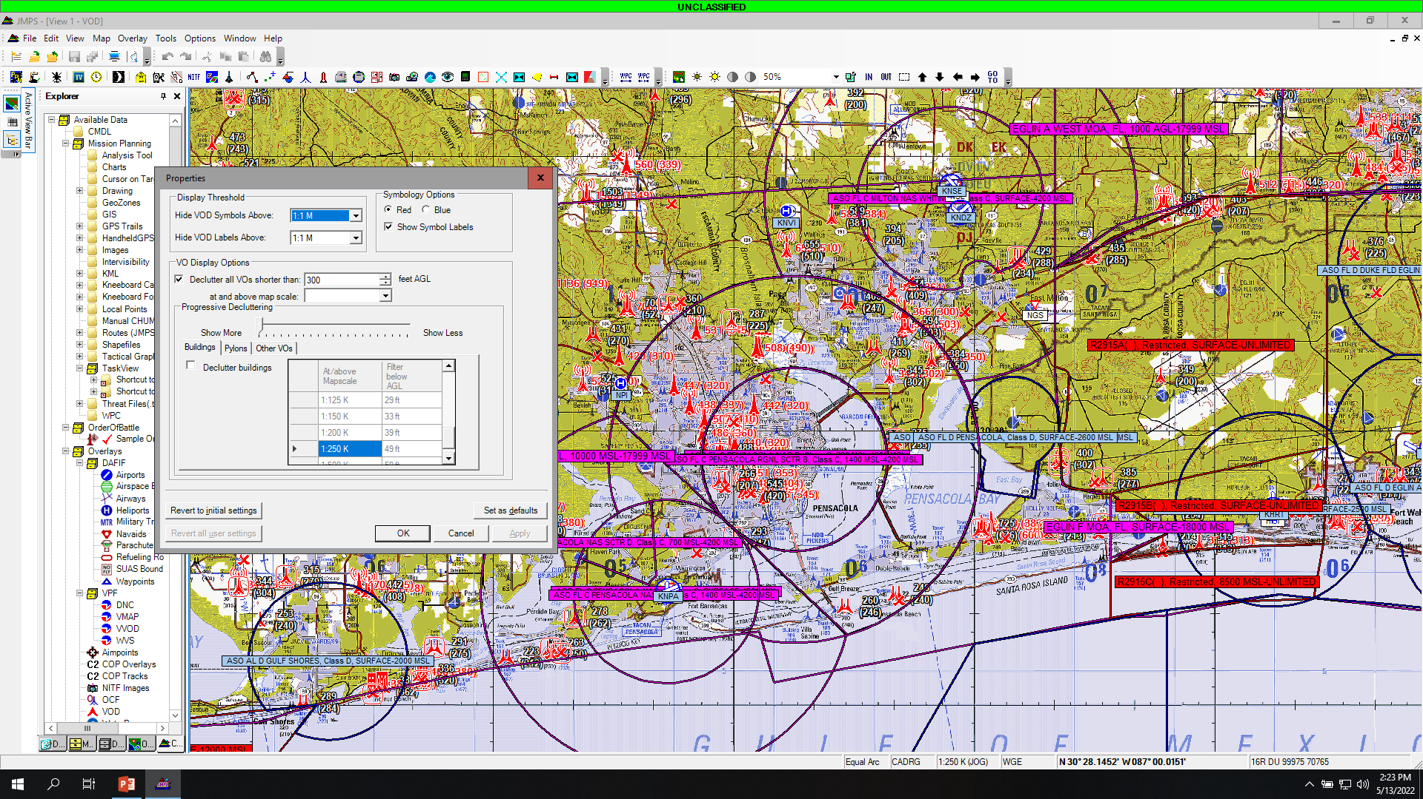
Select “ok.”

Slide 27
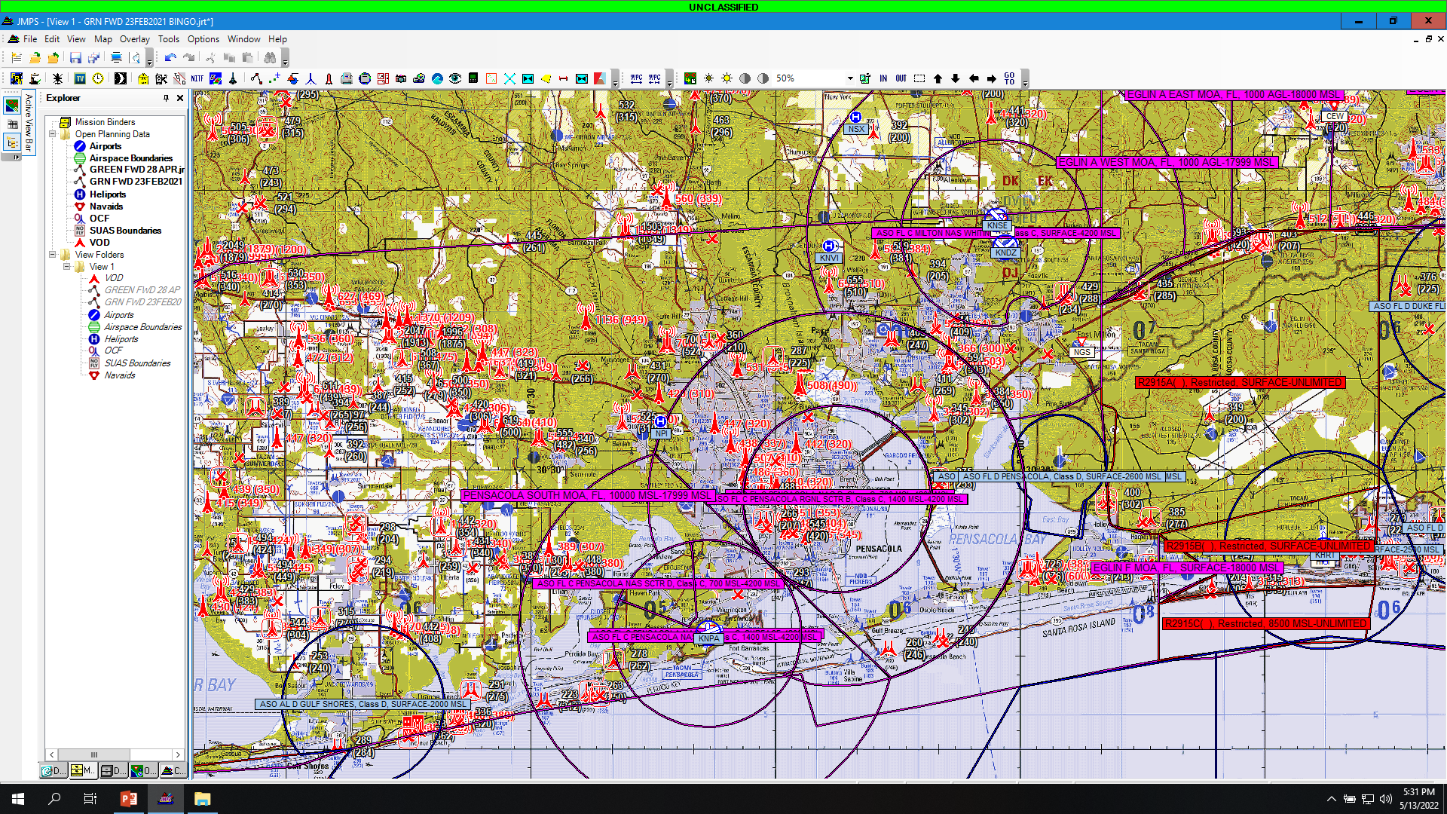

Slide 28
Importing Local Points
Follow the step by step guide.

Slide 29
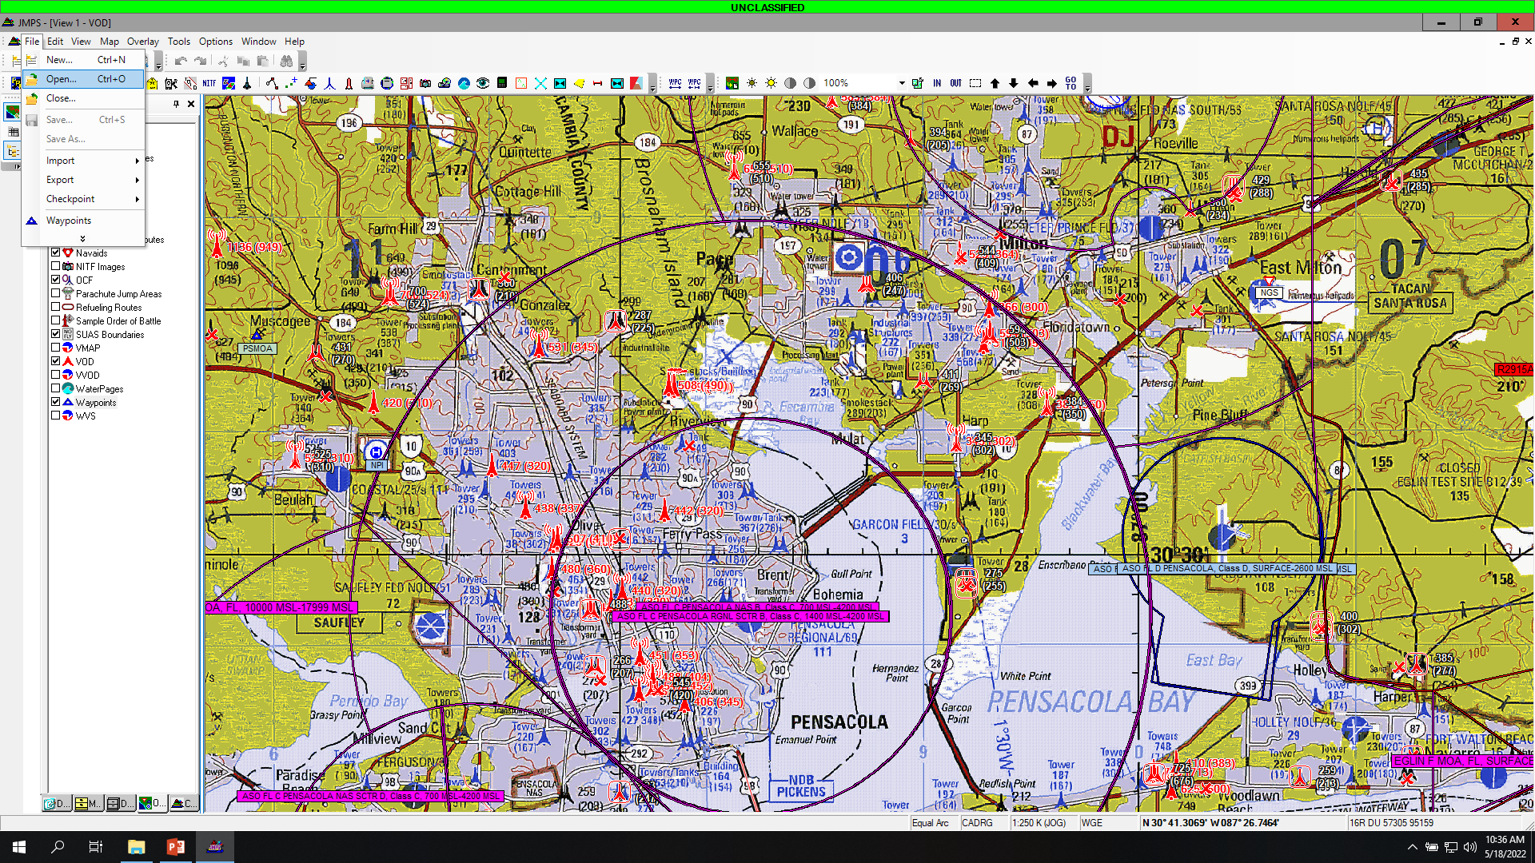
Select File
Select Open

Slide 30
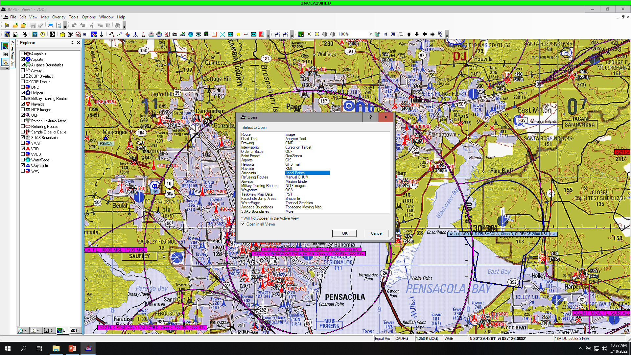
Select “Local Points”

Slide 31
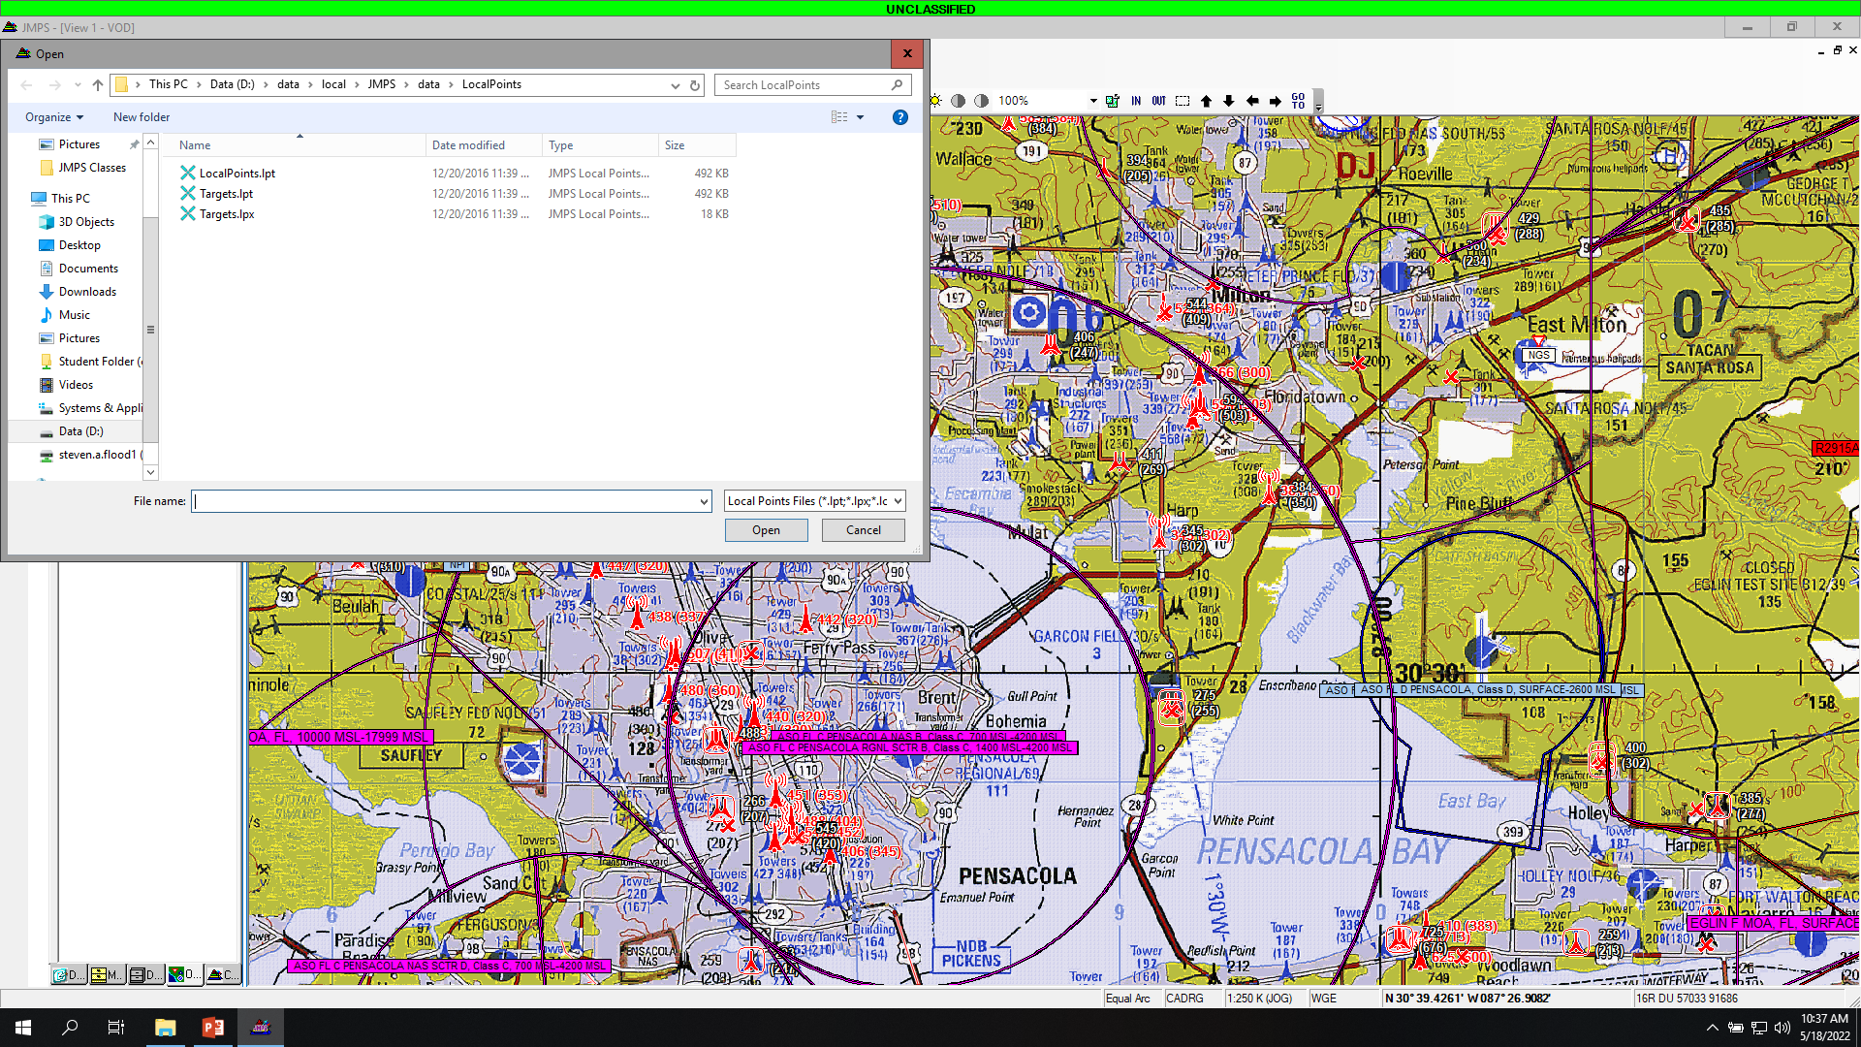
This box will open.

Slide 32
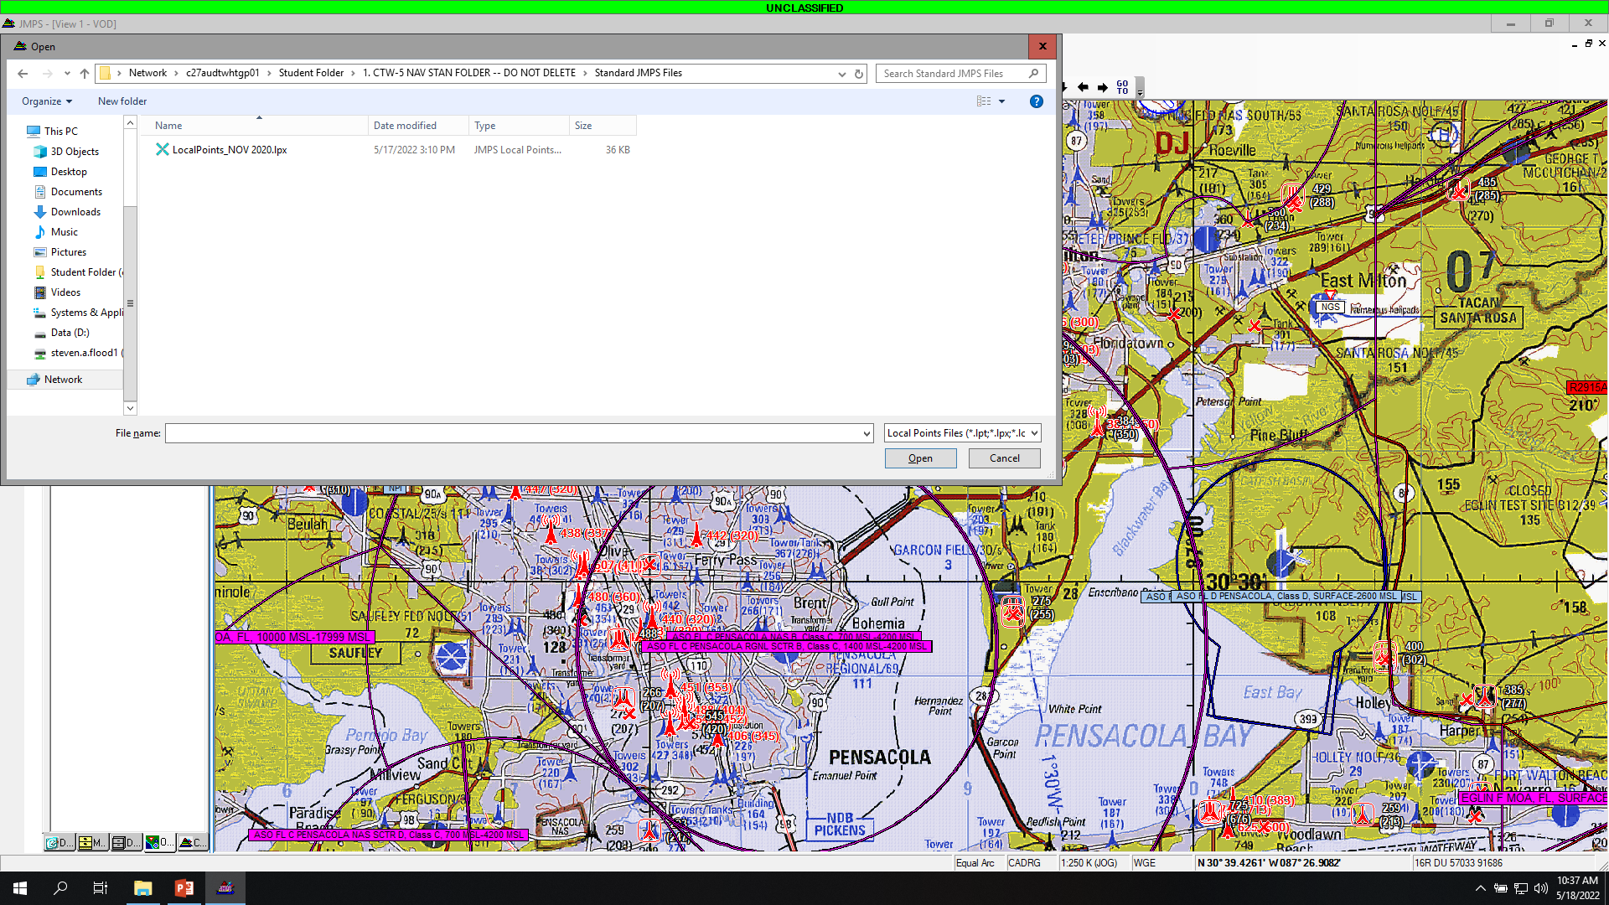
Map to here.
Open: LocalPoints_NOV2020.lpx
*NOTE: Local points may be updated, use latest dated version.
*NOTE: May have to change file type from .lpt to .lpx if you don’t see it.

Slide 33
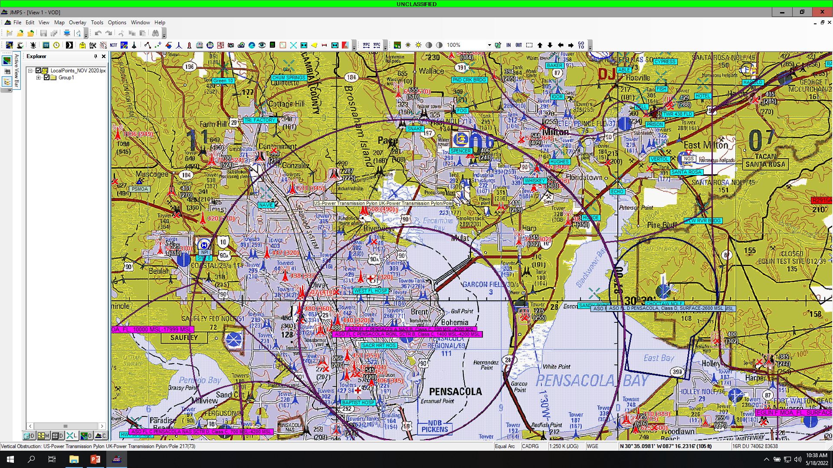
Your Points…

Slide 34
OR……….

Slide 35
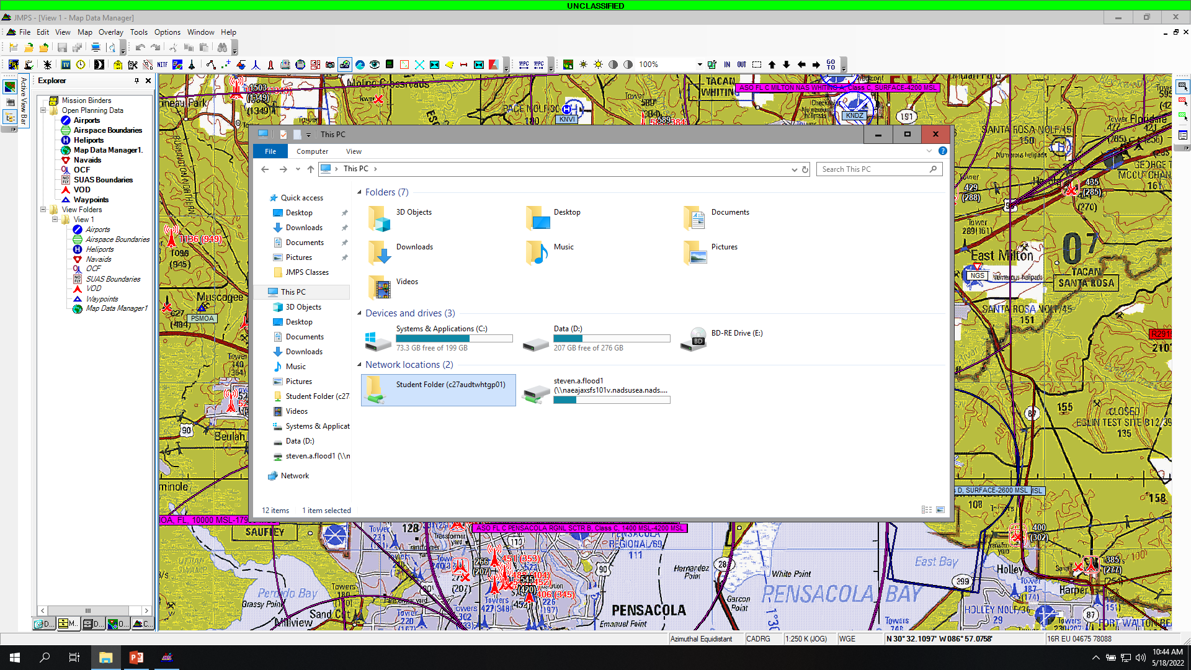
Select Files
Select Student Folder

Slide 36
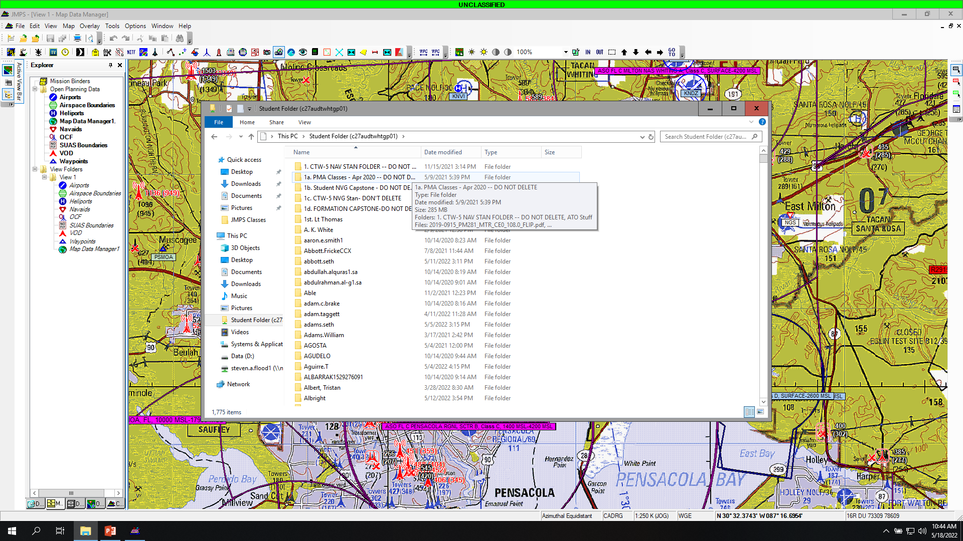
Select CTW-5 NAV STAN FOLDER

Slide 37
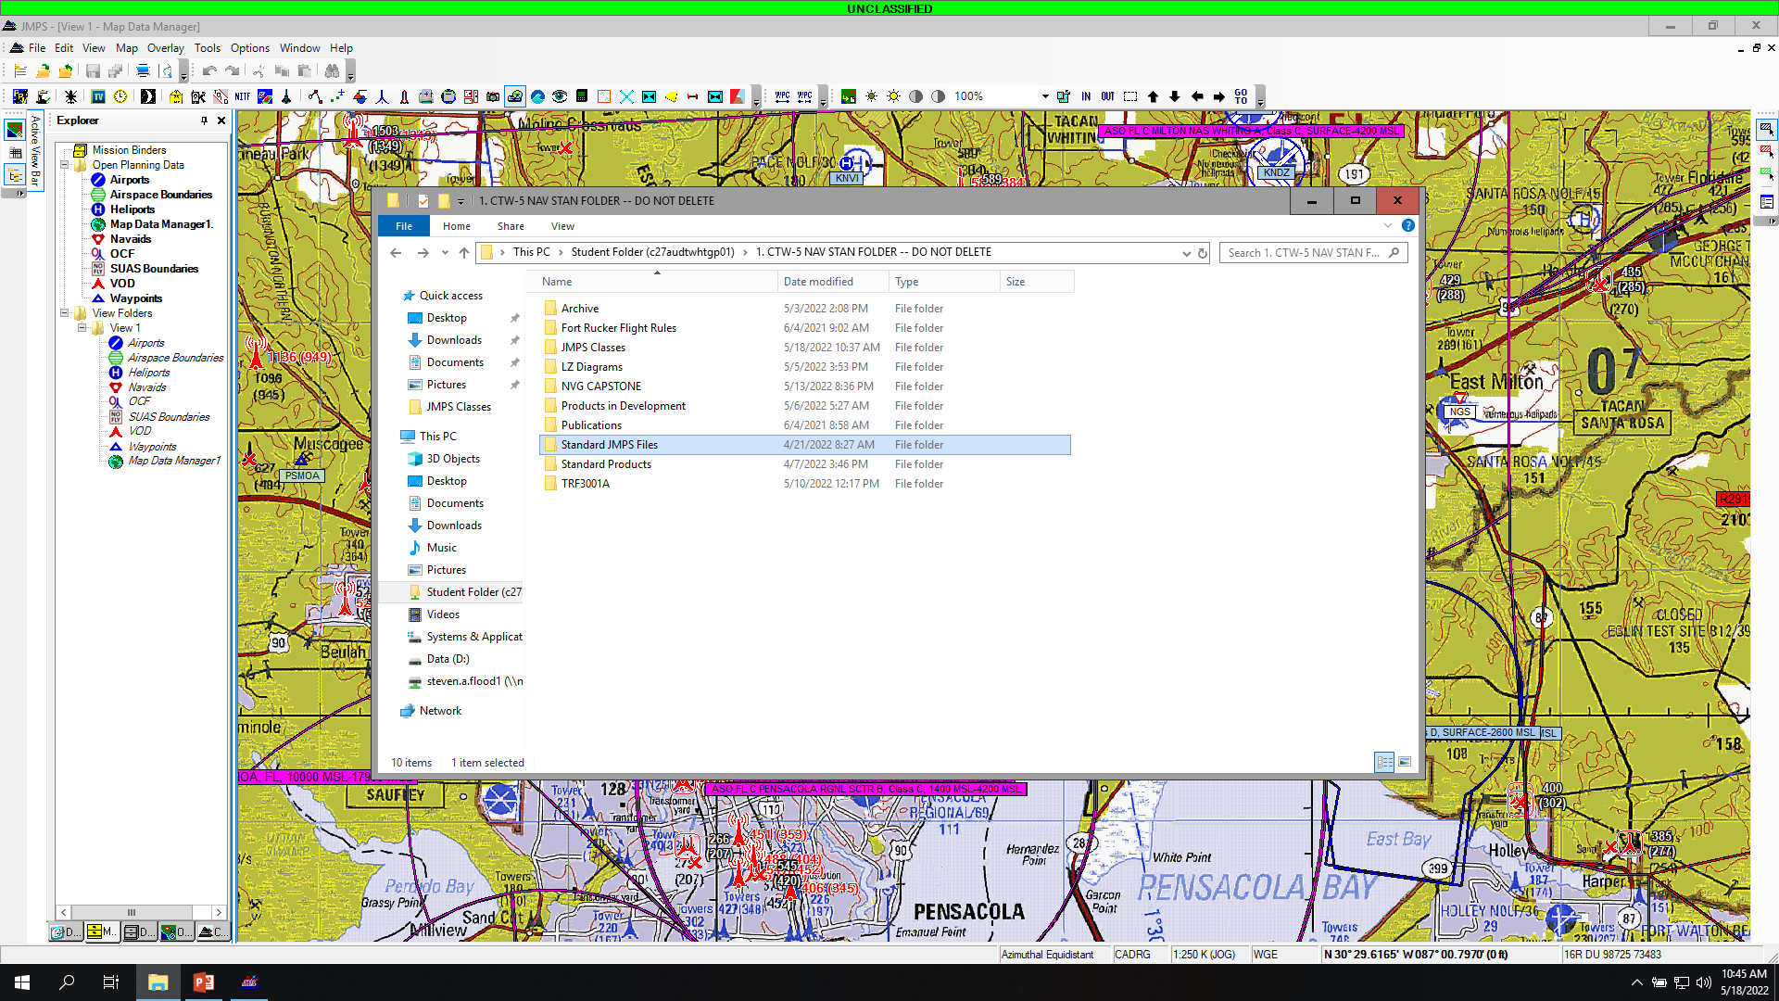
Select Standard JMPS Files

Slide 38
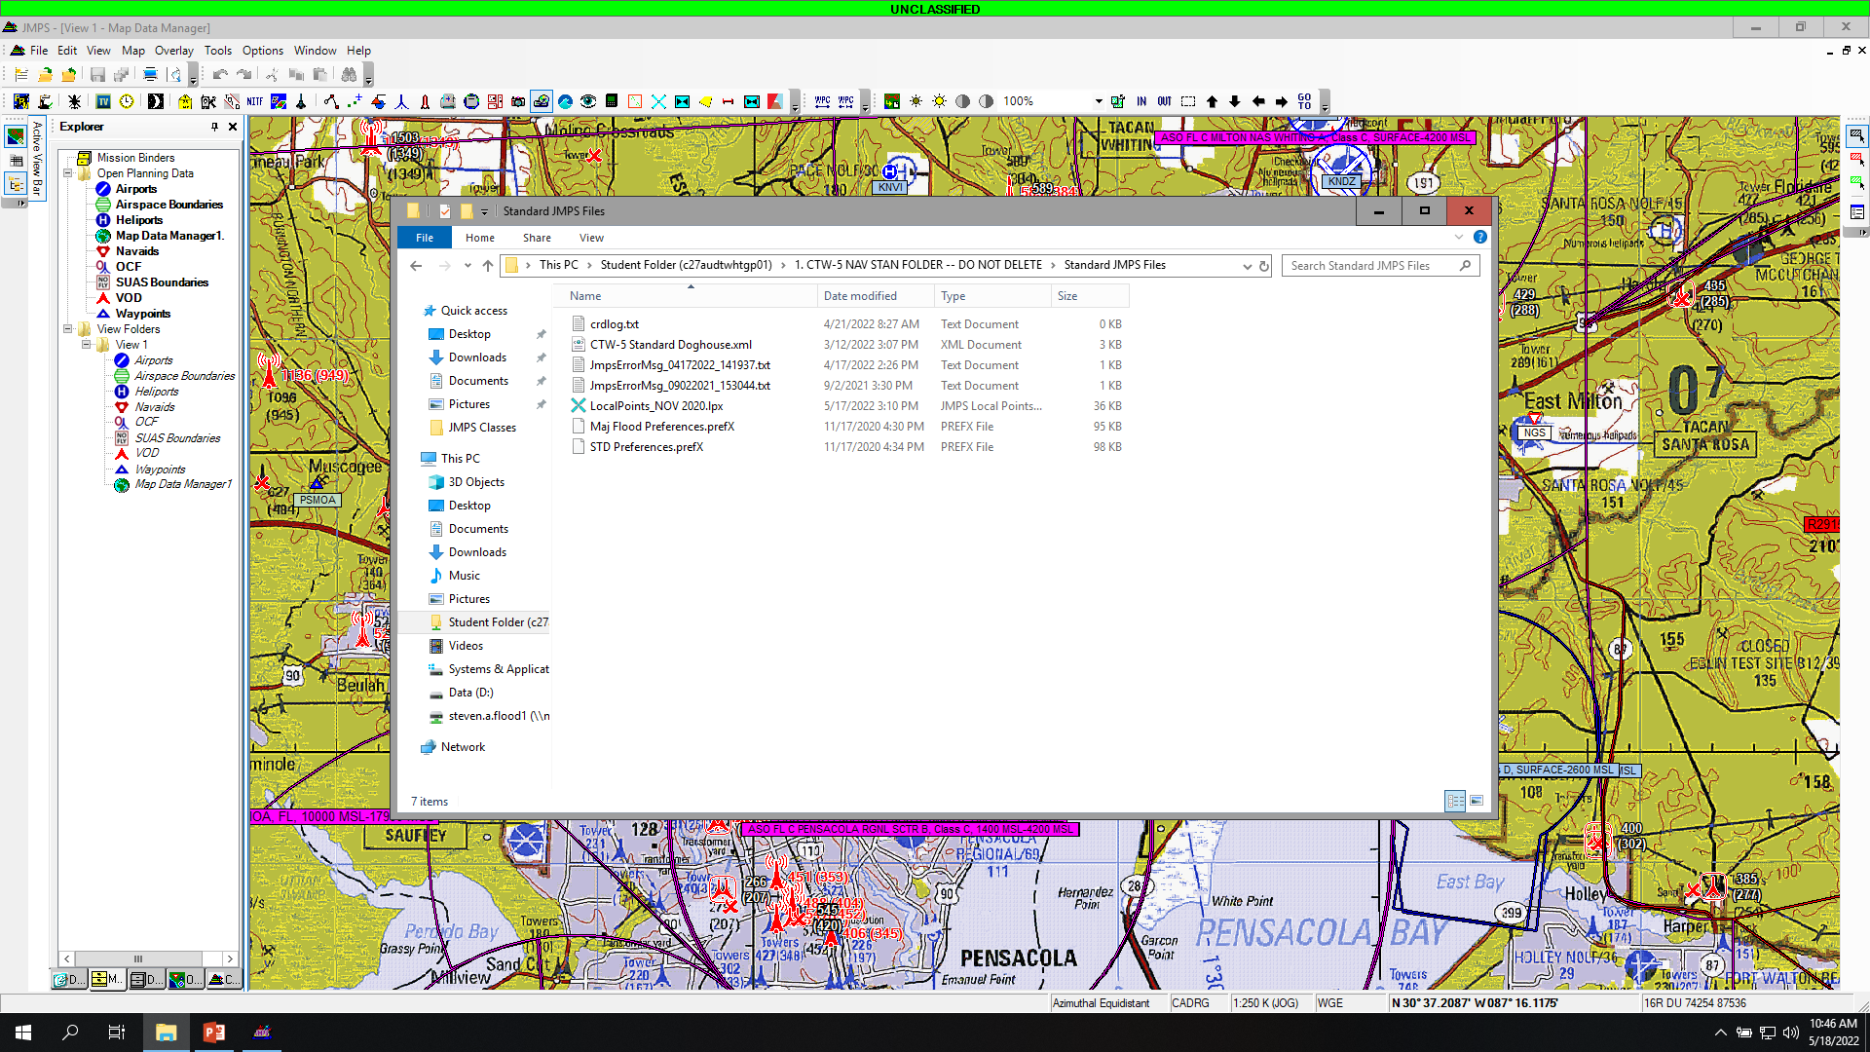

Slide 39

Select: LocalPoints_NOV2020.lpx
Drag and drop the file on the chart.

Slide 40
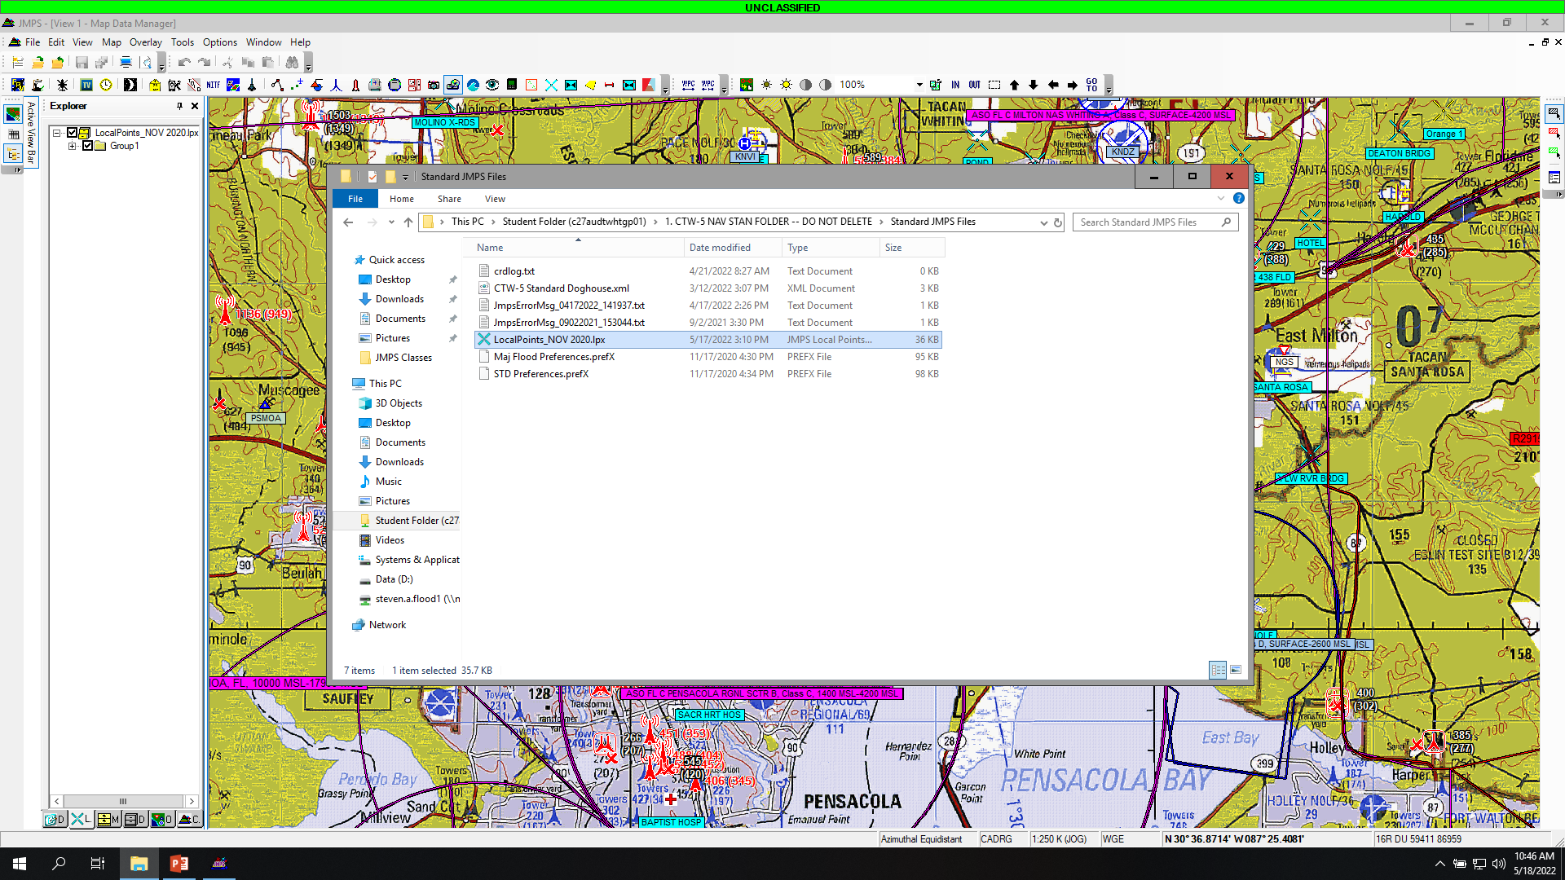
Points will populate.

Slide 41
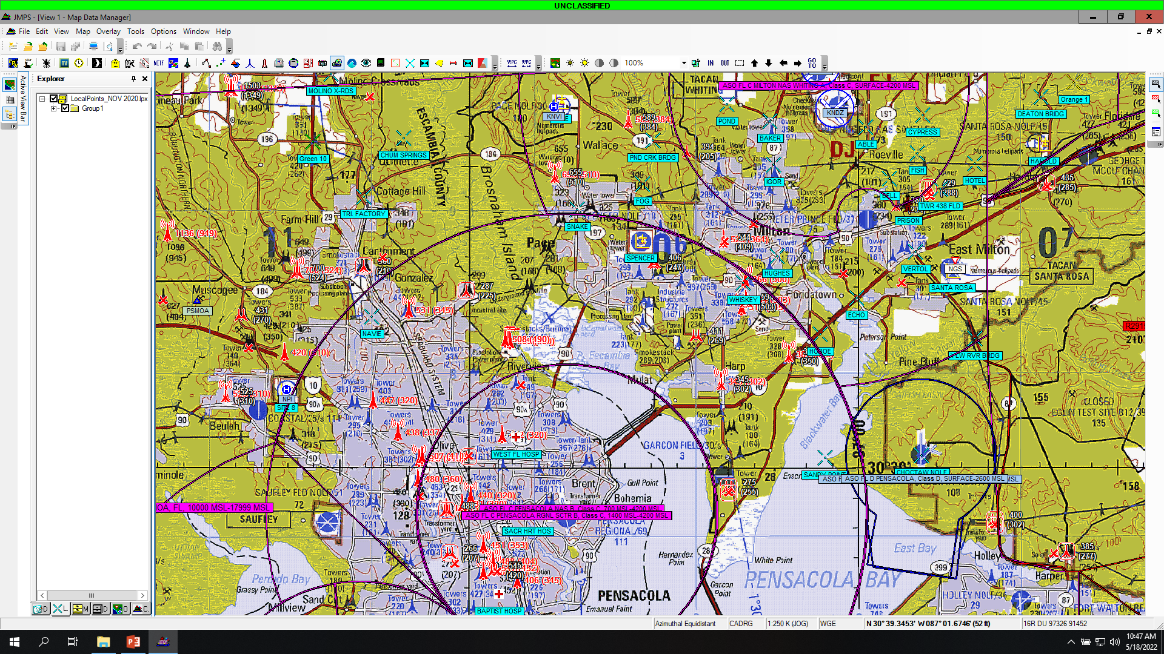
Points will populate.

Slide 42
Save Session Layout
Saving the session layout will save the preferences and system view for the next time you log into that JMPS computer.
Go to “File”
Select “Save Session Layout”

Slide 43
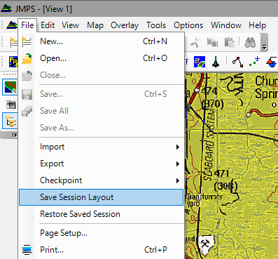

Slide 44
Setting up a Route
Overview: starting a new route, using route editor,

Slide 45
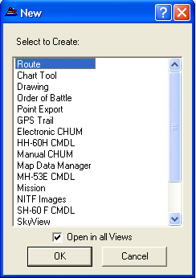
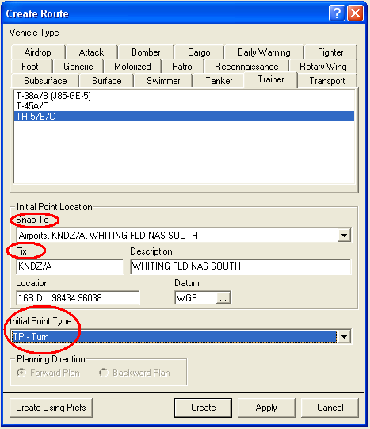
Creating a New Route
Select “File” then “New” then “Route”
Select “Trainer” tab and “TH-57B/C”
Snap To: None
  Will automatically fill with location provided in “Fix”
Fix: KNDZ (Or airport of origin)
Initial Point Type: TP (Turn)
Create

Slide 46
Training Squadron Routes
For your Low Level, Formation and NVG navigation flights, you will need to plan your Route WITH Course Rules.
  Include a copy of this route in your Smart Pack.
  Also Include a copy of your BINGO route in the Smart Pack.

Slide 47
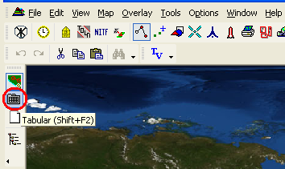
Creating a New Route (cont’d)
Select Tabular display
  Left column, second icon
  or
  Shift + F2

Slide 48
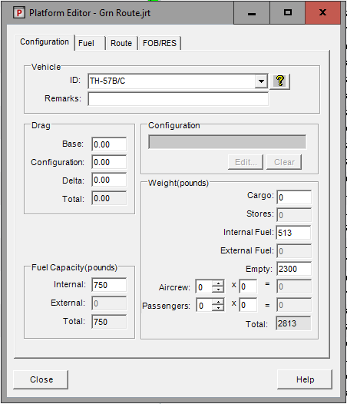
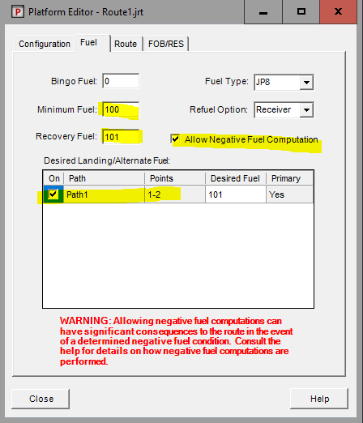
Creating a New Route (cont’d)
Click on “Platform Editor”
  “Weight- Empty” = 2300
Fuel Tab
  “Allow Negative Fuel Computation” = check Configuration tab
  Min Fuel=100, Desired Landing fuel=101
  Select which path in the “Desired Landing/Alternate Path”.*
Platform Editor
*Will not be available until after you have added more than 1 point to your route.

Slide 49
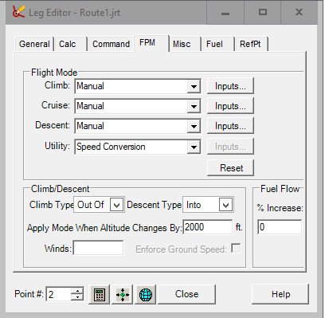
Creating a New Route (cont’d)
Leg Editor; FMP
Click on “Leg Editor” in tabular view
  FMP Tab
  Ensure Manual selected for Climb/Cruise/Descent
  Verify input of Climb:325, Cruise:280, Descent:240
*Will not be available until after you have added more than 1 point to your route.

Slide 50
Building TFR 4001 Route In JMPS
Overview: Use local points to plan route from KNDZ to CP5 of the Green route via course rules. Include instruction of how to program an orbit delay at KNSX. (~20 minutes)

Slide 51
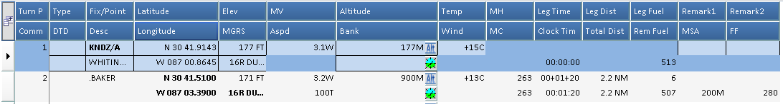
Leg Editor
Permits changing any parameter on segments of the profile
Individual values may be changed by highlighting a cell on the tabular display and entering data
General
  Departure Field- enter ICAO ID
    Lat. / Long. Is provided in D/M/S format
  Bank Angle- Blank = Zero. Do this for all points!

Slide 52
Entering Points with the Tabular Editor
(lat./long. Coordinates)
Left Click or Arrow Down to enter next point
Highlight & enter next fix
Use local points to plan the route.
Coordinates for Course Rules are on A-5 of RWOP
Coordinates for Low Level routes are on page A-7 of RWOP
**JMPS will automatically change a Lat./Long coordinate to the D/M/S format

Slide 53
Entering Points with Graphical Editor
Select Graphical Editor button
  Top button, left hand side
      or
  Shift = F2
Scale the chart as desired using the wheel on the mouse
To add points, ensure Turn Point tool is selected
To move map, ensure the Select tool is selected
Graphical Editor
Turn Point Tool
Select Tool

Slide 54
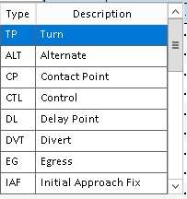
Point Types
Choose point Type from drop-down menu located on top leftmost box of each point
Turn
  Used for most points
Orbit
  Used for patter practice at OLFS
  Time is adjustable
    Typically 20 minutes

Slide 55
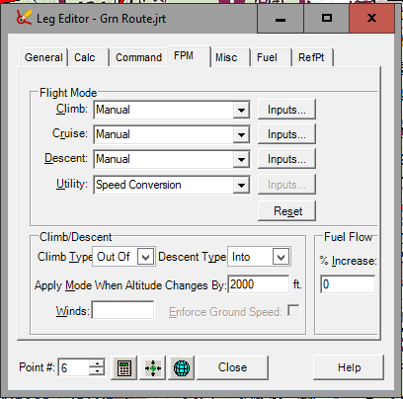
Airspeed Adjustment
Go to the Tabular Editor (Shift + F2)
Highlight the second point on route
Click on the “Route Point” dropdown menu at the top of the screen
Select “Leg Editor”
Select “FPM” Tab
  Climb = Manual
  Cruise = Manual
  Descent = Manual
Close
If the change in altitude between two points (i.e. CP 2 and CP3) exceeds this number, either the ‘Climb’ or ‘Descent’ modes will be enabled.

Slide 56
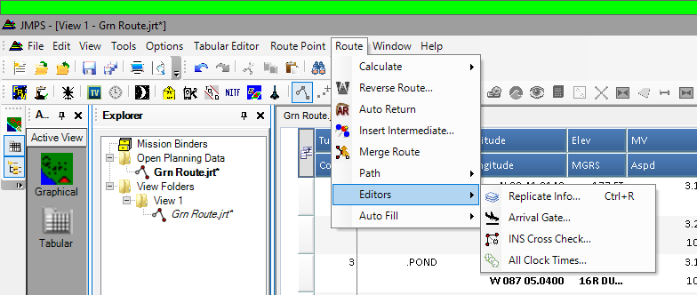
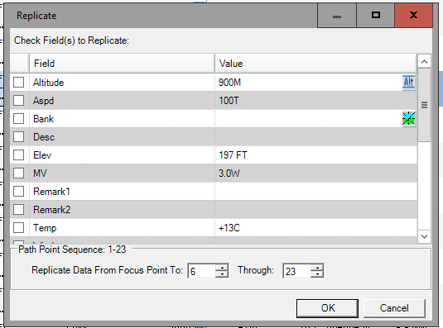
Airspeed Adjustment (cont’d)
Keep the second point highlighted
Click on the “Route” dropdown menu at the top of the screen
Select “Replicate Info”
De-Select any data checkboxes that you do not wish to replicate.
Scroll down to “Flight Modes” and check the box
  This will allow you to adjust airspeed of each leg
    Course Rules = 100T
    Low Level Routes = 90G
    Formation Routes =100G
Select all points and “OK”

Slide 57
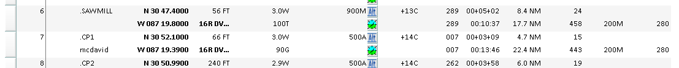
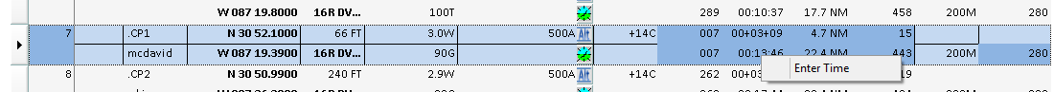
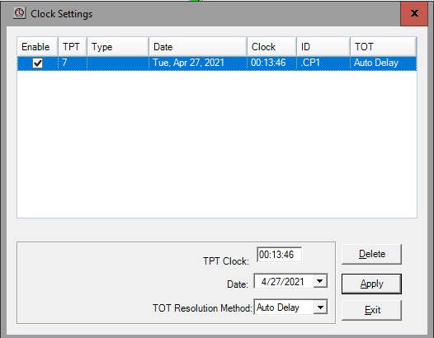
Setting Route Start Time
Right click on the lower time (‘Clock Time’)
Click ‘Enter Time’
Enter time as ‘00:00:00’
Note: This is actually telling the system to set your arrival time at that point as midnight (local or Zulu, depending on JMPS preference settings).

Slide 58
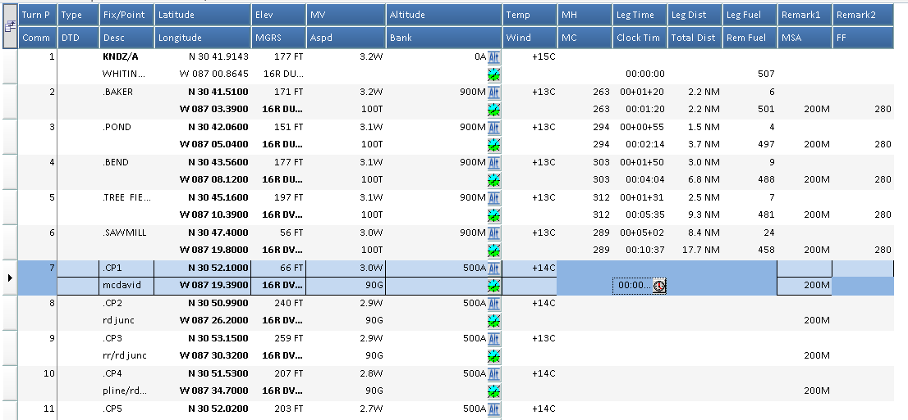
Setting Route Start Time
If adjusting this time after calculating,
you will have to recalculate your route after setting this time (because JMPS and stuff).

Slide 59
Fuel Calculations
Fuel is listed without the decimal point (e.g. 550=55.0 gallons)
Default fuel is 750 (75.0 gallons)
Once route is completed press the “Calculate” button to determine fuel burn
Calculate Button

Slide 60
Fuel Calculations (cont’d)
Determining Mission Fuel
  Method 1 - Manual
    Determine fuel remaining at the completion of the route
    Adjust “Internal Fuel” in “Platform Editor” to make fuel remaining at the end of the route = 101 (minimum fuel
      100 = 10.0 = NATOPS limit
    Mission fuel will be the amount of “Internal Fuel” that yields minimum fuel
    Round up to the nearest gallon
      i.e. 451 = 45.1 = 46 gallons
  Method 2 – Let JMPS do it…
    Select the appropriate ‘Path’ (most likely Path 1) in the ‘Desired Landing/Alternate Path’ of the ‘Internal Fuel’ tab of the ‘Platform Editor’
  Re-Calculate
c

Slide 61
Fuel Calculations (cont’d)
    The last checkpoint should have ’101’ in the ‘fuel’ field.
  Note
    An ‘error’ will pop up.
    READ IT!!!!
    It should be telling you that the starting fuel was adjusted to match the desired landing fuel.
    If it is a different error, inform your instructor.
      You may need to close JMPS out and restart the program if you are planning on your own.

Slide 62
Fuel Calculations (cont’d)
BINGO fuel
  May calculate with JOGAIR and estimate fuel requirement using
    30 lbs. / hr.
    115KIAS
    or
  Plan a new route with JMPS from the furthest point in the route back to NDZ via Course Rules
    Use the procedures outline to adjust “Internal Fuel” to yield 101 at the end of the route
    This number in “Internal Fuel” is BINGO fuel
    191 = 19.1 = 20 gallons

Slide 63
Route Card Preparation
Overview: Demonstrate how to make changes to the route card (i.e. name, dates, aircraft and location, planned hover torques). Show how to print route cards. (~10 minutes)

Slide 64
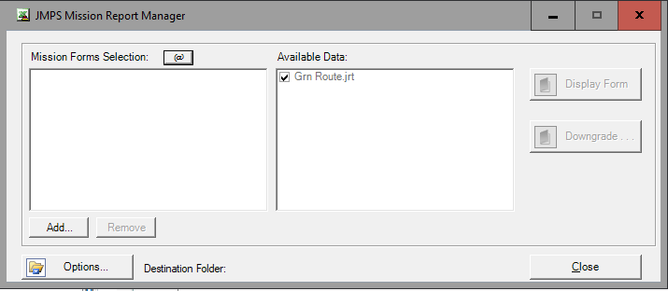
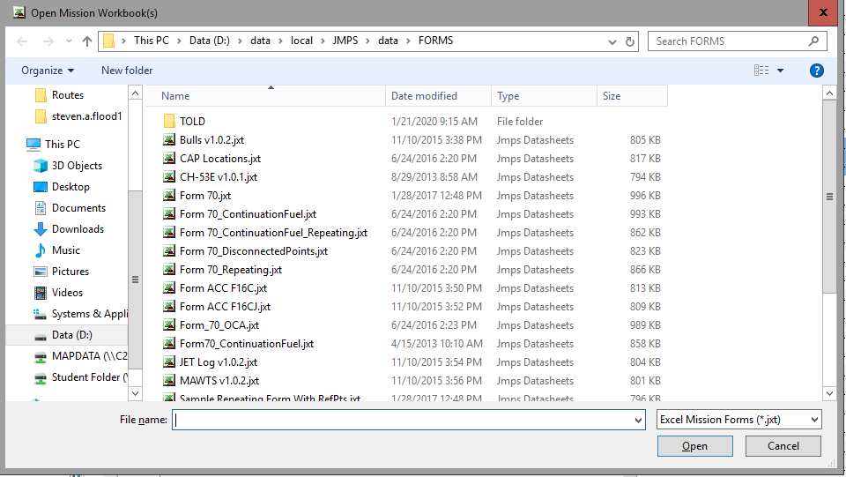
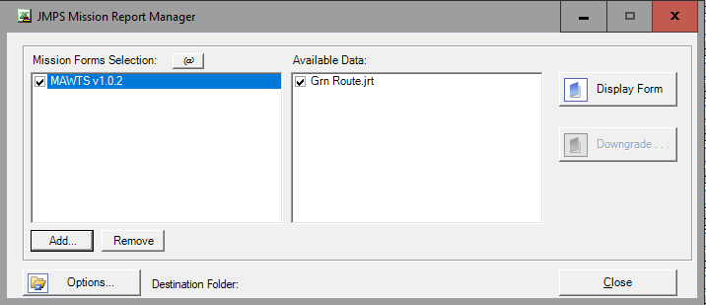
Printing Route Cards
Click “File” then “Print”
A box with different ‘Available Data’ will pop up.
Ensure your route has the box checked next to it.
Select the ‘form’ you desire by clicking ‘Add…’
  A window will pop-up
Select ‘MAWTS v1.0.2.jxt’
Click “Open”
Ensure the proper route is selected in the next window, JMPS will default to printing the first
Select ‘Display Form’
Computer will now appear to be self-destructing. It is not.
Please wait and be patient.

Slide 65
Understanding the Route Cards
Route Cards will open in Microsoft Excel once you press print in JMPS
The Route cards in Excel will change to not include the dates once you print from Excel
Print two copies
  One for you
  One for instructor

Slide 66
Understanding the Route Cards
Route Time (e.x. CP1-CP10) =
  Time elapsed by CP1 – Time elapsed by CP10

Slide 67
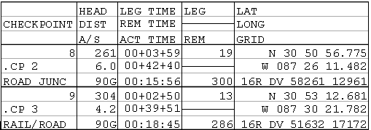




Doghouses

Slide 68

Doghouses (if CTW 5 template doesn’t exist)

Slide 69


Doghouses
1.) Click ‘Doghouse Template Editor
2.) Click ‘Import Templates from File’
3.) Select ‘CTW-5 Standard Doghouse’
4.) Select Open
v

Slide 70




1.) Click ‘Route Properties’
2.) Select the ‘Doghouses’ tab.
3.) Select the ‘Doghouses’ tab.
4.) Select ‘CTW 5 Doghouse’
5.) Click ‘OK’, then ‘Apply’, then ‘OK’ on the open windows.
**Ensure the ‘Doghouse(s) on’ box is selected.

Slide 71

Doghouses
Right-click on the doghouse and select ‘Hide Doghouse’ to remove the doghouse from view.
If you accidentally remove the wrong one, Ctrl+Z works.

Slide 72
SLAP Data And Vertical Obstruction Analysis
Overview: Demonstrate how to retrieve SLAP data at KNDZ. Demonstrate how to conduct vertical obstruction analysis for route.(~15 minutes)

Slide 73
Obtaining Slap Data
Will be used in the NVG syllabus.

Slide 74

STEP 1
Select the SUMO Tool

Slide 75

STEP 2
Find NAS Whiting Fld SUMO Point (YELLOW CIRCLE)
Right Click
Select NAS Whiting Fld Properties

Slide 76

STEP 3
Select ‘Calculate Using Longitude’
Or…
Select appropriate time zone
Click “Apply”
Click “OK”

Slide 77

STEP 4
Go to the Tabular Editor
Select Location to “NAS Whiting Fld”
Enter “Start Time,” “Stop Time,” and “Time on Target,” as desired
The times from ‘Start’ to ‘End’ WILL ROLL OVER to the next day.
  Verified using the SLRS tool.

Slide 78


STEP 5
Select LEAA
Select Print

Slide 79


STEP 6
Select LDI
Select Print

Slide 80
NOTES
A SUMO Point can be added by:
  Switching to the Graphical view
  Selecting the ‘Moon’ (yellow circle) on the top right
  Clicking on the desired location
  Right clicking on the newly dropped ‘Moon’
  Selecting ‘SUMO-Data point XX Properties…’
  Rename the data point to something that makes sense.
  Adjust parameters for when you want to pull the data for as previously discussed.

Slide 81
Conducting Vertical analysis of your route.
Gives analysis of highest obstacles within 1 mile of the route.

Slide 82

Select vertical profile tool.

Slide 83

Wait patiently for the system to conduct analysis of the route.

Slide 84

Ensure this is adjusted to 1 mile.

Slide 85
Chart Preparation Through CP 5
Overview: Have four copies of a properly prepared chart to show the students what “right looks like”. Discuss “smart” doghouse placement as to not cover key map data, identifying key terrain features, and navigational techniques throughout the route. (~30 minutes)

Slide 86
Recommended Equipment
Charts/Maps
Straight edge
Protractor (capable of identifying grid locations)
Stencil (capable of making doghouses, circles, triangles)
Transparent Tape
Scissors
Ultrafine tip Marker (red)
Fine Tip Marker (red, blue and black)

Slide 87
Building your charts
Step 1. Tape the charts/maps together using scotch tape.
JOG-A (1:250,000) - Ensure Lat/Long and terrain features are aligned properly.
1:50,000 TLM - Ensure the gridlines and terrain features are aligned to the max extent possible.
NOTE
Due to differences in the publish dates of the maps, there can be some slight feature misalignment even when the Lat/Long or gridlines are properly aligned. When this occurs, the priority should be with lat/long or gridline alignment.

Slide 88


Building your charts continued…
Step 2. Chum all the obstacles on the chart using ultrafine tip red marker.
Towers shall be marked in fine tip red marker with the elevation in feet AGL at the base.
Power lines shall be marked with in fine tip red marker.
***Use the Chart Updating Manual (CHUM), JMPS, VFR Sectional, JOG-A, and local instructions to update obstacles not that are not printed on the charts/maps.***

Slide 89

Building your charts continued…
Where to find CHUM?
  The AP/1B

Slide 90


Building your charts continued…
Step 3. Plot the airspaces on the chart/map.
Airspaces (Class “C”) shall be marked in fine tip blue marker designating the boundaries of the airspace.
Prohibited Areas, Restricted Areas, and No-Fly Areas shall be marked in fine tip red marker designating the boundaries of the airspace with parallel lines through the middle of the airspace.

Slide 91
Building your charts continued…
Step 4. Cut excess areas from charts/maps.
The chart/map should be cut to a manageable size, but not so small that important details are lost.
A good rule of thumb for the topographic line maps is to keep six grid squares as a border between the checkpoints and the edge of the map. The six grid squares provide 3.6 miles of important terrain/manmade features that could assist in navigation if disoriented. Also, if the grid numbers are listed within +/- one grid, the grid numbers should be kept to assist with navigation. For JOG-A charts, leave enough map area for navigation and for orientation.
Additionally, the chart should be cut in order to leave the grid numbers and lat/long information on the side of the chart. If doing so makes chart/map size untenable, then the margin data should be written in using black marker.

Slide 92

Building your charts continued…
Step 5. Place marginal information on the chart.

Slide 93

Building your charts continued…
Step 6. Place chart/map type, scale, route (if applicable), name, and date on the chart.
Do not cover up important terrain features. Over water is a good place to write this information, if able. If lamination is available, this information should be under the lamination.

Slide 94
Building your charts continued…
Step 7. Use Joint Mission Planning System (JMPS) to plan entire route of flight. Routes shall be planned using course rules from KNDZ or VFR departures from locations other than KNDZ or as directed by the IP. Airspeed for course rules shall in IAW RWOP. Airspeed on the navigation route shall be planned for 90 KTS ground speed. Twenty minutes of DLAs shall be planned at the LZ as applicable.

Slide 95
Building your charts continued…
Step 8. Place the route CPs and LZs on the chart/map. Plot CP’s with the protractor and mark them with a circle. Route CPs are marked with a circle about the size of a nickel using a fine tip black marker. Course rules CPs are marked with a smaller circle about the size of a dime using a fine tip black marker. LZs shall be marked with a triangle using a fine tip black marker. The size of the triangle should be approximately the same size of the route CP circles.

Slide 96

Building your charts continued…
Step 9. Connect the CPs with a single black line using a straight edge drawn from one CP to next CP as depicted below.

Slide 97
Building your charts continued…
Step 10. Label the CPs. Route CPs shall be labeled using the number of the CP and include brief description.
Step 11. Laminate (If available, not a requirement).

Slide 98

Building your charts continued…
Step 12. Place map changeover points (MCPs) and LZs on the chart/map as required. MCPs are marked with a square about the size of a quarter using a fine tip black marker with the letters “MCP.”
LZs should be labeled LZ “name of the OLF or airfield,” i.e., “LZ Bay Minette” or “LZ Harold.”
Mileage tic marks may be used to assist in range estimation while traveling along route. Reference page 1-16 of P-428 Navigation FTI for more detailed instruction.

Slide 99

Building your charts continued…
Step 13. Place doghouses on the chart. Doghouses should not be used for course rules to the route, only on the route itself. Place the doghouses between the appropriate checkpoints but be careful not to cover important features. Doghouses shall contain magnetic heading, distance between CPs, leg time, total time, fuel state and reverse magnetic heading. Grid magnetic angle must be converted to magnetic headings for the course. Use a fine tip black marker.

Slide 100
Briefing Space Set Up Techniques
Overview: Discuss techniques for briefing space layout, chart and podium placement, facing the audience, use of pointer, etc. (~5 minutes)

Slide 101

Briefing Space Set Up Techniques
Things you WILL need:
Applicable JOG or 1:50K map
LZ Diagram
Smart Pack to include:
  Coversheet
  JMPS Route
  JMPS BINGO Route
  LZ Diagram
Low Level Briefing Guide (IAW FTI)
TW5 TRF Debriefing Card

Slide 102
Wall Layout
Map
LZ Diagram
Podium
Techniques:
Don’t stand between map and the audience. (they need to see the map…)
Position your self to audience right of the board if you are right handed to keep from briefing across your body. (See pic for example)
Put the pointer down if not actively using it.
Be confident. Don’t use filler words such as “Um”, “Uh”, and “Like”.
Rehearse. Rehearse. Rehearse.

Slide 103
Navigation Emphasis
Green: Emphasis on aim points, limiting features, funneling features, and intermediate checkpoint. Designed to show how good checkpoint selection gives you multiple ways to identify CP’s.
Orange: Emphasis on funneling and limiting features. Designed to demonstrate how utilizing funneling and limiting features aid in navigation. Most CPs are good ground force CPs but are harder to identify from the air due to lack of aim points. Finding and utilizing funneling features will be key.
Purple: Emphasis on terrain, contours, and limiting features. Designed to show how at low altitude, terrain is easier to distinguish.

Slide 104
IP Demo Of Green Route Through Check Point 5
Overview: Brief the Green Route through CP5, including administrative data, and SWEEP checks for KNSX. (~20 minutes)

Slide 105
Mission Briefing Procedures
All operational missions are preceded with a mission brief. The brief can range from a very simple, short discussion to a complex multimedia presentation involving several different aircraft, combat elements and supporting elements
The format of the brief is the OSMEAC Format (Orientation, Situation, Mission, Execution, Administration and Logistics, Command and Signal). The Formation and Night Tactical Stages will use a similar, but more extensive, form of this brief
The briefing card (Figure 1-10) shall be used when briefing the Low-Level Navigation flights. The information does not need to be memorized word for word, but needs to be presented in the order below. The SNA can use the briefing guide as an aid during the brief but shall not read from a script.

Slide 106


Slide 107
Instructor Briefing Guide TRF4001A
ORIENTATION
“Attention to brief, I am ____________. This will be a N4301 brief. Please hold all questions to the end.”
1. Time hack:
“In one minute (ensure at least 30 sec) the time will be ____. In 30 seconds the time will be…..In 15 seconds the time will be….5,4,3,2,1 Hack, 1,2,3. Does anyone require a new time hack?
(If yes, then repeat. Naval Observatory Master Clock (202) 762-1401.)
2. Aircraft Assignment:
“We will be in aircraft ___ on spot ___.”
3. Smart Card:
“Smart pack inventory is as follows; page one is the coversheet, page two….etc. The following pen and ink changes have been made to the smart pack…..”
4. Maps required:
“Today we will be using the JOG AIR 1:250,000 chart.”
(For subsequent events that require two or more charts, they shall be identified)
5. Weather:
“The current wx is ____________.”
“ The forecasted wx is _________.”
“The required wx for the flight is 600-1.”

Slide 108
Instructor Briefing Guide TRF4001A Cont’d
SITUATION
“Not applicable for today’s flight.”
MISSION
“Today’s mission is the safe completion of a TRF4001A.”
EXECUTION
1. Concept of Operations (Big Picture):
“We will depart out of South Whiting field via course rules to the west, execute the Green route forward, TLAs at Site 8, then course rules
back inbound to South Whiting.”
2. Boundaries:
“The Western Operating Area is bounded to the east by the Escambia river, to the North by hwy 31, to the west by hwy 59 and to the south by I-10.”
3. Obstacles:
Aircraft: “There will be multiple military aircraft as well as civilian traffic in the Western Operating Area. We will primarily deconflict via see and avoid and utilizing a good VFR scan. We will use radio calls as required to deconflict with other TH-57s.”
Birds: “If we encounter birds along the route we will utilize the see and avoid principle and maneuver as necessary to avoid hitting birds.”
Airspace: “There is multiple Class-C airspace to the east and south of our route. All Class C airspace have an inner core of 5 nm up to 4200’ msl and an upper shelf that extends to 10 nm from 1400’-4200’ msl. We will deconflict Class-C airspace by utilizing course rules and appropriate squawks in and out of South Whiting airspace, and utilize our boundaries and limiting features to remain clear of all other Class C airspace.”
Towers: “All towers will be briefed in feet AGL. Throughout the route there are towers that range from 200’ to 2000’. Of significant concern is near checkpoint one there are 2 towers at 220’ and 350’. Just west of checkpoints 5 and 6 are a group of towers between 230’ and 320’.

Slide 109
Instructor Briefing Guide TRF4001A Cont’d
Restricted Areas: No restricted areas exist around the Western Operating Area. However, there is a TW-5 no fly zone within 1 nm radius located around the Alpaca farm in the vicinity of the 1400’ tower north east of checkpoint 9. There is also a TW-5 no fly zone over Steelwood lake and between checkpoints 7 and 8 around the ostrich farm.
Power lines: There are multiple sets of power lines throughout the Western Operating Area. We will be deconflicted with power lines via a 500’ route altitude. However, if we need to descend for any reason or are unsure of the height of the power lines, then we will ensure to cross as the stanchions.

Slide 110
Instructor Briefing Guide TRF4001A Cont’d
SCHEME OF MANEUVER
1. “Preflight will be conducted at T minus 30 minutes.”
2. “Turn-up will be conducted at T minus 15 minutes.”
3. “ Taxi for takeoff at T minus 5 minutes.”
4. “Crossing the hold short execute the 4 T’s, and takeoff at time T.”
{Cover the course rules, squawks and map changeover points (if applicable). Include airspeed, altitudes, and comms and xponder codes. Cover the route from beginning to end mentioning all heading and airspeed changes timing, limiting/funneling features and intermediate checkpoints.}
Enroute:
T/O TO PT BAKER:
“We will depart the appropriate spot in use, climb to 900’ MSL and accelerate to 100kts squawking 0100 enroute to Point Baker. Point Baker is a water tower located at the intersection of HWY 87 and HWY 89.”
PT BAKER TO PT POND:
“At Pt Baker turn to the 2 o’clock position to parallel HWY 89 to Pt Pond.”
PT POND TO PT BEND:
“At Pt Pond we will change our UHF frequency to Btn 9 to monitor Pace, and change the squawk to 1200. From Pt Pond we will proceed to the 11 o’clock position with a backup heading of 290 to Pt Bend and intercept the unimproved road that diverges to the right side of the aircraft at the approximate 1 o’clock position.”
PT BEND TO TREE FIELD:
“ At Pt bend we will turn right to the 1 o’clock position, back up heading of 312 and fly over Tree Field at 900’ MSL. Also at Pt Bend PAC will make a call to Pace Traffic that we are clear to the North then switch to Btn 13 and tell Site X we are PT Bend for Tree field.

Slide 111
Instructor Briefing Guide TRF4001A Cont’d
TREE FIELD TO SAW MILL:
“At Tree Field we will turn to our 11 o’ clock position with a back up heading of 290. After crossing the western boundary of Tree Field we will contact Site X telling them we are clear to the west. We will then switch to Western Common on Btn 19 telling them we are Tree Field for Sawmill and set our squawk to 4777. Halfway through this leg we will cross the Escambia River, at which point we will begin our descent to 500’ AGL and set our RADALT to 300’.
SAWMILL TO CP 1:
“At Sawmill we will turn right to our 3 o’clock position and follow HWY 29 north with a back up heading of 003. At Sawmill the PAC will announce over Btn 19 we are Sawmill for Green CP 1. We will follow the North-South running railroad and cross over East- West running power lines halfway through the leg. CP 1 is defined by the T intersection of an East-West two lane road intersecting a North-South four lane divided hwy. There will be a 350’ AGL tower to the north-west of the intersection. Prior to hitting CP1, we will switch to Green Route Traffic on btn 14.
CP1 TO CP2:
“At CP1 we will turn left to the 10 o’clock position with a back up heading of 261. This leg is 6.1 nm and timing is 4+02. PAC will announce on Btn 14 ‘Lucky XXX CP1 for CP2 green route forward.’ We will cross a north/south running power lines at 1+30 with a 221’ AGL tower 1 nm south of our route. At 2+30 we should be over an intersection of two creeks that converge to the North and to the South. CP 2 is defined as a Y intersection of a north-south hardball road and an southeast-northwest unimproved road. The unimproved road will be a funneling feature and the hardball road along with timing will be our limiting features.”
CP2 TO CP3:
“We will make a right turn to the 2 o’clock position with a back up heading of 303. A good aim point is the grain elevators located just east of CP3 This leg is 4.1 nm and timing is 2+46. PAC will announce on Btn 14 ‘Lucky XXX CP 2 for CP3 green route forward’. We will cross a north-south hardball road at 1+00. Another secondary road will come in at our 5 o’clock position and will be a funneling feature into CP3. We will see the Grain Elevators to the right of our course at 2+00. CP 3 is defined by a north-south running railroad and an east-west hard surfaced secondary road. Limiting features for this leg will be the railroad tracks and timing.”

Slide 112
Instructor Briefing Guide TRF4001A Cont’d
CP3 TO CP4:
“At CP 3 we will turn left to our 10 o’clock position with a back up heading of 249. This leg is 4.1 nm and timing is 2+49. PAC will announce on Btn 14 ‘Lucky XXX CP 3 for CP 4 green route forward’. Heading southwest we will pick up an east-west running underground pipeline cutout off our left side. At 2+00 we will cross over a north-south running creek. CP 4 is defined as that east-west running underground pipeline cutout intersecting with a north-south running hard surfaced 2 lane road.
CP4 TO CP5:
“At CP 4 we will we will make a slight right turn to our 1 o’clock position with a back up heading of 278. This leg is 6 nm and timing is 4+00. PAC will announce on Btn 14 ‘Lucky XXX CP 4 for CP 5 green route forward’. At 2+30 we will cross over a set of power lines running northwest-southeast. At 2+10 will pick up a 2-lane hard surfaced road off our right side heading south then turning west. This road will funnel us into CP 5. CP 5 is defined as that 2-lane hard surfaced road T intersection with HWY 112 running northwest-southeast. Our limiting feature will be a creek running parallel on the west side of the HWY.
Bingo CP:
“CP 5 is our bingo checkpoint. It is the farthest CP from South Whiting. From CP we require 22gal of fuel to fly 115KIAS at 700’ MSL direct to point SNAKE to pick up course rules into South Whiting.

Slide 113
Instructor Briefing Guide TRF4001A Cont’d
COORDINATING INSTRUCTIONS
1. Emergencies and system failures; SAME AS NATOPS BRIEF
2. IIMC; SAME AS NATOPS BRIEF
3. Disorientation Procedures: “If we become disoriented, we will climb in order to identify a known point, circle that known point until reoriented, or return to last known checkpoint and continue the flight.”
ADMIN AND LOGISTICS
1. Flight duration: “We will call outbound for 2+00.”
2. Fuel: “Mission fuel is ____”
“ Bingo fuel is____ from CP___ to ____ at ____ kts”
****Mission fuel: “Min fuel required to complete mission, (course rules, route, landings at LZ, and RTB) and land within NATOPS minimums. Recovery at a NOLF, KNDZ or other airfield is acceptable.
****Bingo fuel is calculated using max range airspeed to the closest point to obtain fuel while landing with no less than 10 gal.

Slide 114
Instructor Briefing Guide TRF4001A Cont’d
COMMAND AND SIGNAL
1. Call sign: LUCKY XXX
2. Communications: “Frequencies and navaids are as briefed and as per the coversheet of the smart pack.”
3. Lost Comms: “If we experience a complete radio failure, we will climb to a safe altitude and begin to troubleshoot. If unable to regain comms, we will maintain VMC, squawk 7600, and continue to make all calls in the blind while proceeding via course rules back to KNDZ. At Pt Igor we will enter the local pattern via lost comm procedures.”
4. ID and Recognition: “ Squawks and callsigns will be as previously briefed.”
Any Questions?

Slide 115

NOLF SITE X
LOCATION | N 30°48.91 / W 87°10.09
ELEVATION | 211 FEET MSL
SIZE | 1200 x 1200 METERS
COMPOSITION | GRASS, GRAVEL
OBSTACLES | 75-100’ TREES, PINNACLE, CRASH SHACK
CAL
PINNACLE
315
45
270
90
225
180
135
MAG VAR -2.1
CRASH SHACK
EGRESS 175°
TO TREE FIELD
PINNACLE
AGENCY | BTN | FREQ
SITE X | 13 | 327.400
WESTERN CMN | 19 | 311.400

Slide 116
IP Inspection Of Route Cards
Overview: QC each SNA’s route card to ensure completion IAW FTI through CP5. (~15 minutes)

Slide 117
Area Clean Up / Q&A
Overview: Ensure working space is clear of all chart prep materials. Be available to answer specific questions for SNAs. IPs shall be the last to leave the room. (~25 minutes)

