Slide 1
ADB SCREENING GUIDE
Standardization and Training Department

Slide 2
References
COMNAVAIRFORINST 4790.2D Naval Aviation Maintenance Program (NAMP)
HT-18 ADB Familiarization Guide

Slide 3
ADB Overview
Per CNAF M-3710.7 Series, each pilot in command (PIC) shall review a record of aircraft discrepancies and corrective actions for the 10 previous flights. As practice, SNAs also review the ADB at TW-5. Maintenance Control will maintain an ADB for each aircraft. It provides an accurate, comprehensive, and chronological record of flights and maintenance performed for at least the last 10 flights.
All outstanding discrepancies shall be displayed in the ADB for the aircrew to be aware of and will accurately reflect the status of all pending maintenance requirements. Maintenance control will evaluate the ADB for completed and outstanding Maintenance Action Forms (MAFs) before certifying the aircraft is safe for flight.

Slide 4
ADB Layout
OPNAV 4790/141 A-Sheet
Daily/Turnaround MX record
Engine Health Data – HIT checks
Engine Start Logs
Oil Consumption Record
Chip history
A-sheets and MAFs for 10 previous flights
Special Inspections
Technical Directives
Unrepaired Dents

Slide 5
Aircraft Inspection and Acceptance Sheet
Block 1
A/C BU/SERNO. Enter the BUNO of the aircraft

Slide 6
Aircraft Inspection and Acceptance Sheet
Block 2
T/M/S of aircraft
170138

Slide 7
Aircraft Inspection and Acceptance Sheet
Block 3
Reporting Custodian
170138
TH-57C

Slide 8
Aircraft Inspection and Acceptance Sheet
Block 4
Amount of Oxygen (N/A)
170138
TH-57C
CTW-5

Slide 9
Aircraft Inspection and Acceptance Sheet
Block 5
Fuel grade and quantity
TH-57
F-24
170138
TH-57C
CTW-5
N/A

Slide 10
Aircraft Inspection and Acceptance Sheet
Block 6
Oil added to each engine
TH-57:
1: ENG
2: XMSN
3: T/R
4: HYD
ENG XMSN T/R HYD
170138
TH-57C
CTW-5
N/A
F-24
70

Slide 11
Aircraft Inspection and Acceptance Sheet
Block 7
Today’s Julian Date
170138
TH-57C
CTW-5
N/A
F-24
70
N/A
0
0
0
0

Slide 12
Aircraft Inspection and Acceptance Sheet
Block 8
Ordnance/special equipment
170138
TH-57C
CTW-5
N/A
F-24
70
N/A
0
0
0
0
21262

Slide 13
Aircraft Inspection and Acceptance Sheet
Block 9
Signature of Plane Captain who inspected the aircraft
170138
TH-57C
CTW-5
N/A
F-24
70
N/A
0
0
0
0
21262
F. M. Maintainer
N/A

Slide 14
Aircraft Inspection and Acceptance Sheet
Block 10
Signature of Maintainer releasing the aircraft SAFE FOR FLIGHT (Reference the HT-18 ADB FAM GUIDE for requirements for this signature)
170138
TH-57C
CTW-5
N/A
F-24
70
N/A
0
0
0
0
21262
F. M. Maintainer
N/A
F. M. SFF

Slide 15
Aircraft Inspection and Acceptance Sheet
Block 11
Signature of PIC accepting Aircraft
1: Reviewed discrepancy reports of the previous 10 flights
2: Insured proper filing of the weight and balance data
3: Accept this aircraft for flight
170138
TH-57C
CTW-5
N/A
F-24
70
N/A
0
0
0
0
21262
F. M. Maintainer
N/A
F. M. SFF
F. M. PIC

Slide 16
Aircraft Inspection and Acceptance Sheet
Hotseat Note
Offgoing PIC will sign block 10, oncoming PIC will sign block 11
170138
TH-57C
CTW-5
N/A
70
0
21262
F-24
N/A
0
0
0
N/A
F. M. PIC #1
F. M. PIC #2

Slide 17
Aircraft Inspection and Acceptance Sheet
Dual Solo Hotseat
First Solo will sign 1st A-Sheet as PIC
170138
TH-57C
CTW-5
N/A
F-24
70
N/A
0
0
0
0
21262
F. M. Maintainer
N/A
F. M. SFF
F. M. Solo #1

Slide 18
Aircraft Inspection and Acceptance Sheet
Dual Solo Hotseat
First Solo will sign 2nd A-Sheet as Safe for Flight
Second Solo will sign 2nd A-Sheet as PIC
170138
TH-57C
CTW-5
N/A
F-24
70
N/A
0
0
0
0
21262
N/A
F.M. Solo #1
F. M. Solo #2

Slide 19
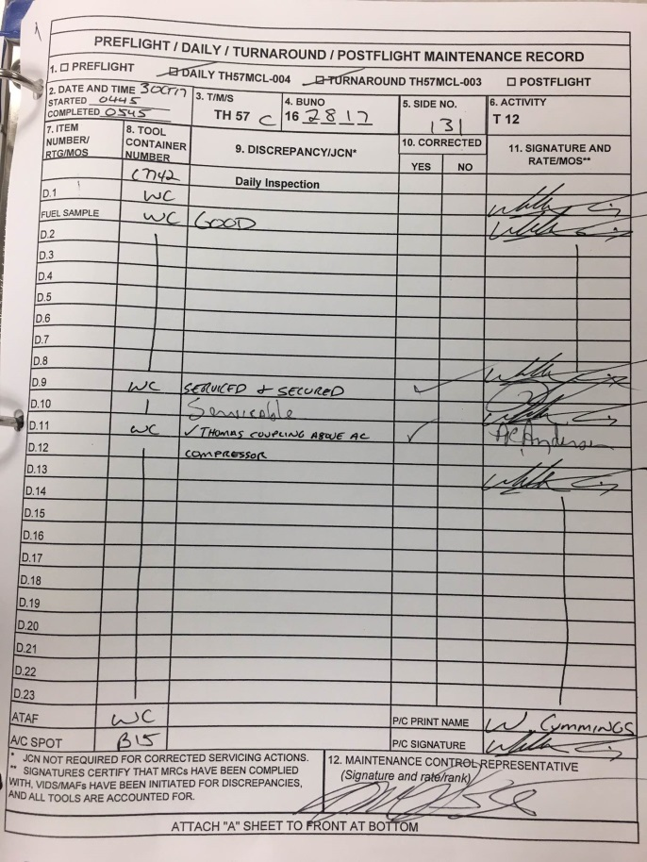
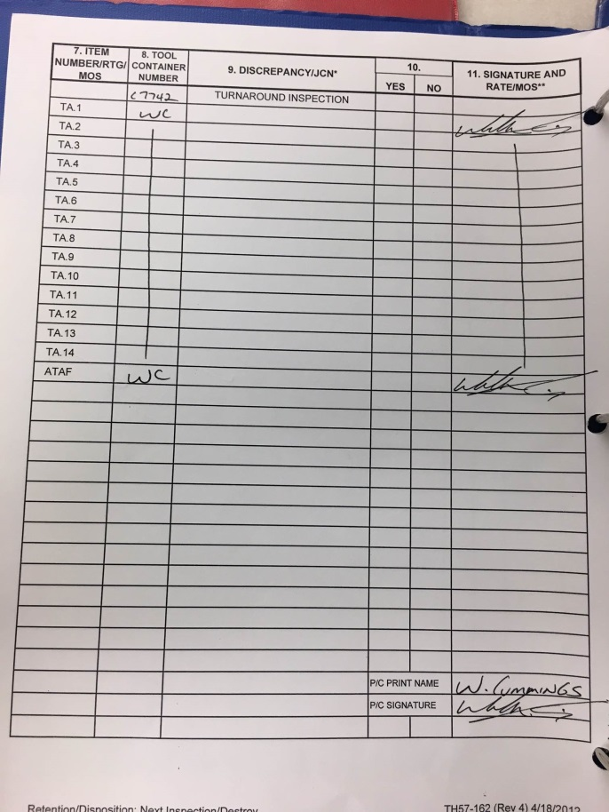
Daily/Turnaround Record
The turnaround and daily inspections are recorded and certified on the Maintenance Record (OPNAV 4790/38).
Block 1 – The type of inspection performed (Daily or Turnaround) is checked off.
Block 2 – DATE AND TIME. Date and time the inspection was performed.
Block 3 – Aircraft T/M/S inspected.
Block 4 – BUNO of aircraft inspected.
Block 5 – Side number of aircraft inspected.
Block 6 – Activity performing the inspection.
Block 7 – Pertains to maintenance checklist steps.

Slide 20
Daily/Turnaround Record
The turnaround and daily inspections are recorded and certified on the Maintenance Record (OPNAV 4790/38).
Block 8 – Tool container number, entered once, on the line where the using technician’s name first appears.
Block 9 – A brief narrative description of each discrepancy.
Block 10 – Checked YES if discrepancy in Block 9 is corrected; NO if discrepancy has not been corrected. If NO is checked, there must be a Job Control Number (JCN) in Block 9.
Block 11 – Signature and rate/MOS of the individual performing the inspection. A signature and rate or MOS must appear for each line entry.

Slide 21
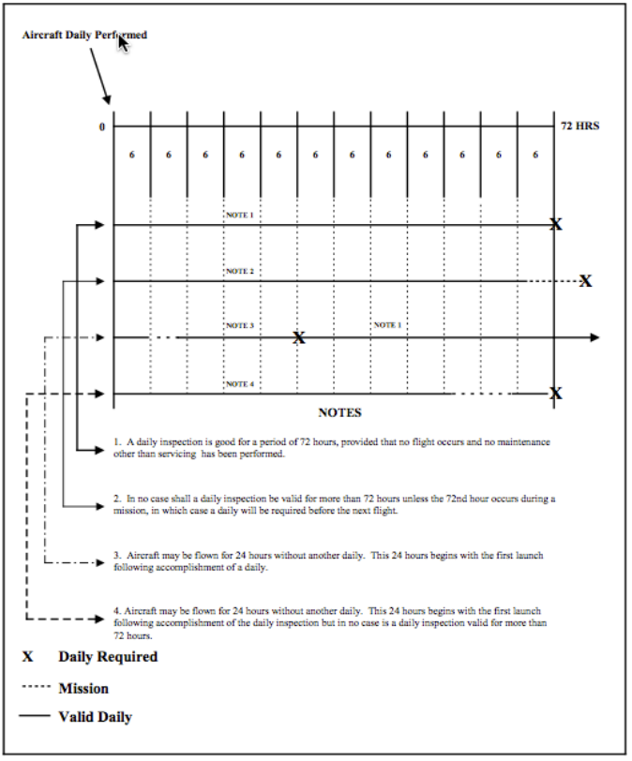
TURNAROUND INSPECTION
Performed between flights that occur after completion of the Daily Inspection. A Turnaround Inspection is conducted to detect material degradation that may have occurred during the previous flight, verify fluid consumption levels were within limits, and service the aircraft. (NAMP 5-35)
Turnaround Inspections are valid for a period of 24 hours commencing from the date and time the inspection is completed, provided no flight and no maintenance other than servicing occurs during this period (NAMP 5-35)

Slide 22
TURNAROUND INSPECTION
Once the aircraft is weight off wheels, the Turnaround Inspection is considered to be expired. (NAMP 5-35)
Completing a Daily Inspection does not satisfy Turnaround Inspection requirements (NAMP 5-35)
Accomplishment of a complete Turnaround Inspection is not required between repetitive flight evolutions interspersed with brief ground periods, such as Hot Seating, hot refueling, passenger or cargo stops, short interruptions for adjustments during helicopter FCFs, or if cold refueling the aircraft for immediate relaunch when the pilot in command remains the same. (NAMP 5-35)
When servicing or other minor maintenance is performed during such ground periods, only those portions of the Turnaround Inspection applicable to that servicing or maintenance need to be performed, as directed by Maintenance Control. (NAMP 5-35)

Slide 23
DAILY INSPECTION
The Daily Inspection is conducted to inspect for defects to a greater depth than the turnaround inspection. (NAMP 5-34)
Daily Inspections are valid for a maximum of 72 hours commencing from the date and time the inspection is completed, provided no maintenance other than servicing is performed and no flight occurs during the 72-hour period. (NAMP 5-34)
Once a flight occurs, the aircraft may make multiple flights within a 24-hour period without performing another Daily Inspection, provided no maintenance other than servicing is performed. (NAMP 5-34)
In no case is a Daily Inspection valid for more than 72 hours unless the end of the 72-hour period occurs while the aircraft is in flight. (NAMP 5-34)
CCX: When aircraft must be operated away from the local area without qualified maintenance support for periods not exceeding 72 hours, the CO may authorize the pilot-in-command to conduct applicable T/M/S NATOPS pilot inspections in lieu of Preflight, Daily, Turnaround and Postflight inspections, certify servicing requirements are accomplished, and sign the Aircraft Inspection and Acceptance in the certification block. (NAMP 5-34)

Slide 24
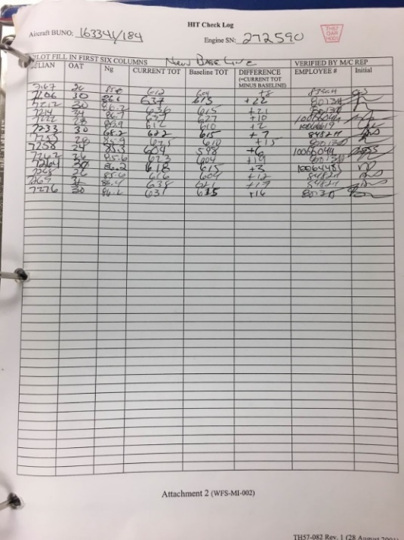
HIT CHECKS
Engine performance is determined by how “hot” the engine “burns” (TOT) for a given power setting compared against a baseline temperature. This difference is logged as a plus or minus from the baseline TOT. A negative number indicates that your engine is burning cooler than the baseline, thus performing well. A positive number indicates your engine is burning hotter than the baseline and may indicate engine degradation.
Maintenance action is required if the HIT check produces a onetime temperature difference of plus 40, or two consecutive HIT Checks producing a temperature difference of plus 25.

Slide 25
Engine Start Logs
This is used by Maintenance Control to track engine starts that are not logged on a NAVFLIR. Ensure the BUNO on this form matches your A/C.

Slide 26
Oil Consumption
The current working copy of the Engine/Gearbox Oil Consumption Record is maintained in the aircraft discrepancy book (ADB). Oil consumption is documented in the Engine/Gearbox Oil Consumption record in the quantity specified. This sheet will provide a summary of all oil added to your A/C.
Note the quantities and dates oil was added and look for trends. Oil usage rate is calculated by maintenance and the consumption limits are printed at the bottom of the page.

Slide 27
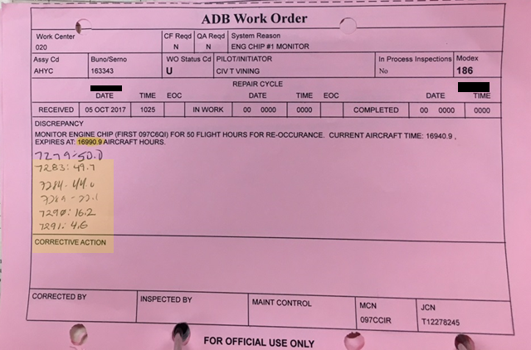
History of Chip Lights
These MAFs will only be present in the event of engine or transmission chips on previous flights that will affect follow on flights if another of the same type of chip occurs. Engine and transmission chip MAFs will be placed backwards in the ADB immediately following the Oil Consumption log. Maintenance control keeps a running log of flight time to let the pilots know when 30 minutes or 50 hours has lapsed.
Note if the chip was in the engine or transmission lubrication system and how many chip occurrences. Refer to NATOPS procedures to determine appropriate response should you get another chip light in flight.

Slide 28
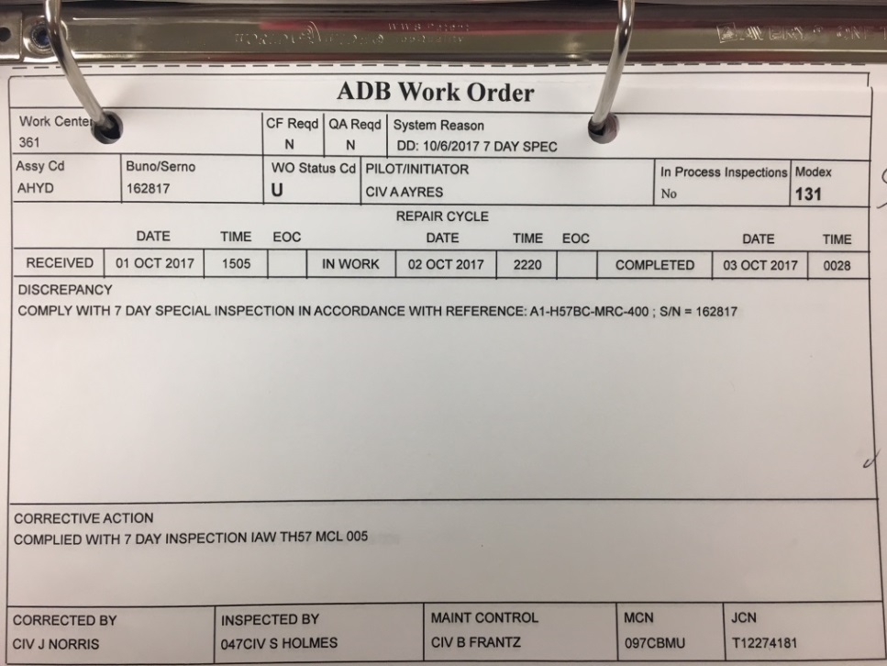
Flight Records and MAFs
This section contains a record of the 10 previous Acceptance sheets and associated Maintenance Actions.
Review there are 10 previous flight records.
Ensure any documented MAFs have corrective action listed and pay particular attention to any “WO Status Cd” – D MAFs.
If a MAF lists “FCF REQUIRED” ensure there is an associated A-Sheet record for the FCF. On the FCF A-Sheet, ensure the FCF is circled complete and note the number of Up/Down discrepancies. All Down discrepancies must have an associated MAF, corrective action, and be signed off before the aircraft can be released to fly. An FCF may or may not require multiple flights to complete, and may have multiple FCF A-Sheets. Any Downing discrepancies discovered on the FCF may or may not require an additional flight to certify complete.

Slide 29
Flight Records and MAFs
Outstanding aircraft discrepancies and special inspections are recorded on a MAF and placed in the right side of the ADB. Once the discrepancy is completed, the corrective action performed is filled out and the MAF is then moved over to the left side of the ADB. Maintenance Control removes the MAF from the ADB after 10 subsequent flights. Especially when reviewing an uncorrected MAF, look at the WO Status Cd block. It will contain a “U” if the discrepancy is not a downing discrepancy. If the block has a “D” the A/C is down.

Slide 30
Special Inspections
Special Inspections are scheduled inspections with a prescribed interval other than daily or phase.
The intervals are specified in the applicable maintenance publication and are based on elapsed calendar time, flight hours, operating ours, or number of cycles or events, for example, 7, 28 days; 50,100, 200 hours. In some cases, aircraft special inspections contain engine inspection requirements, referred to as combined airframe and engine special inspections.

Slide 31
Special Inspections
To meet unusual situations or to ease workload scheduling, the following are allowable deviations to inspections:
A plus or minus 3 days, or a portion thereof, may be applied to the authorized inspection interval of all inspections. The next inspection is scheduled as if no deviation had occurred.
A plus or minus 10 percent, or a portion thereof, may be applied to the authorized inspection interval of all other scheduled maintenance requirements, based on flight hours, operating hours, cycles, or events. The next inspection is scheduled as if no deviation had occurred.
Some inspections provide a window already (i.e. “10–25 hour re-torque inspection”), in which case the window applies instead of the +/-10 percent or +/-3 days.

Slide 32
Special Inspections
Special Inspections with specific inspection windows:
7/14/28 day +/-3 days
56 day +/- 6 days
365 Day +/- 16 days
12 Month M/R Dynamic Balance +/-3 days
12 Month Compass Swing +/- 3 days
728 Day +/- 16 days

Slide 33
Technical Directives
Technical Directives are also recorded on MAFs and located after special inspections in TH-57 ADBs. These are inspection or maintenance actions that concern a T/M/S that are not recurring in nature. These are typically one-time inspections or actions that are a result of a newly discovered hazard or new component to be installed on the A/C.

Slide 34
Dents
The final section of MAFs located in a TH-57 ADB is a record of unrepaired dents. Ensure that all recorded dents are marked as “within limits”, “checks good”, or “within expanded limits”.

Slide 35
Expected Knowledge
A-Sheet
Who signs block 9, 10, 11?
What is in block 10 and who signs block 11 if hot seating?
What does each individual signature mean?
Daily/Turnaround
When is each inspection required?
What are the tolerances for each inspection?
Engine HIT Checks
Trend analysis
What having a positive or negative HIT check means
Automatic downing criteria
Record of Oil Consumption
Trend analysis
How to tell if out of limits
Chip MAFs
Application of NATOPS criteria
Other MAFs
Which side are corrected/outstanding MAFs on?
How do you tell if the MAF is a downing discrepancy?
How long do corrected MAFs remain in the ADB? Or, why are there 10 A-sheets?
What are tolerances on inspections?
What does ‘FCF’ on an A-Sheet mean?
How can you tell that the FCF was completed
The most important thing for the SNA to know is that they need to ask Maintenance Control if they do not understand something.

Slide 36
Additional Information
Conditional Inspections
Phase Inspections
Maintenance Levels
PDM/PMI/IMC
Maintenance Organization

Slide 37
Inspections
Conditional Inspections
Conditional inspections are inspections required due to an over limit condition, specific usage, or operational event. Hard landing, over stress, over temp, lightning strike, over weight takeoff or landing, and field arrestment are examples of over limit conditional inspections. A post-fire gun inspection is an example of a specific usage conditional inspection. Pre-and-post carrier operations are examples of operational event conditional inspections. (NAMP 5-39)
Phase Inspections
Some, but not all, T/M/S aircraft have an established Phase Inspection cycle that divides major inspection and maintenance requirements into ordered segments (Phase A, B, C, D, etc.) performed sequentially at specified flight-hour or calendar intervals. Completion of all required phase inspections in sequence completes the phase inspection cycle, which then starts over. The cycle is repetitive for the service life of the aircraft and is not interrupted during standard rework. Daily/Turnaround (NAMP 5-37)

Slide 38
Maintenance Levels
The NAMP classifies maintenance in three levels based on technical complexity, depth, scope, and range of work performed. The three levels are Organizational (O-level), Intermediate (I-level), and Depot (D-level). (NAMP 3-1)

Slide 39
Maintenance Levels
O-Level
O-level maintenance is basic maintenance performed by an activity on its assigned aircraft and equipment. O-level maintenance is organized to achieve quick turnaround of aircraft and equipment in order to optimize operational availability. O-level maintenance is the upkeep of aircraft and related equipment by the operating unit. O-level maintenance includes inspection, servicing, lubrication, adjustment, incorporation of O-level technical directives, and replacement of parts, minor assemblies and subassemblies.
I-Level
I-level maintenance is performed by designated Intermediate Maintenance Activities (IMA) responsible for supporting units operating aircraft and aeronautical equipment. The primary focus of I-level maintenance is to produce ready-for-issue (RFI) parts and ready-for-use (RFU) support equipment in sufficient quantities to support aircraft operations. I-level maintenance primarily consists of:
Inspection, testing and repair of aeronautical components and support equipment (SE)
I-level calibration
Technical assistance to supported units
Incorporation of I-level Technical Directives (TD)
Manufacture of selected aeronautical components, liquids, and gases
Performance of I-level maintenance on aircraft, such as Non-Destructive Inspection (NDI) of airframe and dynamic components (when required)

Slide 40
Maintenance Levels
D-Level
D-level maintenance and rework is performed by designated depot activities on aircraft, equipment and material requiring overhaul, upgrading, or rebuilding of parts, assemblies, subassemblies, and end items, including manufacture, modification, testing, and reclamation of parts. Rework requires extensive diagnostic equipment and industrial-level manufacturing COMNAVAIRFORINST 4790.2D 1 Feb 2021 3-2 capabilities beyond the capability and resources of O-level and I-level maintenance activities. Rework typically occurs in depot facilities managed by Commander, Naval Air Systems Command (COMNAVAIRSYSCOM) or at original equipment manufacturer (OEM) sites. Selected depot rework and maintenance functions are performed at aircraft operational sites in order to minimize cost and turnaround time. D-level maintenance and rework includes:
D-Level
Aircraft standard and special rework
Rework and repair of engines, components, and SE
Calibration by Navy calibration laboratories and Navy Primary Standards Labs (NPSL)
Incorporation of D-level technical directives (TD)
Modification of aircraft, engines, and support equipment (SE)
Manufacture and modification of parts and kits
Depot Field Team assistance
Technical and engineering assistance
Age exploration (AE) of aircraft and equipment under Reliability Centered Maintenance (RCM)

Slide 41
Planned Maintenance (PDM/PMI/IMC)
Phased Depot Maintenance (PDM)
PDM divides a T/M/S aircraft’s total Standard Rework requirements into phases. PDM phases are based on fixed Operating Service Periods (OSP), expressed in months tailored to the depot maintenance requirements for each T/M/S aircraft. Several titles are used to denote PDM events: F/A-18 aircraft PDM events are called Planned Maintenance Intervals (PMI) events; H-60 aircraft PDM events are called Integrated Maintenance Concept (IMC) events.
Planned Maintenance Interval (PMI)
Period of time for execution of an IMC/P or PDM scheduled maintenance event. Can include O-level, I-level, and D-level maintenance actions.
Integrated Maintenance Concept/Program
IMC/P is scheduled D-level maintenance based on a Fixed Induction Date (FID), and may segregate the Operating Service Period (OSP) into smaller periods of Planned Operational Interval (POI) and PMI.

Slide 42
Maintenance Organization
“Department” applies to all maintenance activities having a department head.
“Division” is a subsection of a department devoted to performing a specific category of maintenance, and in which distinct sub-functions of the division are divided into branches. For example, an O-level Aircraft Division (Work Center Code 100) is often comprised of separate branches for Power Plants (110), Airframes (120), and Aviation Life Support Systems (130).
“Branch” applies to a subsection of a division in which a functional area is divided into separate shops. For example, the Airframes Branch (Work Center Code 120) may be comprised of Structures Shop (12A), Hydraulics Shop (12B), and Corrosion Control Shop (12C).
Work Centers” (often called “shops”) are designated functional areas to which personnel are permanently assigned, for example the Structures Shop (12A), Power Plants Module Repair Shop (414) and Aviation Tool Issue/Tool Control Center (05D). The number and designation of COMNAVAIRFORINST 4790.2D 1 Feb 2021 3-8 work centers will be based upon assessment of required maintenance or support functions, numbers of personnel, span of control, workload schedules, and work locations.

Slide 43
Maintenance Organization
Workcenters
020 – Maintenance Control (SFF)
030 – Maintenance Admin (AZ)
040 – Quality Assurance (QA)
050 – Material Control (LS)
110 – Power Plants Branch (AD)
120 – Airframes Branch (AM)
12C – Corrosion Control Shop
130/13A – Aviation Life Support Branch (PR)
210 – Aviation Electronic Technician (AT)
220 – Aviation Electricians Mate (AE)
230 – Armament Branch (AO)
310 – Plane Captain Branch (PC) “Line Shack”
DEMOT
Troubleshooting teams are often organized into DEMOT groupings that will have one representative from each of the five main work centers. The teams will commonly attend the aircraft during preflight, start-up, and hot seat evolutions. Numbered 1-5. i.e. to call an AD you would make a T with your hands to the PC then hold up 1 finger.
AD – 1
AE – 2
AM – 3
AO – 4
AT – 5

