Slide 1
TH-57 Autorotation Variables and Procedures Review

Slide 2
Reference
NAVAIR 01-H57BC - NATOPS
CNATRA P-457 – CONTACT FTI
COMTRAWINGFIVEINST 3710.8U – RWOP
CNATRA P402 (Rev. 04-11) – Systems Workboo
Notes:
The purpose of the brief is to enhance the procedures that are outlined in the FTI and NATOPS. During the brief, discussion is encourage. Through active participants, I hope to have techniques shared. The ability to take these procedures and apply them to the aircraft during varying condicions is key to developing confidence and instruction. All parameters are reviewed under perfect conditions

Slide 3
Outline
Auto Variables Review
Auto Geometry
FTI Procedures
Hazards
First Auto

Slide 4
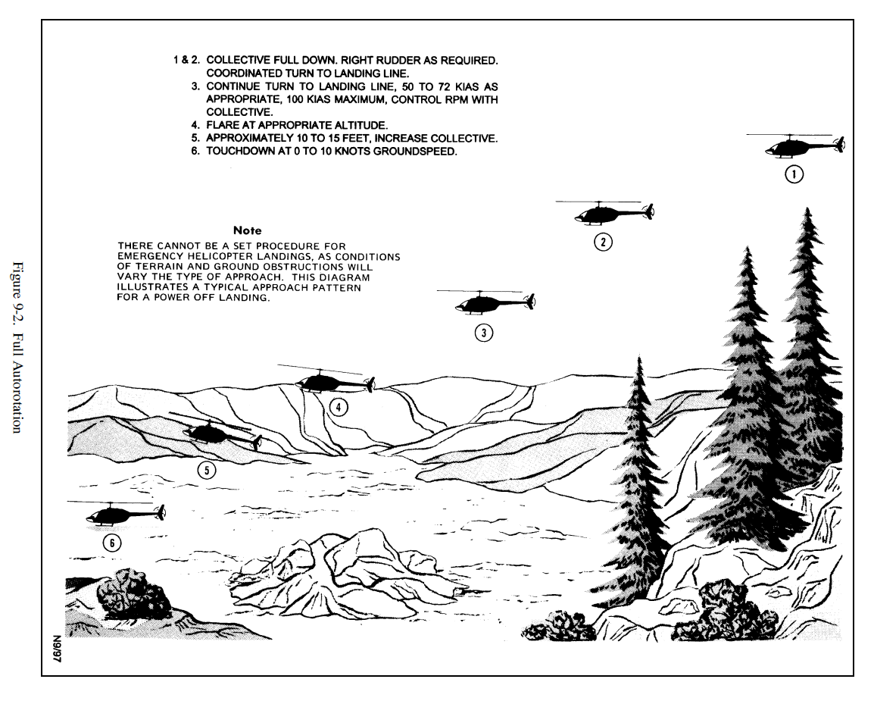
Variables
Controlled
Airspeed
Nr
Reaction Time
Uncontrolled
Gross Weight
DA
Wind
Temperature
Reaction Time
Notes:
Airspeed – Min rate is 50 knots. Max distance is 72 knots. Rate of descent increases at other than 50 knots, while glide distance decreases at other than 72 knots.
Nr – A tradeoff between kinetic energy storage for the flare and cushion or use for reducing ROD. Higher RPM in the descent will increase rate of descent but provide more energy for the cushion. Lower RPM results in lower ROD but less energy for a cushion. Question – Do you have the field made? More RPM is better. Is it questionable? Less RPM may be better. Tight zone and within glide distance? Higher RPM because those trees are tall. Remember though, reducing RPM beyond a certain pt will increase rate of descent.
Gross Weight – Higher gross weight results in more energy transfer (potential to kinetic) to the rotor system requiring a greater collective pitch resulting in a lower ROD. However, momentum will also be greater requiring more pull at the bottom. Also, maneuvering flight has the same effect as a shift in gross weight. The g-loading on the aircraft results in a higher effective weight and higher RPM if not controlled. If controlled, ROD change will be negligible. If not controlled, Nr will become excessive and ROD will increase for two reasons – 1) AOB and 2) RPM increase causing a larger prop region.
DA – Higher DA requires more pitch to maintain a given Nr but will still result in a higher rate of descent. Later pull at bottom preferred
Wind – Strong Headwind effects flare, crosswind corrections.
Temperature - Higher Temp, greater rate of descent
NATOPS Discrepancy – NATOPS notes that DA and gross weight have a negligible effect on autorotational performance. This is not a statement that can be generalized to fleet aircraft. However, in the TH-57 given it’s minimal gross weight changes (typically less than 15% difference from Takeoff to Landing) and typical operating environment, DA and GW changes are negligible. In contrast, an H-60 may be 25% lighter upon landing and an H-53 may be nearly 50% lighter.

Slide 5
TH-57 Glide Characteristics
FTI vs. NATOPS
FTI:
Nr maintained at or above 94% => Larger ROD & GS.
NATOPS:
Assumes 90% Nr
Rate of Descent: 1360 fpm (50kias)
Rate of Descent: 1760 fpm (72kias)
Glide Ratio:
4.1 (72kias)
Glide Ratio:
3.3 (50kias)
Notes:
Let’s compare NATOPS to our experience. A Normal Approach glideslope is 25 degrees producing slightly more than a 2 to 1 glide ratio. With the NATOPS indicating a 3 to 1 and 4 to 1 ratio for 50 KIAS and 72 KIAS respectively, this actually indicates a more shallow glideslope than our normal approach profile. So why does it seem that our actual profile is steeper than this? Flight test data is from “similar type aircraft”. No indication of ECS on/off. Nr is assumed 90% as opposed to our target of 94%. No wind. What to do? See if you can maintain right above the horn (91%) and note the better glide ratio. Please keep in mind however that maintaining a lower Nr in the descent will result in a lower Nr on Flare entry requiring a lower or more aggressive flare to build Nr.
GS: 4 to 1. For every foot of altitude, you will travel 4 feet (no wind). Enter at 600’ AGL, and travel 2,400’.

Slide 6
Auto Geometry
50 KIAS
72 KIAS
Glide Slope Ratio: 3.25
19 DEG
600’ AGL = 1,950’ OTG
(0.37 Miles)
300’ AGL = 975’ OTG
(0.18 Miles)
Glide Ratio: 4.08
14 DEG
600’ AGL = 2,448’ OTG
(0.46 Miles)
300’ AGL = 1224’ OTG
(0.23 Miles)
Notes:
90% Nr used to calculate.
Does not account for flare or reaction time, ranges may vary. Expect longer ranges. Anything greater or less than 90% Nr could create shorter ranges.

Slide 7
Normal Approach Geometry
Glide Slope 2:1
600’ AGL = 1200’ (.23 Miles) OTG
300’ AGL = 600’ (.11 Miles) OTG

Slide 8
Airspeed Comparision
Calculated at 90% Nr | 50 KIAS Min Descent | 72 KIAS Max Glide
Glide Slope | 3.25 | 4.08
Distance OTG (Ft) | 650 | 816
Rate of Descent (FPM) | 1558 | 1780
Time (Sec) | 7.7 | 6.7
*Does not account for flare. Expect longer distances at higher airspeeds.
Notes:
Difficult to account for turns in a auto, simplify problem for straighten auto.
Airspeed indications erratic
Ideal conditions, no wind way.
Calculations do not account for reaction time and flare.

Slide 9
Entry
FTI
Verbals
70 KTS / 600’ AGL
Enter the autorotation by smoothly lowering the collective to the full down position and simultaneously adding right pedal to maintain balanced flight. Reduce twist grip to the flight idle position and turn to the course line.
PAC: “Lane, Lock, Sock”
PAC: “Altitude 600 FT, 70 KIAS, VSI AT OR BELOW ZERO, AIRCRAFT IN TRIM”
PAC: “Down, Right, IDLE, Turn.”
Notes:
Lane, Lock, Sock
What type of nose pitch is required?
Dependent on winds, but calm day requires mostly level nose attitude.
Where are the winds?
Expect winds to push you on the base away from the field. Anticipate crab on final.
10KTS Faster and 100 FT Higher than Natops
“LANE”= check 90 or 180 auto lane and call out any traffic in the lane.
“LOCK” = ensure shoulder harnesses are locked.
“SOCK” = check windsock, ensure there is no tailwind component, and note any crosswind
.
Prior to Entry (600 ft AGL 70 KIAS)
:
“ALTITUDE 600 FT, 70 KIAS” = confirm
.
“VSI AT OR BELOW ZERO, AIRCRAFT IN TRIM” = confirm
.
On Entry
:
“DOWN” = smoothly lower the collective to the full down position in no less than 2 seconds.
“RIGHT” = use right pedal as necessary to center the ball and maintain balanced flight.
“IDLE” = smoothly rotate the twist grip to the flight idle position.
“TURN” = maintain balanced flight,initiate a turn to intercept course line, and establish a crosswind correction as necessary.

Slide 10
Transition to Final
FTI
NATOPS
Transition to 50 to 60 KTS descending attitude. Monitor Nr and control between 90 and 107 % with collective (optimum 94 to 95%).
PAC: “Attitude, Nr, Ball”
Notes:
Gauge vs Outside Scan
Anticipate the Nr Horn
94-95% Nr Optimum
Up Collective can tighten your turn
Nr will build with tighter turn
Right pedal to counter tail rotor lift
“ATTITUDE”= use cyclic to control nose attitude in a 50-60 KIAS descending attitude.
“Nr”= use collective to control Nrbetween 90-107% (94-95% Nris optimum)
“BALL” = use pedals to maintain balanced flight or crosswind correction as necessary.

Slide 11
Final
FTI
Verbals
Intercept the course line and establish crosswind correction as necessary. Maintain the 50 to 60 KTS descending attitude.
Ensure Collective is full down by 150 feet AGL
PAC: “200’ On Courseline”
PAC: “150’ Collective Full Down”
Notes:
Anticipate crosswind component.
Modify collective position to maintain optimum Nr
Most Likely full down
Roll out on final at 100% Nr, decrease Nr to 90% will increase your range.
Low Nr will require nose down (accelerating attitutde)
Energy Management, airspeed, Nr, altitude.
Build outside scan.
Slower than 50 KIAS, requires more power
Calibrate your eyes
“200 FT ON COURSELINE” = at no lower than 200 ft AGL ensure wings are level (or proper crosswind correction is established) and aircraft is on courseline.
“150 FT COLLECTIVE FULL DOWN” = ensure that collective is in the full down position.

Slide 12
Flare
FTI
Verbals
At 75 to 100’ AGL flare with cyclic in order to reduce rate of descent, reduce groundspeed, and increase Nr.
Adjust flare as required to achieve desired groundspeed and minimal rate of descent.
Power Recovery
PAC: “100’ Flare, Twist Grip Full Open”
PNAC: “Roger Twist Grip Full Open”
Full Auto
PAC: “100’ Flare,Twist Grip Flight Idle.”
PNAC: “Roger, Twist Grip is Flight Idle”
Notes:
Too much flare equates to greater descent rate
Too little flare equates to high ground speed in the terminal phase
Not every flare is the same
High DA day, great flare to build turns and slow down aircraft.
Lower Flare equates to greater range, more shallow approach. Similar to sliding landing.
High Flare for steeper, shorter approach. Might require reverse flare
Pitch for a glide slope
“100 FT FLARE, TWIST GRIP FULL OPEN” or
“TWIST GRIP FLIGHT IDLE” = flare with aft cyclic, and with the collective in the full down position, smoothly rotate the twist grip to
the full open position for the power recovery or remain at flight idle for the full auto. Pilot not at the controls confirm twist grip position and verbalizes
“ROGER, TWIST GRIP FULL OPEN”or “ROGER, TWIST GRIP FLIGHT IDLE.”

Slide 13
Recovery
FTI
Verbals
10 to 15’ AGL, coordinate up collective and forward cyclic to slow the rate of descent and lower the noce to level attitude. Maintain heading with the pedals.
PAC: “10-15’ Pull, Pause, Level”
Power Recovery
PAC: “5’ Taxi, Taxi, Taxi”
Full Auto
PAC:“5’ Cushion, Cushion, Cushion.”
Notes:
Higher Pull for steeper approach, shallow out the approach.
Easier on low DA days
Lower Pull
Better on high DA days
“10-15 FT PULL” = pull up collective to arrest rate of descent.
“PAUSE” = momentarily pause to slow groundspeed to 0 to 10 knots.
“LEVEL” = apply forward cyclic to achieve a 5 ft level skid attitude, nose aligned with direction of travel.
“5 FT TAXI, TAXI, TAXI”* (for Power Recovery Auto) = five foot*, level skid attitude hover taxi at 0 to 10 knots groundspeed, aligned with direction of travel (*10 foot for night).
-
or
-
“5 FT CUSHION, CUSHION, CUSHION” (for Full Auto) = five foot level skid attitude, at 0 to 10 knots groundspeed, cushioning touchdown with collective, aligned with direction of travel.

Slide 14
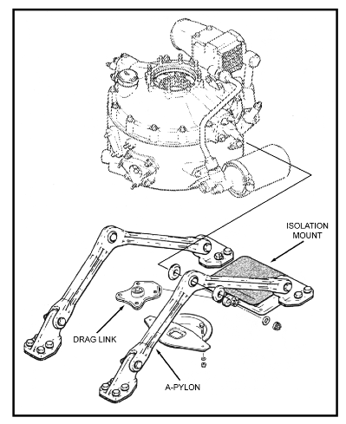
Hazards
Spike Knock
Low RPM,
Poor Auto Landing,
Low G (+.5)
Pylon Whirl
Blade Flapping/Mast Bumping.
Touchdown after an Auto
Tailboom Dynamic Modes
Touchdown after auto (~64% N%)
Highspeed auto (68-73%Nr)
Notes:
57 Natops (9-2)
At less than 70 Percent Nr these conditions by induce destructive vibrations in the aircraft during full auto landings.
Winds greater than 20 KTS and gust greater than 10 KTS
Groundspeed greater than 10 KTS
Cross Wind Greater than 10 KTS
Drag Link – Limit fore and aft movement, spike will indicate excessive movemnt, attached to isolation mount to absorb vibration.
Pylon- permits side to side shift.
OH-58 Natops
Spike Knock – . Spike knock occurs when the round pin in the drag-pin fitting contacts the side of the square hole of the pylon stop, which is mounted to the roof. It creates a loud noise and will occur during a rocking of the pylon. The following factors can cause spike knock, low rotor RPM, extreme asymmetric loading, poor execution of an autorotational landing and low G maneuvers below +.5 Gs.
b. Spike knock will be more prevalent during zero ground run autorotational landings than for sliding autorotational landings and running landings.
c. Spike knock in itself is not hazardous but is an indicator of a condition that could be hazardous. If spike knock is encountered, an entry must be made on the 2408-13 to include the flight conditions under which the spike knock occurred. An inspection will be performed by maintenance personnel before continuing.
d. During landing, starting, and rotor coastdown, spike knock could also occur, especially if there are high winds and/or the elastomeric damper is deteriorated. This type of spike knock is not considered damaging to the aircraft.
Pylon Whirl – Pylon whirl is a condition which occurs after blade flapping and mast bumping. The resultant motion of the pylon is elliptical, and spike knock is apt to occur. If the frequency of motion coincides with a particular natural frequency of the helicopter, and the amplitude and direction of the force is large enough, damaging vibrations can occur in the aft section tailboom of the helicopter. Motion of this type could occur during touchdown autorotations, if operational limits are exceeded.
Critical Tail boom dynamics modes
1. 225 RPM (~64%)
2. 240-260 (68-73%)
Two critical tailboom dynamic modes exist. One of these may occur during an improperly executed touchdown a utorotationa I landing and corresponds to a frequency of less than 225 main rotor RPM D'~ (64 percent ~ ). The second may occurduring a high speed autorotational entry, or any maneuver in which application of collective allows a significant decay in RPM down to a critical frequency corresponding to approximately 240-260 main rotor RPM (A) (68-73 percent (C) ). At high blade angles of attack (increased collective), there may be a point where the blade does not produce more lift. When there is this condition of low rotor speeds and high collective blade angles, there will be excessive flapping of the main rotor. The cycle will be as follows: rotor blade flap, mast bumping, and spike knock which, ultimately, results in main rotor inertia/energy transfer to the airframe. These conditions generate a resonance and the tailboom will rapidly respond to these frequencies. The tailboom will then have up and down movements as it responds to the resonant condition and at some point, a structural failure ~Nill occur. Typically, there will be wrinkles in the tailboom just aft of the boom attaching points. After the tailboom has buckled and/or been damaged, the vibrations may (and usually will) cease; predominately, because the failure unloads the condition or the landing has stopped or main rotor flapping has ceased. This could be aggravated by high winds and abrupt cyclic inputs while in the condition. High forward speed relative to the maneuver may provide the driving force for excessive blade flapping, mast bumping, and, as a result, damaging vibration. Likelihood of encountering the second mode is remote and is avoidable if operating limitations of the helicopter are observed.
High angle of attacks blade no longer procudes lift (stalls) Low rotor speed and high collective blade angles, there will be excessive flapping of the main rotor.
The cycle: rotor blade flap, mast bumping spike knock (transfers main rotor head transfers energy to the airfram creating resonance. Tailboom will then move up and down until a structural failure. Furher aggrevated by cyclic inputs and high winds.
Experience at the end of the auto while leaving collective up for too long.

Slide 15
First Auto
Controlled
Airspeed
Nr
Trim
Reaction Time
Uncontrolled
Gross Weight
DA
Wind
Temperature
Self Critique
Debrief:
Conditions
DA Effects
Winds
Flare
Pull

Slide 16
Questions?

