Slide 1
BEFORE STARTING!!
DON’T SAVE OVER MASTER COPY
Move a copy of the brief to your personal folder
Update all the information in RED to apply to your specific capstone event
Talk with the SL to get specific location and route approved.
Send questions up to your STAN dept
How to conduct presentation
Brief the items on the main slide in order
When you reach an *, hit next to brief the specific slide then next to return to the main slide
“Greyed out items” represent items previously briefed
SL will brief from Orientation to ORM and Situation to Overview. SNAs will split the rest.

Slide 2
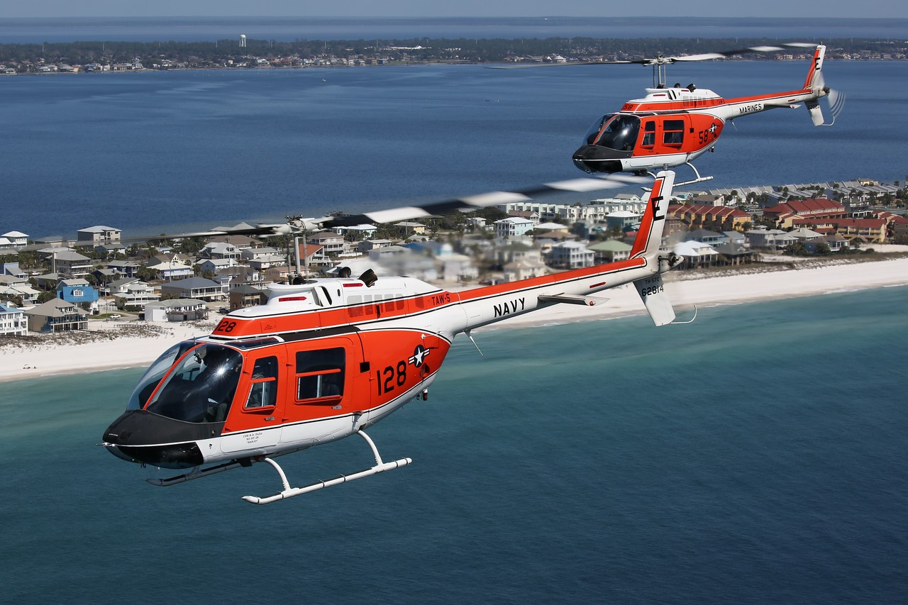
FORMATION CAPSTONE
FRM4101A / FRM4102A

Slide 3
ORIENTATION
Time Hack
Roll Call
EB/FH/LUCKY ____ (SPOT___)
IP 1/ SMA 1
EB/FH/LUCKY ____ (SPOT___)
IP 2 / SMA 2
**Designates SL
External Callsign / Internal Callsign
*ORM
Smart Pack Review
Maps Required
Weather
-Current WX / Forecast WX /
Destination WX / WX Required
SITUATION
Commander’s Intent
MISSION
MISSION EXECUTION
Overview
Obstacles
-ABCTRP
Scheme of Maneuvers
-Walk
-Comm Check
-Takeoff
Route
Objective Area
RTB
CONTINGENCIES
Emergency Procedures
-IMC/VMC Emergencies
-Ditch / Emergency Landing / Egress
-Simulated Emergencies
IIMC
Loss of Visual Contact
Lost Comms
Disorientation Procedures
-Magellan
Down Aircraft
Aborts/Waveoffs
ADMIN & LOGISTICS
Flight Duration
Fuel
-Mission Fuel / Bingo Fuel
COMMAND AND SIGNAL
Communications/ Radio Procedures
Frequencies / NAVAIDS
Brevity
Terminate/KIO
SQUAWK
Visual Signals
ADMIN
CRM
-Control Transfer
-Lookout Procedures
-Vertigo
-Altitude Warnings / RADALT
NATOPS by Exception
DUE OUTS

Slide 4
CAPSTONE ORM Matrix
 |  | PROBABILITY |  |  |  | RAC
 |  | A | B | C | D | 1 | Critical | PROBABILITY |  |  |  | SEVERITY
SEVERITY | I | 1 | 1 | 2 | 3 | 2 | Serious | A - Likely to Occur |  |  |  | I - Death/Mission Failure
 | II | 1 | 2 | 3 | 4 | 3 | Moderate | B - Probably will Occur |  |  |  | II - Serious Injury/Mission Failure
 | III | 2 | 3 | 4 | 5 | 4 | Minor | C - May Occur |  |  |  | III - Minor Injury/Mission Delay
 | IV | 3 | 4 | 5 | 5 | 5 | Negligible | D - Unlikely to Occur |  |  |  | IV - Minimal Threat/Mission Delay
Step 1. |  |  |  |  | Step 2. |  | Step 3. |  | Step 4. |  |  |  |  | Step 5.
Identify Hazards |  |  |  |  | Assess Hazards |  | Make Risk Decisions |  | Implement Controls |  |  |  |  | Supervise
Hazards |  |  | Causes |  | Initial RAC |  | Develop Controls |  | How to Implement |  |  | Final RAC |  | Supervision
MID-AIR, BIRD STRIKE |  |  | POOR FORMATION MANEUVERS OR POSITION |  | B-II |  | UTILIZE STANDARD FORMATION POSITIONS PER FTI. |  | REVIEW FTI MANEUVERS. |  |  | C-II (3) |  | IPs WILL PROVIDE DEFENSIVE POSTURE AND BE READY TO TAKE CONTROLS. SMAs WILL BACK UP IPs WHEN NOT ON THE CONTROLS.
HIGH TRAFFIC AREAS ALONG THE ROUTE |  |  | CONGESTED VFR TRAFFIC IN VFR CORRIDORS AND SPECIAL FLIGHT RULES AREAS |  | B-II |  | PROPER PRE-FLIGHT PLANNING. EXERCISE DILIGENT SEE AND AVOID DOCTRINE. |  | PRE-BRIEF VFR ROUTES, ALTITUDES, AND COMMS. PNAC NAVIGATES, AIRCREW CALL OUT TRAFFIC. |  |  | C-II (3) |  | ENSURE THE ENTIRE CREW IS LOOKING OUTSIDE AND AIDING THE PAC WITH NAVIGATION.
POOR WEATHER |  |  | FREQUENT CHANGES TO THE WEATHER IN THE REGION |  | B-IV |  | ATTAIN PROPER WEATHER DASH 1 FOR THE PLANNED ROUTE. HAVE A BACKUP PLAN TO INCLUDE IIMC BREAK UP WITH ALTERNATE LANDING FIELDS. |  | OBTAIN A COMPLETE WEATHER BRIEF FOR EACH LEG OF FLIGHT VIA NWB OR CIVILIAN BRIEFERS. IN-FLIGHT METRO/FSS. USE DIVERT AIRFIELDS WHEN WEATHER NECESSITATES. |  |  | C-VI (5) |  | UPDATE WEATHER PRIOR LAUNCHING, DO NOT PRESS A BAD SITUATION. REMAIN FLEXIBLE ON ROUTING AND TIMING.
CFIT |  |  | POOR ALTITUDE DISCIPLINE AND BREAKDOWN IN SA. |  | B-II |  | DETERMINE ALTITUDE TO MAINTAIN THE ENTIRE WAY ALONG THE ROUTE |  | MAINTAIN ALTITUDE AND SET RADALTs |  |  | C-II (3) |  | UTILIZE CRM AND CALL OUT ALTITUDE DEVIATIONS
ROUTE DISORIENTATION |  |  | BREAKDOWN IN SITUATIONAL AWARENESS |  | C-III |  | THOROUGHLY BRIEF EACH LEG. REMAIN UNDER POSITIVE CONTROL OR USE FLIGHT FOLLOWING DURING VFR LEGS. |  | BRING APPROPRIATE CHARTS. BACKUP NAV WITH GPS. |  |  | D-III (5) |  | UPDATE ROUTE PROGRESS DURING ENTIRE FLIGHT.

Slide 5
ORIENTATION
Time Hack
Roll Call
EB/FH/LUCKY ____ (SPOT___)
IP 1/ SMA 1
EB/FH/LUCKY ____ (SPOT___)
IP 2 / SMA 2
*Designates SL
External Callsign / Internal Callsign
ORM
Smart Pack Review
Maps Required
Weather
-Current WX / Forecast WX /
Destination WX / WX Required
*SITUATION
Commander’s Intent
MISSION
MISSION EXECUTION
Overview
Obstacles
-ABCTRP
Scheme of Maneuvers
-Walk
-Comm Check
-Takeoff
Route
Objective Area
RTB
CONTINGENCIES
Emergency Procedures
-IMC/VMC Emergencies
-Ditch / Emergency Landing / Egress
-Simulated Emergencies
IIMC
Loss of Visual Contact
Lost Comms
Disorientation Procedures
-Magellan
Down Aircraft
Aborts/Waveoffs
ADMIN & LOGISTICS
Flight Duration
Fuel
-Mission Fuel / Bingo Fuel
COMMAND AND SIGNAL
Communications/ Radio Procedures
Frequencies / NAVAIDS
Brevity
Terminate/KIO
SQUAWK
Visual Signals
ADMIN
CRM
-Control Transfer
-Lookout Procedures
-Vertigo
-Altitude Warnings / RADALT
NATOPS by Exception
DUE OUTS

Slide 6
SITUATION / MISSION
SITUATION
Last week, the gulf coast region was hit by a CAT 4 hurricane damaging multiple areas. The damage was substantial enough to have saturated the capabilities of local authorities and emergency response teams. The entire region has been left without power and water supply and are in need of resources.
The severely damaged infrastructure has prevented the capabilities for water, food, and medical supplies to be distributed via ground forces.
LZs and FOBs have been created and surveyed to allow air assets to bring in supplies and move injured personnel.
Working parties have been sent out via swamp boats and by foot for search and rescue operations.
TW5 HT Squadrons have been tasked to support Humanitarian and Disaster Relief efforts. The assigned assets will assist by transporting water, food, and medical supplies to designated LZs from KNDZ, as well as provide transportation for injured personnel to safer FOBs for medical assistance.
MISSION
2 HT-8/18/28 aircraft will launch as tasked at 0000L and fly out to LZ _____ to deliver supplies.
After departing from LZ ____ , the flight will proceed to FOB ____ to resupply/drop off any injured personnel.
Once complete with resupply, proceed to LZ ____ and drop off supplies.
RTB at the completion of second drop off back to KNDZ.
Assets will be ready to assist with any pop-up SARs throughout the mission.
COMMANDER’S INTENT
Assigned crews shall provide any tasked assistance and safe delivery of supplies.
Movement of injured personnel authorized.
No loss of aircraft and/or personnel.

Slide 7
ORIENTATION
Time Hack
Roll Call
EB/FH/LUCKY ____ (SPOT___)
IP 1/ SMA 1
EB/FH/LUCKY ____ (SPOT___)
IP 2 / SMA 2
*Designates SL
External Callsign / Internal Callsign
ORM
Smart Pack Review
Maps Required
Weather
-Current WX / Forecast WX /
Destination WX / WX Required
SITUATION
Commander’s Intent
MISSION
MISSION EXECUTION
*Overview
Obstacles
-ABCTRP
Scheme of Maneuvers
-Walk
-Comm Check
-Takeoff
Route
Objective Area
RTB
CONTINGENCIES
Emergency Procedures
-IMC/VMC Emergencies
-Ditch / Emergency Landing / Egress
-Simulated Emergencies
IIMC
Loss of Visual Contact
Lost Comms
Disorientation Procedures
-Magellan
Down Aircraft
Aborts/Waveoffs
ADMIN & LOGISTICS
Flight Duration
Fuel
-Mission Fuel / Bingo Fuel
COMMAND AND SIGNAL
Communications/ Radio Procedures
Frequencies / NAVAIDS
Brevity
Terminate/KIO
SQUAWK
Visual Signals
ADMIN
CRM
-Control Transfer
-Lookout Procedures
-Vertigo
-Altitude Warnings / RADALT
NATOPS by Exception
DUE OUTS

Slide 8
OVERVIEW
INSERT AN OVERVIEW PICTURE OF THE ROUTE FROM JMPS!!
USE SNIPPING TOOL

Slide 9
ORIENTATION
Time Hack
Roll Call
EB/FH/LUCKY ____ (SPOT___)
IP 1/ SMA 1
EB/FH/LUCKY ____ (SPOT___)
IP 2 / SMA 2
*Designates SL
External Callsign / Internal Callsign
ORM
Smart Pack Review
Maps Required
Weather
-Current WX / Forecast WX /
Destination WX / WX Required
SITUATION
Commander’s Intent
MISSION
MISSION EXECUTION
Overview
Obstacles
-ABCTRP
Scheme of Maneuvers
-Walk
-Comm Check
-Takeoff
*Route
Objective Area
RTB
CONTINGENCIES
Emergency Procedures
-IMC/VMC Emergencies
-Ditch / Emergency Landing / Egress
-Simulated Emergencies
IIMC
Loss of Visual Contact
Lost Comms
Disorientation Procedures
-Magellan
Down Aircraft
Aborts/Waveoffs
ADMIN & LOGISTICS
Flight Duration
Fuel
-Mission Fuel / Bingo Fuel
COMMAND AND SIGNAL
Communications/ Radio Procedures
Frequencies / NAVAIDS
Brevity
Terminate/KIO
SQUAWK
Visual Signals
ADMIN
CRM
-Control Transfer
-Lookout Procedures
-Vertigo
-Altitude Warnings / RADALT
NATOPS by Exception
DUE OUTS

Slide 10
ROUTE ADMIN / ROLES
Formation
Cruise Formation inside Controlled Airspace
Combat Cruise in Uncontrolled
All legs will be flown at 500AGL – Unless otherwise assigned
All legs will be flown at 100 kts – Unless power limited
LEAD
Primary Navigation
Handle all ATC calls (flight following)
Track section fuel consumption
WING
Acquire ATIS’s
Monitor CTAFs
Backup Navigation

Slide 11
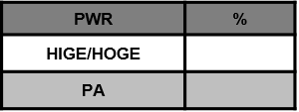
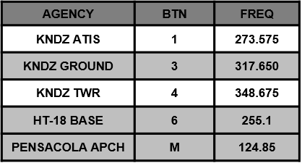
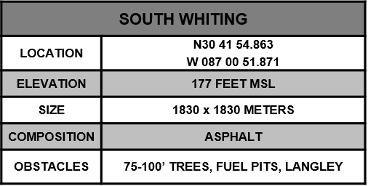
SOUTH WHITING
315
45
NORTH WHITING AIRSPACE
270
90
225
180
135
MAG VAR -2.0
HANGARS
FUEL PITS
EGRESS 135°
TO ABLE
F- Cruise Formation
A- 100KIAS, 900’MSL
L-Normal Lighting
C- BTN 4, 121.95, 0100
O: KNSE, MX Pattern
N: GTN Route
INGRESS 051°
FROM IGOR

Slide 12
ROUTE
ROUTE FROM NDZ TO ENROUTE LZ!!
Use snipping tool on jmps computers to capture route
Use JOGAIR 1:250k or sectional, whatever used when printing out route.
Ok to break it into multiple slides

Slide 13
TERMINAL AREA
Drop a picture of your 1st LZ here from the LZ diagram PPT!
MAKE SURE TO UPDATE THE INFORMATION
Refer slide 1 on the LZ diagram PPT

Slide 14
ROUTE
ROUTE FROM ENROUTE LZ TO FOB!!
Use snipping tool on jmps computers to capture route
Use JOGAIR 1:250k or sectional, whatever used when printing out route.
Ok to break it into multiple slides

Slide 15
FOB
Drop a picture of your OUT-IN location here from the LZ diagram PPT!
MAKE SURE TO UPDATE THE INFORMATION
Refer to slide 1 on the LZ diagram PPT

Slide 16
ROUTE
ROUTE FROM FOB TO ENROUTE LZ!!
Use snipping tool on jmps computers to capture route
Use JOGAIR 1:250k or sectional, whatever used when printing out route.
Ok to break it into multiple slides

Slide 17
TERMINAL AREA
Drop a picture of your 2nd LZ here from the LZ diagram PPT!
MAKE SURE TO UPDATE THE INFORMATION
Refer to slide 1 on the LZ diagram PPT

Slide 18
ROUTE
ROUTE FROM 2nd ENROUTE LZ to NDZ!!
Use snipping tool on jmps computers to capture route
Use JOGAIR 1:250k or sectional, whatever used when printing out route.
Ok to break it into multiple slides

Slide 19
SOUTH WHITING
315
45
NORTH WHITING AIRSPACE
270
90
225
180
135
MAG VAR -2.0
HANGARS
FUEL PITS
EGRESS 135°
TO ABLE
F- Parade for Homefield Break
A- 100KIAS, 300’ AGL
L-Normal Lighting
C- BTN 4, 121.95, 0400
O: KNSE, MX Pattern
N: GTN Route
INGRESS 051°
FROM IGOR

Slide 20
ORIENTATION
Time Hack
Roll Call
EB/FH/LUCKY ____ (SPOT___)
IP 1/ SMA 1
EB/FH/LUCKY ____ (SPOT___)
IP 2 / SMA 2
*Designates SL
External Callsign / Internal Callsign
ORM
Smart Pack Review
Maps Required
Weather
-Current WX / Forecast WX /
Destination WX / WX Required
SITUATION
Commander’s Intent
MISSION
MISSION EXECUTION
Overview
Obstacles
-ABCTRP
Scheme of Maneuvers
-Walk
-Comm Check
-Takeoff
Route
Objective Area
RTB
CONTINGENCIES
Emergency Procedures
-IMC/VMC Emergencies
-Ditch / Emergency Landing / Egress
-Simulated Emergencies
*IIMC
Loss of Visual Contact
Lost Comms
Disorientation Procedures
-Magellan
Down Aircraft
Aborts/Waveoffs
ADMIN & LOGISTICS
Flight Duration
Fuel
-Mission Fuel / Bingo Fuel
COMMAND AND SIGNAL
Communications/ Radio Procedures
Frequencies / NAVAIDS
Brevity
Terminate/KIO
SQUAWK
Visual Signals
ADMIN
CRM
-Control Transfer
-Lookout Procedures
-Vertigo
-Altitude Warnings / RADALT
NATOPS by Exception
DUE OUTS

Slide 21
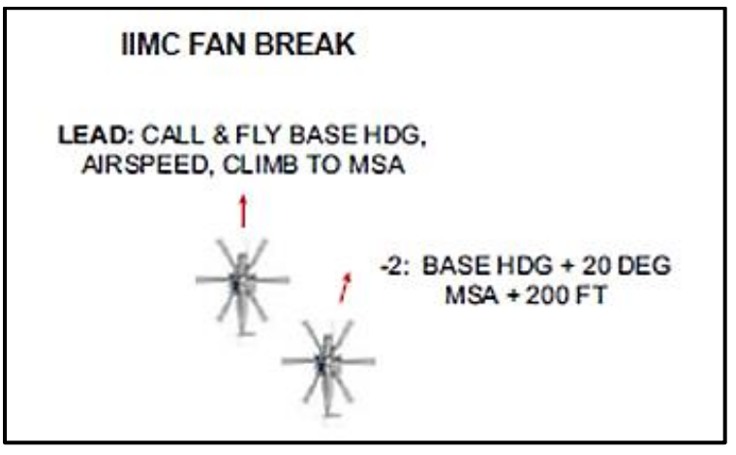
IIMC
FAN break procedure
MSA: (update MSA along your route. Use highest one)
CASE
1: VMC/VMC
2: IMC/VMC
3: IMC/IMC
ATC

Slide 22
ORIENTATION
Time Hack
Roll Call
EB/FH/LUCKY ____ (SPOT___)
IP 1/ SMA 1
EB/FH/LUCKY ____ (SPOT___)
IP 2 / SMA 2
*Designates SL
External Callsign / Internal Callsign
ORM
Smart Pack Review
Maps Required
Weather
-Current WX / Forecast WX /
Destination WX / WX Required
SITUATION
Commander’s Intent
MISSION
MISSION EXECUTION
Overview
Obstacles
-ABCTRP
Scheme of Maneuvers
-Walk
-Comm Check
-Takeoff
Route
Objective Area
RTB
CONTINGENCIES
Emergency Procedures
-IMC/VMC Emergencies
-Ditch / Emergency Landing / Egress
-Simulated Emergencies
IIMC
Loss of Visual Contact
Lost Comms
Disorientation Procedures
-Magellan
Down Aircraft
Aborts/Waveoffs
ADMIN & LOGISTICS
Flight Duration
Fuel
-Mission Fuel / Bingo Fuel
COMMAND AND SIGNAL
Communications/ Radio Procedures
Frequencies / NAVAIDS
Brevity
Terminate/KIO
SQUAWK
Visual Signals
ADMIN
CRM
-Control Transfer
-Lookout Procedures
-Vertigo
-Altitude Warnings / RADALT
*NATOPS by Exception
DUE OUTS

Slide 23
NATOPs By Exception
Weight and Balance
Flight Publications Required
NOTAMs
Emergencies
Dynamic Rollover
PAC/PNAC Responsibilities

Slide 24
Due Outs
Update Weather
Fuel Card
Call FBO
Confirm hours
GPU

Slide 25
Questions

