Slide 1
NOLF HAROLD
AGENCY | BTN | FREQ
HAROLD | 12 | 237.900
EAST FORM CMN | 17 | 308.650
KNDZ TWR | 4 | 348.675
HT-18 BASE | 6 | 255.100
315
020@5
45
EGRESS 350°
TO DEATON R. BRG
270
90
225
180
135
MAG VAR -2.1
WINDS 020 5KTS
1300S
AZ: 270
EL: 36
WAVE OFF EAST
PINNACLE
CRASH SHACK
POWER LINES
PWR | %
HIGE/HOGE
PA
NOLF HAROLD
LOCATION | 16REV 113 940 N30 40.72 W086 52.78
ELEVATION | 159 FEET MSL
SIZE | 1500 x 1500 METERS
COMPOSITION | GRASS, GRAVEL
OBSTACLES | 75-100’ TREES, PINNACLE, CRASH SHACK, PWR LINES
INGRESS 257°
FROM RACETRACK
LAND 360°

Slide 2
NOLF HAROLD
INGRESS 180°
FROM TWR 438
315
45
EGRESS 275°
TO VERTOL
270
90
225
180
135
MAG VAR -2.0
WINDS 020 5KTS
1300S
AZ: 270
EL: 36
WAVE OFF WEST
020@5
PINNACLE
CRASH SHACK
POWER LINES
PWR | %
HIGE/HOGE
PA
NOLF SANTA ROSA
LOCATION | 16REU 05812 86204 N30 36.66W086 5636
ELEVATION | 150 FEET MSL
SIZE | 1250 x 1250 METERS
COMPOSITION | GRASS, ASPHALT
OBSTACLES | 75-100’ TREES, CRASH SHACK
LAND 360°
AGENCY | BTN | FREQ
SANTA ROSA | 11 | 361.100
EASTERN COMMON | 20 | 281.750
KNDZ TWR | 4 | 348.675
HT-18 BASE | 6 | 255.1

Slide 3
NOLF HAROLD
315
45
FUEL PITS
270
90
POWER LINES
225
135
LAND 220°
180
MAG VAR -2.5
WINDS 020 5KTS
1300S
AZ: 270
EL: 36
HANGARS
EGRESS 350°
TO DEATON R. BRG
FBO
PWR | %
HIGE/HOGE
PA
240@5
AGENCY | BTN | FREQ
0J4 CTAF | NA | 123.00
CAIRNS APPROACH | NA | 133.45
EASTERN FORM | 17 | 308.65
ALTERNATE FORM | 18 | 277.00
LAND 360°
INGRESS 355°
FROM G2
LZ FLORALA
LOCATION | 16REV 65755 34632 N31 02.61 W086 18.65
ELEVATION | 314 MSL
SIZE | 3197 X 75 FEET
COMPOSITION | ASPHALT RUNWAY
OBSTACLES | HANGERS, FUEL PITS, PWR LINES, TREES
WAVE OFF EAST

Slide 4
AGENCY | BTN | FREQ
CQF CTAF | NA | 123.00
CQF AWOS | NA | 118.425
MOBILE APPR | NA | 118.50
WESTERN CMN | 19 | 311.40
315
020@5
45
270
90
225
180
135
WAVE OFF EAST
MAG VAR -1.4
1300S
AZ: 270
EL: 36
EGRESS 060°
TO GEO DOMES
CRASH SHACK
PWR | %
HIGE/HOGE
PA
LZ CALLAHAN
LOCATION | 16RDU 15810 70191 N31 27.65 W087 52.62
ELEVATION | 91 MSL
SIZE | 6604 X 100 FEET
COMPOSITION | ASPHALT RUNWAY
OBSTACLES | HANGERS
LAND 010°
INGRESS 240°
FROM TRIANGLE

Slide 5
AGENCY | BTN | FREQ
54J CTAF | NA | 123.05
54J AWOS | NA | 118.725
EGLIN APPR | NA | 124.05
EASTERN CMN | 20 | 281.75
315
45
270
90
EGRESS 060°
TO GEO DOMES
225
180
135
MAG VAR -2.6
1300S
AZ: 270
EL: 36
020@5
INGRESS 240°
FROM TRIANGLE
WAVE OFF EAST
CRASH SHACK
PWR | %
HIGE/HOGE
PA
LZ DEFUNIAK
LOCATION | 16REV 81029 00271 N30 43.95 W086 09.21
ELEVATION | 289 MSL
SIZE | 4146 X 60 FEET 2700 X 60 FEET
COMPOSITION | ASPHALT/DIRT RUNWAY
OBSTACLES | HANGERS, DUST, TREES
LAND 360°

Slide 6
NOLF HAROLD
AGENCY | BTN | FREQ
82J CTAF | NA | 122.8
PENSACOLA APPR | NA | 120.65
NPA TWR | NA | 120.70
PNS TWR | NA | 119.9
315
45
EGRESS 350°
TO DEATON R. BRG
270
90
225
180
135
MAG VAR -1.7
WINDS 020 5KTS
PINNACLE
WAVE OFF EAST
1300S
AZ: 270
EL: 36
020@5
PWR | %
HIGE/HOGE
PA
INGRESS 257°
FROM RACETRACK
CRASH SHACK
POWER LINES
PWR | %
HIGE/HOGE
PA
LZ FERGUSON
LOCATION | 16RDU 66486 63037 N30 23.93 W087 20.93
ELEVATION | 27 MSL
SIZE | 3200 X 200 FEET
COMPOSITION | ASPHALT RUNWAY
OBSTACLES | HANGERS, TREES, DEER
LAND 360°

Slide 7
NOLF HAROLD
AGENCY | BTN | FREQ
1R8 CTAF | NA | 122.80
MOBILE APPR | NA | 118.50
WESTERN CMN | 19 | 311.40
GREEN ROUTE | 14 | 328.20
315
020@5
45
270
90
225
135
CRASH SHACK
180
MAG VAR -1.4
WINDS 020 5KTS
PINNACLE
1300S
AZ: 270
EL: 36
PWR | %
HIGE/HOGE
PA
WAVE OFF EAST
POWER LINES
LAND 360°
PWR | %
HIGE/HOGE
PA
LZ BAY MINNETTE
LOCATION | 16RDV 21729 15517 N30 52.21 W087 49.12
ELEVATION | 248 MSL
SIZE | 5500 X 79 FEET
COMPOSITION | ASPHALT RUNWAY
OBSTACLES | HANGERS, TREES
EGRESS 350°
TO DEATON R. BRG
INGRESS 257°
FROM RACETRACK

Slide 8
NOLF HAROLD
LZ ATMORE
LOCATION | 16RDV 57357 31482 N31 00.97 W087 26.80
ELEVATION | 286 MSL
SIZE | 5001 X 80 FEET
COMPOSITION | ASPHALT RUNWAY
OBSTACLES | HANGERS, TREES, PWR LINES
315
45
270
90
225
180
135
WAVE OFF EAST
MAG VAR -1.7
WINDS 020 5KTS
020@5
AGENCY | BTN | FREQ
0R1 CTAF | NA | 122.8
PENSACOLA APPR | NA | 127.35
WESTERN CMN | 19 | 311.40
GREEN ROUTE | 14 | 328.20
PWR | %
HIGE/HOGE
PA
1300S
AZ: 270
EL: 36
HANGARS
FBO
INGRESS 355°
FROM G2
EGRESS 350°
TO DEATON R. BRG
LAND 360°
POWER LINES

Slide 9
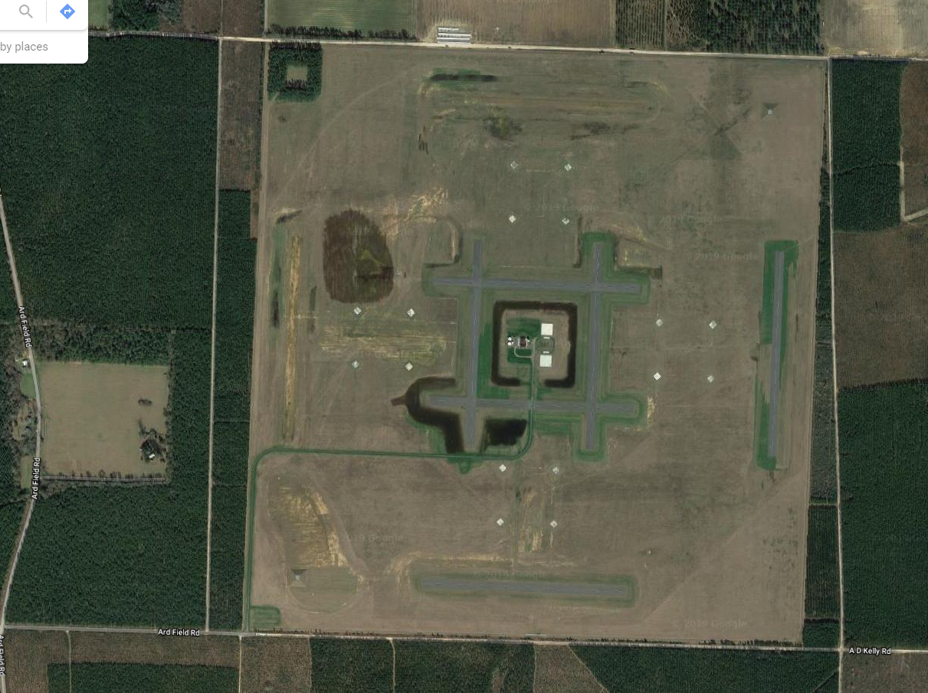
AGENCY | BTN | FREQ
SITE X | 13 | 327.400
WESTERN CMN | 19 | 311.400
PACE | 9 | 250.000
HT-18 BASE | 6 | 255.100
020@5
315
45
CAL
PINNACLE
270
90
225
180
135
MAG VAR -2.1
NOLF SITE X
LOCATION | N 30°48.91 / W 87°10.09
ELEVATION | 211 FEET MSL
SIZE | 1200 x 1200 METERS
COMPOSITION | GRASS, GRAVEL
OBSTACLES | 75-100’ TREES, PINNACLE, CRASH SHACK
WAVE OFF EAST
PWR | %
HIGE/HOGE
PA
CRASH SHACK
1300S
AZ: 270
EL: 36
INGRESS 350°
FROM GATOR
EGRESS 175°
TO TREE FIELD
LAND 360°
PINNACLE

