Slide 1
CAT II IP Stan Training
UNCLASSIFIED

Slide 2
Overview
Gradecards
Review how to write appropriate comments.
Examine together examples and discuss how they should be revised.
We will review actual gradecards. Names have been removed.
Grading
What can and can’t be graded, how to assess performance.
UNCLASSIFIED

Slide 3
Overview
Event Execution
“C” Contact Flights
BI Flights
CCX Profiles
RI Flights
Low Level Flights
GPS Procedures
ILS-Y/Z
Holding PTA reports
Aircraft Aborts
IP Mindset
IP Preparation
UNCLASSIFIED

Slide 4
Writing Gradecards
“GTN-650 Configured Aircraft” or “KLN-900 Configured Aircraft”
Do not write: “ADS-B Bird,” “Legacy Bird,” or anything else.
Spelling/grammar errors are not acceptable.
BAW: Tell us how their trim and scan are progressing (BIs particuarly).
Don’t just provide a list of parameters. Tell us why the SNA was off parameters.
Delete “Above/Below Average” from your gradecard vocabulary.
Refrain from using comments that grade an NFS relative to peers (e.g., “above average”) rather than relative to CTS. These comments are not appropriate in Standards-Based Training and shall not be used on ATFs.(1500.4J pg 6-4)
UNCLASSIFIED
Notes:
TIMS has spellcheck, use it!

Slide 5
I4002 Gradecard (1/2): What issues do you see?
UNCLASSIFIED

Slide 6
I4002 Gradecard (2/2): What issues do you see?
UNCLASSIFIED

Slide 7
I4002 Gradecard (1/2): What issues do you see?
Great info about scan… but what about trim?
UNCLASSIFIED

Slide 8
I4002 Gradecard (2/2): What issues do you see?
The SNA needs to perform 5 maneuvers for the first time up to MIF on an EOB flight?
Inappropriate.
Clearly the SNA is struggling… but zero comments on #4 BAW?
UNCLASSIFIED

Slide 9
I4003 Gradecard: What issues do you see?
UNCLASSIFIED

Slide 10
I4003 Gradecard: What issues do you see?
Where did you go?
Which Departure?
Not where WX goes.
UNCLASSIFIED

Slide 11
I4303 Gradecard: What issues do you see?
UNCLASSIFIED

Slide 12
I4303 Gradecard: What issues do you see?
How did you get to the West?
Which approaches did you do?
Failed card PTP and holding?
UNCLASSIFIED

Slide 13
I4303 Gradecard: What issues do you see?
UNCLASSIFIED

Slide 14
I4303 Gradecard: What issues do you see?
List the approaches.
???
Did you really do an ILS approach?
UNCLASSIFIED

Slide 15
I4303 Gradecard: What issues do you see?
UNCLASSIFIED

Slide 16
I4303 Gradecard: What issues do you see?
How did you get to NBJ?
How did the flight terminate?
Failed card PTP?
UNCLASSIFIED

Slide 17
I4402 Gradecard: What issues do you see?
UNCLASSIFIED

Slide 18
I4402 Gradecard: What issues do you see?
Which approaches did you do?
How was the airspace brief?
Stab off for most of the flight?!?
Zero other comments?
Where did you hold?
Any SNA deficiencies/trends?
Approaches don’t match comments!!!
Why is LOC approach graded?
UNCLASSIFIED

Slide 19
C4801 Gradecard: What issues do you see?
UNCLASSIFIED

Slide 20
C4801 Gradecard: What issues do you see?
Where did you do your landings?
Logged 1.8 but only did 4 landings? Hmm…
UNCLASSIFIED

Slide 21
SNA Progression: What issues do you see?
I4301
I4302
UNCLASSIFIED

Slide 22
SNA Progression: What issues do you see?
I4301
I4302
No ILS Y or Z on either flight???
(This SNA is on I4404 today and *still* hasn’t flown either of the ILS Y/Z approaches.)
Show the SNA these approaches on the I4301 and I4302.
UNCLASSIFIED

Slide 23
“If it’s not in the FTI, it’s not how we do it.”
TA Manual (1500.4J), paragraph 512 “Adding Items to an Event”
“The instructor shall not demonstrate, nor shall the NFS perform, unnumbered items and items not in the stage (except for weather-driven instrument approaches and pre-briefed maneuvers flown for instructor proficiency.”
Examples of things you cannot ask the SNA to perform:
Failed Card ILS / GPS Approaches (no CTS exists)
Failed Card Holding (no CTS exists)
Other than TACAN/VOR/NDB Approach on BIs (not on the card)
Two Minute Holding Legs (contradicts FTI and FAR/AIM)
Stab-Off Partial Panel Oscar Pattern (come on…)
UNCLASSIFIED

Slide 24
C4600 Event Execution
C4601/2
Com/Nav Checklist and Preflight is a 4.
Do the comm/nav even if hotseating. You can preflight after shutdown as well.
Help SNA avoid over controlling the aircraft
Review basics from Bravos
Taxi on the lines
Turn about the mast
Land in the center of the box.
Power Off Maneuvers
Demo the first cut-gun to a “4.”
No surprise cut-guns, ensure that cut-gun ORM is performed in the ORM brief.
Hit hard on proper use of trim from the beginning. They could fly contacts in the “B”, now they need to start learning to trim in attitudes
C4601
Trim Fam in transit (FT button / Fly Through / Pedal Trim)
UNCLASSIFIED

Slide 25
C4700 Flight Execution
C4701/2
Take opportunities to preflight with SNA.
(They’ve been through BIs/Ris since the previous block!)
EPs in context
Power limited to a sliding landing
FCS failure prior to steep approach (flex to normal)
Reinforce two part power checks! (Contact FTI)
Autorotation profile management (over, back, up not a fixed input every time).
Pattern geometry and corrections for winds/performance
C4702 Specific
Ensure SNA has seen an Echo arrival to KNDZ.
Single-Instrument Indications!
Opportunity to discuss EPs in context.
UNCLASSIFIED

Slide 26
C4800 Flight Execution
Bulk of the flight should be spent conducting low work and landing patterns.
C4801 recommendations:
2R4 / KNDZ Pads + auto demo
C4802 recommendations:
KCEW / 2R4 (discuss BI scan enroute)
Hospital fam only if everything else going well.
Two landing patterns + Hospital/Eglin corridor is NOT an appropriate profile.
UNCLASSIFIED
Notes:
Don’t cheat the student out of a flight!

Slide 27
I4000/I4100 Flight Execution
Focus on trim & scan pattern
IPs need to be looking at both the gauges and the SNA’s physical manipulation of the controls (CTS for BAW includes proper use of trim and attitudes)
Seek a mix of WABEN/BAWDI departures.
At least 1 BAWDI in the I4100 block please!
Newer IPs, if you need an East refresher, just ask!
Actual vs. Student approaches are valuable to practice different skills:
Student approaches are great for point-to-point and allow more deviations, while actual approaches are great for practicing live ATC comms/real-world flow.
UNCLASSIFIED
Notes:
Easy way to practice a Point-to-Point on every BI? Once you determine your landmark (ie, Fireworks Stand), tell the SNA to perform a PTP to that location (using the student plates).

Slide 28
I4000/I4100 SNA Expectations
IPs should expect SNAs to maintain a running commentary throughout – including describing what the instruments are showing, whether they are ahead or behind in a specific maneuver, and what inputs they are making to correct.
SNAs should begin to demonstrate instrument flight CRM and cockpit management skills.
IP should ask the SNA to describe his scan… The IP should continue to monitor and correct the SNA’s trim technique.
One or two simulated emergencies/malfunctions per flight are sufficient.
SNAs should be able to do their own maneuver complete reports. If they cannot-something is wrong with their trim.
UNCLASSIFIED

Slide 29
I4300/I4400/I4500 Big Picture
I4300
SNA learns to shoot approaches, BAW maintained, IP demonstrates value of copilot/crew.
I4400
Out and Ins!
SNA handles approaches well enough to execute EPs and BAW, SNA tasks IP/crew . Able to fight through (minor) task saturation.
I4500
IP talks about “HAC” decisions, reinforce trim usage, shows GPS functionality, cockpit setup & prepares for inst check!
All Blocks:
Take every opportunity to practice preflight with SNA.
UNCLASSIFIED
Notes:
Take every opportunity for the SNA to practice preflights!

Slide 30
I4300/I4400 Flight Execution
Stress the FTI Procedures
WRNTB / TINTS / PASTTG&G / 6 T’s every time.
SNAs should be verbalizing their procedures and setup process.
Majority instruction vs. evaluation, but SNA should demonstrate knowledge and execution of sound procedures.
“Where are you on the approach?”
Reinforce visualizing their location in space.
UNCLASSIFIED
Notes:
And CHAIRFLYING!

Slide 31
I4300 Flight Execution
I4301
KPNS
Hold @ PENSI/NUN, Approaches at KPNS, end with ILS Z/Y at KNDZ, or
KCEW
Hold @ CEW, VOR-A, Approaches at KCEW (ILS/LOC/RNAV), end with ILS Z/Y at KNDZ.
I4302
Fly the profile above the SNA hasn’t seen.
Students should see both the ILS-Y and Z by the end of I4302.
Chairfly the approach with them prior to launch the first time they execute.
UNCLASSIFIED

Slide 32
I4303 Flight Execution (sample profile)
Western Operating Area
PTP from WABEN to EAGLE (Student App Plates)
EAGLE for the TCN 33
JORDN for the TCN 24 arcing approach
Contact PNS Approach for the No-Gyro PAR at KNDZ.
UNCLASSIFIED
Notes:
As one example. The flight can be performed to the east as well, of course.

Slide 33
I4300 vs. I4400: EPs in Flight
I4300 – One to two simulated emergencies/malfunctions per flight are sufficient (FIG).
Ex. Gauge failure, Simulated Engine Fire in Flight.
Apply lost comms decision tree in flight.
I4400 – One to three simulated emergencies, during approaches, are sufficient (FIG).
Ex. Engine fire, ENG/XMSN Chip Lights, Oil Pressure or Oil Temp, Gyro Instruments, Lost Comms, Smoke and Fume Elimination.
UNCLASSIFIED

Slide 34
GPS Procedures
Using RNAV approach for destination/alternate
With WAAS capable GPS (GTN-650) you CAN plan for both destination and alternate with RNAV mins.
Shooting approach with GAD failure
GAD only controls your green needle
Your deviation bar will still work
By utilizing DEFAULT NAV page, map page, or Vectors from ATC you can still navigate to the IAF and shoot the approach with the deviation bar
Ensure you are teaching these (and they can practice flying with GAD failure if you pull the CB)
UNCLASSIFIED

Slide 35
I4402 / I4404 Event Execution
I4402 Airspace Brief
Bring charts to the brief the SNA hasn’t seen (ex. ORD TAC, Denver Sectional, LAX Sectional).
Show examples for every type of airspace.
I4404 “Pre-check” Event
In-depth cross-section of information across all pubs/procedures. *Practice holding!*
UNCLASSIFIED

Slide 36
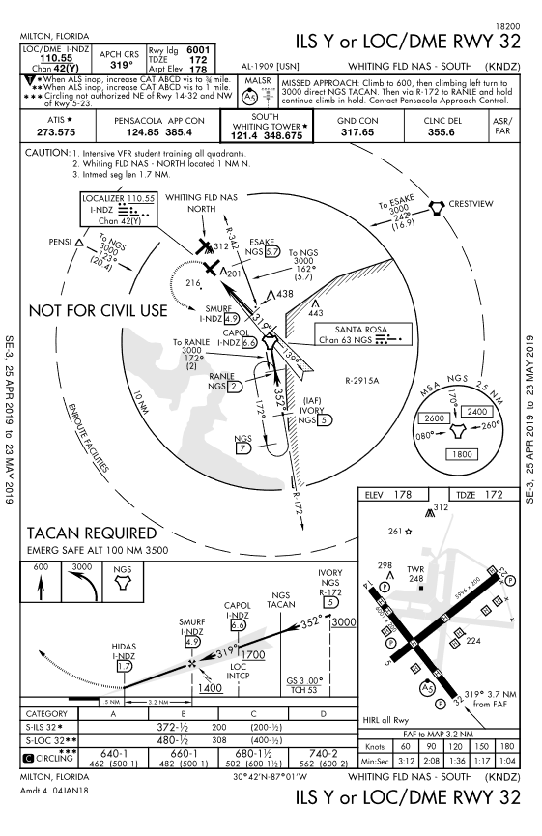
ILS-Y
CRM
Brief specific NFP requirements during approach brief
NAVAID Change
Brief NAVAID swap during approach brief
Use MIN DME!
When established on LOC
Stepdown from 17 to 14
FAF on precision approach
ILS Minimums
Precision approaches can only be shot to precision mins
UNCLASSIFIED

Slide 37
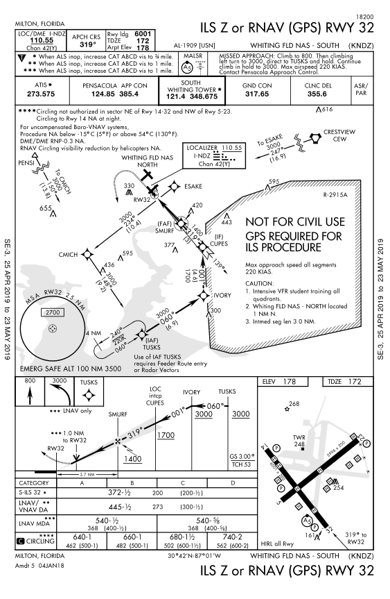
ILS-Z
Same as ILS-Y plus…
Loading approach
RNAV-32 vs ILS-Z
TUSKS vs VECTORS
Activate CUPES leg
Talk to VLOC Auto Switch
Turn Anticipation at CUPES
UNCLASSIFIED

Slide 38
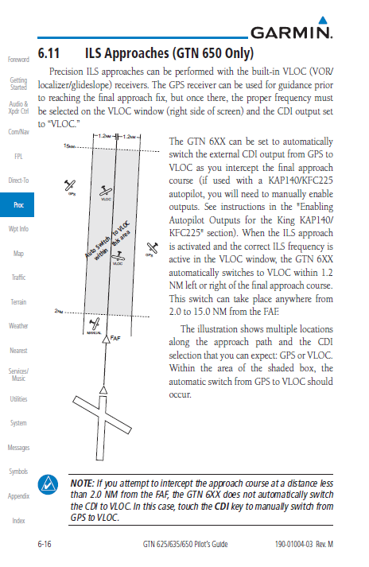
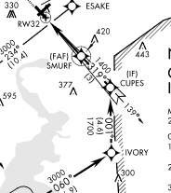
ILS-Z VLOC Auto Switch
UNCLASSIFIED

Slide 39
Holding PTA Reports
“The following reports should be made to ATC or FSS facilities without a specific ATC request:”
“(f) The time and altitude or flight level upon reaching a holding fix or point to which cleared.”
“(g) When leaving any assigned holding fix or point.”
“NOTE – The reports in subparagraphs (f) and (g) may be omitted by pilots of aircraft involved in instrument training at military terminal area facilities when radar service is being provided.
AIM 5-3-4
UNCLASSIFIED

Slide 40
Aircraft Aborts
If you can not complete the event safely or you can not conduct training with a specific degradation then abort.
If there is an associated EP, execute the EP and adhere to landing criteria.
This decision will greatly be assisted by your knowledge of the aircraft systems.
Electrical systems: understand what equipment is affected and how that will impact your flight profile.
Bottom line, Don’t automatically cancel if something is broken.
Yaw servo
Yaw servo WILL overheat in flight and freeze.
With a frozen yaw servo you can still manipulate the pedals.
If the yaw servo is behaving erroneously, pulling the CB and leaving it out is valid.
Training can be accomplished safely with a failed yaw servo.
UNCLASSIFIED

Slide 41
IP Mindset
We are not the SNA’s peers.
We are their instructors.
CCX / Prepo Ops / Onwing does not change this.
Rank / Name is the proper way to address and be addressed by students.
No first names.
Be the model officer / instructor / pilot.
If you wouldn’t want them to do it, don’t do it.
UNCLASSIFIED

Slide 42
IP Preparation
We know the FTI procedures/knowledge better than the SNA.
We instruct the FTI and uphold the standard.
We have a working knowledge of the following:
All FTIs (with current changes)
Squadron SOP
The TW-5 Flight Instructor Guide (FIG)
The MPTS / MCG
Wing FIST (with CH-1)
CNATRA 1542 GTN Note
CNATRA 1500.4J TA Manual
How to submit TCRs…
FAR/AIM (the 2019 version…)
Supplementary FAA Information (Advisory Circulars, etc.)
UNCLASSIFIED

Slide 43
Questions?
UNCLASSIFIED

