Slide 1
SAR TACAID

Slide 2
STEP 1

Slide 5
Remember that U.S. military Parachutes open at 14,000 feet. Then simply read off your drift from the table.

Slide 7
Rule Of Thumb
Pick the lowest altitude that gives you the best Sweep Width (You want the HIGHER Sweep Width value, time permitting)

Slide 8
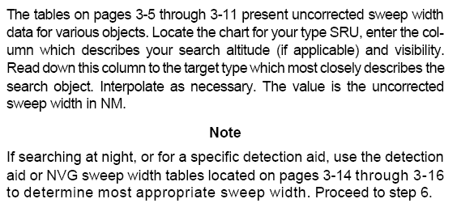

Slide 9
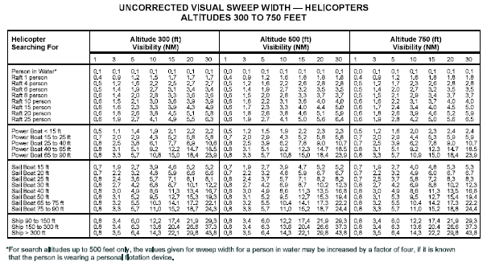
PASSIVE
Do not forget the NOTE at the bottom, applicable to persons in the water

Slide 10
PASSIVE

Slide 12
PASSIVE

Slide 13
PASSIVE

Slide 14
What are Active and Passive Searches?
With active searches go to the applicable TACAID page and read off the Corrected Sweep Width.
ACTIVE | PASSIVE
NVG, FLIR or the Survivor has a Red Hand Flare, Strobe or some other device/means that can gain the attention of the SRU. | F-18 goes down in the ocean and the survivor is not known to have any signaling devices. SRU not equipped with NVG’s or FLIR

Slide 15
PASSIVE SEARCHING OVERWATER
Use the Equation:
Wc=Wu*Ww*Wf*Wa
Where:
Wu=Uncorrected Sweep Width (pg 3-5 to 3-7)
Ww=Correction for weather (pg 3-12)
Wf=Fatigue Correction (pg 3-12)
Wa=Correction for SRU airspeed (pg 3-13)

Slide 16
ACTIVE SEARCHING OVERWATER
Just pick your corrected sweep widths from the following Tables.

Slide 17
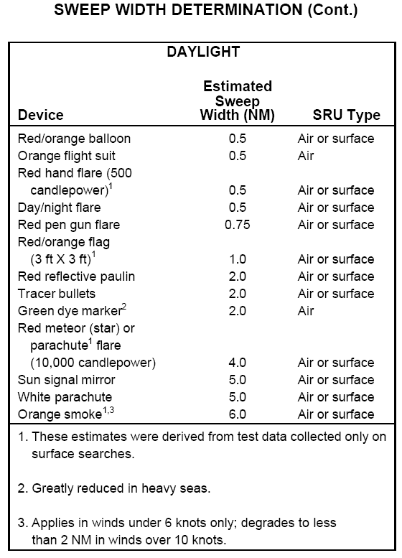
ACTIVE
Just pick your Corrected Sweep Width off the chart and NO other Sweep Width corrections are needed.

Slide 18
ACTIVE
Just pick your Corrected Sweep Width off the chart and NO other Sweep Width corrections are needed.

Slide 19
ACTIVE
Remember that everything after the 10ths place is a note Example: 0.21 is .2 and Note 1.
0.31 is 0.3 and Note 1
Just pick the Corrected Sweep Width Off the Table and NO other sweep width corrections are needed.

Slide 20
ACTIVE
These are the NVG NOTES 1 and 2.

Slide 23
Just pick your Altitude and Corrected Sweep Width off the chart and no other Sweep Width corrections are needed.
ACTIVE

Slide 26
For Over water searches, Average your Coverage factors from all searches to determine the POD for a given search. Example: First search you have a C of .8 and second search you have a C of 1.0. This gives an average C of .9 for both search’s enter the chart and obtain a POD of 93%.

Slide 30
A C-12 or Cessna are light aircraft.

Slide 31
Remember to read the note at the bottom here. All the Values given in this table are Corrected Sweep widths. No other corrections required.

Slide 32
Remember to use the closest value for Track Spacing. Example: If Track Spacing is 0.7 use 0.5 (Do NOT round up or down, just use the closest value). If visibility is 5mi in the problem your given use 4 mi (Closest value).

Slide 33
For Overland searches just use the chart. Use Previous or Cumulative POD and POD for this search. Intersect and read off the Cumulative POD

Slide 37
QUESTIONS?

