Slide 1
BEFORE STARTING!!
DON’T SAVE OVER MASTER COPY
Move a copy of the brief to your personal folder
Update all the information in RED to apply to your specific capstone event
Talk with the Formation Stage Manager to get specific location and route approved.
Send questions up to your STAN dept
How to conduct presentation
Brief the items on the main slide in order
When you reach an *, hit next to brief the specific slide then next to return to the main slide
“Greyed out items” represent items previously briefed

Slide 2
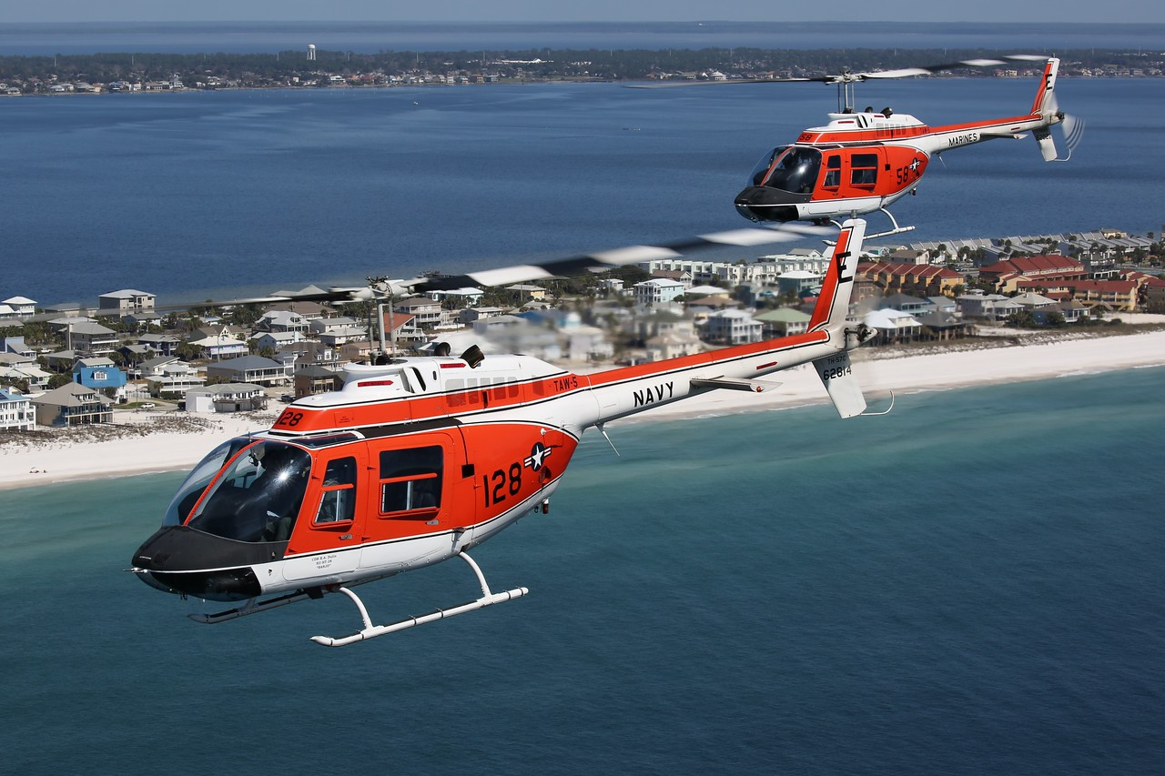
FORMATION CAPSTONE
FRM4101A / FRM4102A

Slide 3
ORIENTATION
Time Hack
Roll Call
EB/FH/LUCKY ____ (SPOT___)
IP 1/ SMA 1
EB/FH/LUCKY ____ (SPOT___)
IP 2 / SMA 2
**Designates SL
External Callsign / Internal Callsign
Smart Pack Review
Maps Required
Weather
-Current WX / Forecast WX /
Destination WX / WX Required
SITUATION
Commander’s Intent
MISSION
MISSION EXECUTION
Overview
Obstacles
-ABCTRP
Scheme of Maneuvers
-Walk
-Comm Check
-Takeoff
Route
Objective Area
RTB
CONTINGENCIES
Emergency Procedures
-IMC/VMC Emergencies
-Ditch / Emergency Landing / Egress
-Simulated Emergencies
IIMC
Loss of Visual Contact
Lost Comms
Disorientation Procedures
-Magellan
Down Aircraft
Aborts/Waveoffs
ADMIN & LOGISTICS
Flight Duration
Fuel
-Mission Fuel / Bingo Fuel
COMMAND AND SIGNAL
Communications/ Radio Procedures
Frequencies / NAVAIDS
Brevity
Terminate/KIO
SQUAWK
Visual Signals
ADMIN
CRM
-Control Transfer
-Lookout Procedures
-Vertigo
-Altitude Warnings / RADALT
NATOPS by Exception
DUE OUTS

Slide 4
ORIENTATION
Time Hack
Roll Call
LUCKY ____ (SPOT___)
IP 1/ SMA 1
LUCKY ____ (SPOT___)
IP 2 / SMA 2
*Designates SL
External Callsign / Internal Callsign
Smart Pack Review
Maps Required
Weather
-Current WX / Forecast WX /
Destination WX / WX Required
*SITUATION
Commander’s Intent
MISSION
MISSION EXECUTION
Overview
Obstacles
-ABCTRP
Scheme of Maneuvers
-Walk
-Comm Check
-Takeoff
Route
Objective Area
RTB
CONTINGENCIES
Emergency Procedures
-IMC/VMC Emergencies
-Ditch / Emergency Landing / Egress
-Simulated Emergencies
IIMC
Loss of Visual Contact
Lost Comms
Disorientation Procedures
-Magellan
Down Aircraft
Aborts/Waveoffs
ADMIN & LOGISTICS
Flight Duration
Fuel
-Mission Fuel / Bingo Fuel
COMMAND AND SIGNAL
Communications/ Radio Procedures
Frequencies / NAVAIDS
Brevity
Terminate/KIO
SQUAWK
Visual Signals
ADMIN
CRM
-Control Transfer
-Lookout Procedures
-Vertigo
-Altitude Warnings / RADALT
NATOPS by Exception
DUE OUTS

Slide 5
SITUATION / MISSION
SITUATION
Skrussian forces have invaded sovereign Blukrainian territory in attempt to overthrow the government and annex the region.
The war has reached a stalemate with each side sustaining heavy casualties.
Last month, NATO began efforts to directly support Blukrainian forces with naval, air, and ground forces.
U.S. forces are being directed to assist Blukraine’s military, while attempting to avoid direct conflict with Skrussian forces.
LZs and FOBs have been created and surveyed to allow air assets to bring in supplies and move injured personnel.
TW5 HT Squadrons have been tasked to support NATO efforts. The assigned assets will provide armed surveillance and reconnaissance and theater mobility to and from designated LZs from KNDZ, as well as provide transportation for injured personnel to safer FOBs for medical assistance.
MISSION
2 HT-28 aircraft will launch as tasked at 0000L and fly out to LZ _____ to deliver ammunition to Blukrainian forces.
After departing from LZ ____ , the flight will proceed to FOB ____ to resupply/drop off any injured personnel.
Once complete with resupply, proceed to LZ ____ and drop off supplies.
RTB at the completion of second drop off back to KNDZ.
Assets will be ready to assist with any pop-up tasking throughout the mission.
COMMANDER’S INTENT
Assigned crews shall provide any tasked assistance and safe delivery of supplies.
Movement of injured personnel authorized.
No loss of aircraft and/or personnel.

Slide 6
ORIENTATION
Time Hack
Roll Call
EB/FH/LUCKY ____ (SPOT___)
IP 1/ SMA 1
EB/FH/LUCKY ____ (SPOT___)
IP 2 / SMA 2
*Designates SL
External Callsign / Internal Callsign
ORM
Smart Pack Review
Maps Required
Weather
-Current WX / Forecast WX /
Destination WX / WX Required
SITUATION
Commander’s Intent
MISSION
MISSION EXECUTION
*Overview
Obstacles
-ABCTRP
Scheme of Maneuvers
-Walk
-Comm Check
-Takeoff
Route
Objective Area
RTB
CONTINGENCIES
Emergency Procedures
-IMC/VMC Emergencies
-Ditch / Emergency Landing / Egress
-Simulated Emergencies
IIMC
Loss of Visual Contact
Lost Comms
Disorientation Procedures
-Magellan
Down Aircraft
Aborts/Waveoffs
ADMIN & LOGISTICS
Flight Duration
Fuel
-Mission Fuel / Bingo Fuel
COMMAND AND SIGNAL
Communications/ Radio Procedures
Frequencies / NAVAIDS
Brevity
Terminate/KIO
SQUAWK
Visual Signals
ADMIN
CRM
-Control Transfer
-Lookout Procedures
-Vertigo
-Altitude Warnings / RADALT
NATOPS by Exception
DUE OUTS

Slide 7
OVERVIEW
INSERT AN OVERVIEW PICTURE OF THE ROUTE FROM JMPS!!
USE SNIPPING TOOL

Slide 8
ORIENTATION
Time Hack
Roll Call
EB/FH/LUCKY ____ (SPOT___)
IP 1/ SMA 1
EB/FH/LUCKY ____ (SPOT___)
IP 2 / SMA 2
*Designates SL
External Callsign / Internal Callsign
ORM
Smart Pack Review
Maps Required
Weather
-Current WX / Forecast WX /
Destination WX / WX Required
SITUATION
Commander’s Intent
MISSION
MISSION EXECUTION
Overview
Obstacles
-ABCTRP
Scheme of Maneuvers
-Walk
-Comm Check
-Takeoff
*Route
Objective Area
RTB
CONTINGENCIES
Emergency Procedures
-IMC/VMC Emergencies
-Ditch / Emergency Landing / Egress
-Simulated Emergencies
IIMC
Loss of Visual Contact
Lost Comms
Disorientation Procedures
-Magellan
Down Aircraft
Aborts/Waveoffs
ADMIN & LOGISTICS
Flight Duration
Fuel
-Mission Fuel / Bingo Fuel
COMMAND AND SIGNAL
Communications/ Radio Procedures
Frequencies / NAVAIDS
Brevity
Terminate/KIO
SQUAWK
Visual Signals
ADMIN
CRM
-Control Transfer
-Lookout Procedures
-Vertigo
-Altitude Warnings / RADALT
NATOPS by Exception
DUE OUTS

Slide 9
ROUTE ADMIN / ROLES
Formation
Cruise Formation inside Controlled Airspace
Combat Cruise in Uncontrolled
All legs will be flown at 500AGL/1,000MSL – Unless otherwise assigned
All legs will be flown at 100 kts – Unless power limited
LEAD
Primary Navigation
Handle all ATC calls
Track section fuel consumption
WING
Acquire ATIS’s
Monitor CTAFs
Backup Navigation

Slide 10
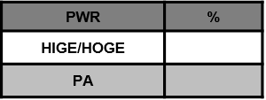
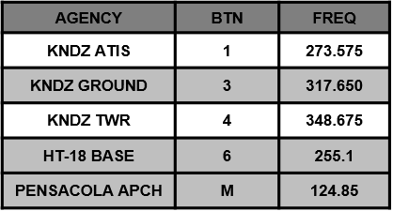
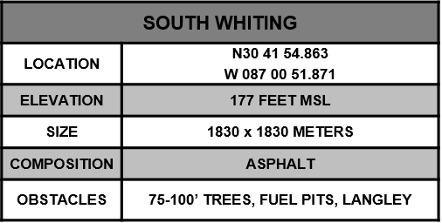
SOUTH WHITING
315
45
NORTH WHITING AIRSPACE
270
90
225
180
135
MAG VAR -2.0
HANGARS
FUEL PITS
EGRESS 135°
TO ABLE
F- Cruise Formation
A- 100KIAS, 900’MSL
L-Normal Lighting
C- BTN 4, 121.95, 0100
O: KNSE, MX Pattern
N: GTN Route
INGRESS 051°
FROM IGOR

Slide 11
ROUTE
ROUTE FROM NDZ TO ENROUTE LZ!!
Use snipping tool on jmps computers to capture route
Use JOGAIR 1:250k or sectional, whatever used when printing out route.
Ok to break it into multiple slides

Slide 12
TERMINAL AREA
Drop a picture of your 1st LZ here from the LZ diagram PPT!
MAKE SURE TO UPDATE THE INFORMATION
Refer slide 1 on the LZ diagram PPT

Slide 13
ROUTE
ROUTE FROM ENROUTE LZ TO FOB!!
Use snipping tool on jmps computers to capture route
Use JOGAIR 1:250k or sectional, whatever used when printing out route.
Ok to break it into multiple slides

Slide 14
FOB
Drop a picture of your OUT-IN location here from the LZ diagram PPT!
MAKE SURE TO UPDATE THE INFORMATION
Refer to slide 1 on the LZ diagram PPT

Slide 15
ROUTE
ROUTE FROM FOB TO ENROUTE LZ!!
Use snipping tool on jmps computers to capture route
Use JOGAIR 1:250k or sectional, whatever used when printing out route.
Ok to break it into multiple slides

Slide 16
TERMINAL AREA
Drop a picture of your 2nd LZ here from the LZ diagram PPT!
MAKE SURE TO UPDATE THE INFORMATION
Refer to slide 1 on the LZ diagram PPT

Slide 17
ROUTE
ROUTE FROM 2nd ENROUTE LZ to NDZ!!
Use snipping tool on jmps computers to capture route
Use JOGAIR 1:250k or sectional, whatever used when printing out route.
Ok to break it into multiple slides

Slide 18
SOUTH WHITING
315
45
NORTH WHITING AIRSPACE
270
90
225
180
135
MAG VAR -2.0
HANGARS
FUEL PITS
EGRESS 135°
TO ABLE
F- Parade for Homefield Break
A- 100KIAS, 300’ AGL
L-Normal Lighting
C- BTN 4, 121.95, 0400
O: KNSE, MX Pattern
N: GTN Route
INGRESS 051°
FROM IGOR

Slide 19
ORIENTATION
Time Hack
Roll Call
EB/FH/LUCKY ____ (SPOT___)
IP 1/ SMA 1
EB/FH/LUCKY ____ (SPOT___)
IP 2 / SMA 2
*Designates SL
External Callsign / Internal Callsign
ORM
Smart Pack Review
Maps Required
Weather
-Current WX / Forecast WX /
Destination WX / WX Required
SITUATION
Commander’s Intent
MISSION
MISSION EXECUTION
Overview
Obstacles
-ABCTRP
Scheme of Maneuvers
-Walk
-Comm Check
-Takeoff
Route
Objective Area
RTB
CONTINGENCIES
Emergency Procedures
-IMC/VMC Emergencies
-Ditch / Emergency Landing / Egress
-Simulated Emergencies
*IIMC
Loss of Visual Contact
Lost Comms
Disorientation Procedures
-Magellan
Down Aircraft
Aborts/Waveoffs
ADMIN & LOGISTICS
Flight Duration
Fuel
-Mission Fuel / Bingo Fuel
COMMAND AND SIGNAL
Communications/ Radio Procedures
Frequencies / NAVAIDS
Brevity
Terminate/KIO
SQUAWK
Visual Signals
ADMIN
CRM
-Control Transfer
-Lookout Procedures
-Vertigo
-Altitude Warnings / RADALT
NATOPS by Exception
DUE OUTS

Slide 20
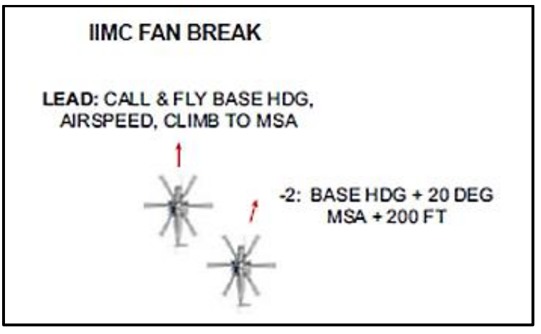
IIMC
FAN break procedure
Safe Headings/MSA: (update MSA along your route. Use highest one)
CASE
1: VMC/VMC
2: IMC/VMC
3: IMC/IMC
ATC

Slide 21
ORIENTATION
Time Hack
Roll Call
EB/FH/LUCKY ____ (SPOT___)
IP 1/ SMA 1
EB/FH/LUCKY ____ (SPOT___)
IP 2 / SMA 2
*Designates SL
External Callsign / Internal Callsign
ORM
Smart Pack Review
Maps Required
Weather
-Current WX / Forecast WX /
Destination WX / WX Required
SITUATION
Commander’s Intent
MISSION
MISSION EXECUTION
Overview
Obstacles
-ABCTRP
Scheme of Maneuvers
-Walk
-Comm Check
-Takeoff
Route
Objective Area
RTB
CONTINGENCIES
Emergency Procedures
-IMC/VMC Emergencies
-Ditch / Emergency Landing / Egress
-Simulated Emergencies
IIMC
Loss of Visual Contact
Lost Comms
Disorientation Procedures
-Magellan
Down Aircraft
Aborts/Waveoffs
ADMIN & LOGISTICS
Flight Duration
Fuel
-Mission Fuel / Bingo Fuel
COMMAND AND SIGNAL
Communications/ Radio Procedures
Frequencies / NAVAIDS
Brevity
Terminate/KIO
SQUAWK
Visual Signals
ADMIN
CRM
-Control Transfer
-Lookout Procedures
-Vertigo
-Altitude Warnings / RADALT
*NATOPS by Exception
DUE OUTS

Slide 22
NATOPs By Exception
Weight and Balance
Flight Publications Required
NOTAMs
Emergencies
Dynamic Rollover
PAC/PNAC Responsibilities

Slide 23
Due Outs
Update Weather
Fuel Card
Call FBO
Confirm hours
GPU

Slide 24
Questions

