Slide 1
SLAP Data From JMPS
Mar 2019

Slide 2
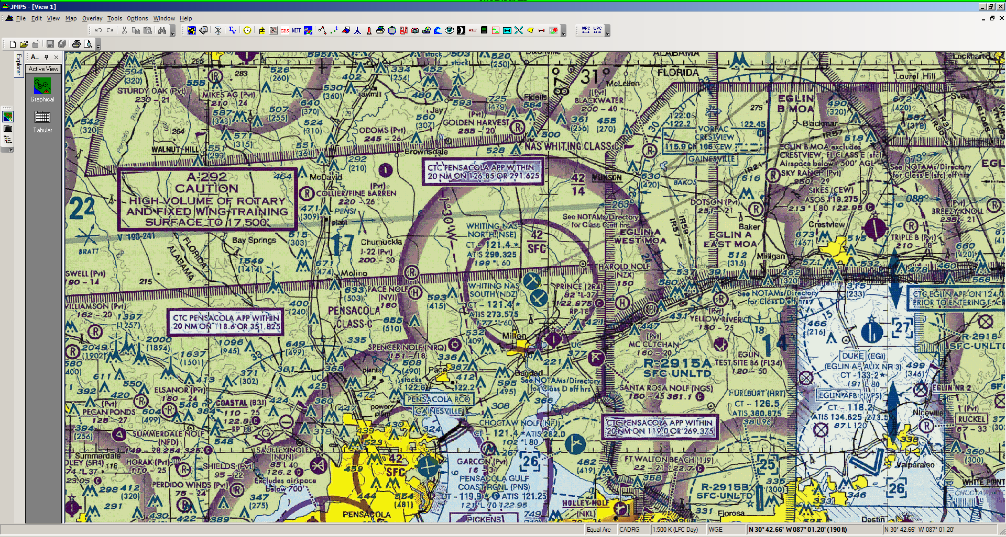
STEP 1
Select the SUMO Tool

Slide 3
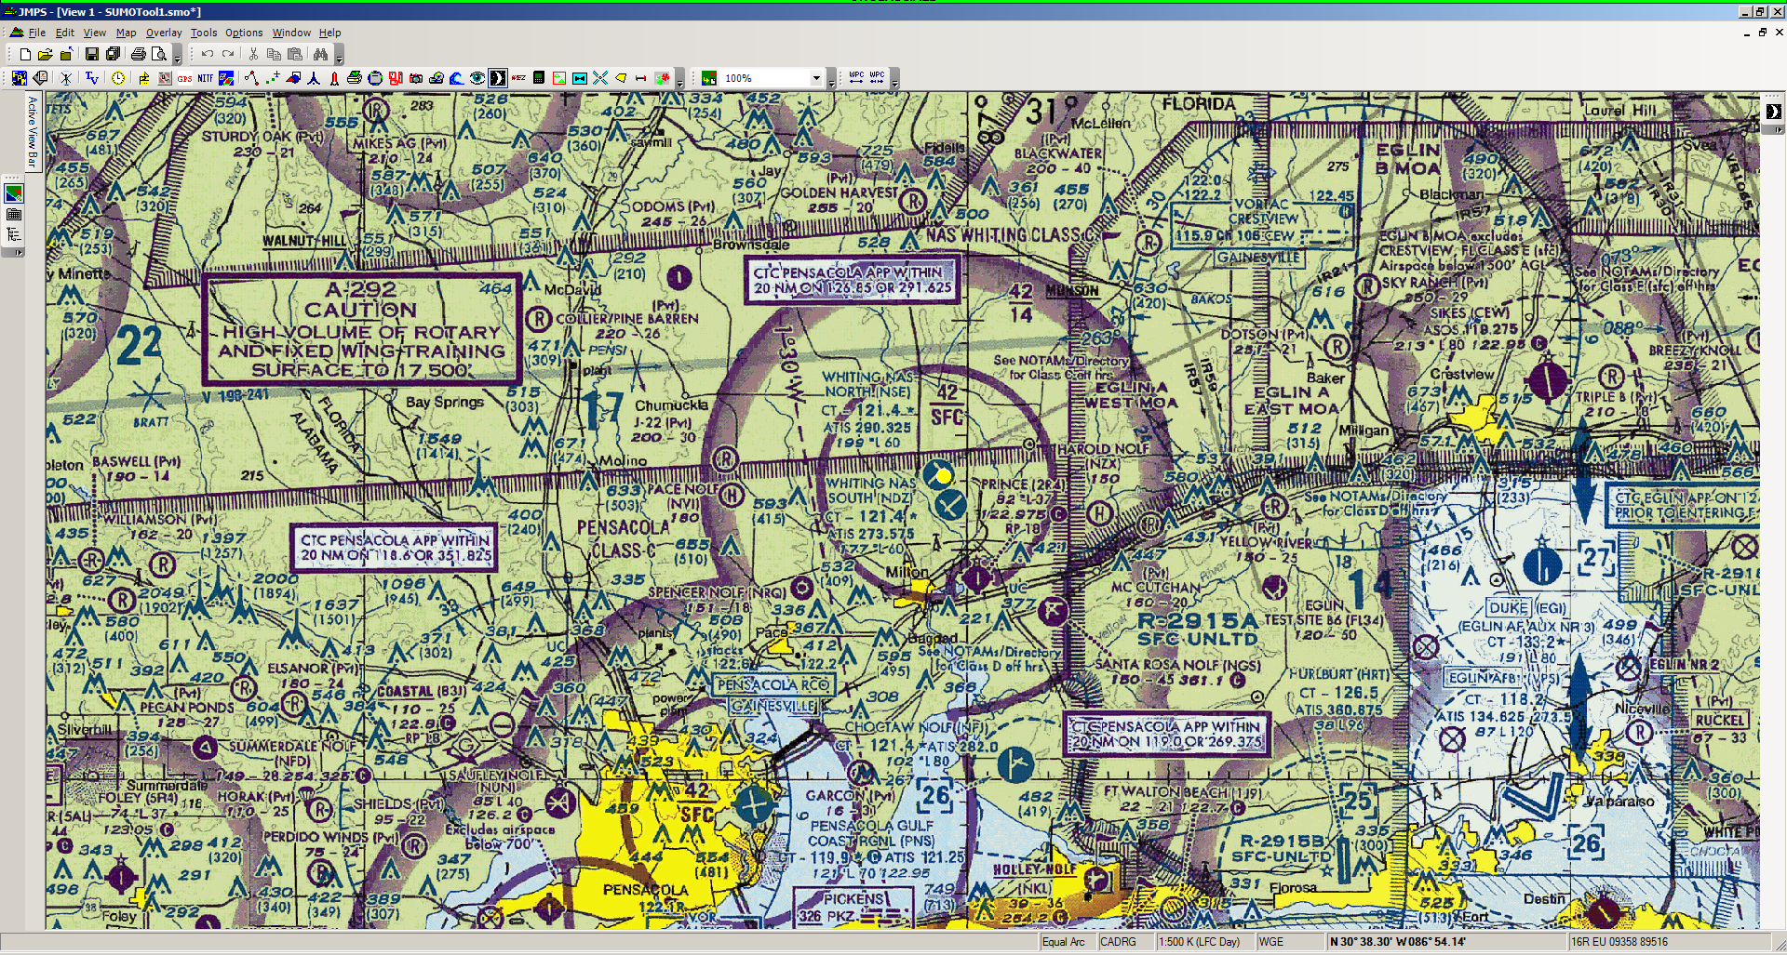
STEP 2
Find NAS Whiting Fld SUMO Point (YELLOW CIRCLE)
Right Click
Select NAS Whiting Fld Properties

Slide 4
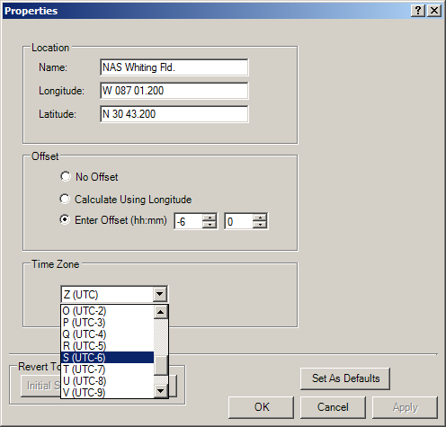
STEP 3
Select appropriate time zone
Click “Apply”
Click “OK”

Slide 5
STEP 4
Go to the Tabular Editor
Select Location to “NAS Whiting Fld”
Enter “Start Time,” “Stop Time,” and “Time on Target,” as desired

Slide 6
STEP 5
Select LEAA
Select Print

Slide 7
STEP 6
Select LDI
Select Print

