Slide 1
Print Instructions
  Select: Print Pages 3-20
  Select: Actual Size
  Select: Print on both sides (flip pages on SHORT edge)
  Select color or b/w

Slide 2
  This page intentionally left blank.

Slide 3
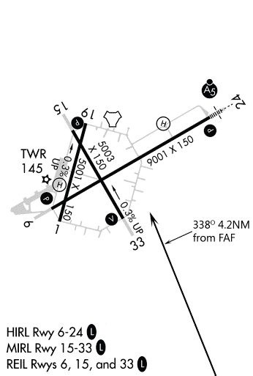
GATESWOOD, ALABAMA
VORTAC NBJ
Chan 60
APP CRS
338°
Rwy ldg 5003
THRE 146
Apt Elev 150
TACAN RWY 33
GATESWOOD MCAS (KNGW)
TRAINING AIR WING FIVE
T
Aircraft are granted an exemption from AIM 1-1-19, f(1)b for this approach only and may simulate NBJ by manually entering N 30°43.37’ W 87°32.62’. If flown with GPS, then RNP is 1.0NM, 0.3NM on final.
MISSED APPROACH: Climb straight ahead to 2000, turn right and intercept NBJ R-158 to EAGLE and hold.
KPNS ATIS
121.25
PENSACOLA APP CON
118.6 351.825
WESTERN COMMON
311.4 / CH 19 (CTAF)
STUDENT RADIO INSTRUMENT APPROACH &
DEPARTURE PLATES
5 NM
GATESWOOD
CHAN 60 NBJ
N 30°43.37’
W 87°32.62’
ʌ
.
1549
SNYPE
NBJ 0.8
ʌ
***FOR TRAINING ONLY -- VFR ONLY***
CROWE
NBJ 3
.
1096
338°
MSA NBJ 25NM
158°
3100
(IAF)
EAGLE
NBJ 5
ʌ
ʌ
338°
7 DME
ʌ
.
ʌ
ʌ
FLIGHT SUPPORT
ADVANCED HELICOPTER
2019
.
1397
ʌ
ʌ
ELEV 150
THRE 146
2047
.
ʌ
2000
.
R-158
1637
CROWE
NBJ 3
EAGLE
NBJ 5
TACAN
SNYPE
NBJ 0.8
158°
338°
338°
2000
1300
2.2 NM
2 NM
CATEGORY
A
B
C
D
S-33
750-1 600 (600-1)
CIRCLING
850-1 700 (700-1)
GATESWOOD, ALABAMA
GATESWOOD MCAS (KNGW)
TACAN RWY 33
COMTRAWINGFIVEINST 3710.25
9

Slide 4
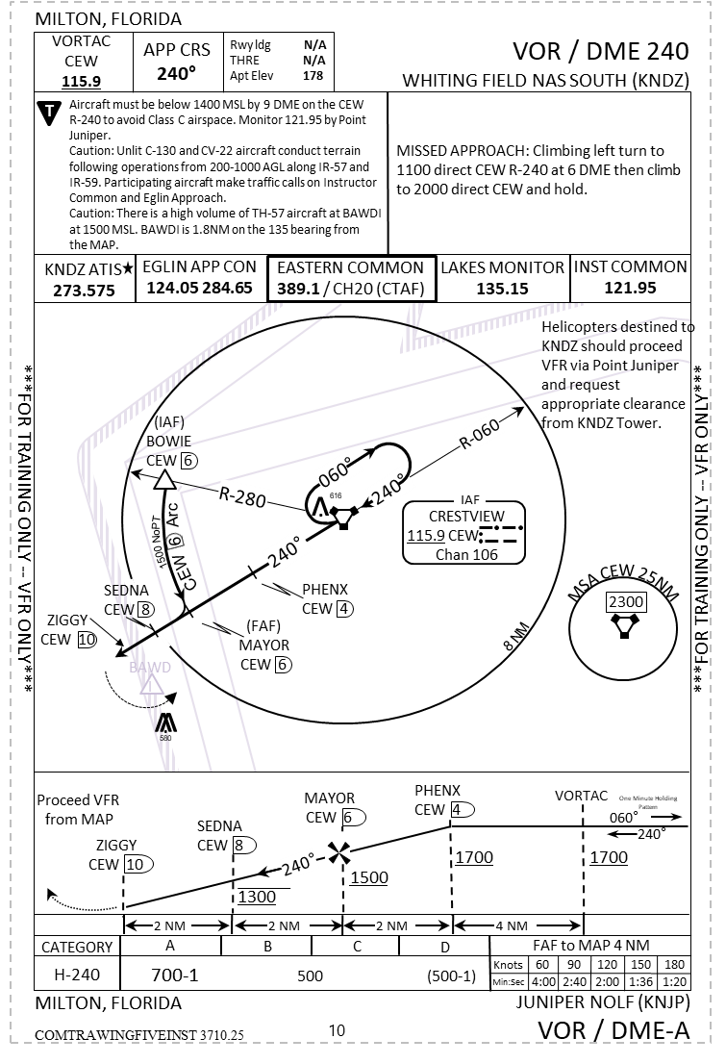
THIS PAGE LEFT INTENTIONALLY BLANK
I

Slide 5
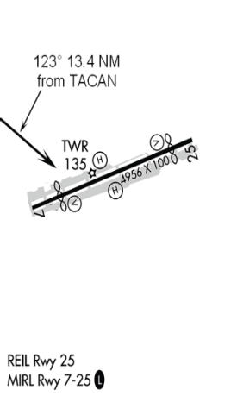
Change Summary
The following Interim Changes have been cancelled or incorporated into this edition:
CANTONMENT, FLORIDA
TACAN-A
NAVIE OLF (KNVE)
TACAN NBJ
Chan 60
APP CRS
123°
Rwy ldg N/A
THRE N/A
Apt Elev 150
Interim Change Number | Remarks/Purpose
T
Caution: Utilize caution for traffic at 1000’ to 2200’ at NAVIE on the NAVIE Departure.
Aircraft are granted an exemption from AIM 1-1-19, f(1)b for this approach only and may simulate NBJ by manually entering N 30°43.37’ W 87°32.62’. If flown with GPS, then RNP is 1.0NM, 0.3NM on final.
MISSED APPROACH: Climbing right turn to 2000 direct EAGLE and hold.
KPNS ATIS
121.25
PENSACOLA APP CON
118.6 351.825
WESTERN COMMON
311.4 / CH 19
IAF
MSA NBJ 25NM
R-303
GATESWOOD
CHAN 60 NBJ
N 30°43.37’
W 87°32.62’
3100
078ᵒ
258ᵒ
The following Interim Changes have been incorporated in this Change/Revision:
123ᵒ
Affected Procedure | Remarks/Purpose
ʌ
(FAF)
ELLIS
NBJ 5
.
1549
***FOR TRAINING ONLY -- VFR ONLY***
INKOM
NBJ 8.5
***FOR TRAINING ONLY -- VFR ONLY***
EAGLE
NBJ 5
ʌ
ʌ
158°
.
ʌ
1096
ʌ
.
NAVIE
NBJ 13.4
10 NM
ʌ
ʌ
.
1397
ʌ
ʌ
338°
2047
.
ʌ
7 DME
2000
.
1637
R-158
The following Interim Changes are outstanding and shall be maintained by the custodian of this manual:
Interim Change Number | Remarks/Purpose | Page(s) Affected | Remarks/Purpose
2000
ELEV 150
Remain
Within 10 NM
TACAN
EAGLE
303°
ELLIS
NBJ 5
2500
123°
123°
INKOM
NBJ 8.5
NAVIE
NBJ 13.4
2500
2300
2000
5 NM
3.5 NM
4.9 NM
CATEGORY
A
B
C
D
CIRCLING
1200-1 1050 (1100-1)
CANTONMENT, FLORIDA
NAVIE OLF (KNVE)
TACAN-A
COMTRAWINGFIVEINST 3710.25
II
COMTRAWINGFIVEINST 3710.25
11

Slide 6
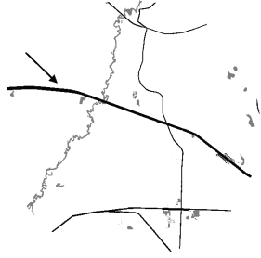
WELCOME STATION, FLORIDA
COPTER TACAN 147°
SITE 8 NOLF (CLOSED) (KNS8)
TABLE OF CONTENTS
INDEX OF SUPPLEMENTARY ENCLOSURES
TACAN NBJ
Chan 60
APP CRS
147°
Rwy ldg N/A
THRE N/A
Apt Elev 159
c
T
Aircraft are granted an exemption from AIM 1-1-19, f(1)b for this approach only and may simulate NBJ by manually entering N 30°43.37’ W 87°32.62’. If flown with GPS, then RNP is 1.0NM, 0.3NM on final.
MISSED APPROACH: Climbing right turn to 1500 direct NBJ. Contact ATC.
CHANGE SUMMARY………..…PAGE II
TABLE OF CONTENTS……….PAGE III
HOT SPOTS……………………PAGE IV
EASTERN AREA OVERLAY.…PAGE V
WESTERN AREA OVERLAY..PAGE VI
INOP COMP/VIS AIDS TABLE..…....PAGE VII
RADAR IAP MINIMUMS ………...….PAGE VIII
EXAMPLE RADAR IAP COMMS…….PAGE IX
WAYPOINT CREATION GUIDE…… PAGE 23
SIAP IMPROVEMENT PROCESS…..PAGE 24
CLIMB/DESCENT TABLE…………....PAGE 25
KPNS ATIS
121.25
PENSACOLA APP CON
118.6 351.825
WESTERN COMMON
311.4 / CH 19
CAUTION: Green route traffic approx 4 nm south of NBJ at 500 AGL.
`
INDEX OF INSTRUMENT PROCEDURE CHARTS
147⁰ 10 NM from
NBJ TACAN
R-327
Welcome
Station
NAME PAGE
BAY MINETTE MUNI (1R8)
RADAR MINIMUMS…………..….…… VIII
TACAN-A…………………..................... . 1
BAY MINETTE ONE DEPARTURE..….. 2
CRESTVIEW NAS (KNCE)
TACAN RWY 9R………………………… 3
COPTER VOR RWY 9L ………...…...… 4
TACAN RWY 18L……………….……..... 5
FLORALA MUNI (1R8)
RADAR MINIMUMS………….……..... VIII
TACAN RWY 4…………………..….…… 6
BURRITO-ONE DEP…………………… 7
GATESWOOD MCAS (KNGW)
TACAN RWY 24………………….……... 8
TACAN RWY 33…………….…………… 9
GULF SHORES (KJKA)
RADAR MINIMUMS…………………... VIII
JUNIPER NOLF (KNJP)
VOR/DME-240…………………....……. 10
NAME PAGE
NAVIE OLF (KNVE)
TACAN-A…………………………..……….. 11
SITE 8 NOLF (KNS8)
COPTER TACAN 147………………..…… 12
SITE X NOLF (KNSX)
TACAN-A…………………………………... 13
SITE X DEPARTURE…………………….. 14
SOUTH WHITING FIELD (KNDZ)
BAWDI ONE DEPARTURE………........... 15
NAVIE ONE DEPARTURE……………… 16
SHIPBOARD APPROACHES
CV-3 TACAN (HELICOPTER)……….…. 17
AIR-CAPABLE SHIPS
TACAN (HELICOPTER)………….……….. 18
LH-4 (HELICOPTER)……………………… 19
EMERGENCY LOW-VISIBILITY
APPROACH PATTERN (ELVA)…….…… 20
(ELVA) PATTERN - RADIO CALLS.……. 21
SHIP RESUME IX-514………………........ 22
102ᵒ
282ᵒ
IAF
147ᵒ
GATESWOOD
CHAN 60 NBJ
N 30°43.37’
W 87°32.62’
ʌ
.
***FOR TRAINING ONLY -- VFR ONLY***
1549
***FOR TRAINING ONLY -- VFR ONLY***
ʌ
147ᵒ
ʌ
ʌ
.
ʌ
ʌ
ʌ
.
1397
ʌ
ʌ
.
MSA NBJ 25NM
2047
.
ʌ
3100
2000
.
1096
10 NM
1637
RICHI
NBJ 10
SITE 8 NOLF is closed, operations at the field are prohibited.
See Inset
ELEV 159
327°
TACAN
1500
NBJ
TWR
18
1500
147°
1500
RICHI
NBJ 10
1500
147°
9
3907 x 20
27
Proceed VFR
3907 x 20
CATEGORY
10 NM
36
HELICOPTER
H-147°
1000-1 550 (600-1)
WELCOME STATION, FLORIDA
SITE 8 NOLF (CLOSED) (KNS8)
COPTER TACAN 147°
COMTRAWINGFIVEINST 3710.25
12
COMTRAWINGFIVEINST 3710.25
III

Slide 7
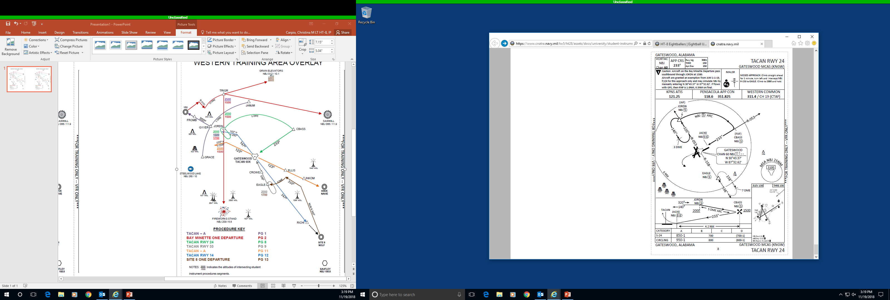


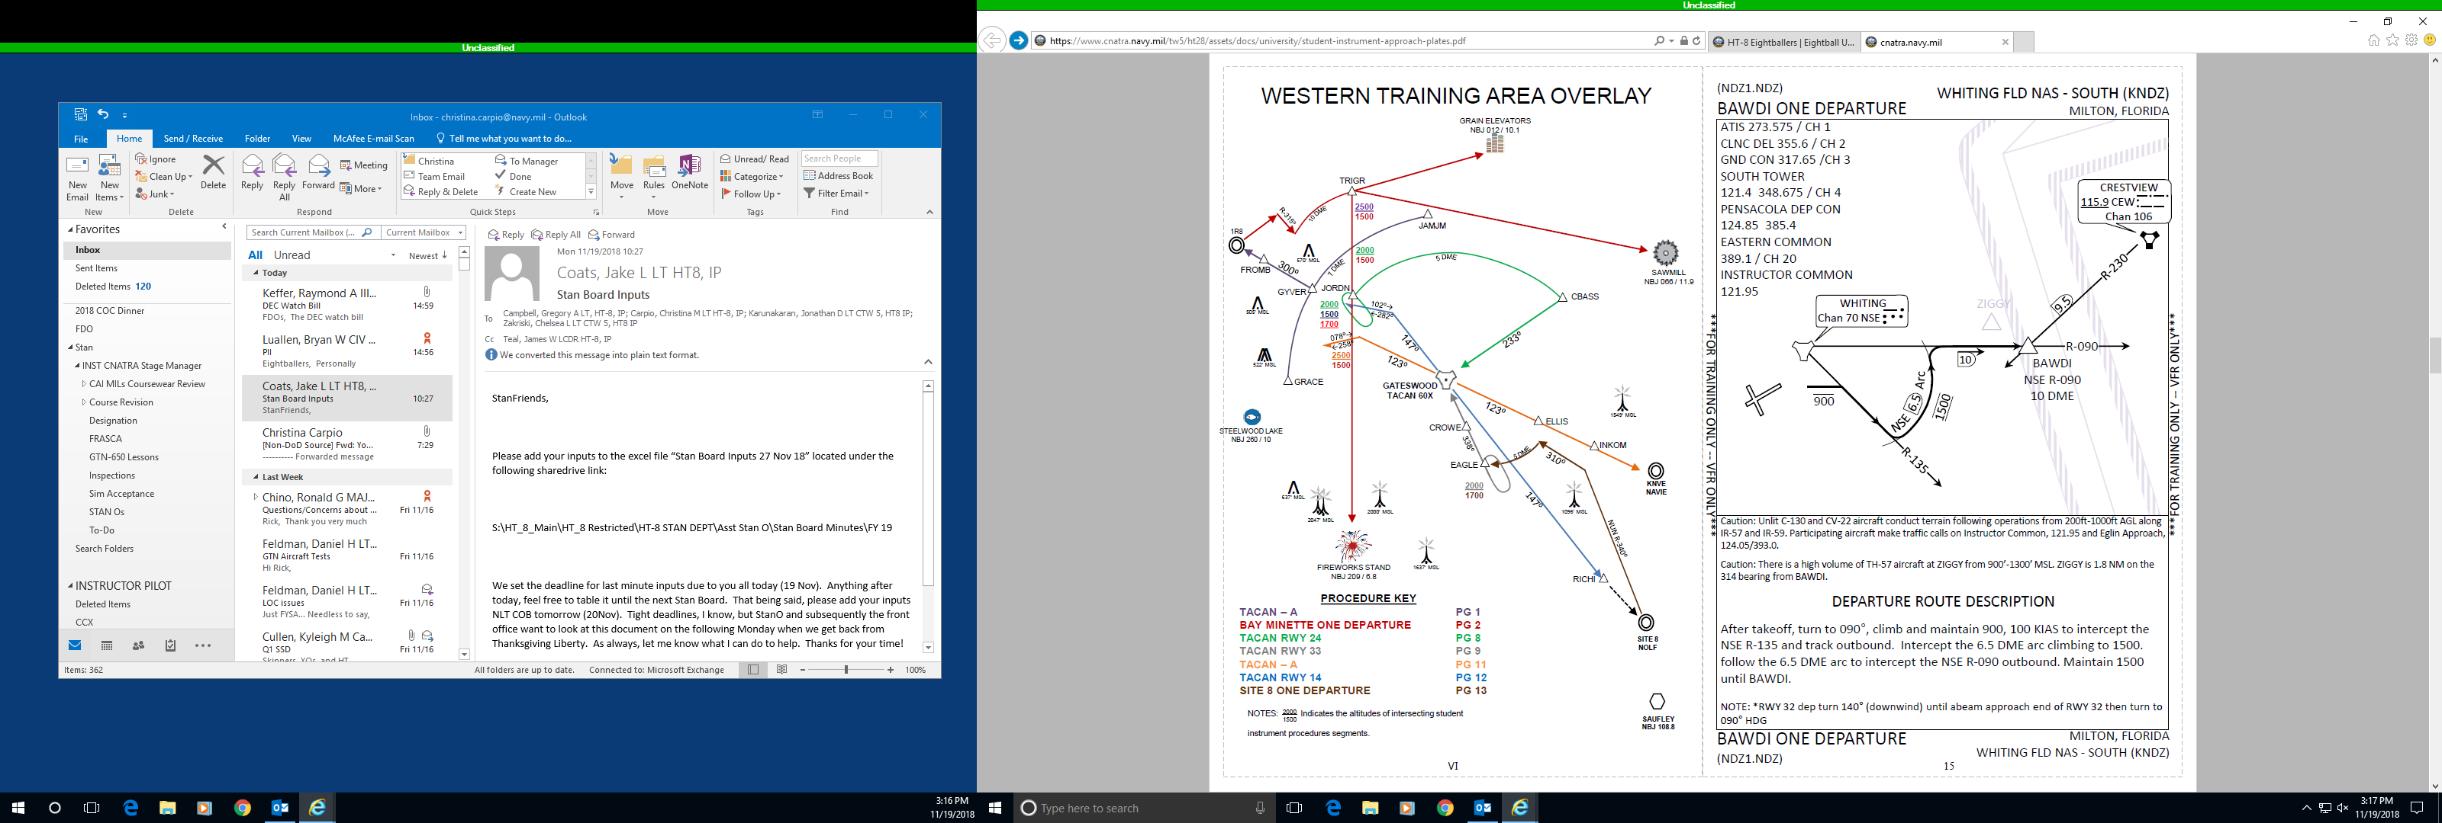
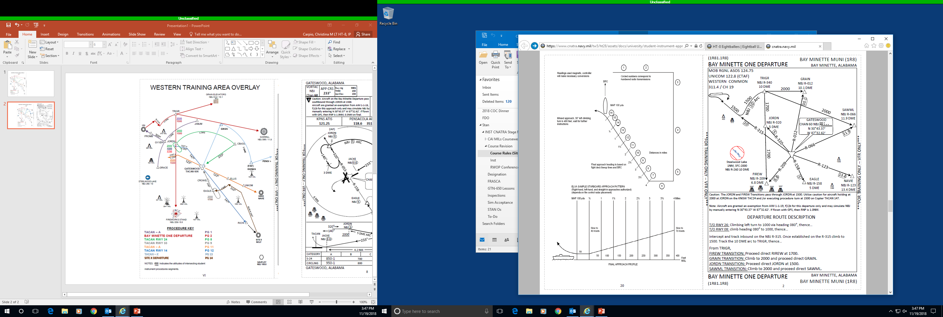

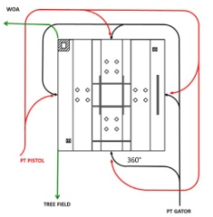

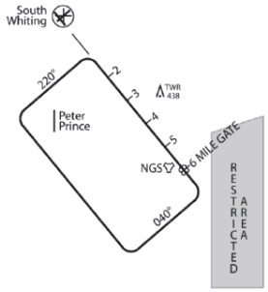
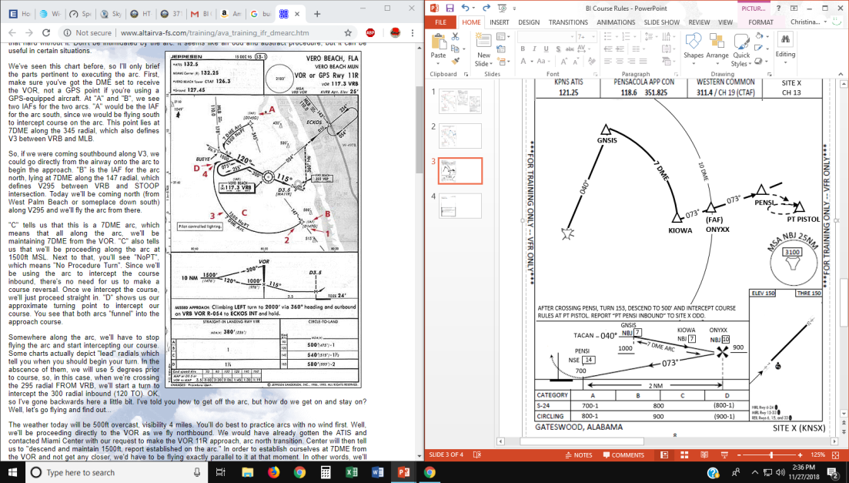
AIRSPACE HAZARD SPOTS
A “hazard spot” is an area of airspace with a history of or potential risk of collision where heightened attention by pilots is necessary. Hazard spots are depicted as circles or polygons designated as “HS 1”, “HS 2” , etc. and tabulated in the list below with a brief description of each hazard spot. Hazard spots will remain charted until such time that the increased risk has been reduced or eliminated.
Hazard Spot 1 – Bear Lake. There is a high volume of TH-57 aircraft in the vicinity of Bear Lake performing basic instrument maneuvers. Unlit C-130 and CV-22 aircraft conduct terrain following operations from 200-1000 AGL southbound along IR-57 and IR-59, both of which intersect at Bear Lake. Participating aircraft make calls on Instructor Common and Eglin Approach.
Hazard Spot 2 – Point BAWDI. There is a high volume of TH-57 aircraft converging in the vicinity of Point BAWDI on the BAWDI Departure and the Juniper VOR/DME-A approach. Unlit C-130 and CV-22 aircraft conduct terrain following operations from 200-1000 AGL southbound along IR-57 and IR-59, Participating aircraft make calls on Instructor Common and Eglin Approach.
Hazard Spot 3 – KNDZ PAR final. The Point Able VFR departure and BAWDI Student Instrument Departure cross the PAR final from approximately 1 to 3 DME off I-NDZ.
Hazard Spot 4 – Intersection of Burrito One Departure and the CEW and Bear Lake Transitions. The KCEW ILS17 and RNAV17 final approach courses cross the CEW and Bear Lake Transitions of the Burrito One Departure co-altitude at approximately the CEW R-054 at 8.7 DME. IFR traffic on the ILS17 and RNAV17 is typically monitoring the KCEW CTAF on 122.95. VFR traffic should contact EGLIN Approach on 124.05 for traffic advisories.
Rwy ldg N/A
THRE N/A
Apr Elev 211
TACAN-A
076°
SITE X (KNSX)
Caution: BI traffic operating at SAWMILL at 1000’ and above. Aircraft transiting TRIGR to SAWMILL over MAVRK at 2000’. Traffic on the TACAN RWY 24 approach to NBJ are 2000’ crossing TACAN X traffic 040/5 to MAVRK.
NOTE: PENSI: NSE 289/14
MISSED APPROACH: Climbing right turn to 107◦ and 1000', proceed direct to PT Pistol (NSE 291/10) and hold west utilizing right hand turns.
KPNS ATIS
121.25
PENSACOLA APP CON
118.6 / 351.825
WESTERN COMMON
311.4 / CH 19 (CTAF)
SITE X
327.4 / CH 13
SITE X
327.4 / CH 13
MAVRK
NBJ
7
7 DME
900
10 DME
PENSI
NBJ
040°
14.5
Mill
076°
***FOR TRAINING ONLY -- VFR ONLY***
076°
(FAF)
HLYWD
***FOR TRAINING ONLY -- VFR ONLY***
GOOSE
NBJ
Boat Ramp
PT PISTOL
NBJ
12
CEW
RNAV/ILS17
FAC
7
515’ MSL
549’ MSL
HS 1
BURRITO
ONE DEP
040°
220°
GATESWOOD
60 NBJ (IAF)
N 30°43.37’
W 87°32.62’
BEAR LAKE
211
HS 4
AT FAF, TUNE CH 13 AND REPORT “TRAFFIC, [C/S], TACAN-A INBOUND”. AFTER CROSSING PENSI, TURN 107, DESCEND TO 500’ AND INTERCEPT COURSE RULES AT PT PISTOL. REPORT “PT PENSI INBOUND” TO SITE X.
HWY 87
CRESTVIEW VOR
MAVRK
1000
PISTOL
GOOSE
NBJ
7
040°
NBJ
HS 3
CRESTVIEW
900
NBJ
7
7 DME ARC
1200
BAWDI
I-10
HLYWD
076°
PENSI
12
14.5
HS 2
NBJ
800
NBJ
700
2.5 NM
700-1
550
(600-1)
SITE X (KNSX)
IV
13
TACAN-A
COMTRAWINGFIVEINST 3710.25
13
COMTRAWINGFIVEINST 3710.25
COMTRAWINGFIVEINST 3710.25

Slide 8
EASTERN TRAINING AREA OVERLAY
SITE X DEPARTURE
SITE X (KNSX)
070°
GATESWOOD, ALABAMA
0J4
SITE X: 327.4 CH 13
PENSACOLA APPROACH: 118.6 / 351.825
WESTERN COMMON: 311.4 CH 19 (CTAF)
LILAN
2000
1500
GINGR
GRAIN
NBJ R-012
10.1 DME
NO NAME LAKE
CEW 325 / 14.2
BLRUP
NSE 065⁰
CARPI
NBJ R-059
16 DME
ODOMS PVT AIRPORT
CEW 12 DME
14 DME
2000
1500
SITE X
CH 13
.
.
1249’ MSL
WEDOM
RITEO
900
PETRO
NBJ R-075
16DME
RC Park
HORSE FARM
CEW 314 / 12.5
2000
1700
2000
1500
NBJ 16 Arc
HURRICANE LAKE
CEW 329 / 7.8
EDMAC
TANIA
←216⁰
ANNNA
GNSIS
SAWMILL
NBJ R-066
11.9 DME
175⁰
036⁰→
234⁰
PENSI
NBJ R-076
14.5 DME
KNSX
ASHLE
2000
1600
1500
1500
GATESWOOD
CHAN 60 NBJ
N 30°43.37’
W 87°32.62’
7 DME
10 DME
1600
1500
HS 4
040°
BEAR LAKE
CEW 282 / 08
1500
1200
KOBRA/
GIYAT
070°
PENSI
146⁰→
←326⁰
ʌ
CLAIR
BOWIE
101⁰
ʌ
FIREW
NBJ R-209
6.8 DME
070°
***FOR TRAINING ONLY -- VFR ONLY***
BOSSE
.
171⁰
KIOWA
(FAF)
ONYXX
PT PISTOL
HS 1
616’ MSL
BARBI
081⁰
2200
1700
106⁰
Caution: CAL traffic operating on the NW of SITE X. Aircraft transiting from the Green Route CP 1 will be at 700’ MSL inbound to PT Pistol. Use caution while departing and climbing to PETRO.
Caution: Entire area is inside of A-292, high volume of training aircraft.
Caution: Traffic inbound to SITE X crossing PENSI at 700’MSL
Note: Do not overfly the RC Park or the Odoms Private Airport in the vicinity of SITE X.
DEPARTURE ROUTE DESCRIPTION
Depart NW corner of SITE X and turn 270. Climb to 900’ MSL. At 18 DME, turn and intercept NBJ 075/16. Prior to PETRO, switch to CH 19, report “on Site X DEPARTURE” and state intended location, then..
SAWMILL: Upon reaching PETRO, turn direct to SAWMILL (NBJ 066/11.9) and climb to working altitude. Monitor Western Common (CH19) and deconflict with traffic.
GRAIN ELEVATORS: Upon reaching PETRO, maintain 900’ MSL and continue north on NBJ 16DME arc to CARPI (NBJ 059/16). At CARPI, turn direct to GRAIN ELEVATORS (NBJ 012/10.1) and climb to working altitude. Monitor Western Common (CH 19) to deconflict with traffic.
FIREWORKS STAND: Upon reaching PETRO, maintain 900’ MSL and turn direct to FIREW(NBJ 209/6.8). When established at FIREW, climb to working altitude. Monitor Western Common (CH19) and deconflict with traffic. Be cautions of traffic on the Site X TACAN-A.
GATESWOOD: Upon reaching PETRO, maintain 900’ MSL and turn direct to NBJ .Monitor Western Common (CH19) and deconflict with traffic. Be cautions of traffic on the Site X TACAN-A.
5 DME
1700
1500
CEW VORTAC
115.9 / 106X
240⁰
SEDNA
MAYOR
4 DME
KCEW
KNIFE EDGE
FIELD
ZIGGY
MADEN
1500
700
BAWDI
030⁰
PROCEDURE KEY
TACAN RWY 9R PG 3
COPTER VOR RWY 9L PG 4
TACAN RWY 18L PG 5
TACAN RWY 4 PG 6
BURRITO ONE DEPARTURE PG 7
VOR/DME –240 PG 10
BAWDI DEPARTURE PG 15
ILS or LOC RWY 17 VOL 19
RNAV (GPS) RWY 17 VOL 19
VOR - A VOL 19
PT
JUNIPER
HS 2
ʌ
ʌ
.
6.5 DME
ʌ
512’ MSL
TACAN
040°
.
NBJ
580’ MSL
1000
7 DME ARC
900
NSE
070°
700
R-2915A
2 NM
NOTES::
Indicates the altitudes of intersecting student
instrument procedure segments.
2. For Hazard Spot descriptions refer to page VII of the
Student Instrument Approach and Departure Procedures.
2000
1500
SITE X DEPARTURE
14
GATESWOOD, ALABAMA
V
COMTRAWINGFIVEINST 3710.25
SITE X (KNSX)
COMTRAWINGFIVEINST 3710.25
V

Slide 9
NDZ 106
BAWDI ONE DEPARTURE
WHITING FLD NAS - SOUTH (KNDZ)
MILTON, FLORIDA
ATIS 273.575 / CH 1
CLNC DEL 355.6 / CH 2
GND CON 317.65 /CH 3
SOUTH TOWER
121.4 348.675 / CH 4
PENSACOLA DEP CON
124.85 385.4
EASTERN COMMON
389.1 / CH 20
INSTRUCTOR COMMON
121.95
LAKES MONITOR
135.15
c
CARPI
CRESTVIEW
115.9 CEW
Chan 106
2500
1700
2000
1000
16 DME
MAVRK
PETRO >
2000
1700
1500
1000
R-230
040°
7 DME
PENSI >
WHITING
Chan 70 NSE
ZIGGY
9.5
(FAF)
HLYWD
R-090
2500
1700
076°
10
GOOSE
BAWDI
NSE R-090
10 DME
515’
MSL
549’
MSL
NSE 6.5 Arc
900
1500
***FOR TRAINING ONLY -- VFR ONLY***
***FOR TRAINING ONLY -- VFR ONLY***
R-135
Caution: Unlit C-130 and CV-22 aircraft conduct terrain following operations from 200ft-1000ft AGL along IR-57 and IR-59. Participating aircraft make traffic calls on Instructor Common, 121.95 and Eglin Approach, 124.05/393.0.
Caution: There is a high volume of TH-57 aircraft at ZIGGY from 900’-1300’ MSL. ZIGGY is 1.8 NM on the 314 bearing from BAWDI.
DEPARTURE ROUTE DESCRIPTION
After takeoff, turn to 090°, climb and maintain 900, 100 KIAS to intercept the NSE R-135 and track outbound. Intercept the 6.5 DME arc climbing to 1500. Follow the 6.5 DME arc to intercept the NSE R-090 outbound. Maintain 1500 until BAWDI.
NOTE: *RWY 32 dep turn 140° (downwind) until abeam approach end of RWY 32 then turn to 090° HDG. Remain clear of the maintenance pattern.
TACAN – A PG 13
SITE X DEPARTURE PG 14
SAUFLEY
NUN 108.8
BAWDI ONE DEPARTURE(NDZ1.NDZ)
MILTON, FLORIDA
WHITING FLD NAS - SOUTH (KNDZ)
COMTRAWINGFIVEINST 3710.25
COMTRAWINGFIVEINST 3710.25
15

Slide 10
NDZ 103
NAVIE ONE DEPARTURE
WHITING FLD NAS - (KNDZ)
MILTON, FLORIDA
INOP COMPONENTS
ATIS 273.575 / CH 1
CLNC DEL 355.6 / CH 2
GND CON 317.65 / CH 3
SOUTH TWR 348.675 / CH 4
PENSACOLA DEP CON
124.85 351.825
WESTERN COMMON
311.4 / CH 19
INST COMMON
121.95
INOPERATIVE COMPONENTS OR VISUAL AIDS TABLE
Landing minimums published on instrument approach procedure charts are based upon full operation of all components and visual aids associated with the particular instrument approach chart being used. Higher minimums are required with inoperative components or visual aids as indicated below. If more than one component is inoperative, each minimum is raised to the highest minimum required by any single component that is inoperative. ILS glide slope inoperative minimums are published on the instrument approach charts as localizer minimums. This table may be amended by notes on the approach chart. Such notes apply only to the particular approach category(ies) as stated. See legend page for description of components indicated below.
(1) ILS, MLS, PAR and RNAV (LPV line of minima)
Inoperative Component or Aid | Approach Category | Increase Visibility
ALSF 1 & 2, MALSR, & SSALR | ABCD | ¼ mile
R-247
CRESTVIEW
115.9 CEW
Chan 106
R-240
220ᵒ
(2) ILS with visibility minimum of 1,800 RVR
NAVIE
CEW R-247
36 DME
ALSF 1 & 2, MALSR, & SSALR TDZL RCLS RVR | ABCD ABCD ABCD | To 4000 RVR To 2400 RVR* To ½ mile
24
***FOR TRAINING ONLY -- VFR ONLY***
***FOR TRAINING ONLY -- VFR ONLY***
1,800 RVR authorized with the use of FD or AP or HUD to DA.
(3) VOR, VOR/DME, TACAN, LOC, LOC/DME, LDA, LDA/DME,
SDF, SDF/DME, GPS, ASR and RNAV (LNAV/VNAV, LNAV
and LP lines of minima)
R-240
Inoperative Visual Aid | Approach Category | Increase Visibility
ALSF 1& 2, MALSR, & SSALR SSALS, MALS, & ODALS | ABCD ABC | ½ mile ¼ mile
DEPARTURE ROUTE DESCRIPTION
After takeoff, heading 220°, intercept and track outbound on CEW R-240.
Climb and maintain 1700. At 24 DME, proceed direct NAVIE.
At NAVIE report clear to the west with Pensacola Departure.
NOTE: Expect climb to 2200 after hand-off. Remain clear of the maintenance pattern.
(4) NDB
ALSF 1 & 2, MALSR, & SSALR MALS, SSALS, ODALS | C ABD ABC | ½ mile ¼ mile ¼ mile
NAVIE ONE DEPARTURE (NDZ2.NDZ)
MILTON, FLORIDA
WHITING FLD NAS – SOUTH (KNDZ)
INOP COMPONENTS
VII
COMTRAWINGFIVEINST 3710.25
16
COMTRAWINGFIVEINST 3710.25
VII

Slide 11
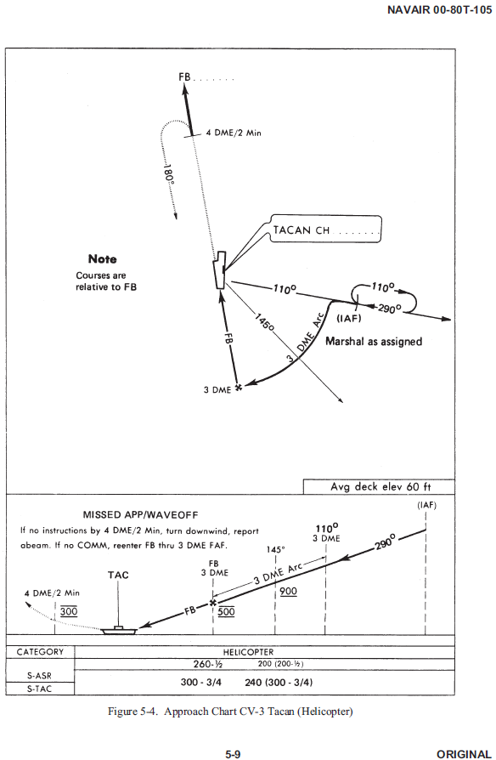
RADAR INSTRUMENT APPROACH MINIMUMS
TRAWINGFIVENOTICE 3710
CV-3 TACAN (Helicopter) Shipboard Approach
BAY MINETTE MUNI (1R8), Al (Bay Minette, AL) ELEV 248
INSTRUCTOR APP CON 121.95
 | RWY | GS/TCH/RPI | CAT | DA/ MDA-VIS | HAT/HATh HAA | CEIL-VIS
PAR | 8 | 3.0⁰/54/965 | ABCDE | 406 – ½ | 200 | 200 – ½
 | 26 | 3.0⁰/39/665 | ABCDE | 348 – ¼ | 100 | 100 – ¼
ASR | 8 |  | ABCDE | 556 – 1 | 350 | 400 – 1
 | 26 |  | ABCDE | 598 – 1 | 350 | 400 – 1
CIR | 8 |  | ABCDE | 706 - 1 ¼ | 500 | 500 - 1 ¼
 | 26 |  | ABCDE | 748 - 1 ¼ | 500 | 500 - 1 ¼
FLORALA MUNI (0J4), Al (Florala, AL) ELEV 314
INSTRUCTOR APP CON 121.95
 | RWY | GS/TCH/RPI | CAT | DA/ MDA-VIS | HAT/HATh HAA | CEIL-VIS
PAR ① | 4 | 3.0⁰/54/965 | ABCDE | 388 – ¼ | 100 | 200 – ¼
 | 22 | 3.0⁰/39/665 | ABCDE | 514 – ½ | 200 | 200 – ½
ASR ① | 4 |  | ABCDE | 628 – 1 | 350 | 400 - 1
 | 22 |  | ABCDE | 664 - 1 | 350 | 400 - 1
CIR ② | 4 |  | ABCDE | 788 – 1 ¼ | 500 | 500 – 1 ¼
 | 22 |  | ABCDE | 814 – 1 ¼ | 500 | 500 – 1 ¼
***FOR TRAINING ONLY -- VFR ONLY***
***FOR TRAINING ONLY -- VFR ONLY***
① Contact Sunshine Aero for hot fuel 10 minutes prior to arrival on 123.0.
② Circling NA at night.
GULF SHORES (KJKA), Al (Gulf Shores, AL) ELEV 17
INSTRUCTOR APP CON 121.95
 | RWY | GS/TCH/RPI | CAT | DA/ MDA-VIS | HAT/HATh HAA | CEIL-VIS
PAR ① | 9 | 3.0⁰/54/965 | ABCDE | 216 - ½ | 200 | 200 – ½
 | 27 | 3.0⁰/39/665 | ABCDE | 116 – ¼ | 100 | 100 – ¼
ASR ① | 9 |  | ABCDE | 366-1 | 350 | 400-1
 | 27 |  | ABCDE | 366-1 | 350 | 400-1
CIR ② | 17 |  | ABCDE | 516 – 1 ¼ | 500 | 500 – 1 ¼
 | 35 |  | ABCDE | 516 – 1 ¼ | 500 | 500 – 1 ¼
① When local altimeter not received use Pensacola Regional altimeter setting and increase all DA/MDAs by 80 feet..
② Circling to runways 17/35 NA at night.
RADAR INSTRUMENT APPROACH MINIMUMS
COMTRAWINGFIVEINST 3710.25
VIII
COMTRAWINGFIVEINST 3710.25
17

Slide 12
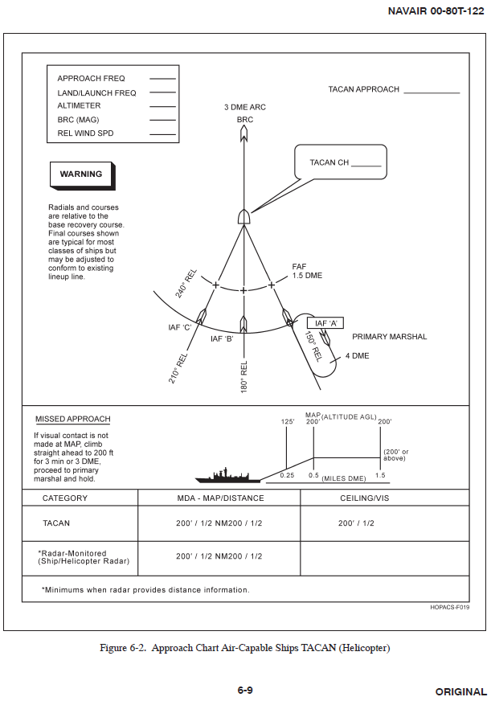
TACAN (Helicopter) Shipboard Approach
Example Radar Instrument Approach Communications
Reference: FAA Order 7110.65U, Chapter 5, Sections 10, 11, and 12
Initial Contact
(Aircraft call sign), (name of facility) final controller, how do you hear me?
(Number) miles (direction) of (airport name) airport, perform landing checks.
This will be a (no-gyro) (surveillance/PAR) approach.
Lost Communications
If no transmissions are received for (time interval) in the pattern or (five/fifteen) seconds on the final approach, attempt contact on (frequency) and proceed VFR. If unable proceed with the (nonradar approach) maintain (altitude) until established (on/over) the (fix/NAVAID/approach procedure).
Approach to an Uncontrolled Field
5. No traffic or landing runway information available for the airport.
No-Gyro PAR Approach
6. Make half-standard rate turns.
Approach Guidance
7. (Aircraft call sign) do not acknowledge further transmissions.
8. From (above/on/below) glideslope begin descent.
9. On or (slightly/well) (above/below) glideslope. (On/slightly/well) (left/right) of course.
10. (Aircraft call sign) cleared to land (runway number)
(Reason). If runway, approach lights or runway lights not in sight execute (missed
approach/alternative instructions).
Note:
Typical reasons for missed approach instructions:
“Radar contact lost.”
“Too high/low for safe approach.”
“Too far right/left for safe approach.”
GCA Glideslope Estimation
Note: VASI or PAPI may be used as a reference for glideslope instructions.
***FOR TRAINING ONLY -- VFR ONLY***
***FOR TRAINING ONLY -- VFR ONLY***
Distance from airfield (NM)
0 1 2 3 4 5 6 7 8 9 10
0 319 637 956 1275 1593 1912 2231 2549 2868 3187
Recommended AGL Altitude (ft)
COMTRAWINGFIVEINST 3710.25
18
COMTRAWINGFIVEINST 3710.25
IX

Slide 13
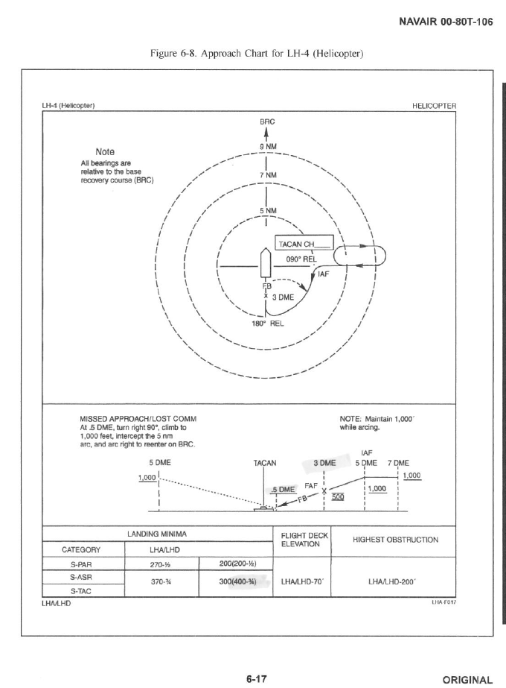
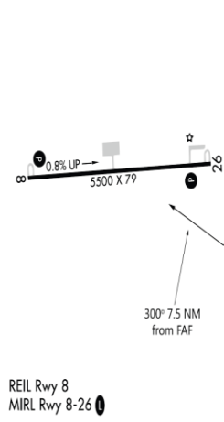
BAY MINETTE, ALABAMA
TACAN NBJ
Chan 60
APP CRS
300°
Rwy ldg N/A
TDZE N/A
Apt Elev 248
TACAN-A
BAY MINETTE MUNI (1R8)
T
c
Use KMOB altimeter setting; if not received use KBFM altimeter setting and increase all MDA’s 20ft. Aircraft are granted an exemption from AIM 1-1-19, f(1)b for this approach only and may simulate NBJ by manually entering N 30°43.37’ W 87°32.62’. If flown with GPS, then RNP is 0.3NM.
A
NA
MISSED APPROACH: Climbing left turn to 2500 direct GRACE INT and hold.
MOBILE RGNL ASOS
124.75
MOBILE APP CON
118.5 269.3
WESTERN COMMON
311.4 / CH 19
UNICOM
122.8 (CTAF)
L
RONIN
NBJ 17.5
(FAF)
FROMB
NBJ 10
ʌ
ʌ
300ᵒ
.
.
ʌ
570
2500 TO GYVER
551
.
NBJ 7 Arc
(IAF)
JAMJM
NBJ 5
SLABB
NBJ 13
505
10 NM
(IF)
GYVER
NBJ 7
R-360
(IAF)
GRACE
NBJ 7
2500 TO
GYVER
GATESWOOD
CHAN 60 NBJ
N 30°43.37’
W 87°32.62’
ʌ
ʌ
NBJ 7 Arc
R-300
A-292
.
.
***FOR TRAINING ONLY -- VFR ONLY***
460
522
***FOR TRAINING ONLY -- VFR ONLY***
270°
R-270
ʌ
090°
.
MSA NBJ 25NM
1549
3100
ʌ
.
ʌ
ʌ
ʌ
ʌ
.
.
631
ʌ
ʌ
.
1397
ʌ
ʌ
1096
2047
.
ʌ
2000
.
ELEV 248
1637
2500
GRACE
INT
FROMB
NBJ 10
GYVER
NBJ 7
RONIN
NBJ 17.5
SLABB
NBJ 13
2500
1.5 NM
to RWY
300°
1500
1000
4.5 NM
3 NM
3 NM
CATEGORY
A
B
C
D
CIRCLING
750-1 502 (600-1)
750-1 ¾
502 (600-1 ¾)
NA
BAY MINETTE, ALABAMA
1
BAY MINETTE MUNI (1R8)
TACAN-A
19
COMTRAWINGFIVEINST 3710.25
COMTRAWINGFIVEINST 3710.25

Slide 14
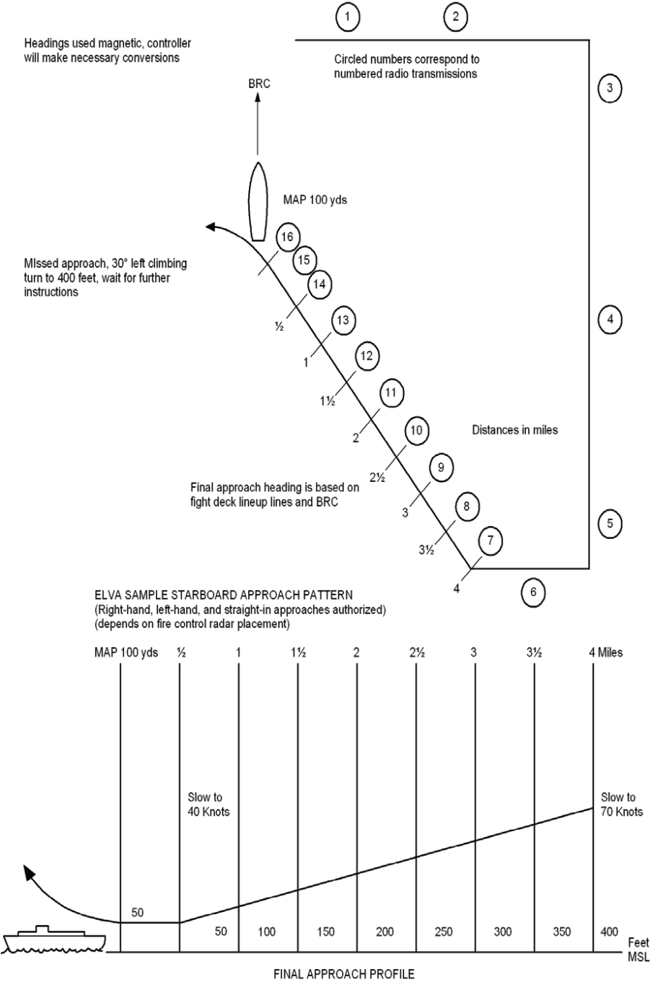

Emergency Low Visability Approach Pattern (ELVA)
1R8 101R
BAY MINETTE ONE DEPARTURE
BAY MINETTE MUNI (1R8)
BAY MINETTE, ALABAMA
MOB RGNL ASOS 124.75
UNICOM 122.8 (CTAF)
WESTERN COMMON
311.4 / CH 19
TRIGR
NBJ R-340
10 DME
GRAIN
NBJ R-012
10.1 DME
2000
1500
10.1
NBJ 10 Arc
1500
1700
ʌ
2000
SAWML
NBJ R-066
11.9 DME
.
ʌ
ʌ
JORDN
NBJ R-320
5 DME
400
.
GATESWOOD
CHAN 60 NBJ
N 30°43.37’
W 87°32.62’
570
10
R-315
5
11.9
R-320
R-012
R-066
1700
ʌ
.
Steelwood Lake
1NM, SFC-2000
NBJ R-260 10 DME
R-209
R-158
R-123
1549
***FOR TRAINING ONLY -- VFR ONLY***
***FOR TRAINING ONLY -- VFR ONLY***
FIREW
NBJ R-209
6.8 DME
6.8
5
13.4
EAGLE
NBJ R-158
5 DME
ʌ
NAVIE
NBJ R-123
13.4 DME
ʌ
.
ʌ
ʌ
ʌ
ʌ
ʌ
ʌ
.
ʌ
2047
2000
1637
.
1397
.
.
1096
Caution: The JORDN and FIREW Transitions pass through JORDN at 1700. Utilize caution for aircraft holding at 2000 at JORDN on the KNGW TAC24 and /or executing procedure turn at 1500 on Copter TACAN 147.
Note: Aircraft are granted an exemption from AIM 1-1-19, f(1)b for this departure only and may simulate NBJ by manually entering N 30°43.37’ W 87°32.62’. If flown with GPS, then RNP is 1.0NM.
DEPARTURE ROUTE DESCRIPTION
T/O RWY 26: Climbing left turn to 1000 via heading 080°, thence…
T/O RWY 08: climb heading 080° to 1000, thence…
Intercept and track inbound on the NBJ R-315. Once established on the R-315 climb to 1500. Track the 10 DME arc to TRIGR, thence…
From TRIGR,
FIREW TRANSITION: Proceed direct FIREW at 1700.
GRAIN TRANSITION: Climb to 2000 and proceed direct GRAIN.
JORDN TRANSITION: Proceed direct JORDN at 1700.
SAWML TRANSITION: Climb to 2000 and proceed direct SAWML.
BAY MINETTE ONE DEPARTURE(1R81.1R8)
BAY MINETTE, ALABAMA
BAY MINETTE MUNI (1R8)
COMTRAWINGFIVEINST 3710.25
20
COMTRAWINGFIVEINST 3710.25
2

Slide 15
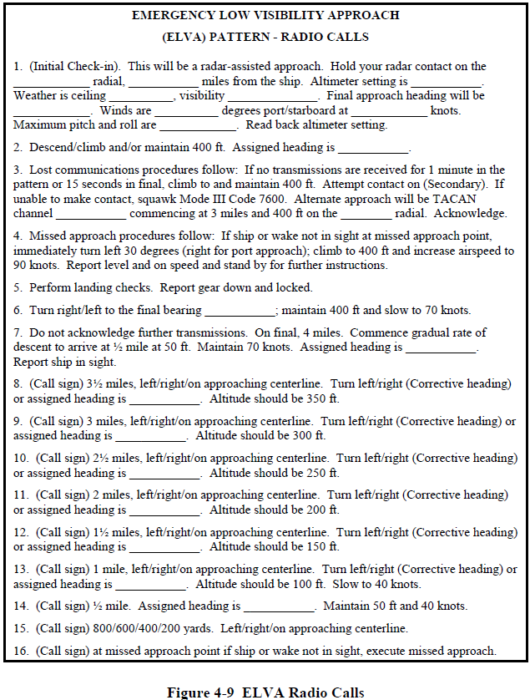
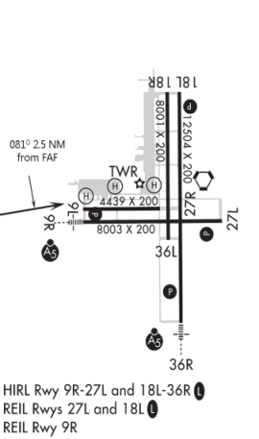
CRESTVIEW, FLORIDA
(ELVA) Pattern Radio Calls
VORTAC
CEW
Chan 106
APP CRS
081°
Rwy ldg 8003
TDZE 214
Apt Elev 215
TACAN RWY 9R
CRESTVIEW NAS (KNCE)
c
T
R-2915A located south of Highway 90. Do not exceed 8 DME while holding at MADEN without clearance into R-2915A.
MALSR
MISSED APPROACH: Climbing right turn to 2000 heading 210°, proceed to MADEN and hold.
A
NA
A
5
KCEW ATIS
119.275
EGLIN APP CON
124.05 284.65
EASTERN COMMON
389.1 / CH20 (CTAF)
LAKES MONITOR
135.15
INST COMMON
121.95
5 NM
CRESTVIEW
115.9 CEW
Chan 106
CANDY
CEW 0.5
(FAF)
BARBI
CEW 3
ʌ
ʌ
.
081°
616
R-261
***FOR TRAINING ONLY -- VFR ONLY***
***FOR TRAINING ONLY -- VFR ONLY***
CEW 4 Arc
1500
R-210
R-240
MSA CEW 25NM
(IAF)
MADEN
CEW 5
2300
210°
7 DME
030°
ʌ
ʌ
.
ELEV 215
R-210
.
462
512
(IAF)
MADEN
CEW 5
CEW
R-240
030°
BARBI
CEW 3
VORTAC
210°
1700
4 DME ARC
CANDY
CEW 0.5
1500
081°
2.5 NM
CATEGORY
A
B
C
D
S-9R
815-1 600 (600-1)
CIRCLING
900-1 685 (700-1)
CRESTVIEW NAS (KNCE)
TACAN RWY 9R
CRESTVIEW, FLORIDA
3
21
COMTRAWINGFIVEINST 3710.25
COMTRAWINGFIVEINST 3710.25

Slide 16
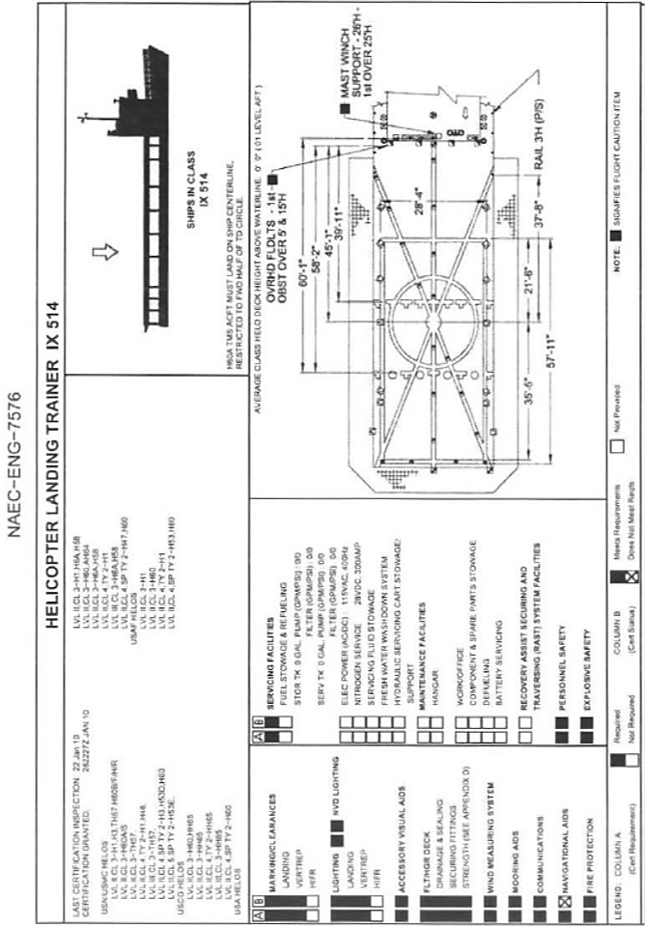
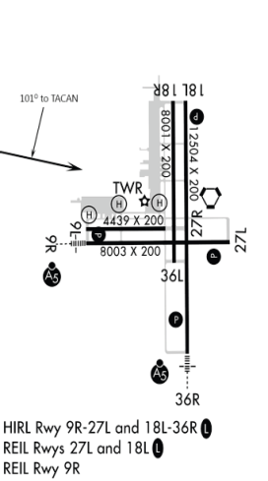
CRESTVIEW, FLORIDA
VORTAC CEW
115.9
APP CRS
101°
Rwy ldg 4439
THRE 214
Apt Elev 215
COPTER VOR RWY 9L
CRESTVIEW NAS (KNCE)
c
T
R- 2915A located south of Highway 90. Do not exceed 8 DME while holding at MADEN without clearance into R-2915A.
MISSED APPROACH: Climbing right turn to 2000 heading 210°, proceed to MADEN and hold.
A
NA
KNDZ ATIS
273.575
EGLIN APP CON
124.05 284.65
EASTERN COMMON
389.1 / CH20 (CTAF)
LAKES MONITOR
135.15
INST COMMON
121.95
6 NM
(FAF)
BOSSE
CEW 3
IAF
R-281
146ᵒ
326ᵒ
CRESTVIEW
115.9 CEW
Chan 106
101ᵒ
ʌ
ʌ
.
616
***FOR TRAINING ONLY -- VFR ONLY***
***FOR TRAINING ONLY -- VFR ONLY***
185°
MADEN
CEW 5
7 DME
MSA CEW 25NM
005°
2300
ʌ
ʌ
.
.
462
R-210
512
Remain
Within 6 NM
VORTAC
ELEV 215
281⁰
1600
101⁰
BOSSE
CEW 3
CATEGORY
3 NM
COPTER
S-9L
915-1 700 (700-1)
CIRCLING
NOT AUTHORIZED
BOSSE FIX MINIMUMS
S-9L
815-1 600 (600-1)
CIRCLING
NOT AUTHORIZED
CRESTVIEW NAS (KNCE)
COPTER VOR RWY 9
22
CRESTVIEW, FLORIDA
4
COMTRAWINGFIVEINST 3710.25
COMTRAWINGFIVEINST 3710.25

Slide 17
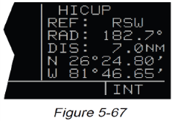
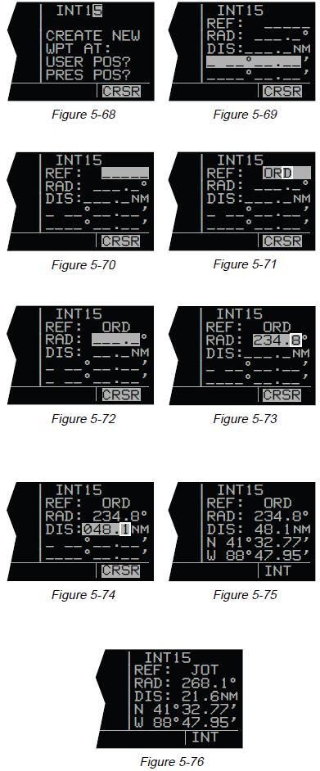
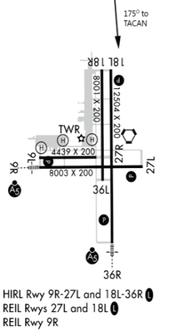
CRESTVIEW, FLORIDA
KLN-900 Manual Waypoint Creation Guide
VORTAC CEW
Chan 106
APP CRS
175°
Rwy ldg 12504
THRE 214
Apt Elev 215
TACAN RWY 18L
CRESTVIEW NAS (KNCE)
5.4.4 Creating Intersection Or Supplemental User Waypoints
A user defined intersection or supplemental waypoint must contain an identifier, latitude, and longitude. The identifier for either can be one to five characters in length. There are two procedures which may be used to define these waypoints. Both procedures begin by selecting the INT or SUP type waypoints, as appropriate.
The first method is similar to that described for creating an airport, VOR, or NDB user waypoint. Only a latitude and longitude need be entered to complete creating the waypoint.
The second method is to define the waypoint’s position in terms of a radial and distance from any other published or previously defined user waypoint. To create a user waypoint in this manner:
1. Use the right outer knob to select INT or SUP type waypoints, as appropriate (figure 5-67).
2. Use the right and the right inner and outer knobs in the
manner previously described in section 5.4.1, “Creating An
Airport User Waypoint”, to select the waypoint identifier (figure 5-68).
3. Rotate the right outer knob to position the cursor over USER POS? and press . A user waypoint page will appear with the identifier at the top with the cursor over a dashed latitude field (figure 5-69).
4. Turn the right outer knob counterclockwise to position the
cursor over the dashes to the right of REF (figure 5-70).
5. Rotate the right inner knob to select the first character of an identifier for a “reference waypoint”. This waypoint may be any existing waypoint.
6. Use the right outer knob to position the cursor, and the right inner knob to select the characters so that the entire identifier for the reference waypoint is displayed (figure 5-71).
7. Press to see the waypoint page for the reference waypoint just entered.
8. Press again to approve this waypoint page. The waypoint
page being created will return with the cursor over the dashes to the right of RAD (figure 5-72).
9. Use the right inner and outer knobs to select the radial (from the reference waypoint). The radial may be selected
to the nearest tenth of a degree (figure 5-73).
10. Press . The cursor will move to the dashes to the right
of DIS.
11. Use the right inner and outer knob to select the distance.
The distance may be selected to the nearest tenth of a nautical mile or kilometer (figure 5-74).
12. Press V . The latitude and longitude is calculated and
displayed. The user waypoint is now defined (figure 5-75).
NOTE: Entering the reference waypoint, radial, and distance is done only to define the user waypoint’s latitude and longitude position. The reference waypoint, radial, and distance are not stored as part of the user waypoint. As soon as another page is viewed on the right side, these parameters are lost. If the waypoint page for a user-defined intersection or Supplemental waypoint is viewed later on, it will display the radial and distance from the VOR nearest the user-defined waypoint (figure 5-76) The original reference waypoint may be reentered at any time.
T
R-2915A located south of Highway 90. Do not exceed 8 DME while holding at MADEN without clearance into R-2915A.
MISSED APPROACH: Climb to 2000 heading 210°, proceed to MADEN and hold.
A
NA
KNDZ ATIS
273.575
EGLIN APP CON
124.05 284.65
EASTERN COMMON
389.1 / CH20 (CTAF)
LAKES MONITOR
135.15
INST COMMON
121.95
ʌ
.
ʌ
1249
.
844
8 DME
175°
(IAF)
EDMAC
CEW 6
355°
CRSR
175°
(FAF)
ASHLE
CEW 3
ENT
5 NM
LUKEE
CEW 0.4
***FOR TRAINING ONLY -- VFR ONLY***
***FOR TRAINING ONLY -- VFR ONLY***
ʌ
ʌ
.
CRESTVIEW
115.9 CEW
Chan 106
616
R-210
MSA NBJ 25NM
2300
MADEN
CEW 5
ENT
210°
ENT
7 DME
030°
ʌ
ELEV 215
ʌ
.
.
462
R-210
512
1700
EDMAC
CEW 6
ASHLE
CEW 3
VORTAC
ENT
175°
LUKEE
CEW 0.4
355°
175°
1200
ENT
3 NM
2.6 NM
CATEGORY
A
B
C
D
S-18L
715-1 500 (500-1)
CIRCLING
815-1 600 (600-1)
CRESTVIEW, FLORIDA
5
CRESTVIEW NAS (KNCE)
TACAN RWY 18L
23
COMTRAWINGFIVEINST 3710.25
COMTRAWINGFIVEINST 3710.25

Slide 18
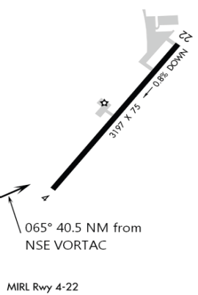
SIAP IP
STUDENT INSTRUMENT APPROACH PROCEDURE IMPROVEMENT PROCESS
FROM: (Rank/Name) (Optional) Unit DSN Phone Date Submitted
TO: TW-5 TH-57 Standardization Officer
VIA:
Squadron Standardization Officer Date
SIAP recommendation (Include affected approach and page)
Action:
FLORALA, ALABAMA
TACAN NSE
Chan 70
APP CRS
065°
Rwy ldg 3197
THRE 309
Apt Elev 314
TACAN RWY 4
FLORALA MUNI (0J4)
c
T
Aircraft are granted an exemption from AIM 1-1- 19, f(1)b for this approach only and may simulate NSE by manually entering N 30°43.44’ W 87°01.09’. If flown with GPS, then RNP IS 0.3NM.
MISSED APPROACH: Climbing left turn to 2000 direct BLRUP and hold.
ASOS
124.17
EGLIN APP CON
124.05 284.65
EASTERN COMM
389.1 / CH20
CAIRNS APP CON
135.45 239.4
INST COMMON
121.95
UNICOM
123.0 (CTAF)
(IAF)
BLRUP
CEW 12
LEFTY
NSE 40.5
(FAF)
SNIVL
NSE 34
180°
ʌ
R-065
.
2000 to RITEO
CEW 12 ARC
ʌ
360°
ʌ
.
470
.
715
672
NSE
ʌ
(IAF)
RITEO
NSE 30.1
WHITING
CHAN 70 NSE
N 30°43.44’
W 87°01.09’
R-360
R-065
.
***FOR TRAINING ONLY -- VFR ONLY***
582
***FOR TRAINING ONLY -- VFR ONLY***
R-044
R-065
MSA CEW 25NM
2300
CRESTVIEW
115.9 CEW
Chan 106
ELEV 314
THRE 309
RITEO
NSE 30.1
2000
BLRUP
SNIVL
NSE 34
2000
065°
2.5 NM
to RWY
LEFTY
NSE 40.5
1200
3.9 NM
6.5 NM
CATEGORY
A
B
C
D
S-4
900-1 600 (700-1)
CIRCLING
1200-1 900 (700-1)
1200-1 ¾
900 (1000-1 ¾)
1200-1 ¾
900 (1000-1 ¾)
COMTRAWINGFIVEINST 3710.25
24
FLORALA, ALABAMA
6
FLORALA MUNI (OJ4)
TACAN RWY 4
COMTRAWINGFIVEINST 3710.25

Slide 19
OJ4 101R
BURRITO ONE-DEPARTURE
FLORALA MUNI (0J4)
FLORALA, ALABAMA
CLIMB/DESCENT TABLE
ASOS 124.17
UNICOM 123.0 (CTAF)
EASTERN COMMON
389.1 / CH20
CAIRNS APP 133.45 / 239.275
EGLIN APP 124.05 / 284.65
LAKES MONITOR 135.15
INST COMMON 121.95
INSTRUMENT TAKEOFF OR APPROACH PROCEDURE CHARTS
RATE OF CLIMB/DESCENT TABLE
(ft. per min)
A rate of climb/descent table is provided for use in planning and executing climbs or descents under known or approximate ground speed conditions. It will be especially useful for approaches when the localizer only is used for course guidance. A best speed, power, altitude combination can be programmed which will result in a stable glide rate and altitude favorable for executing a landing if minimums exist upon breakout. Care should always be exercised so that minimum descent altitude and missed approach point are not exceeded.
1500
NONAM
CEW R-324
14.1 DME
LILAN
CEW R-360
12.2 DME
GINGR
CEW R-025
14 DME
ʌ
1500
.
ʌ
470
2000
ʌ
1500
.
.
ʌ
715
1249
.
R-054
14.1
844
14
CEW R-350
10 DME
1500
CEW 14 Arc
R-360
ʌ
R-324
.
672
VERTICAL PATH ANGLE
1500
ʌ
ANNNA
CEW R-054
14 DME
HORSE FARM
CEW R-314
12.5 DME
HURRI
CEW R-329
7.8 DME
2000
TANIA
CEW R-025
8.1 DME
.
7.8
14
582
R-329
R-025
1500
1500
CLAIR
CEW R-054
5 DME
***FOR TRAINING ONLY -- VFR ONLY***
***FOR TRAINING ONLY -- VFR ONLY***
BEARL
CEW R-282
8 DME
8
R-282
5
CRESTVIEW
115.9 CEW
Chan 106
Caution: Unlit C-130 and CV-22 aircraft conduct terrain following operations from 200-1000 AGL along IR-57 and IR-59. Participating aircraft make traffic calls on Instructor Common and Eglin Approach.
Caution: The KCEW ILS 17 and RNAV 17cross the CEW and Bear Lake transitions co-altitude at 1500’-1600’ at approximately the CEW R-054 at 8.7 DME.
DEPARTURE ROUTE DESCRIPTION
T/O RWY 04: Climbing left turn to 1500 via heading 220°, thence…
T/O RWY 22: Climb heading 220° to 1500, thence…
Intercept the CEW R-054 and track inbound to ANNNA, thence…
From ANNNA,
BEAR LAKE TRANSITION: Track the R-054 inbound to CLAIR. At CLAIR proceed direct to BEARL.
CEW TRANSITION: Track inbound on the CEW R-054 to CEW.
HURRICANE TRANSITION: Proceed direct to HURRI. At TANIA, climb to 2000.
NO NAME LAKE TRANSITION: Track the 14 DME arc to GINGR, then proceed direct to NONAM. At LILAN, climb to 2000.
BURRITO ONE DEPARTURE (0J41.0J4)
FLORALA, ALABAMA
FLORALA MUNI (0J4)
CLIMB/DESCENT TABLE
COMTRAWINGFIVEINST 3710.25
7
COMTRAWINGFIVEINST 3710.25
25

Slide 20
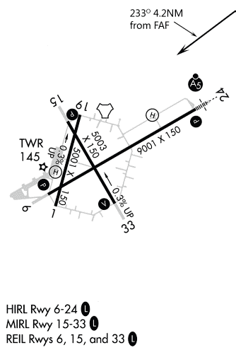
GATESWOOD, ALABAMA
VORTAC NBJ
Chan 60
APP CRS
233°
Rwy ldg 9001
THRE 150
Apt Elev 150
TACAN RWY 24
GATESWOOD MCAS (KNGW)
T
Caution: Aircraft on the Bay Minette Departure pass southbound through JORDN at 1700.
Aircraft are granted an exemption from AIM 1-1-19, f(1)b for this approach only and may simulate NBJ by manually entering N 30°43.37’ W 87°32.62’. If flown with GPS, then RNP is 1.0NM, 0.3NM on final.
MALSR
MISSED APPROACH: Climb straight ahead for 1 minute, turn left and intercept NBJ R-158 to EAGLE. Climb to 2000 and hold.
A
5
KPNS ATIS
121.25
PENSACOLA APP CON
118.6 351.825
WESTERN COMMON
311.4 / CH 19 (CTAF)
(IAF)
JORDN
NBJ 5
NBJ 5 ARC
R-053
320°
140°
JACKE
NBJ 0.8
(FAF)
CBASS
NBJ 5
R-320
233°
3 DME
ʌ
***FOR TRAINING ONLY -- VFR ONLY***
GATESWOOD
CHAN 60 NBJ
N 30°43.37’
W 87°32.62’
.
***FOR TRAINING ONLY -- VFR ONLY***
1549
R-158
MSA NBJ 25NM
ʌ
3100
6 NM
EAGLE
NBJ 5
.
158°
1096
ʌ
ʌ
ʌ
.
ʌ
ʌ
ELEV 150
THRE 150
.
1397
ʌ
ʌ
2047
.
ʌ
338°
7 DME
2000
.
1637
JORDN
NBJ 5
320°
CBASS
NBJ 5
TACAN
140°
2000
5 DME ARC
1500
JACKE
NBJ 0.8
233°
CATEGORY
4.2 NM
A
B
C
D
S-24
850-1 700 (700-1)
CIRCLING
950-1 800 (800-1)
GATESWOOD MCAS (KNGW)
TACAN RWY 24
GATESWOOD, ALABAMA
8
COMTRAWINGFIVEINST 3710.25

