Slide 1
EAST 1
EAST ROUTE 1
Depart KNPA IFR- JAYDI INBRD CEW DEFUN...then VNAV
Altitude Point Fac RAD/DME Lat/Long
2000’ MSL A – RADOME MAI 251050 30°33'54.3"N 85°55'18.2"W
2000’ MSL B - CEMETERY MAI 271029 30°47'48.4"N 85°41'22.5"W
2000’ MSL C - WHITE BLDG MAI 253008 30°44'54.5"N 85°16'05.3"W
2000’ MSL D - HWY 90 BRDG MAI 109016 30°42'04.6"N 84°51'32.4"W
2000’ MSL E – RR BRDG MAI 094031 30°54'53.6"N 84°34'52.6"W 2000’ MSL F - SOLAR FARM MAI 039030 31°10'18.0"N 84°45'45.8"W
SKYVECTOR POINTS
303331N0855541W 304748N0854122W 304448N0851618W 304215N0845129W 305452N0843449W 311024N0844559W

Slide 2
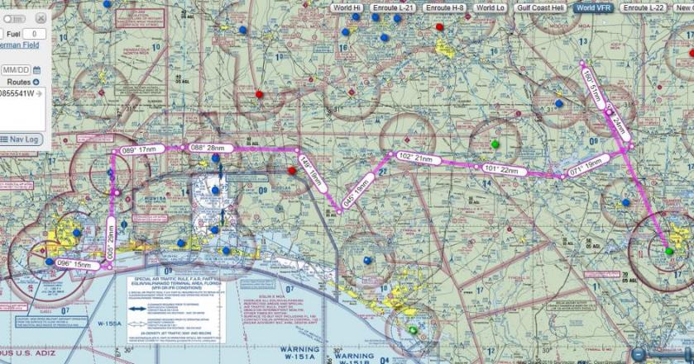
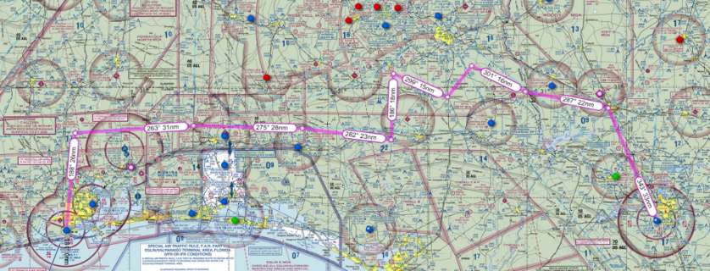
East Route 1 & 2

Slide 3
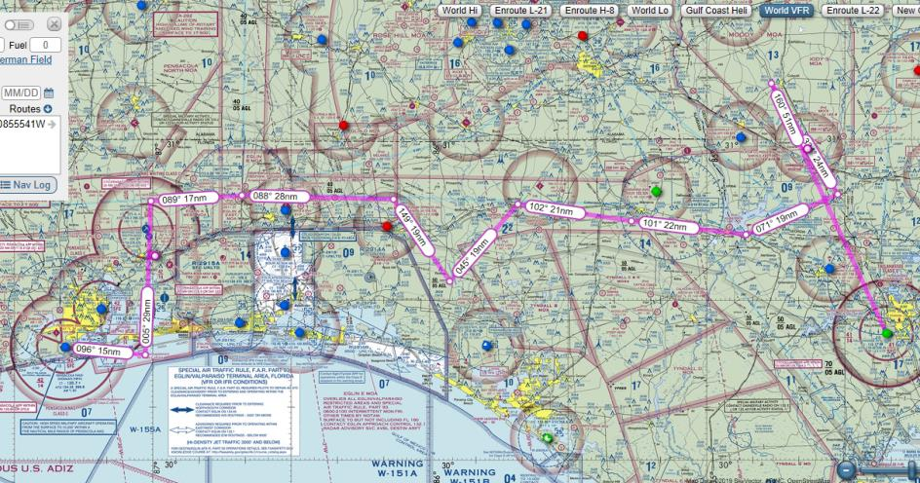
NPA to TLH East Route 1 Overview

Slide 4
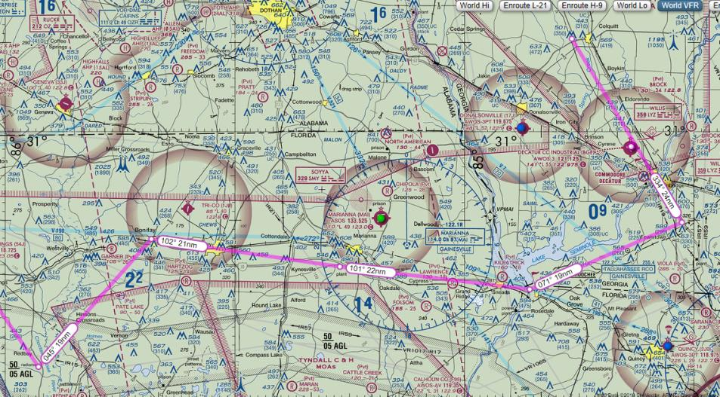
East Route 1
CPs 1-6
PT F - SOLAR FARM
PT B - RD/RR INT
PT E - RD/PWR LINE INT
PT C LRG WHITE BLDG
PT D – HWY 90 BRDG
PT A - RADOME

Slide 5
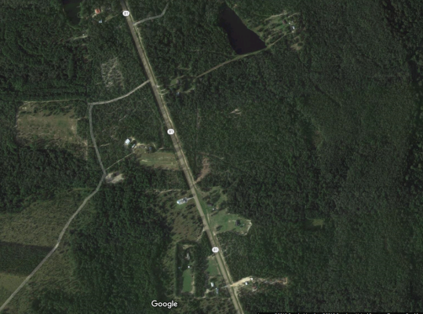
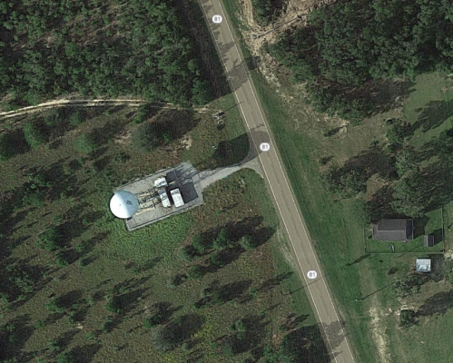
PT A - RADOME

Slide 6
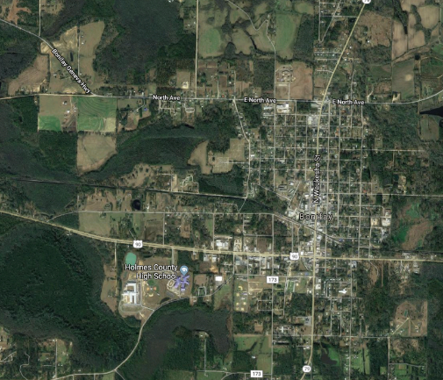
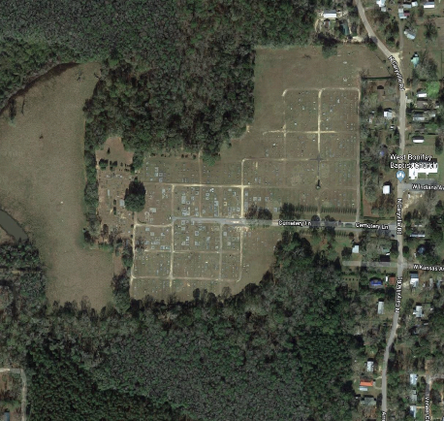
PT B – CEMETERY

Slide 7
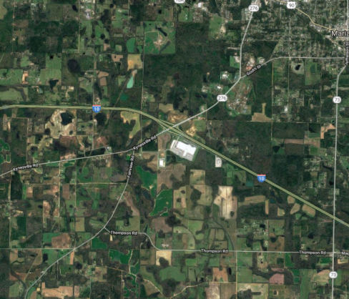
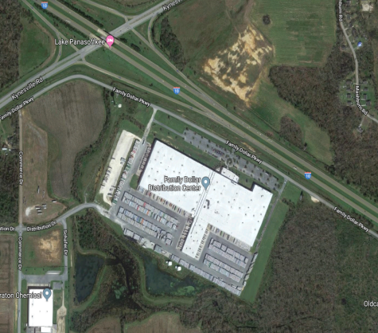
PT C – LRG WHITE BLDG

Slide 8
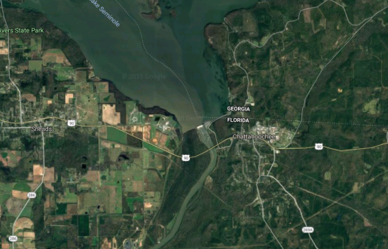
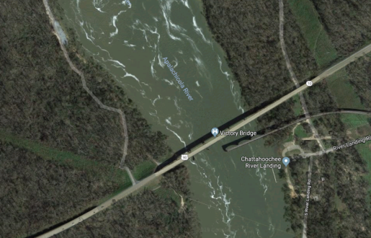
PT D – HWY 90 BRDG

Slide 9
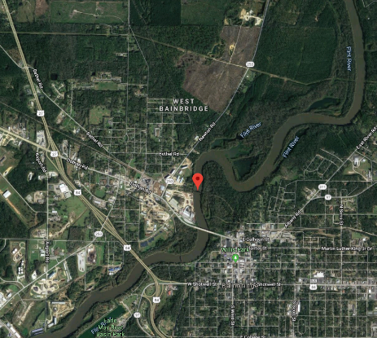
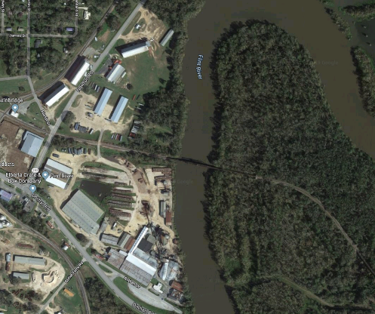
PT E – RR BRDG

Slide 10
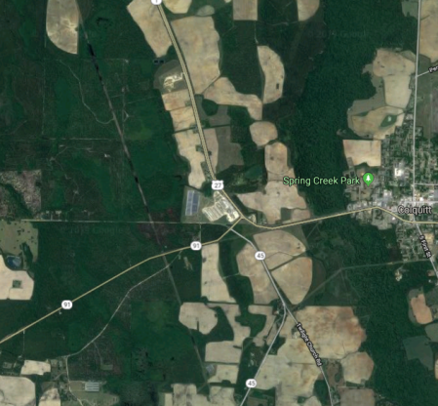
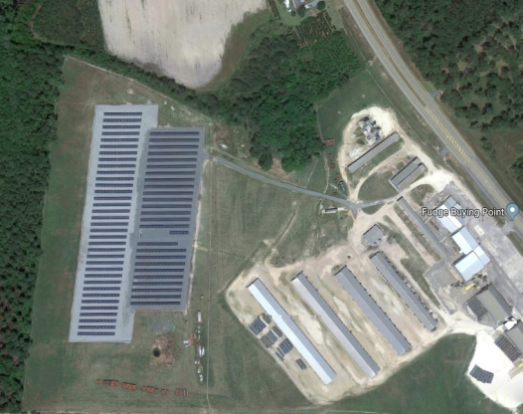
PT F – SOLAR FARM

