Slide 1
EAST 2
EAST ROUTE 2
Depart KTLH VFR to VNAV
Altitude Point Fac RAD/DME Lat/Long
As assigned to A – 6 WATER TANKS MAI 075025 30°54'20.4"N 84°35'35.0"W
2500’ MSL B – HWY BRDG MAI 027014 30°58'38.8"N 85°00'21.4"W
2500’ MSL C – DRAG STRIP MAI 337019 31°05'58.8"N 85°16'44.2"W
2500’ MSL D – 5 WAY INT MAI 306018 30°56'58.7"N 85°24'08.3"W
2500’ MSL E – LAKE MAI 300035 31°03'40.1"N 85°40'10.4"W
2500’ MSL F – HWY/I-10 INT MAI 266029 30°45'45.8"N 85°41'05.5"W
IFR after VNAV route... DEFUN CEW PENSI KNPA
SKYVECTOR POINTS
305420N0843534W 305848N0850036W 310545N0851647W 305719N0852404W 310338N0854021W 304546N0854105W

Slide 2
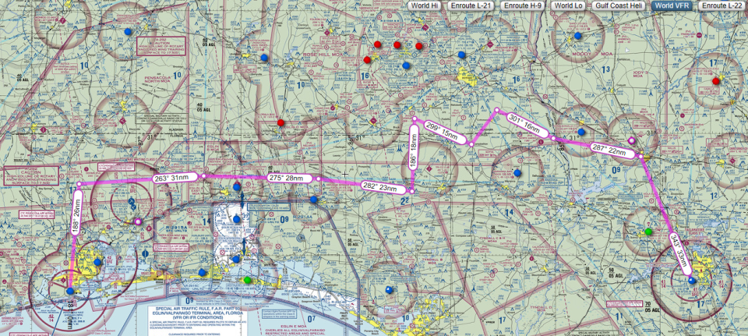
TLH to NPA East Route 2 Overview

Slide 3
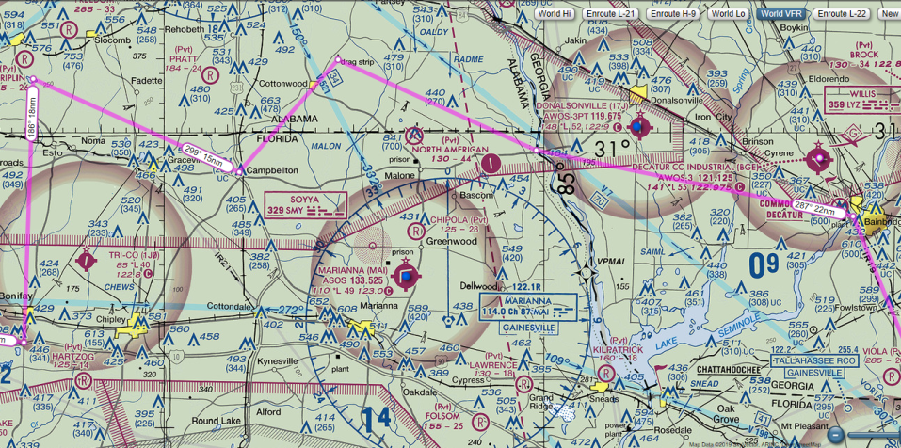
East Route 2
CPs 1-6
PT C – DRAG STRIP
PT E - LAKE
PT B – HWY RIVER INT (BRDG)
PT D – 5 WAY INT
PT A – 6 WATER TANKS
PT F – HWY/I-10 INT

Slide 4
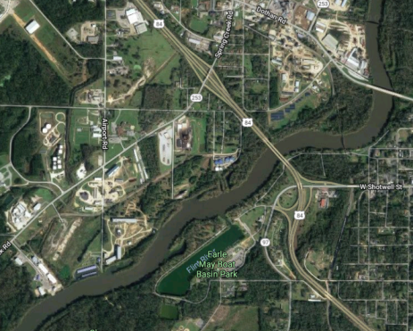
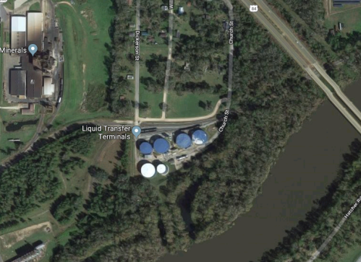
PT A – 6 WATER TANKS

Slide 5
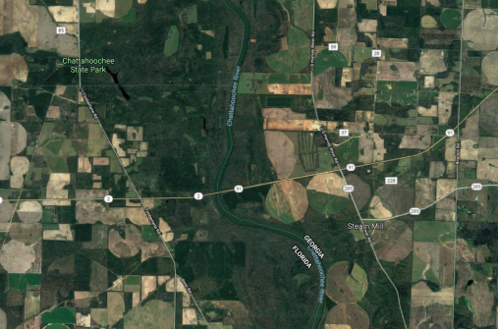
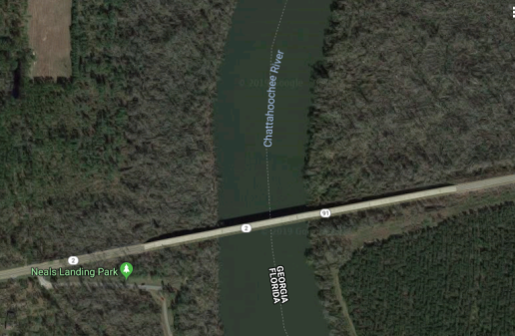
PT B – HWY BRDG

Slide 6
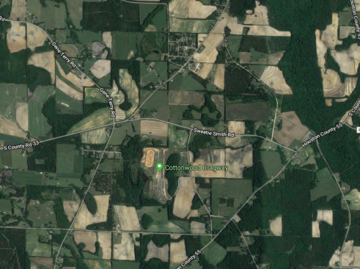
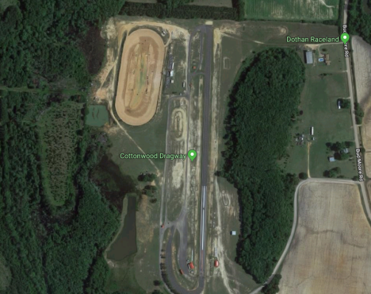
PT C – DRAG STRIP

Slide 7
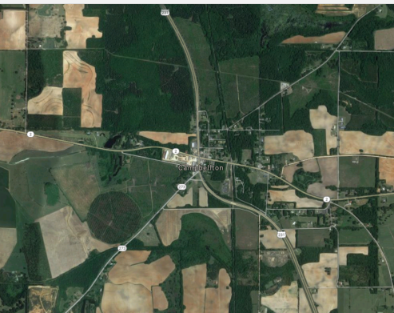
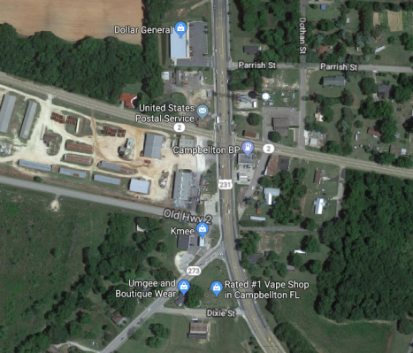
PT D – 5 WAY INT

Slide 8
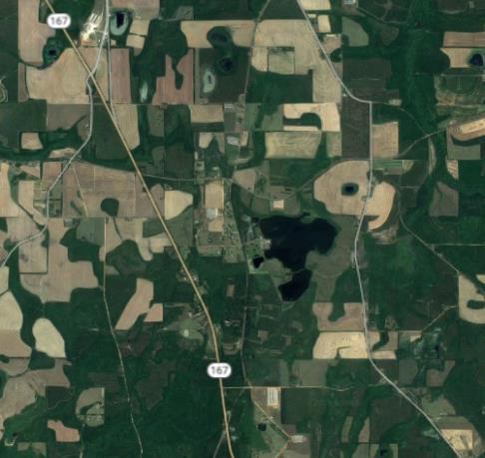
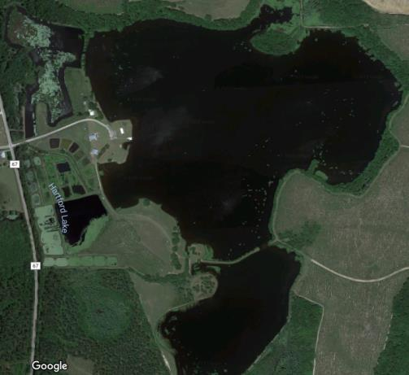
PT E - LAKE

Slide 9
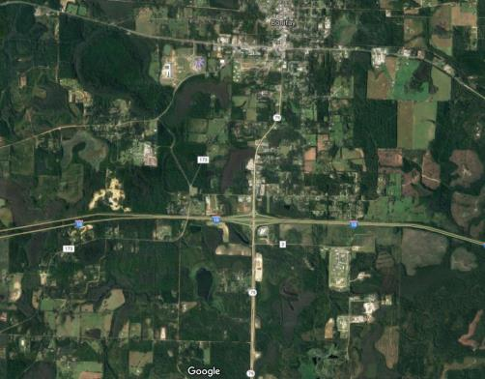
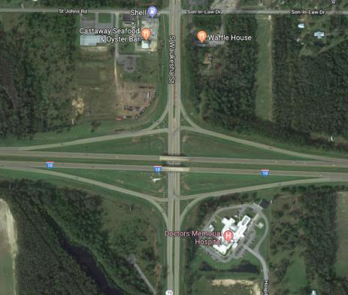
PT F – HWY/I-10 INT

