Slide 1
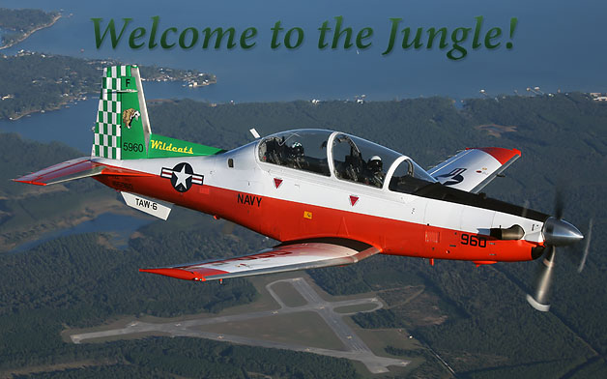
FUN 41XX

Slide 2
ADMIN
Time Hack
Event Title / Mission Objective / Training Objectives
Product Review (KBC, Jet Logs, DD-1801, Strip Charts, TOLD)
Weather / NOTAMS / TFRs / BASH
Marshal / Taxi / Takeoff / Rendezvous / Enroute
Recovery (Transit / Pattern / Destination Airfield Diagram Review)
Contingencies / Emergencies
Weather
Aircraft
Aborts
Midair / Damaged Aircraft
NORDO
SAR / On-Scene Commander
Lost Sight
Lost Comm and lost sight
Ejection
ORM
DOR / TTO Policy
Discuss Items / Q.O.D.

Slide 3
TAC ADMIN
On Deck Check-In / NAV Check to __________
FENCE – IN / G-Warm
Area or Route Entry / Area or Route Management / Area or Route Comms
Advisory Calls / Entry Times / Time Hack / Squawks
Blind / Terminate / KIO (as required)
Area or Route Exit / FENCE – OUT / Battle Damage Checks
Training Rules (As required)
Questions on TAC ADMIN?

Slide 4
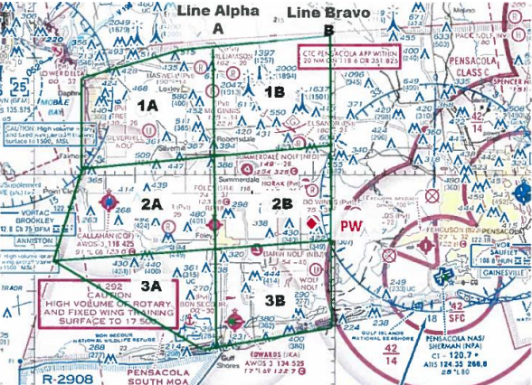

Wahoo
Area Entry
Area Management – Block Assignment
1A / 2A / 3A / 1B / 2B / 3B
Area Comm
BTN 17 PRI (303.15)
BTN 16 (118.5) or 6 (120.65) AUX
Transponder – Squawk 4700
Area Exit
HAZARDS
High Volume of Air Traffic
Class E Airspace
Parachute Jumps IVO 2B
PSMOA above 11,000MSL

Slide 5
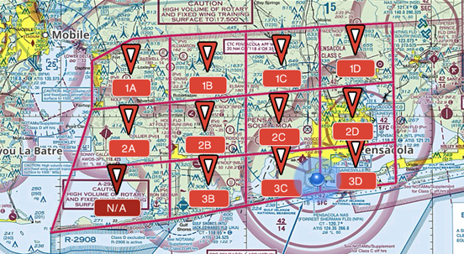

PSMOA
Area Entry
NPA 630
Area Management – ATC Block Assignment
1A / 2A / 1B / 2B / 3B / 1C / 2C / 3C / 1D / 2D / 3D
Area Comm
BTN 16 PRI (360.72)
BTN 5 (120.05)
Transponder – ATC Assigned
Area Exit
HAZARDS
Wahoo below 9,500MSL

Slide 6
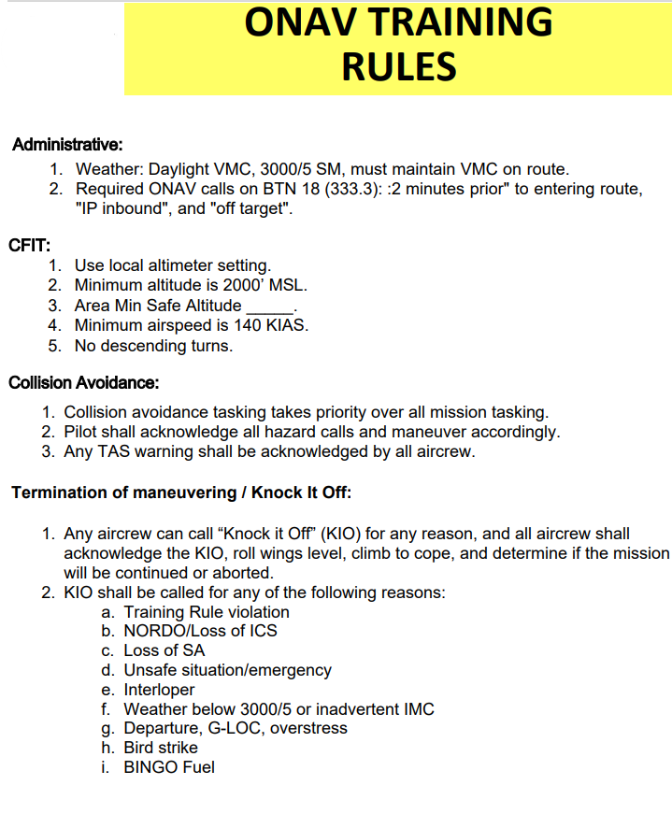
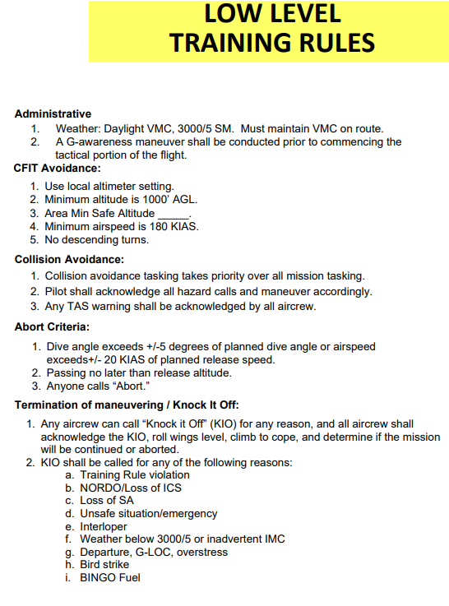
TAC ADMIN Training Rules

Slide 7
Fundamental Conduct
Mission Conduct
Maneuvers based off of MCG Block requirements.
SNFO shall create a conduct plan for event and place it here.
Questions on Conduct?

Slide 8
Discuss Items
FUN 4101
Entry into a MOA, ADMIN / TAC ADMIN and Conduct, any aerobatic maneuver, VT-10 TACSOP
FUN 4102
CNAF 3710 M-3710.7; NATOPS change recommendations, individual NATOPS evaluations definitions, oxygen mask usage, aerobatic flight
FUN 4103
CNAF 3710.7 nonessential flights, NATOPS flight performance charts, any emergency procedure or maneuver
FUN4104
CNAF 3710.7 NFO classification and requirements for qualifications, any emergency procedure or maneuver
FUN4105
CNAF 3710 NATOPS cross-country training flight, flight planning, instrument ratings and qualifications, Airman Safety Action Program (ASAP)
FUN4106
VT-10 TACSOP
FUN4107 / 4108
Any emergency procedure or maneuver

