Slide 1
HOW TO DTS
AS OF Feb 2022

Slide 2
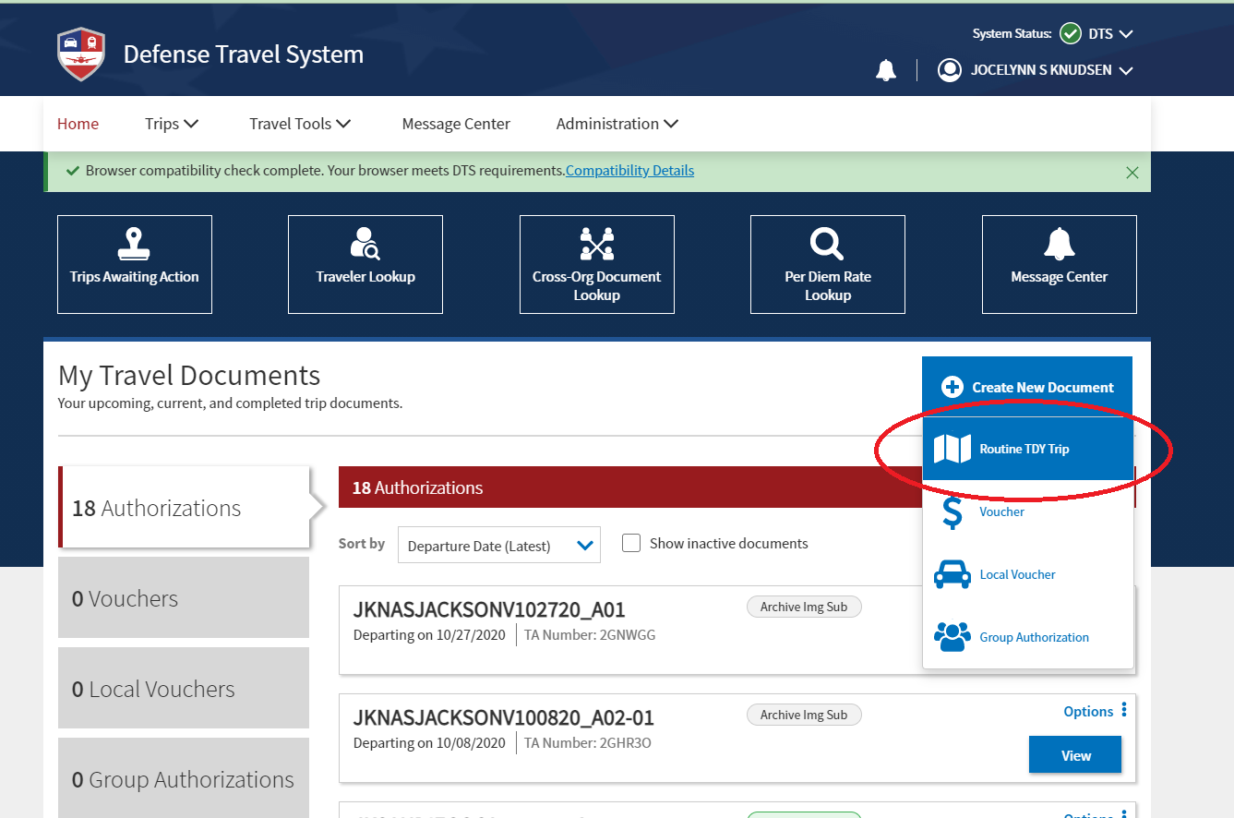

Slide 3
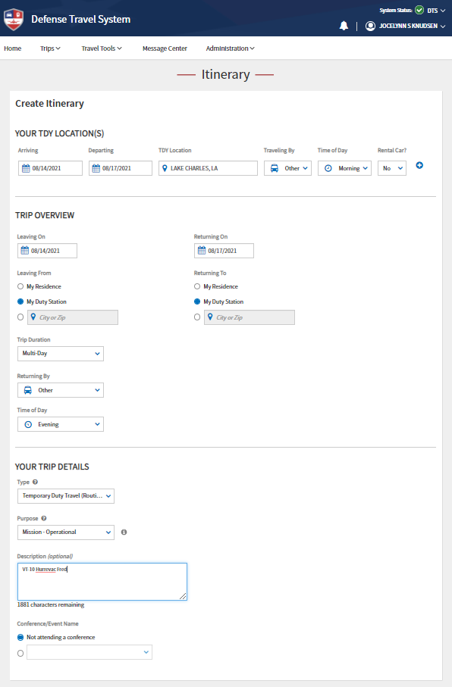
TDY LOCATION:
CITY YOU ARE HEADING TO
TRAVEL BY/RETURNING BY:
SELECT “OTHER” SINCE YOU ARE FLYING A T-6A
Description:
Cross Country Flight Training

Slide 4
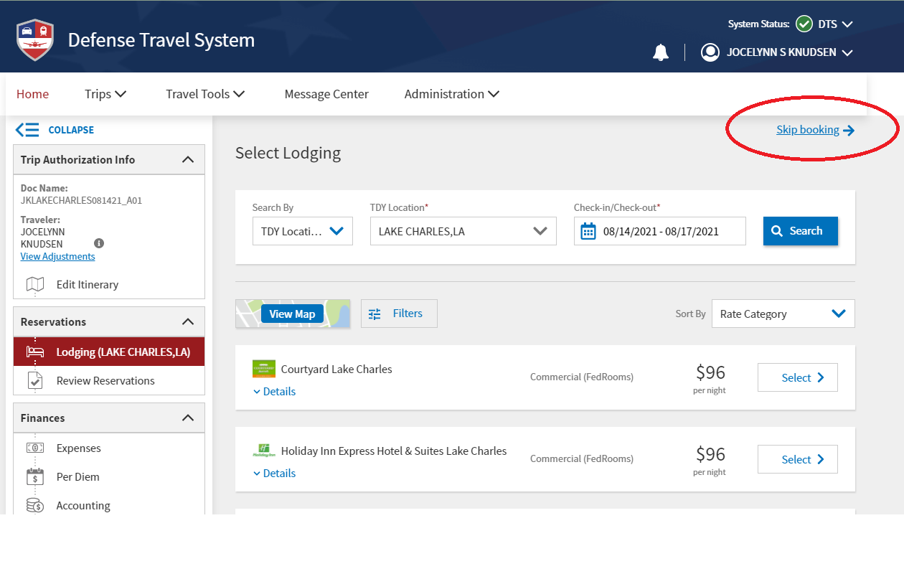
SKIP BOOKING IF YOUR IP ALREADY MADE HOTEL ARRANGEMENTS. OTHERWISE MAKE YOUR HOTEL BOOKING THROUGH THIS PAGE.

Slide 5
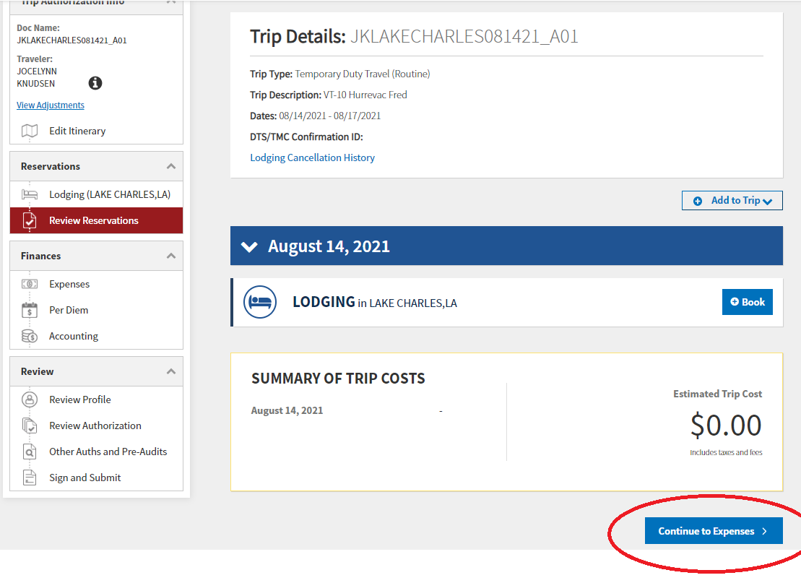
SHOULD EQUAL TOTAL LODGING COST IF BOOKED THROUGH DTS. OTHERWISE, IF BOOKED OUTSIDE DTS, IT WILL BE $0.00

Slide 6
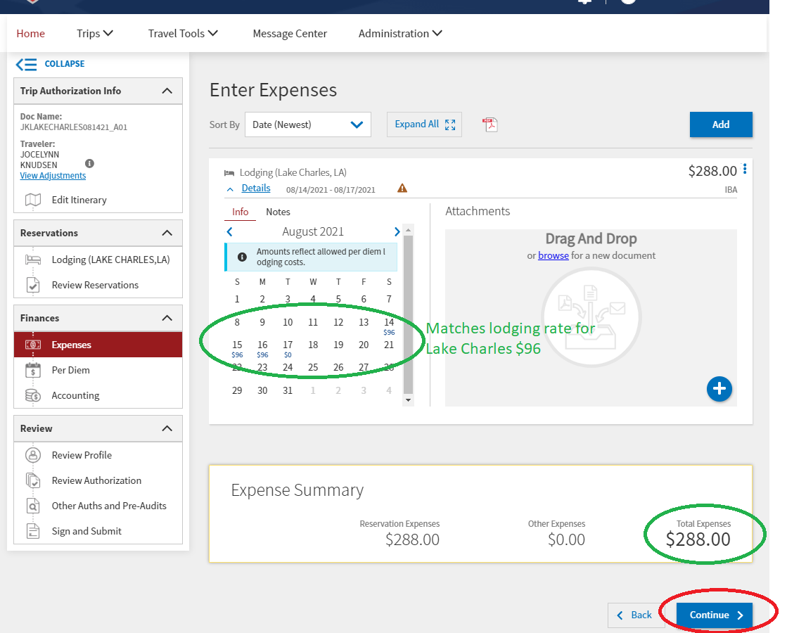
MATCHES LODGING RATE FOR YOUR TDY LOCATION. If not, see NOTE *
ENSURE RESERVATION EXPENSES + OTHER EXPENSES= TOTAL EXPENSES
*NOTE: If the lodging rate does NOT match calculated perdiem rate from https://www.defensetravel.dod.mil/site/perdiemCalc.cfm, you must edit it. Select the three vertical dots on the right side of the page, select edit. Scroll down to select “Actual Lodging Cost”. Then, additionally, type in approved perdiem rate from defensetravel calculator in the yellow box at bottom of pop-up. Save Adjustments. Later, you will need to add justification on the pre-audits page: be sure to explain the situation in the notes.
Notes:
If the lodging rate does NOT match calculated perdiem rate from https://www.defensetravel.dod.mil/site/perdiemCalc.cfm, you must edit it. Select the three vertical dots on the right side of the page, select edit. Scroll down to select “Actual Lodging Cost”. Then type in approved perdiem rate from defensetravel calculator. You will need to add justification on the pre-audits page later on. Be sure to explain the situation in the notes.

Slide 7
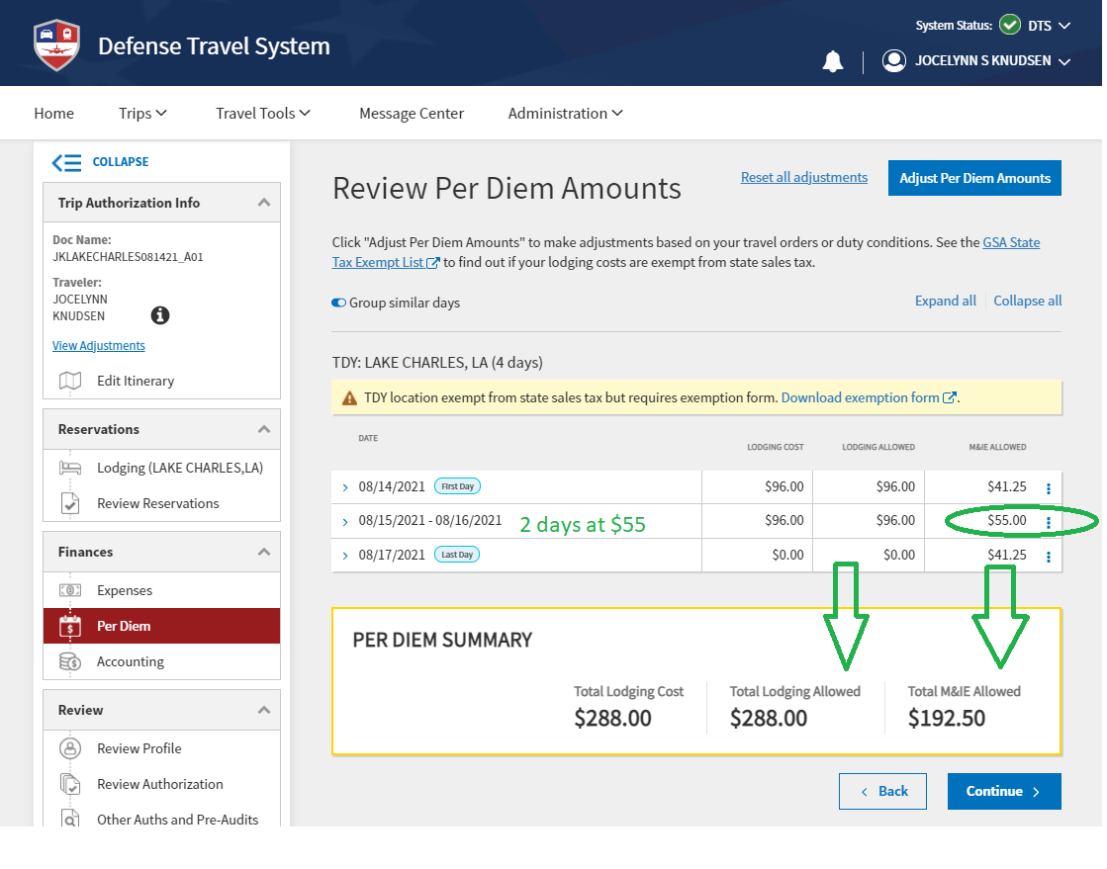
PERDIEM COST IS BROKEN DOWN BY FULL DAYS AND PARTIAL DAYS (TRAVEL DAYS). Ensure none of the “M&IE ALLOWED” days are $0.00!
THESE SHOULD MATCH

Slide 8
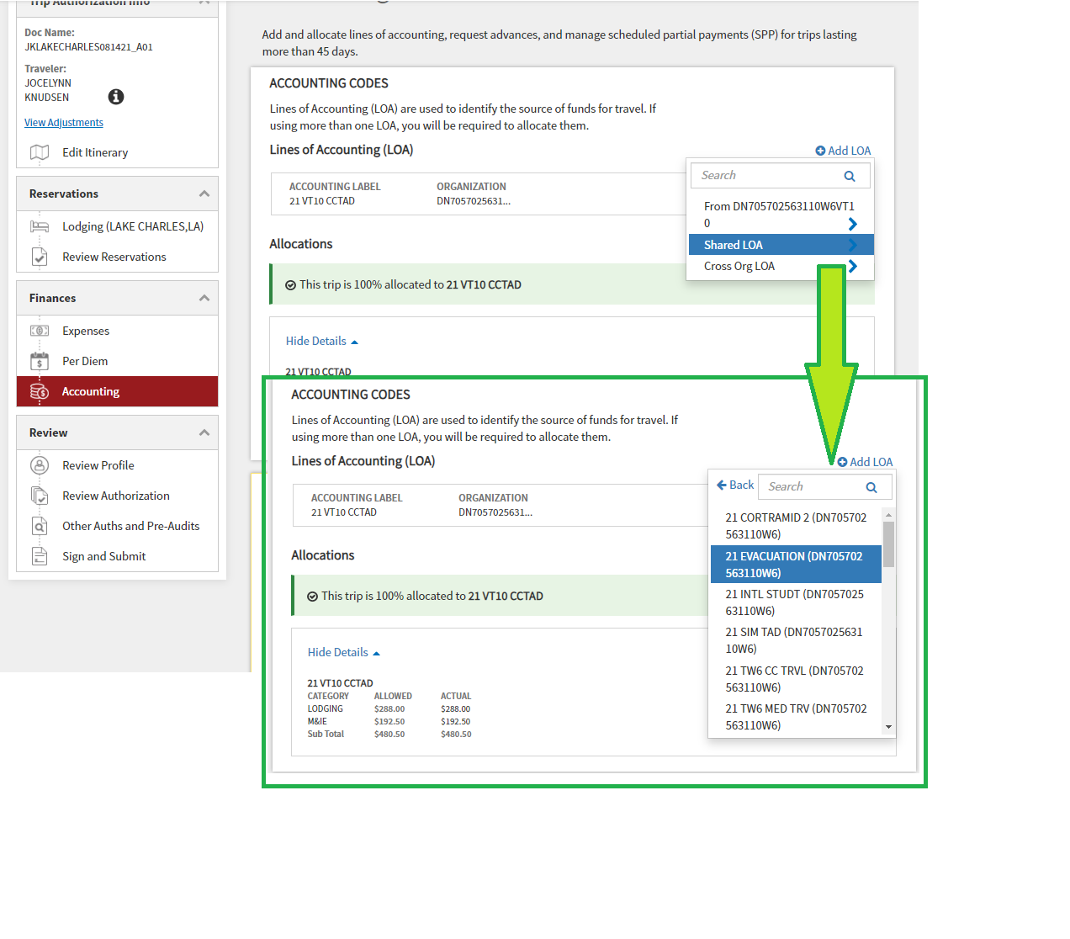
ARE YOU GOING CROSS COUNTRY? YES! ENSURE YOU USE THIS LINE OF ACCOUNTING (LOA): ‘FY’ VT10 CCTAD
NOTE: ‘FY’ BEING CURRENT FISCAL YEAR
ARE YOU GOING ON HURREVAC? YES! USE THE SHARED LOA WITH CTW-6 LINE OF ACCOUNTING (LOA): ‘FY’ EVACUATION
NOTE: ‘FY’ BEING CURRENT FISCAL YEAR.
IF YOU DON’T HAVE ACCESS TO SHARED LOA, SEEK BETTY (ADMIN SUPERVISOR).

Slide 9
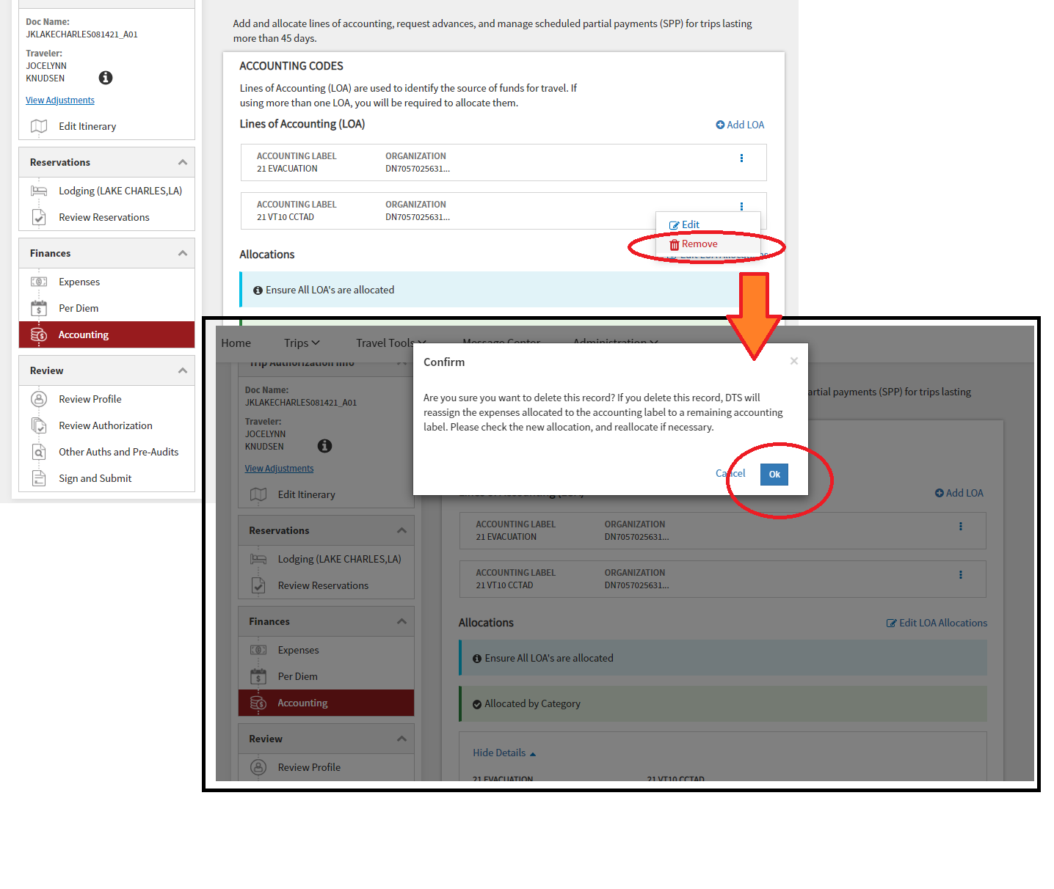
ARE YOU GOING ON HURREVAC?
YES! DELETE CROSS COUNTRY LOA FROM THE LIST!! OTHERWISE, SKIP THIS STEP AND CONTINUE BOOKING.

Slide 10
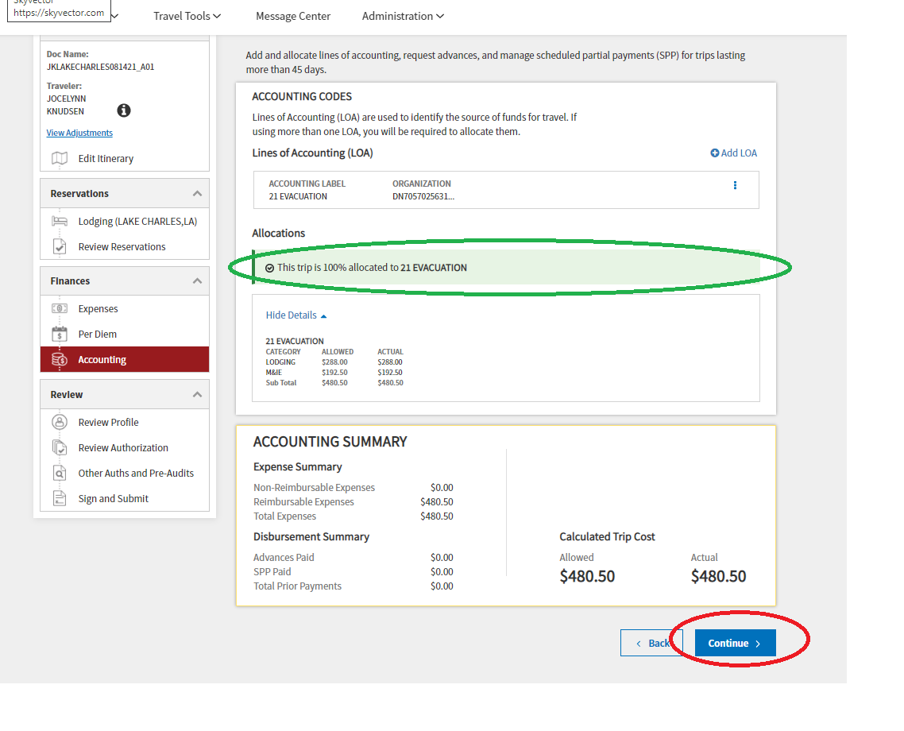
ARE YOU GOING ON HURREVAC?
YES! THIS TRIP SHOULD BE 100% ALLOCATED TO ONE LOA: ‘FY’ EVACUATION.
OTHERWISE, THIS TRIP SHOULD BE 100% ALLOCATED TO ONE LOA: ‘FY’ VT10 CCTAD.

Slide 11
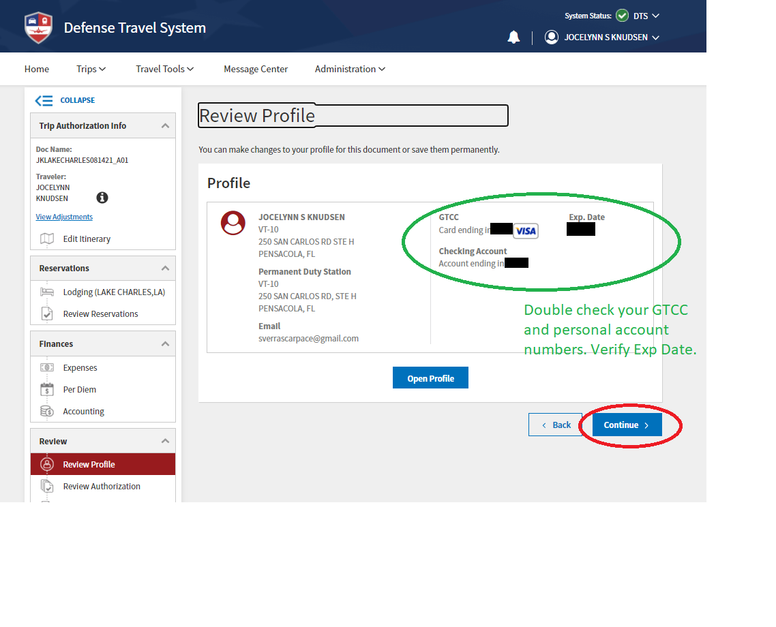

Slide 12
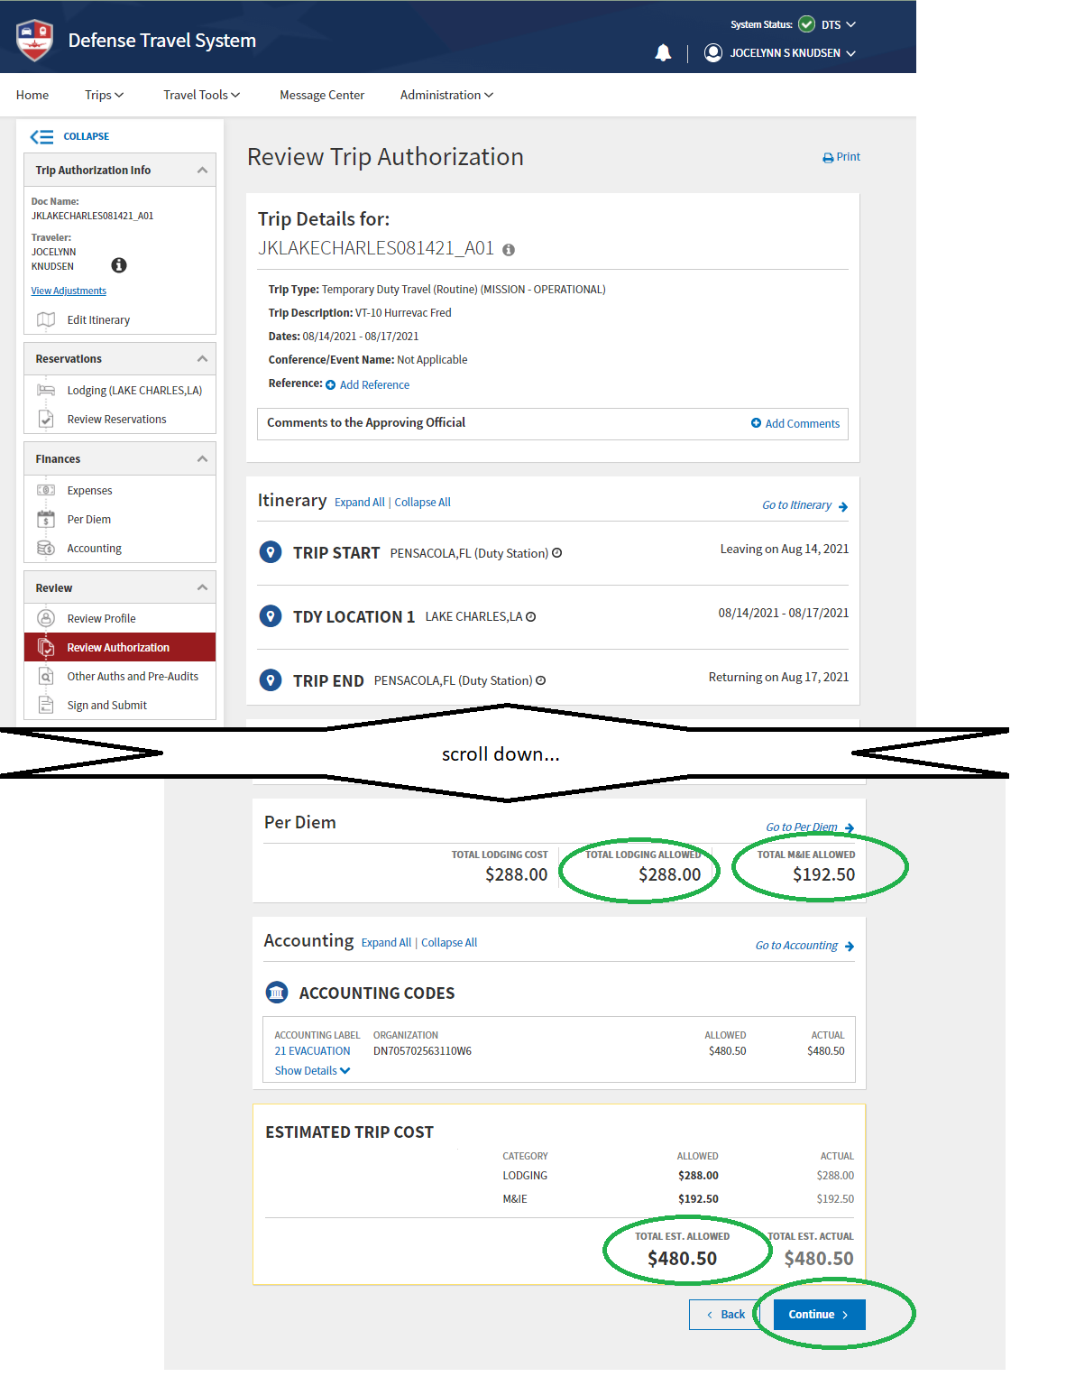
LODGING + M&IE SHOULD ADD UP TO TOTAL ESTIMATED ALLOWED

Slide 13
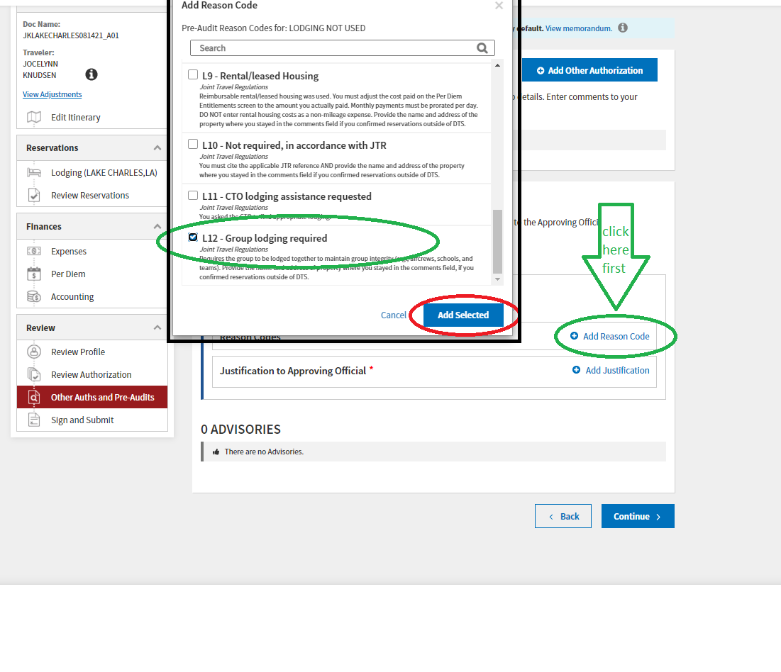

Slide 14
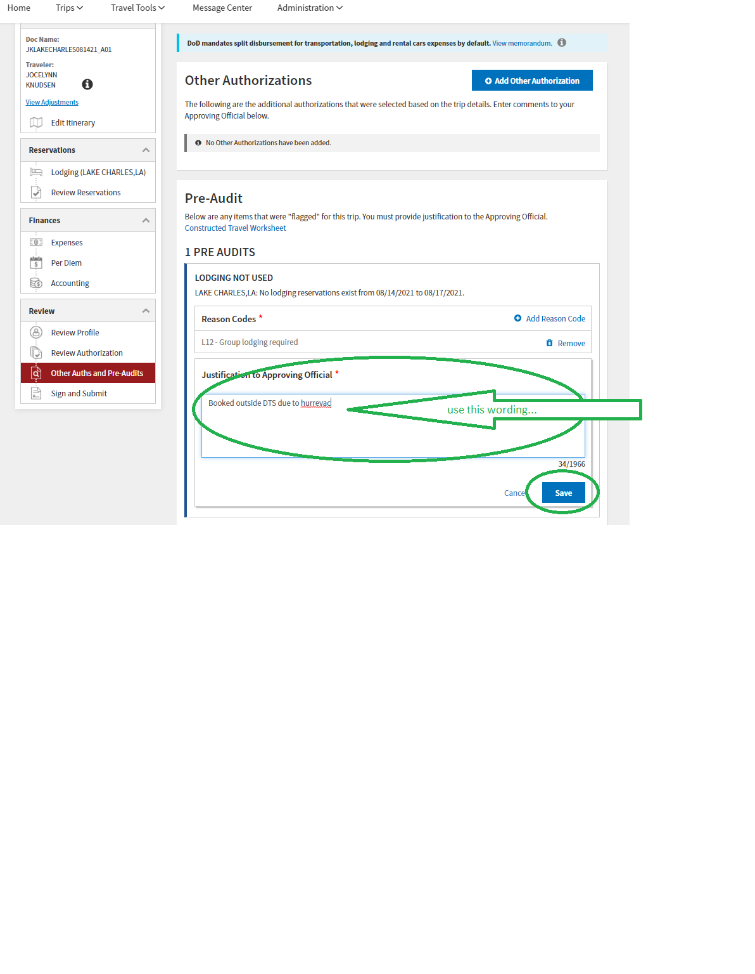
ADD JUSTIFICATION.
FOR EXAMPLE:
“BOOKED OUTSIDE DTS FOR GROUP LODGING BY INSTRUCTOR”

Slide 15
