Slide 1
Take Off and Landing Data (TOLD)
VT-10

Slide 2
TOLD calculations are crucial for flight safety because they help pilots determine if an aircraft can safely takeoff and land given the prevailing conditions (weight, altitude, temperature, runway length, etc.). Performance Charts: TOLD calculations rely on performance charts found in NATOPS. Factors to Consider: These calculations take into account various factors, including: 1. Aircraft Weight: The heavier the aircraft, the longer the distances required for takeoff and landing. 2. Atmospheric Conditions: Altitude and temperature significantly impact aircraft performance. 3. Runway Conditions: Runway length, surface type (e.g., dry, wet, ice), and elevation all influence takeoff and landing distances. 4. Wind: Headwinds help with takeoff and landing, while tailwinds can increase distances.
Purpose of calculating TOLD

Slide 3
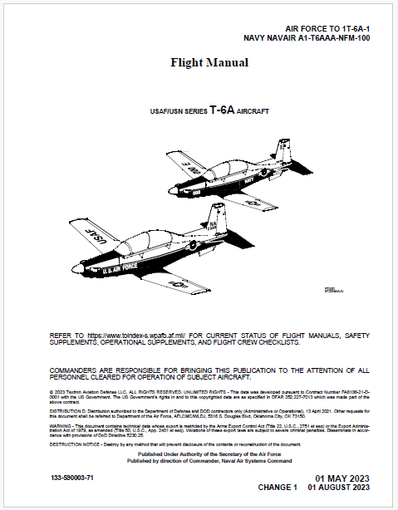
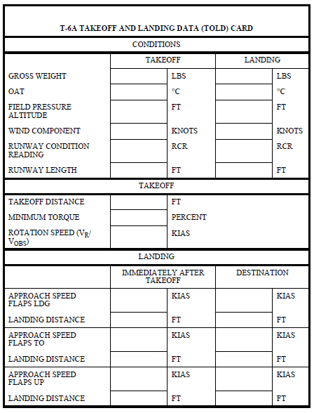
TOLD Card
TOLD card is found in the T-6A NATOPS (Page A9-8, Figure A9-2)
Prior to brief it is the student’s responsibility to ensure the TOLD card is accurate for the brief.
The SDO will normally have the TOLD calculated for the environmental conditions for the day for Navy Sherman (KNPA)
It is your responsibility to ensure the data is correct
If the data does not support your planned route of flight, (ie. Destination other than KNPA, Field PA, runway conditions, etc) calculate TOLD data that will support your flight!!!!

Slide 4
Condition Data - Gross Weight
Takeoff and landing gross weight for the aircraft can be found on the Form-F found in the ADB in Maintenance control
You can assume at take off max gross weight (6500lbs)
For landing gross weight subtract your expected amount of fuel burn from your takeoff weight
As a rule of thumb, you will be approximately 500lbs per hour while flying
If you are flying an event that is 2.0 you will burn approximately 1000lbs
If you flying an event that is a scheduled 1.5 you will burn approximately 750lbs (round to 800lbs)
Example (6500lbs take off weight – 800lbs of fuel burn = 5700lbs landing weight)

Slide 5
Condition Data – OAT / PA
OAT
OAT can be found on the DD175-1 in the remark section
Utilize the MAX forecasted OAT to account for the worst possible conditions of the day
Pressure Altitude
Pressure Altitude can be found on the DD175-1 in the remark section
If your destination airfield is different from the departure airfield make sure to calculate landing data with the environmental conditions expected at the destination

Slide 6
Condition Data – Wind Component
Wind Component
Wind is a very important consideration when calculating TOLD
Headwinds will decrease takeoff and landing distances and tailwinds will increase takeoff and landing distances
For pre-flight planning purposes assuming a wind component of zero is a conservative approach in most cases:
However, if you know you will have to takeoff or land with a tail wind it is imperative you calculate TOLD with your expected tail wind component
In most cases, airports will normally operate runways with a headwind component, but in certain cases aircrew may accept a tailwind (within NATOPS limits) due to instrument approach requirements, terrain avoidance, or other factors
Gusts factors increase landing threshold and touchdown speeds by 50% of the gust factor up to a maximum speed of 10 knots.
Example: (winds are 320 @ 10 gust 24) increase landing threshold and touchdown speeds by 6 knots. ((24-10) / 2)

Slide 7
Condition Data - RCR
Runway Condition Reading (RCR) is a measure of the braking friction coefficient. RCR is given as a whole number. Values vary from 26 (the maximum braking friction coefficient), to 2 (the minimum braking friction coefficient).
This value is used to define the braking characteristics for various runway surface conditions.
International Civil Aviation Organization (ICAO) standards (good, medium, and poor). The following illustrates the relationship between RCR and ICAO reports:

Slide 8
Condition Data – Runway Length
Input the runway length of your destination and departure airfield
If there are multiple runways assume the shortest (legal) runway

Slide 9
Takeoff Charts
All takeoff figures can be found in NATOPS Appendix A – Part 3
This section incudes calculating the following:
1. Takeoff Distance
2. Minimum Torque at 60KIAS
3. Rotation Speed / Obstacle speed

Slide 10
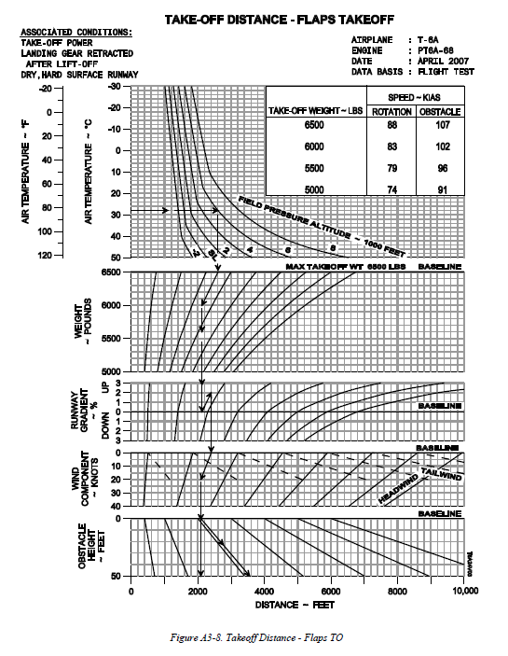
Takeoff Charts
Takeoff Distance
All takeoff figures can be found in NATOPS Appendix A – Part 3 or in the PCL under the performance tab
Assume a takeoff flap configuration of flaps T/O

Slide 11
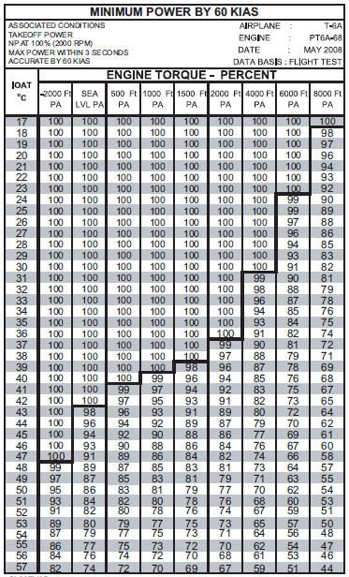
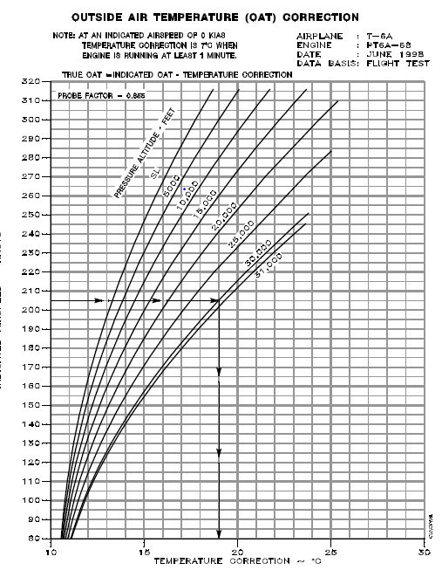
Takeoff Charts
Minimum Power at 60KIAS
All takeoff figures can be found in NATOPS Appendix A – Part 3
You will need to calculate expected IOAT corrected for OAT
(True OAT=Indicated OAT-Temperature Correction)
Prior to brief we know our OAT so we will need to add the temperature correction of 7
(21˚=IOAT-7˚) 21+7=28

Slide 12
Takeoff Charts
Rotation Speed
All takeoff figures can be found in NATOPS Appendix A – Part 3
Assume a takeoff flap configuration of flaps T/O
Rotation speed obstacle speed can be found in the top right hand corner of the chart

Slide 13
Landing Charts
All landing data figures can be found in NATOPS Appendix A – Part 8 or in the PCL under performance tab
This section incudes calculating the following for your departure and destination airfield:
1. Approach speed for each flap configuration (LDG/TO/UP)
2. Landing distance for each flap configuration (LDG/TO/UP)

Slide 14
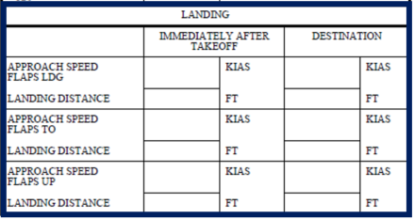
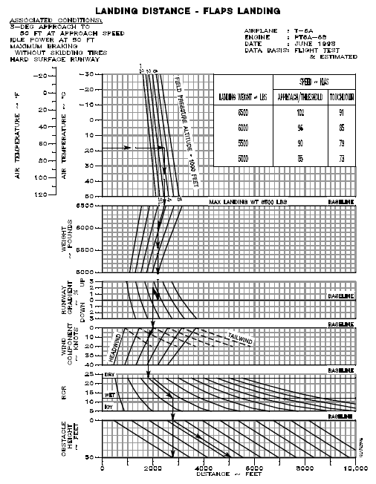
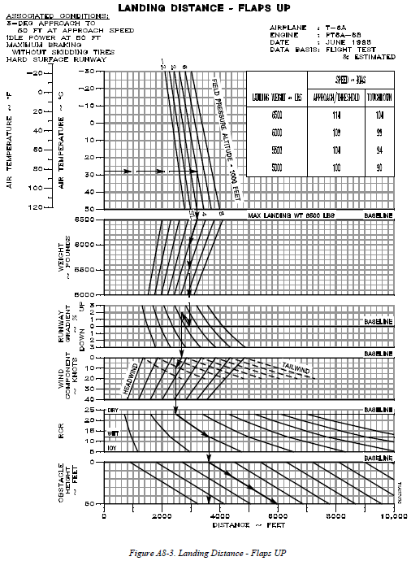
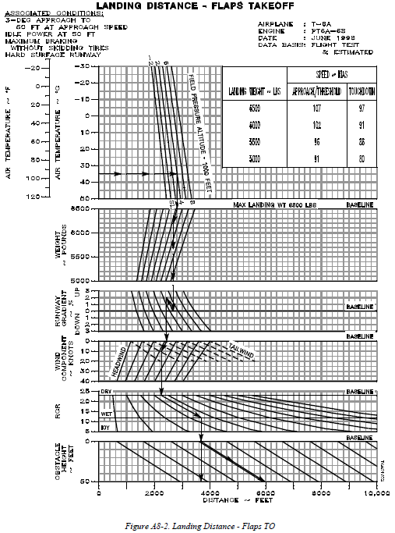
Landing Charts
Landing Distance – Flaps LDG/TO/UP

Slide 15
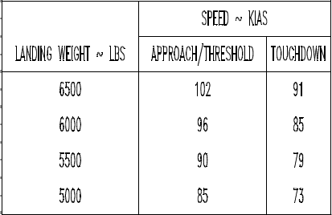
Landing Charts
Landing Distance – Flaps LDG/TO/UP
Enter the chart at the left hand side
Follow the chart down and correct for the existing conditions
Approach and Touchdown Speed
Approach and touchdown speed can be found in the top right hand corner of the chart
Make sure to subtract your fuel burn for the destination airfield and round to the nearest 500lbs
***We will go through a practice example next***

Slide 16
Class decides: 1. Do the problem on your own 2. Work the problem as a class

Slide 17
Example TOLD Problem Follow Along with your PCL
Given Takeoff Data
Gross Weight – 6500lbs (FORM-F)
OAT: 25˚ C (DD175-1)
Field Pressure Altitude: 25ft (DD175-1)
Wind Component: 0 Knots
RCR: Dry - 25
Runway Length: 5000ft (Field Diagram)
Given Landing Data
Gross Weight – 5700lbs (FORM-F)
OAT: 30˚ C (DD175-1)
Field Pressure Altitude: 4000ft (DD175-1)
Wind Component: 0 Knots
RCR: Wet: 12
Runway Length: 5000ft (Field Diagram)

Slide 18
Example TOLD Solution
Given Takeoff Data
Gross Weight – 6500lbs (FORM-F)
OAT: 25˚ C (DD175-1)
Field Pressure Altitude: 25ft (DD175-1)
Wind Component: 0 Knots (assume worst case scenario)
RCR: Dry - 25
Runway Length: 5000ft (Field Diagram)
6500
5700
Given Landing Data
Gross Weight – 5700lbs (FORM-F)
OAT: 30˚ C (DD175-1)
Field Pressure Altitude: 4000ft (DD175-1)
Wind Component: 0 Knots (assume worst case scenario)
RCR: Wet
Runway Length: 5000ft (Field Diagram)
25
30
25
4000
0
0
25
12
5000
5000
3000
100
88/107
102/91
90/79
2200
3200
107/97
96/86
2600
3600
114/104
104/94
2800
3900

Slide 19
Takeoff Data
Given Takeoff Data
Gross Weight – 6500lbs (FORM-F)
OAT: 25˚ C (DD175-1)
Field Pressure Altitude: 25ft (DD175-1)
Wind Component: 0 Knots
RCR: Dry - 25
Runway Length: 5000ft (Field Diagram)

Slide 20
Takeoff Considerations
We need to account for all takeoff data to determine our takeoff distances and power. It is imperative we calculate our landing data for the environmental conditions present at departure due to unforeseen circumstances such as emergencies which require a landing immediately after departure.

Slide 21
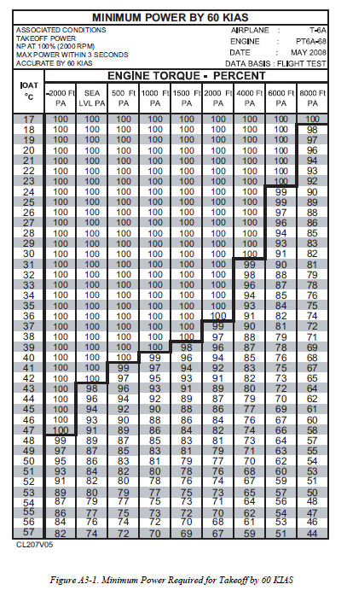
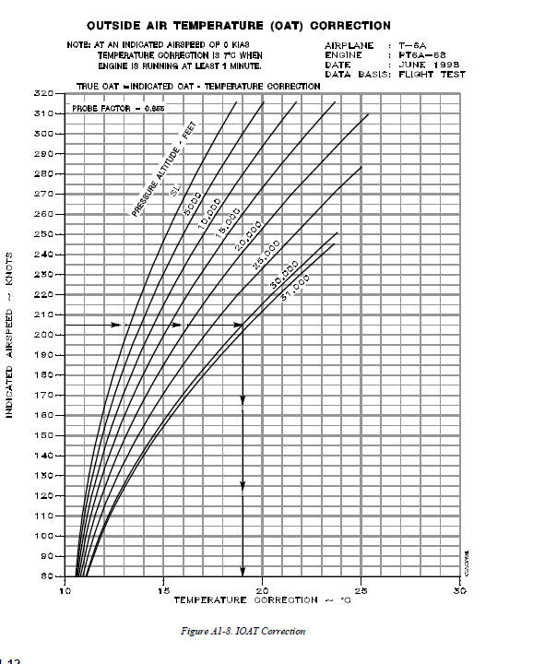
OAT: 25˚ C (DD175-1)
100
(OAT+Correction)
IOAT = 25+7=32

Slide 22
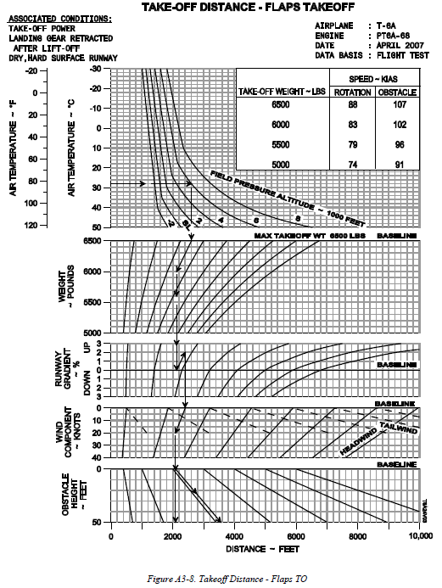
Given Takeoff Data
Gross Weight – 6500lbs (FORM-F)
OAT: 25˚ C (DD175-1)
Field Pressure Altitude: 25ft (DD175-1)
Wind Component: 0 Knots (assume worst case scenario)
RCR: Dry - 25
Runway Length: 5000ft (Field Diagram)
1600
100
88 /107
Takeoff Distance Explained
Enter at OAT for the day (25˚C)
Track over to the Field PA (25FT-
Follow chart to Gross Weight (6500LBS)
Input runway gradient (0 in this case)
Wind Component (Assume 0 head wind)
Obstacle height (Assumed 0 if no known obstacles)
Track down to read take off distance (1600 ft)

Slide 23
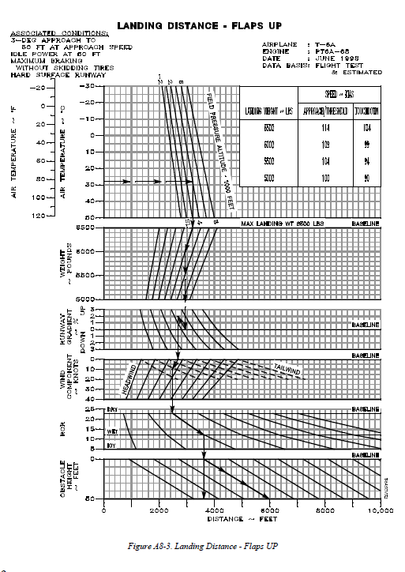
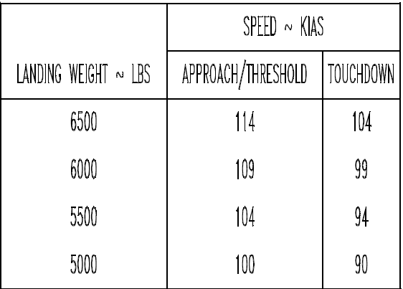
6500
25
25
Landing Distance Explained
Enter Chart at OAT (25˚C)
Track over to PA (25ft)
Track down to Gross Weight (6500LBS)
Track down to runway gradient (0%)
Track down to wind component (0knots)
RCR (Dry)
Obstacle Height (0ft)
Landing Distance 2800ft
0
25
5000
1600
100
88 /107
114/104
2800

Slide 24
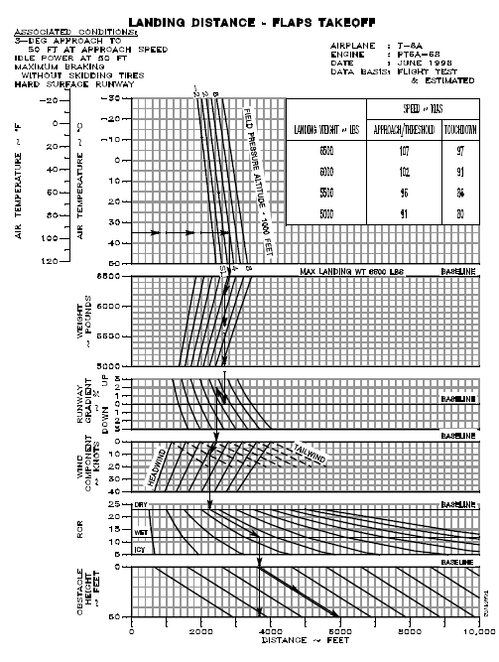
6500
25
25
Landing Distance Explained
Enter Chart at OAT (25˚C)
Track over to PA (25ft)
Track down to Gross Weight (6500LBS)
Track down to runway gradient (0%)
Track down to wind component (0knots)
RCR (Dry)
Obstacle Height (0ft)
Landing Distance 2500ft
0
25
5000
1600
100
88 /107
107/97
2500
114/104
2800

Slide 25
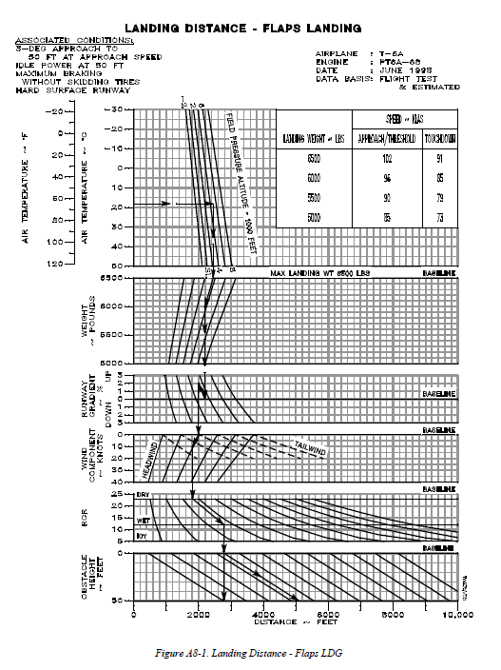
6500
25
25
Landing Distance Explained
Enter Chart at OAT (25˚C)
Track over to PA (25ft)
Track down to Gross Weight (6500LBS)
Track down to runway gradient (0%)
Track down to wind component (0knots)
RCR (Dry)
Obstacle Height (0ft)
Landing Distance 2200ft
0
25
5000
1600
100
88 /107
102/91
2200
107/97
2500
114/104
2800

Slide 26
Landing (Destination) Data
Given Landing Data
Gross Weight – 5700lbs (FORM-F)
OAT: 30˚ C (DD175-1)
Field Pressure Altitude: 4000ft (DD175-1)
Wind Component: 0 Knots (assume worst case scenario)
RCR: Wet -12
Runway Length: 5000ft (Field Diagram)

Slide 27
Landing Considerations
Many different items can change between the departure and destination airfields that need to be taken into considerations. Examples of changes are as follows:
Aircraft weight due to fuel burn
OAT
Pressure altitude changes due to elevation gain at destination
Runway conditions (RCR) due to weather (precipitation)
It is important to note, as this example shows, your landing data may not always be better than your departure data!!!

Slide 28
6500
25
25
Landing Distance Explained
Enter Chart at OAT (30˚C)
Track over to PA (4000ft)
Track down to Gross Weight (6700LBS)
Track down to runway gradient (0%)
Track down to wind component (0knots)
RCR (Wet)
Obstacle Height (0ft)
Landing Distance 3900ft
0
25
5000
1600
100
88 /107
102/91
2200
107/97
2500
114/104
104/94
2800
3900

Slide 29
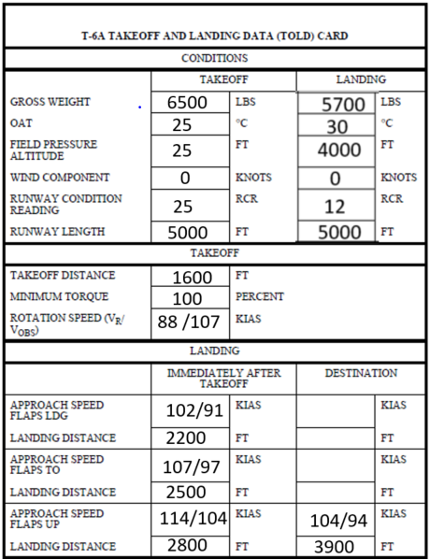
Landing Distance Explained
Enter Chart at OAT (30˚C)
Track over to PA (4000ft)
Track down to Gross Weight (5700LBS)
Track down to runway gradient (0%)
Track down to wind component (0knots)
RCR (Wet)
Obstacle Height (0ft)
Landing Distance 3400ft
96/86
3400

Slide 30
Landing Distance Explained
Enter Chart at OAT (30˚C)
Track over to PA (4000ft)
Track down to Gross Weight (5700LBS)
Track down to runway gradient (0%)
Track down to wind component (0knots)
RCR (Wet)
Obstacle Height (0ft)
Landing Distance 2900ft
90/79
2900
96/86
3400

Slide 31
Example TOLD Solution
Given Takeoff Data
Gross Weight – 6500lbs (FORM-F)
OAT: 25˚ C (DD175-1)
Field Pressure Altitude: 25ft (DD175-1)
Wind Component: 0 Knots (assume worst case scenario)
RCR: Dry - 25
Runway Length: 5000ft (Field Diagram)
6500
5700
Given Landing Data
Gross Weight – 5700lbs (FORM-F)
OAT: 30˚ C (DD175-1)
Field Pressure Altitude: 4000ft (DD175-1)
Wind Component: 0 Knots (assume worst case scenario)
RCR: Wet
Runway Length: 5000ft (Field Diagram)
25
30
25
4000
0
0
25
12
5000
5000
3000
100
88/107
102/91
90/79
2200
3200
107/97
96/86
2600
3400
114/104
104/94
2800
3900

Slide 32
Questions?

