Slide 1
WEST 1
WEST ROUTE 1
Depart KNPA IFR- KNPA TEEZY TRADR PLEBE MINDO...then VNAV
Altitude Point Fac RAD/DME Lat/Long
2000’ MSL A – I-12/RIVER INT HMU 260014 30°28'29.6"N 90°40'26.6"W
2000’ MSL B - RIVER/PWR LN INT RQR 316017 30°16'51.0"N 90°47'38.9"W
2000’ MSL C – RIVER ISLAND LSU 155018 30°11'48.6"N 91°09'35.2"W
2000’ MSL D – RIVER Y LFT 093025 30°10'47.2"N 91°31'41.4"W
2000’ MSL E – I-10 BRDG LFT 054017 30°20'36.9"N 91°43'05.1"W
2000’ MSL F – RR INT LSU 280016 30°33'12.6"N 91°34'35.6"W

Slide 2
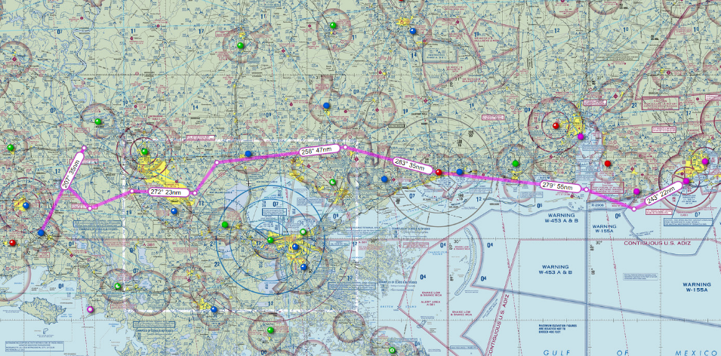
West Route 1 & 2

Slide 3
NPA to KARA West Route 1 Overview

Slide 4
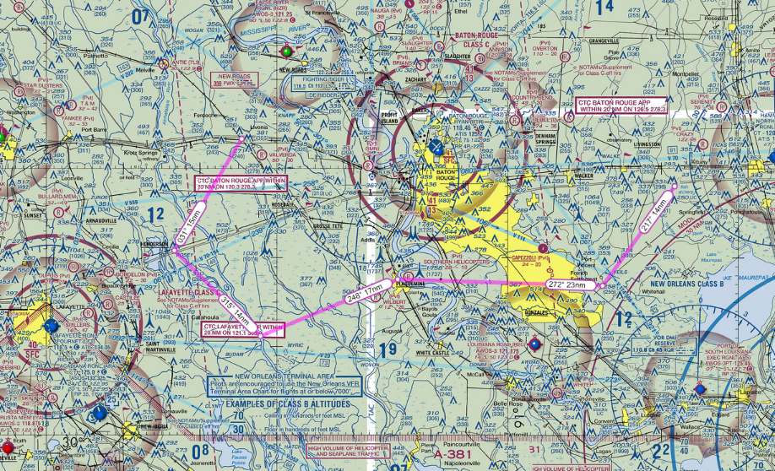
West Route 1
CPs 1-6
PT F – RR INT
PT A – SQUARE POND
PT E – I-10 BRDG
PT C RR BRDG
PT B - RIVER/PWR LINE INT
PT D – RIVER Y

Slide 5
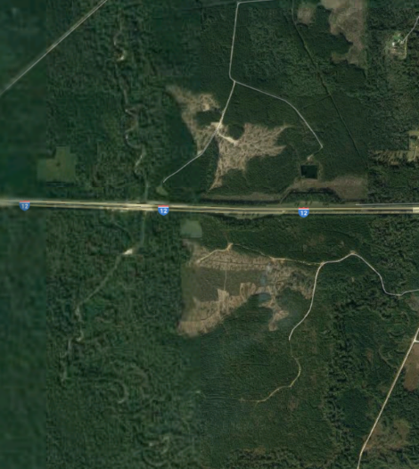
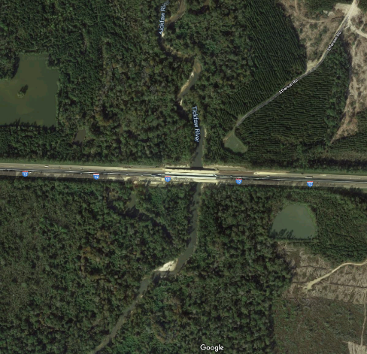
PT A – I-12 RIVER INT

Slide 6
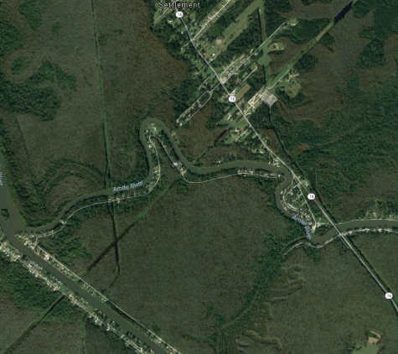
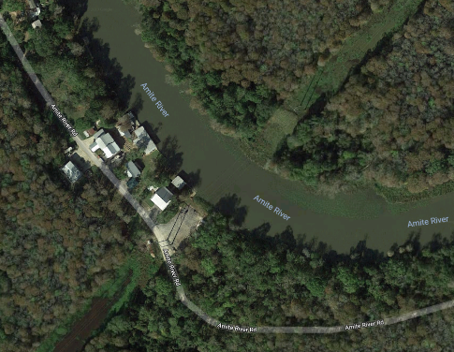
PT B – RIVER/PWR LINE INT

Slide 7
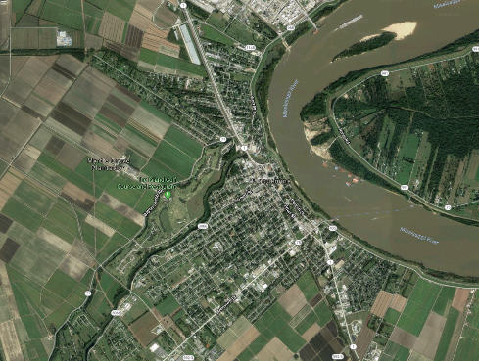
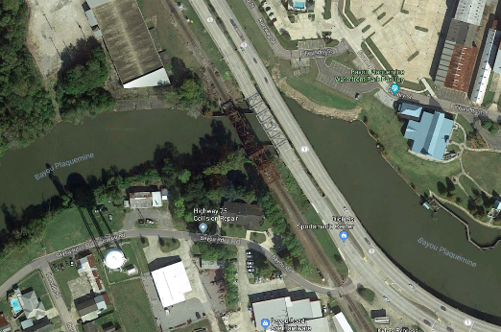
PT C – RR BRDG

Slide 8
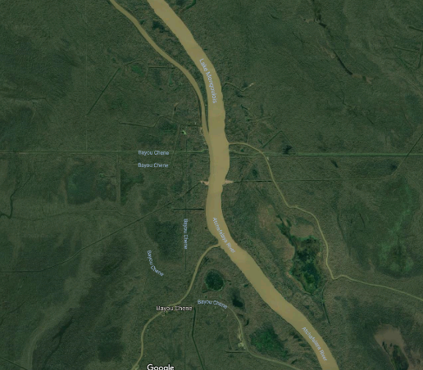
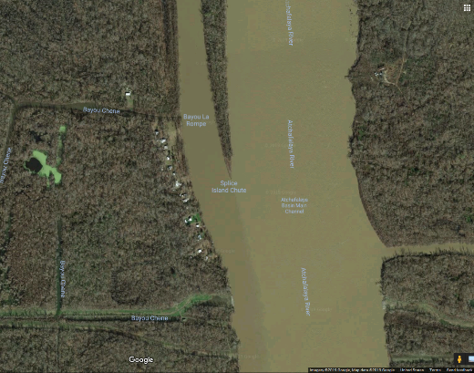
PT D – RIVER Y

Slide 9
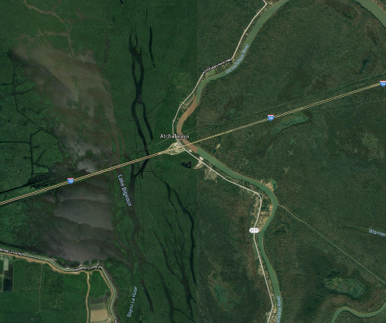
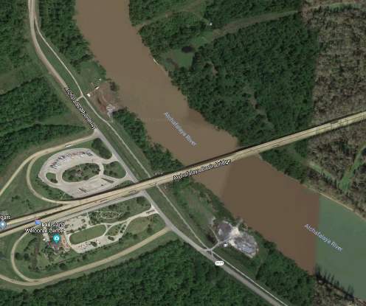
PT E – I-10 BRDG

Slide 10
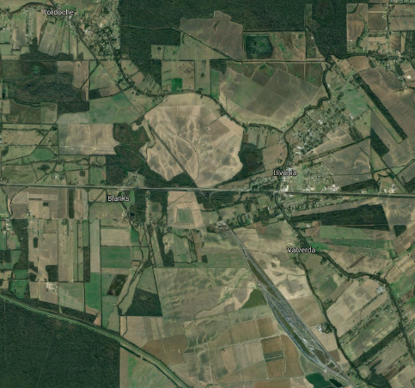
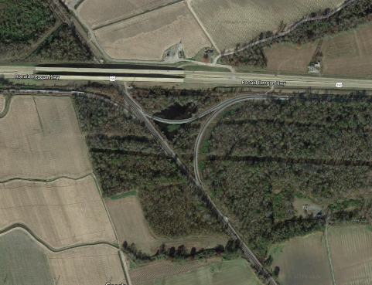
PT F – RR INT

