Slide 1
West 2
WEST ROUTE 2
Depart KARA VFR to VNAV
Altitude Point Fac RAD/DME Lat/Long
2000’ MSL A – OBSERVATORY HMU 269019 30°33'46.4"N 90°46'27.3"W
2000’ MSL B - RD/RIVER INT HMU 346016 30°46'39.0"N 90°29'53.4"W
2000’ MSL C – HORSE TRACK HMU 049013 30°38'05.1"N 90°12'24.7"W
2500’ MSL D – PAPER MILL PCU 328015 30°46'30.7"N 89°51'47.0"W
2500’ MSL E – RD INT MCB 122028 31°02'09.7"N 89°48'23.6"W
2500’ MSL F – OIL TANKS LBY 187024 31°02'08.1"N 89°26'57.2"W
IFR after VNAV route... WIGGO SJI JERYS TEEZY

Slide 2
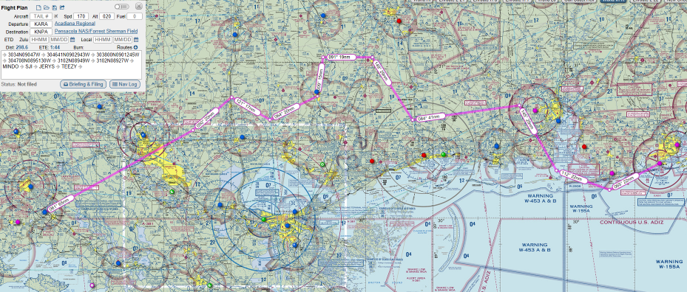
ARA to NPA West Route 2 Overview

Slide 3
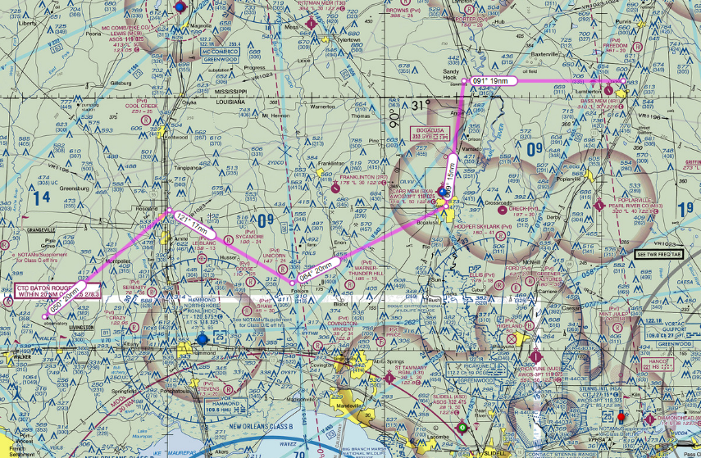
West Route 2
CPs A-F
PT E – SAW MILL
PT F – OIL TANKS
PT B – RD/RIVER INT
PT D – PAPER MILL
PT C HORSE TRACK
PT A - OBSERVATORY

Slide 4
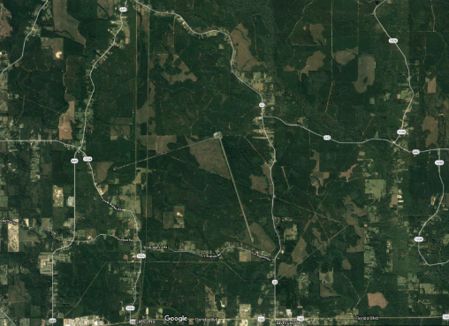
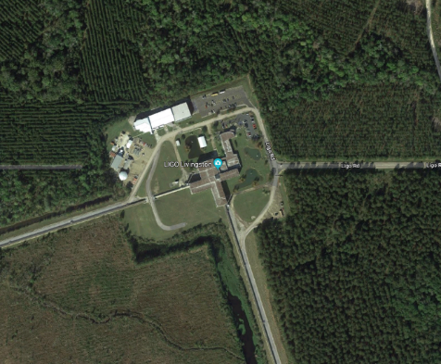
PT A – Observatory

Slide 5
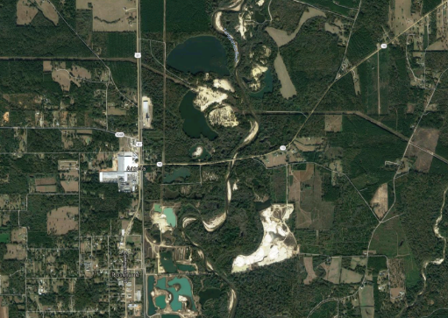
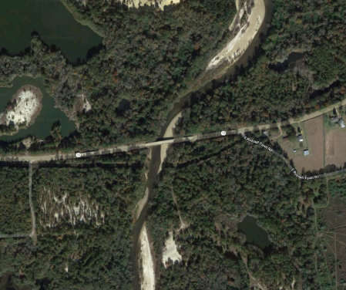
PT B – RD/RIVER INT

Slide 6
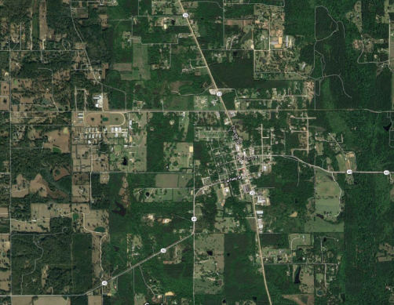
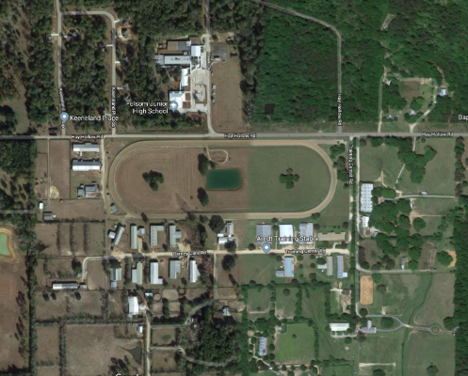
PT C – HORSE TRACK

Slide 7
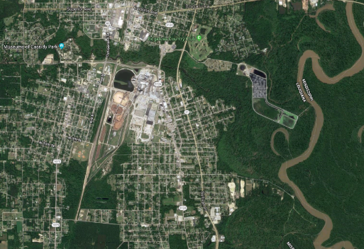
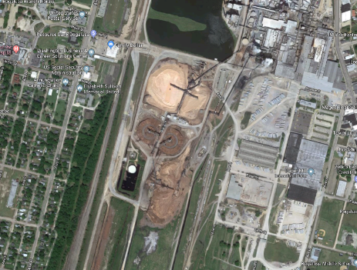
PT D – PAPER MILL

Slide 8
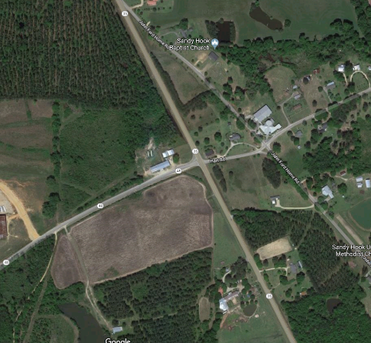
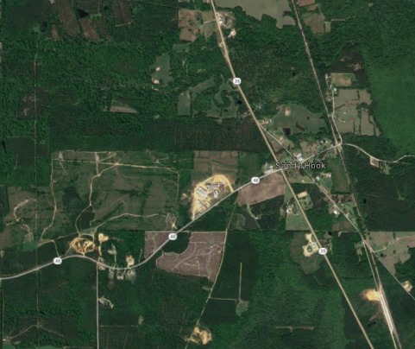
PT E – RD INT

Slide 9
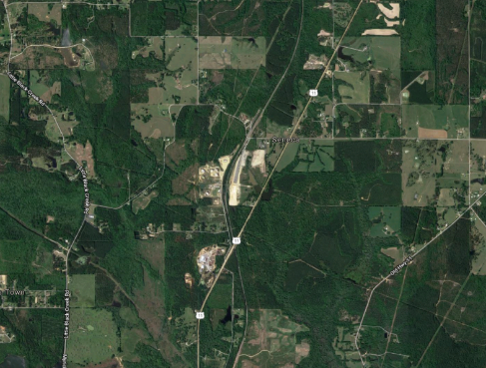
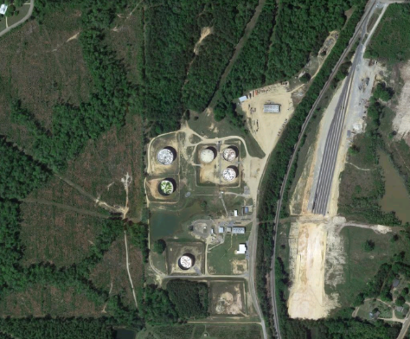
PT F – OIL TANKS

